Slide 1

Last year the number of students who graduated with a driving licence reached 200, 000, a(n) _____ of 40, 000 per year. ［2010江西, 35］
A. average B. number
C. amount D. quantity
【解析】选A。句意：去年考过驾照的考生人数达到了20万，平均每年是4万。an average of平均有。

Slide 2
▶We subscribe to all the main medical journals.
我们订阅所有主要的医学杂志。
▶He subscribes to the view that children benefit from being independent.
他赞同孩子们能从独立中获益这一观点。
▶He subscribed his name to the contract.
他在合同上签名。
▶He has subscribed much money to the flooded area.
他向洪水灾区捐了大量的钱。

Slide 3

Each time cigarettes _____ in price, Tom makes up his mind to give up smoking.
A. rise up B. go up
C. lift up D. raise up
【解析】选B。rise up“起来”; go up“上升, 增长”; lift up“举起, 吊起”；raise通常不与up连用。句意为：每次香烟的价格上涨，汤姆就决定戒烟。

Slide 4
When I watch NBA, I _____ to focus on the players like LeBron James and Kobe Bryant. ［2011青岛高二检测］
A. used B. turn C. tend D. intend
【解析】选C。句意：当我看NBA比赛时，我倾向于集中注意力于像勒布朗·詹姆斯和科比·布莱恩特的球员。tend to do sth. 表示“倾向于做某事”；而used to表示过去的习惯而现在不做了，与前面的watch不符；turn to do sth. 转过头来做某事；intend to do sth. 打算要做某事，与题意不符。故C项正确。

Slide 5
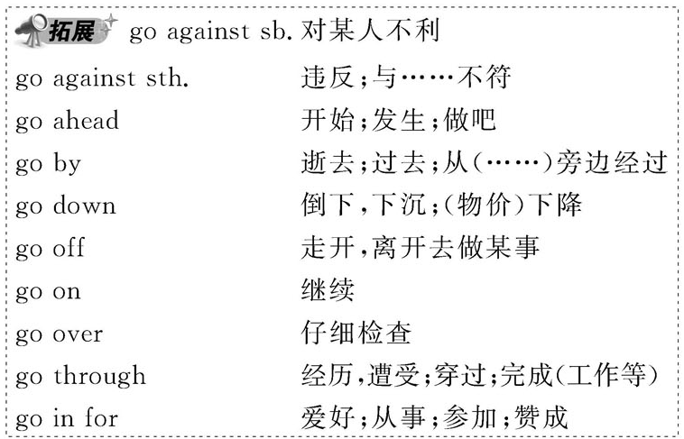
▶He has gone off to the south of France for the summer.
他动身去法国南部过夏天。

Slide 6
Jenny nearly missed the flight _____ doing too much shopping. ［2009全国卷Ⅱ，13］
A. as a result of B. on top of
C. in front of D. in need of
【解析】选A。考查介词与名词构成的短语。A项意为“由于”，符合句意；其余on top of“在……顶上”，in front of“在……前面”，in need of“需要”，均不合逻辑。

Slide 7
We are totally opposed _____ any changes in the plan. ［2011石家庄高二检测］
A. making B. to make
C. to making D. against making
【解析】选C。句意：我们坚决反对对这个计划作任何改动。be opposed to为固定搭配，意为“反对……”，其中to为介词。

Slide 8
(1) oppose sth. /doing sth. / sb.doing sth.
反对某事/做某事/某人做某事
oppose sth. to/against sth.
使某事物与另一事物对照或对抗
(2) opposed adj. 相反的；对立的
be opposed to... 反对……；与……对立

Slide 9
Many houses were completely destroyed in the hurricane which struck the area last week. _____, the victims had to live in the temporary shelters offered by the Red Cross.
A. As a result of B. As a consequence
C. As usual D. As for
【解析】选B。考查短语辨析。句意: 很多房子被上周袭击这个地区的飓风完全毁坏了，结果受害者不得不住在红十字会提供的临时住处。A“由于……的结果”；B“结果 ”；C“像平时一样”；D“至于”，故选B。

Slide 10
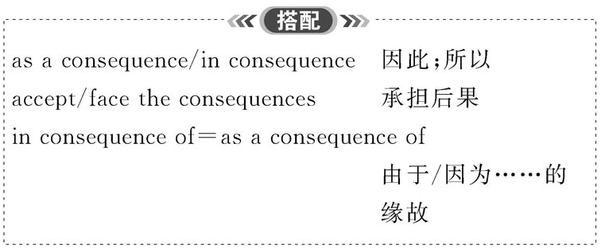

Slide 11
The top leaders of the two countries are holding talks in a friendly _____. ［2008湖北，22］
A. atmosphere B. state
C. situation D. phenomenon
【解析】选A。句意：两国的高层领导人在友好的氛围中进行谈话。atmosphere气氛；state情况，状态；situation情况；phenomenon现象。

Slide 12
(1) in a/an state (of) 处于…的状态
(2) state＋n./that­clause /wh­clause 声明…,说明…
It is stated that... 据宣布……
(3) statement n. 陈述，叙述；声明
stated adj. 指定的，预定的，宣布的
stateless adj. 无国籍的

Slide 13
(1)a wide range of 一系列……
a full range of 各种……
in/within range 在射程以内，在……范围内
beyond/out of range 在射程外，在……范围外
in/out of the range of 在/超出……范围
out of one’s range 某人能力达不到的，知识以外的
(2) range from...to... 在……范围内变动，
包括(由……到……)之间的各类事物
range between...and... 在……和……范围内变动

Slide 14
build up 逐渐增加，聚集
build up one’s fortune 累积/ 聚集财富
build up one’s body 健身
build up one’s strength 养精蓄锐, 增强体力
e.g.: We are building up a good business.
我们的生意兴隆。

Slide 15

They _____ some of his wages to pay for the damage.
A. kept off B. keep out
C. kept on D. kept back
【解析】选D。句意：他们扣下他的一部分工资以赔偿损失。keep back意为“扣除”，符合句意。

Slide 16
The rain kept me _____ the party yesterday.
A. to attend B. attending
C. from attending D. attended
【解析】选C。句意：昨天的雨使我未能参加宴会。keep sb. from doing sth. 阻止某人做某事。

Slide 17
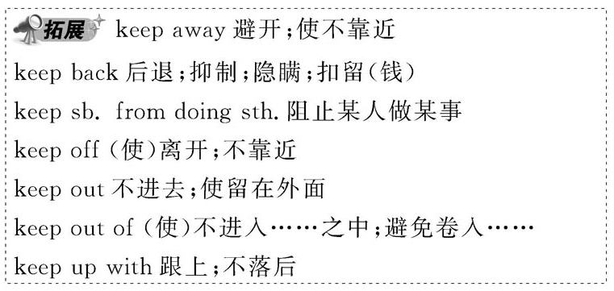
▶Warm clothing will keep out the cold.
暖和的衣服可以御寒。
▶She told us most of the story, but kept back the bit about her aunt.
她把事情的大部分都和我们说了，可是保留了有关她姑妈
的那一部分。

Slide 18
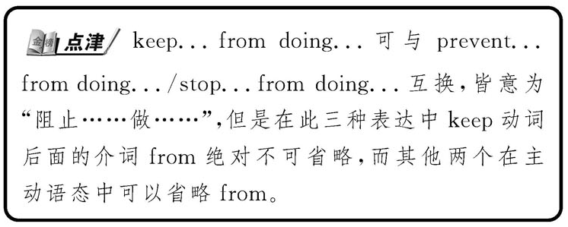

Slide 19
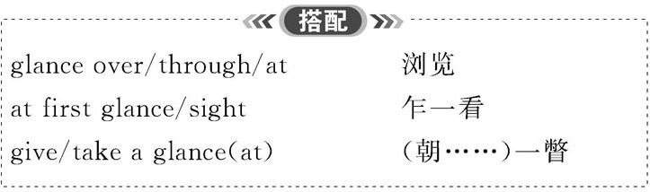

Slide 20
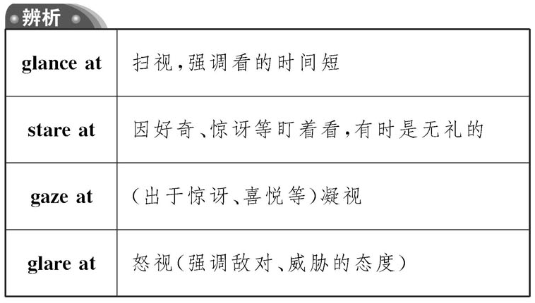

Slide 21

Line 2: That probably does not seem much to you or me, but it is a rapid increase when compared to other natural changes. (P₂₆)
这个数值对你我来说很可能无关紧要，但是跟其他自然变化相比较而言，这却是一种快速的增长。

Slide 22

when compared to. . . 是时间状语从句的省略，其完整形式为：when it is compared to. . .
状语从句的省略的用法：
省略成分：从句主语+be
适用的从句：时间、条件、让步等状语从句
省略条件：主从句主语一致或从句主语是it，且从句谓语含有be

Slide 23
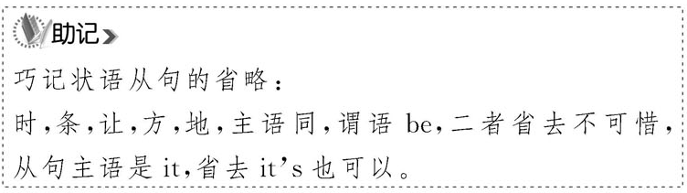
▶Don’t come in unless (you are) asked to.
没有叫你不要进来。
▶If (it is) necessary, ring me at home.
如果有必要，往我家里打电话。

Slide 24
We all know that, _____, the climate change will get worse.
A. not if dealt carefully with
B. if not carefully dealt with
C. if dealt not carefully with
D. not if carefully dealt with
【解析】选B。考查状语从句的省略。状语从句的省略原则之一为：从句的主语和主句的主语一致且含有be的形式，可以省略状语从句中的主语和be。该句补充完整为：if the climate change is not carefully dealt with。

Slide 25
doubt作为名词:
若用于否定句或疑问句中，后面接that引导的同位语从句；
若用于肯定句中，后面接whether引导的同位语从句。
注意此时不可以用if替换whether。
doubt作为动词:
若用于否定句和疑问句中，后面接that引导的宾语从句；
若用于肯定句中，后面一般接whether或if引导的宾语从句。
doubt 组成的一些短语：
in doubt 怀疑，拿不定主意
no/without/beyond doubt 无疑地，必定

Slide 26
▶There is no doubt that he is right.
毫无疑问他是对的。
▶I doubt whether/if he will come tonight.
我怀疑他今晚是否会来。
▶I never doubted (that) she would come.
我从未怀疑过她会来。

Slide 27
You may have your own decision on this matter, and I have little doubt _____ you will succeed.
A. if B. whether
C. that D. what
【解析】选C。doubt用作名词，在否定句中后接that引导的同位语从句，补充说明doubt的内容。

Slide 28
Line 21: Some byproducts of this process are called “greenhouse” gases, the most important one of which is carbon dioxide. (P26)
在这个过程中所产生的一些副产品就叫做“温室”气体，其中最重要的就是二氧化碳。
the most important one of which引导非限制性定语从句，是“介词(短语)+关系代词”形式，这种结构引导的定语从句常与先行词用逗号分开。出于表达需要，介词前可出现名词、代词或数词。
Line 39: — all of which will make life for human beings better. (P27)

Slide 29
It is reported that two schools, _____ are being built in my hometown, will open next year.
A. they both B. which both
C. both of them D. both of which
【解析】选D。考查非限制性定语从句。先行词为two schools, 故选both of which。

Slide 30
Line 29: Without the ‘greenhouse effect’, the earth would be about thirty-three degrees Celsius cooler than it is. (P26) 如果没有‘温室效应’，地球温度将比现在低大约33摄氏度。
此句为虚拟语气句，without引起虚拟语气。Without the ‘greenhouse effect’=If there were not the ‘greenhouse effect’, 是一个与现在事实相反的虚拟条件句。后面的句子使用了would be表示与现在事实相反的结果。

Slide 31

I _____ through that bitter period without your generous help. ［2011陕西, 32］
A. couldn’t have gone B. didn’t go
C. wouldn’t go D. hadn’t gone
【解析】选A。考查虚拟语气的用法。句意：如果没有你的热心帮助，我肯定无法度过那段艰难的日子。根据句意可知，此句为对过去事情的假设，主句应该为“情态动词+ have done”结构，故A项正确。

Slide 32
The engineers are so busy that they have zero time for outdoor sports activities, _____ they have the interest. ［2010安徽，29］
A. wherever B. whenever C. even if D. as if
【解析】选C。考查连词的用法。句意：工程师们如此忙碌，以至于他们没有时间进行户外体育运动，即使他们有这种兴趣。even if即使，符合句意。

Slide 33
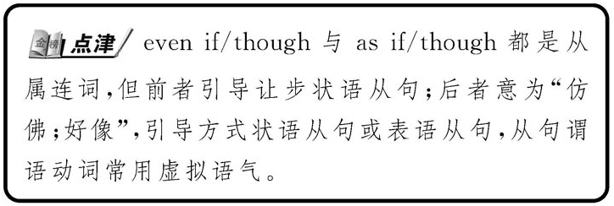
▶When a pencil is partly in a glass of water, it looks as if it were broken.
当一根铅笔部分在水里的时候，它看起来好像断了。
▶He behaved as if nothing had happened.
他表现得若无其事。

