Slide 1
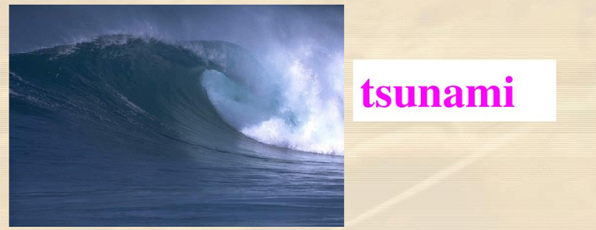
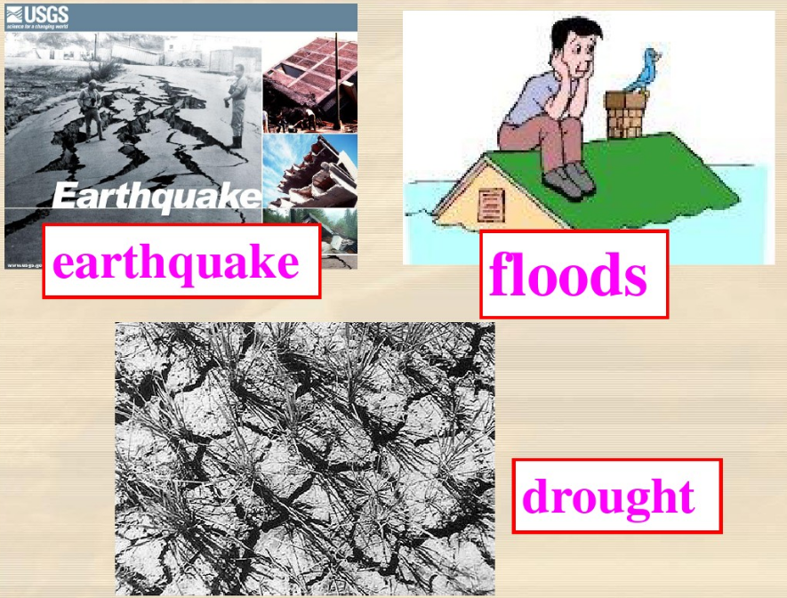
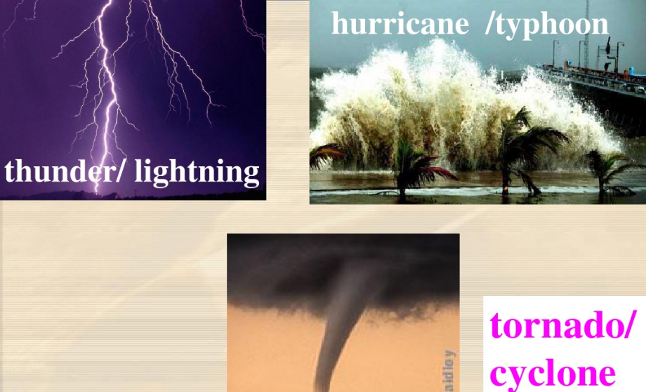

Slide 2
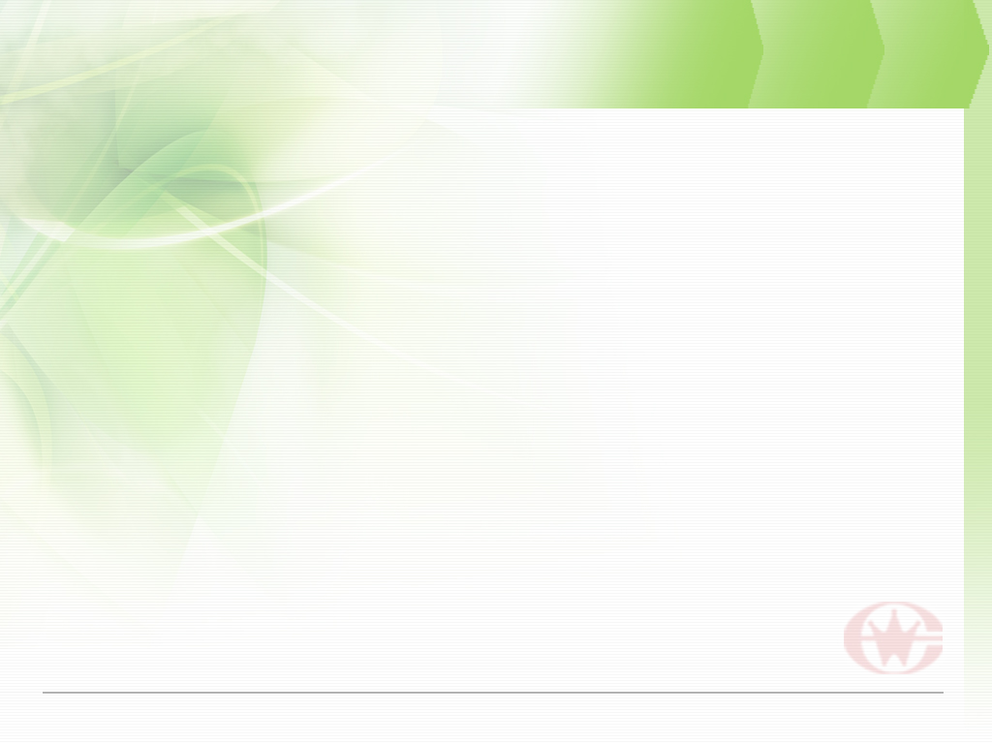
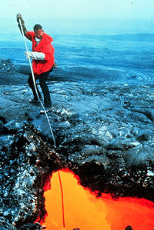
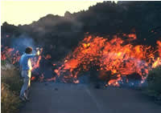
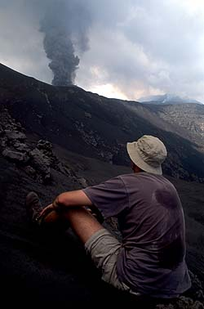
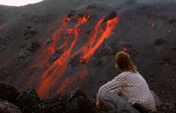

Slide 3


2.The writer doesn’t mind the
occasional danger of his job because
________.
A. He travels to unusual places and meets
interesting people from all over the
world
B. He likes the different ways of working
C. He thinks his job the most important
D. He is excited about dangers and feels
alive

Slide 4
3.As a result of the volcanologist's
work, _________.
other scientists predict the progress
of lava from the volcano
B. many people have been warned to
leave their homes
C. the eruption causes less damage
D. the eruption may be prevented
breaking out

Slide 5
4.Why did the volcanologist's run out of the house into the back garden?
A. Because his bed began shaking.
B. Because his bedroom suddenly became
as bright as day.
C. Because he thought there was an
earthquake in Hawaii.
D. Because he wanted to collect
information about the eruption.

Slide 6
5. What does the writer mean by using “lucky” in the sentence “ I was lucky enough to have a much closer look at it. ” ?
A. He left much safer on the top while the
other two scientists climbed down into the crater.
B. It was his first sight of an eruption.
C. It was the first time for him to watch the crater.
D. both B and C.

Slide 7

6. What does the word “alive” mean in
the sentence “... danger excites me and
makes me feel alive”?
Living or not dead.
B. Active or lively.
C. Continuing.
D. Healthy.

Slide 8
7. Why did the writer put on special clothes to look at the crater?
Because he wanted to take some
special photos.
B. Because he was concerned about his
safety.
C. Because the other two scientists asked
him to.
D. Because he wanted to climb down into
the crater.

Slide 9
1. Divide the whole text into several parts and share your reasons.
P1-2 The writer’s job and its importance
P3-4 The writer’s experience of watching the volcano
P5 The reasons for the writer’s enthusiasm about his job

Slide 10
2. How many signals were there to make the author realize that the volcano was erupting?
The bed began shaking
Heard a strange sound
Bedroom became as bright as day
Red hot lava was fountaining hundreds of meters into the air
5. An absolutely fantastic sight

Slide 11
3. How many steps did the scientist take to reach the crater after the eruption of the volcano?
Put on protective suits, helmets, big boots and special gloves
They were dropped as close as possible to the crater
Slowly made their way to the edge of the crater
Looked down into the red, boiling center

Slide 12
假如你是Earth Care杂志社主编，目前某中学正在提倡学生参与实施保护环境的计划。该校学生李华认为个人的力量非常微弱，不足以改变环境状况，因此，你代表杂志社写回信给李华，提出你的建议并对李华同学予以支持和鼓励。具体要点如下：
不使用电器时请及时关闭
回收瓶罐、塑料袋、报纸等物品，尽可能购买由可回收材料制成的物品
做一个环保教育者
鼓励李华重视个人的环保行为

Slide 13
Dear Li Hua,
You are not alone to believe individuals have little power to improve our environment. However, global warming actually comes as a result of many things we do every day. Here are a few suggestions which should get you started with your project.
First, remember to turn off the electrical appliances when you are not using them. Next, keep it a habit to recycle cans, bottles, plastic bags and newspapers and if you can, buy things made from recycled materials. Finally and most importantly, be an educator by talking with your family and friends about global warming and telling them what you have learned.
Your contribution counts and individuals can make a difference. We do not have to be the victim of global warming but the victor against it.
Earth Care

Slide 14
Dear Li Hua,
I learn from your letter that you want to do something to reduce the emission of greenhouse gases. I am glad that you’ve come to me for help and here are some suggestions which I hope can be helpful to you.
First of all, remember to turn off electrical appliances when you are not using them. Meanwhile, make it a habit to recycle things like cans, bottles, plastic bags, newspapers, etc. and if possible, buy products made from recycled materials. Most importantly, take every possible chance to talk with your families and friends about global warming and tell them what you have learned.
Always bear in mind that every individual’s contribution counts. You can make a difference by adopting a more responsible lifestyle.
Best wishes.
Earth Care

