Slide 1
The present and perfect -ing form
Examine the sentences below and tell the similarity and difference between these two sentences.
Looking carefully at the ground, I made my way to the edge of the crater.
Having experienced quite a few earthquakes in Hawaii already, I didn’t take my notice.
The –ing form can be used as an adverbial in a sentence to give information about time, reasons or results. We use the construction having+past participle to refer to an action that took place before the time expressed by the main verb.

Slide 2

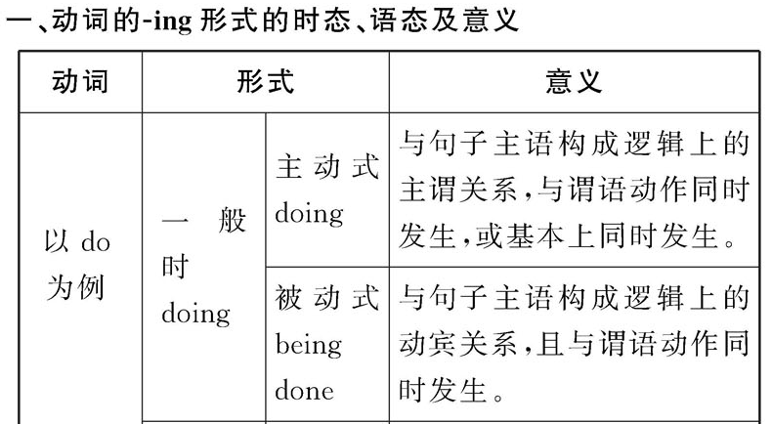

Slide 3
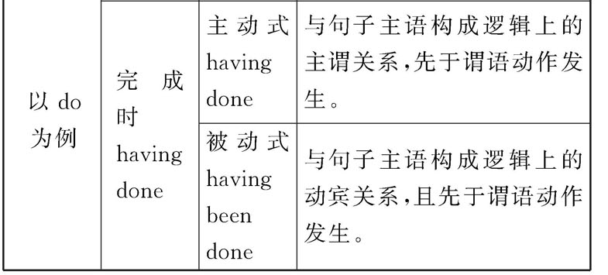

Slide 4
▶Hearing the news, they immediately set off.
听到这个消息，他们立即出发了。
▶Having written a letter, I listened to music for a while.
写完信后，我听了一会儿音乐。
▶Having been held back by the traffic jam, she couldn’t get there on time.
她被交通阻塞耽搁了，无法准时到达那里。

Slide 5
二、现在分词作状语的种类
现在分词作状语时，表示的动作是主语动作的一部分，用来修饰谓语动词，常表示动作发生的时间、原因、条件、结果、方式、伴随、让步等情况， 多用逗号跟句子其他成分隔开。并可以转换成相应的状语从句或并列句。

Slide 6
1. 作时间状语
▶Walking in the park，she saw an old friend.
=When she was walking in the park, she saw an old friend. 在公园散步时，她看到一个老朋友。
▶Having finished the work, he went out to meet his friends.
=After he finished the work, he went out to meet his friends. 完成工作后，他出去会朋友了。

Slide 7
如果强调两个动作同时发生，分词前可加when或while。
▶Be careful when crossing the street.
过马路时一定要小心。
▶Don’t mention this while talking to him.
与他交谈时不要提这件事。

Slide 8
2. 作原因状语
▶Not knowing how to deal with the problem, he turned to his teacher for help.
=As he didn’t know how to deal with the problem, he turned to his teacher for help.
由于不知道如何处理这个问题，他向老师求助。
▶Having traveled to many places，he knows a lot.
=Since he has traveled to many places, he knows a lot.
到过很多地方旅游，他知道很多。

Slide 9
3. 作方式或伴随状语
▶He sent me an e-mail，hoping to get further information.
=He sent me an e-mail，and (he) hoped to get further information.
他给我发了封电子邮件，希望得到更多的消息。
▶ The children ran out of the room, laughing and talking merrily.
那些孩子们跑出房间，愉快地笑着、说着。

Slide 10
4. 作条件状语
▶Working hard, you’ll surely succeed.
=If you work hard, you’ll surely succeed.
如果你努力工作，你就会成功。
▶ Turning to the left, you will find the school.
=If you turn the left, you will find the school.

Slide 11
5. 作让步状语
▶Admitting what she has said, I don’t think that she has tried her best.
=Though I admit what she has said, I don’t think that she has tried her best.
尽管承认她所说的话，但我认为她没有尽最大努力。

Slide 12
6. 作结果状语(必然结果)
▶The train was caught in heavy snow，thus causing the delay.
=The train was caught in heavy snow and caused the delay.
火车遇上了大雪，因此造成了耽搁。

Slide 13

①Do you wake up every morning _____ energetic and ready to start a new day?
［2011湖南，29］
A. feel B. to feel
C. feeling D. felt
【解析】选C。考查非谓语动词。句意：你每天早上醒来时都精力充沛，准备着开始新的一天吗？现在分词在此作伴随状语，与句子的主语存在逻辑上的主谓关系。

Slide 14
②Sit down, Emma. You will only make yourself more tired, _____ on your feet.
［2011北京, 33］
A. to keep B. keeping
C. having kept D. to have kept
【解析】选B。考查非谓语动词作状语。句意为：爱玛，坐下。老站着只会让你更累。根据语境该空需用现在分词短语作伴随状语，故答案为B项。不定式短语作状语时一般作目的状语或结果状语。

Slide 15
③ _____ around the fire, the tourists danced with the local people.
［2011辽宁, 30］
A. Gather B. To gather
C. Gathering D. To be gathering
【解析】选C。考查非谓语动词。句意为：围着篝火，游客们和当地人跳起了舞。分析句型可知gather around the fire作伴随状语，而且与逻辑主语the tourists之间的关系是主动的，要用doing。

Slide 16
④Sarah pretended to be cheerful, _____ nothing about the argument.
［2011全国卷Ⅱ, 18］
A. says B. said
C. to say D. saying
【解析】选D。
考查非谓语动词。句意为：萨拉假装很高兴，关于争论什么也没说。say和逻辑主语Sarah之间是主谓关系，故用现在分词saying，答案为D。

Slide 17
⑤At one point I made up my mind to talk to Uncle Sam. Then I changed my mind, _____ that he could do nothing to help. ［2011上海, 33］
A. to realize B. realized
C. realizing D. being realized
【解析】选C。
考查非谓语动词。句意为：我一度下定决心和山姆叔叔交谈。然后，当意识到他不能帮忙时，我改变了主意。I 与realize之间是主动关系，因此要用realizing形式表示主动关系，故选C。

Slide 18
三、现在分词作状语的注意事项
1. 主语一致
现在分词作状语时，分词的逻辑主语要与句子的主语保持一致，否则就要在分词前加上其自身的逻辑主语构成分词的独立结构。
▶Mary coming back, they discussed that together.
玛丽回来后，他们一起讨论了那件事。
▶Weather permitting, we shall go there on foot.
天气允许的话，我们就步行去那儿。

Slide 19
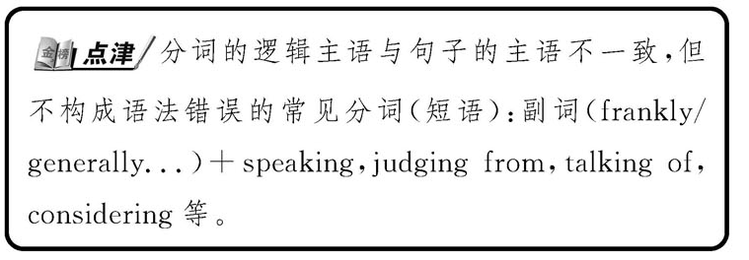

Slide 20
2. 否定形式
现在分词的否定形式是“not+现在分词”。
▶Not knowing his address, I was anxious.
由于不知道他的地址，我很担心。

Slide 21
⑥_____ that he was in great danger， Eric walked deeper into the forest. ［2008浙江，10］
A. Not realized B. Not to realize
C. Not realizing D. Not to have realized
【解析】选C。句意：没有意识到他处于危险当中，艾里克走进森林深处。此题考查现在分词作状语的否定形式，其逻辑主语为Eric。

Slide 22
3. 现在分词的完成式
如果V-ing 表示的动作发生在句子谓语之前，则要用V-ing 的完成式，即是： Having +P.P(过去分词)…, 主语+谓语
▶ Having finish her work, she went home.
After she had finished her work, she went home.
▶ Having invited him here to speak, we’d better go to his lecture.
As we have invited him here to speak, we’d better go to his lecture.

Slide 23
Rewrite the sentences using the present or the perfect –ing form of the underlined verbs.
When they heard about the volcano they ran down to the village.
After the scientists had studied the information they predicted that the lava would flow through the village.
Hearing about the volcano, they ran down to the village.
Having studied the information, the scientists predicted that the lava would flow through the village.

Slide 24

Exercises
1. _____ the championship, he was awarded a million dollars.
A. Won B. Winning
C. Having won D. Being won
2. ______ only book knowledge, you will not be able to work well.
A. Had B. Have C. Having D. To have
3. I saw a lot of children playing in the garden most of them _____ girls.
A. are B. being C. were D. having

Slide 25
4. The old man could not sleep at night, his wrongs _____ him no peace.
A. gave B. give
C. being giving D. giving
5. The decision _____, what is to be done now is how to carry it out.
A. made B. has been made
C. having being made D. being made
6. ____ in the queen for half an hour, I suddenly realized that I had left my wallet at home.
A. To wait B. Waiting
C. Having waited D. To have waited

Slide 26
7. “We can’t go out in this winter,” said Ted, ____ out of the window.
A. looking B. to look
C. looked D. having looked
8. Finding her car stolen, _____.
A. a police was asked to help
B. the area was searched thoroughly
C. it was looked for everywhere
D. she hurried to a police for help
9. _____ a reply, he decided to write again.
A. Not receiving B. Receiving not
C. Not having received D. Having not received

Slide 27
10. ____ the room, I found the recorder stolen.
A. Entering B. To enter C. Enters D. Entered
11. “What on earth have you done?” mother said ____ to the broken vase on the ground.
A. angrily pointing B. and point angrily
C. angrily pointed D. and angrily pointing
12. _____ by car, we visited many places.
A. Travel B. Traveling
C. To travel D. Having travelled
Notes:
英语学习辅导报
英语学习辅导报

Slide 28
“You can’t catch me!” Janet shouted, _______ away.
A. run B. running
C. to run D. ran
解析：答案B。
running away在此作shouted的伴随状语，由Janet发出这一动作。

Slide 29
2. The storm left, ________ a lot of damage to this area.
A. caused B. to have caused
C. to cause D. having caused
解析：答案D。
题意：暴雨过去了，只留下给这一地区造成的巨大损害。由上下文逻辑意义看，此处应表示自然而然的结果，故用现在分词作结果状语。

Slide 30
3. ________ in the queue for half an hour, Tom suddenly realized that he had left his wallet at home.
A. to wait B. have waited
C. having waited D. to have waited
解析：答案C。
此处为现在分词的完成式作时间状语，表明该动作发生在realized之前。

Slide 31
4. _______ such heavy pollution already, it may now be too late to clean up the river.
A. Having suffered B. Suffered
C. To suffer D. Suffered
解析：答案A。
由already提示，分词动作发生在谓语之前，故须用分词的完成式。

Slide 32
5. The secretary worked all night long, _____ a long speech for the president.
A. to prepare B. preparing
C. prepared D. was preparing
解析：答案B。
非谓语动词充当伴随状语，与主语the secretary是主动关系，因此用v.-ing形式。

