Slide 1

1. To summarize the main idea of the passage
2. To grasp what Tony did to help Claire and how Claire’s emotion developed during Tony’s stay at her house
3. To learn to use some words, expressions and patterns in the passage

Slide 2

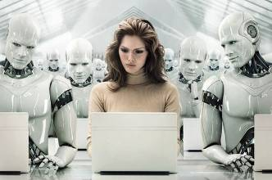
What role do robots play
in the future?

Slide 3

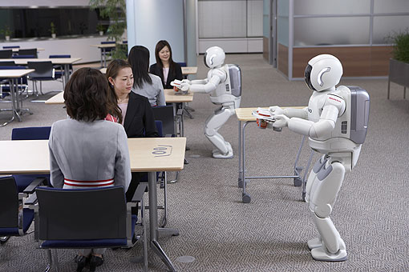
Let’s enjoy a video.
The future for robots could be in the home. These robots aren’t just fun to play with, they can do real work. For example, household robots could take over daily tasks like vacuuming carpets and cleaning windows. They are supposed to serve Chinese elders and housewives.

Slide 4
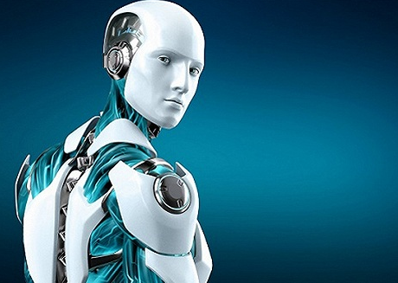
Unit 2 Reading
Satisfaction guaranteed

Slide 5
Background information
The reading passage is a retelling of an
Isaac Asimov’s science fiction called
Satisfaction Guaranteed. This story, about a
human-like robot, illustrates (阐明) Asimov’s
first law for robots:
A robot must not injure human beings or allow
them to be injured. In this case the injury is
not a physical one but a psychological one.
During the process of following the law, the
robot, which is very human-like, causes the
main character, Claire, to have some very
confused feelings.

Slide 6


Skimming for general idea

Slide 7
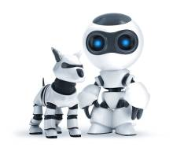
(1) Answer the following questions.
1. How many characters are mentioned?
2. Who are they?
3. What is the relation between them?

Slide 8
Characters in the story:
- employed in a company
that makes robots
- Larry’s wife, a housewife
- the robot to be
tested out by Claire in her house
– one of the richest and
most powerful women around, a
woman that Claire envies
Larry Belmont
Claire
Tony
Gladys Claffern

Slide 9
Scanning for specific information

Slide 10

What is the beginning of the story?
Larry’s company had begun experimenting with a household robot. It was going to be tested out by Claire.
Read the passage and answer the questions.
How did Claire feel when she first saw the robot?
She felt alarmed.
Why?
He was more like a human.
He was Tall and handsome with smooth hair and a deep voice.
His facial expression never changed.

Slide 11


When Claire refused to have the robot in her house, Larry said to Claire that Tony would be a bonus. What did he mean?
What were Claire’s problems? How did Tony help her?
Tony would not harm Claire or allow her to be harmed.

Slide 12
She didn’t think she was clever.
She was overweight.
She felt her house wasn’t elegant enough.
She wasn’t like Gladys.
Claire’s problems
Tony’s help
curtains, cushions, a carpet and bedding, a necklace.
Tony gave Claire a new hair cut and changed the makeup she wore. He also wrote out a list of items for her to buy…
When Claire came back from the jewellery shop, she was quite angry with Gladys.
Tony told her and suggested that she invite Gladys and her friends to the house the night before he was to leave and Larry was to return.

Slide 13
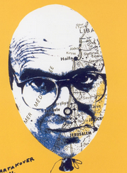

Brain storm
What would Tony do next?
Read the passage and find out what Tony did and the reactions of Claire, Gladys and her friends.
Tony showed Gladys and her friends his affection towards Claire.

Slide 14
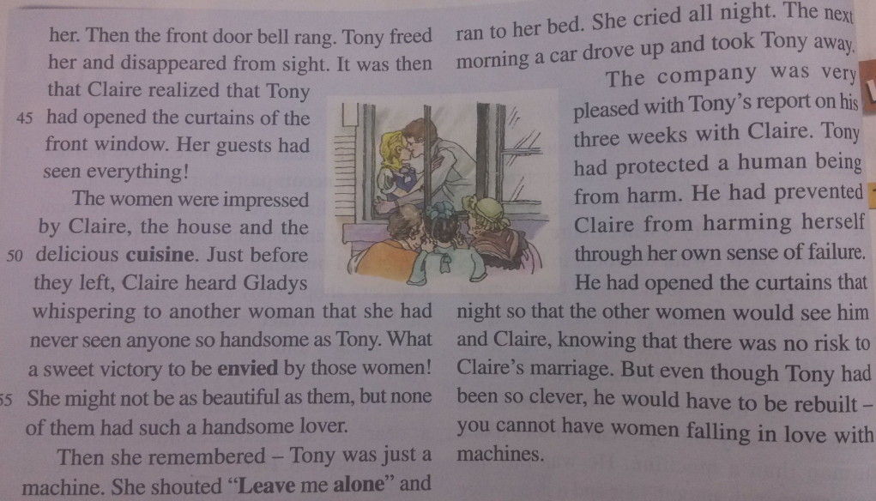
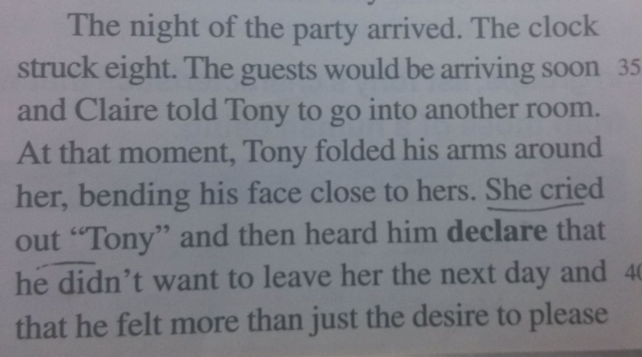
Claire’s reaction:
surprised, happy, panic
Gladys and her friends:
impressed, envied

Slide 15

Discussion
The company was very pleased with Tony’s report, what do you think of it? Do you think Tony had protected Claire from harm?
The answer is open.
One Possible answer
I don’t think so. Because of Tony’s help, Claire and her home had become more elegant, and Claire was envied by Gladys and her friends. However, Tony hurt Claire’s feeling. Claire believed that she had fallen in love with a robot.

Slide 16
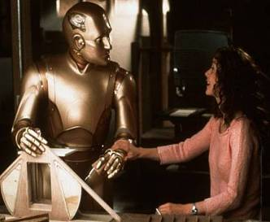
P12 1
(2) Answer the following questions.
Claire’s feelings towards Tony changed as the story developed. Fill in the occasions when Claire had these feelings.

Slide 17
The Change of Claire’s Feelings to Tony
Occasion
Claire
Before he arrived
disliked him
When he arrived
was alarmed
When he offered to
help her dress
felt embarrassed
When he offered to
help her improve her
house and herself
admired him

Slide 18
The Change of Claire’s Feelings to Tony
Occasion
Claire
When he helped her
with the salesman
called him a dear
When she fell off a
ladder and was caught
by Tony
felt his warmth

Slide 19
The Change of Claire’s Feelings to Tony
Occasion
Claire
When she heard Gladys
whispering to another
woman that she had never
seen anyone so handsome
as Tony
felt being envied
She remembered Tony
was just a machine
cried all night

Slide 20
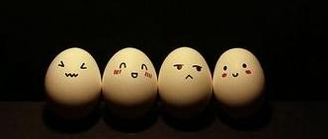
Review Claire’s emotional development.
At first refused to have Tony at her house
→ accepted him
→ trusted him
→ proud of him
→ sad to remember
he was just a machine
→ loved him

Slide 21
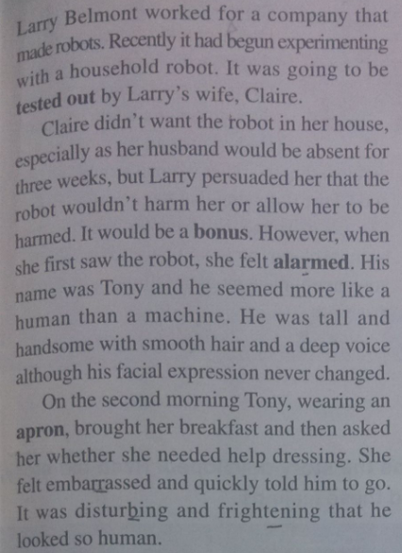
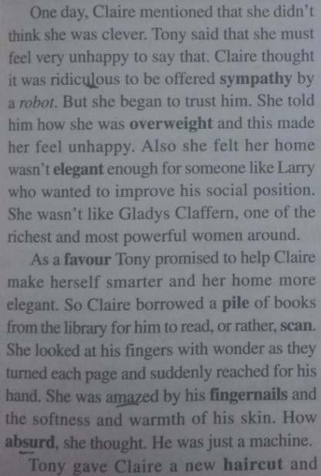
Claire’s feelings

Slide 22
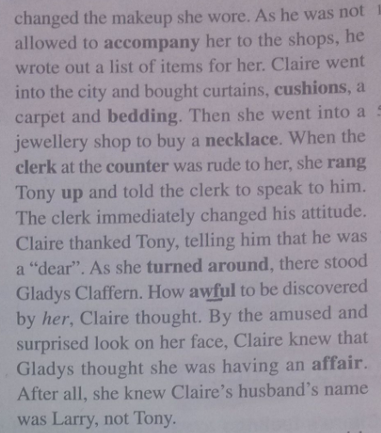
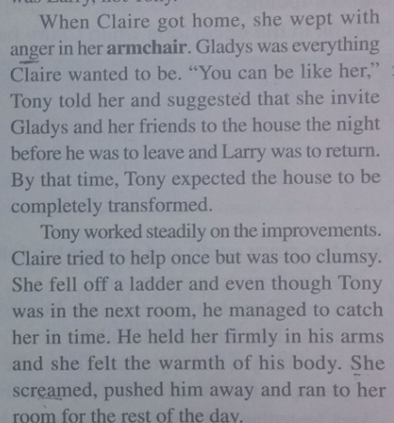
In Claire’s mind, Tony is more like a human than a machine. So Claire struggled when she was with Tony. If you had a robot like Tony, would you treat him as a human?

Slide 23
(4) Fill in the form below.
P12 3
In groups, list Tony’s characteristics
that were similar to those of a human being and that were different.
Characteristics | Similar | Different
Physical
Mental

Slide 24
Charac-teristics | Similar | Different
Physical
Facial expressions
never changed.
Quicker reactions (She fell off a ladder and even
though Tony was
in the next room,
he managed to catch her in time.)
Looks like a
human being. Body and skin soft and warm. Hair and fingernails realistic. Voice
like a human’s.

Slide 25
Charac-teristics | Similar | Different
Mental
Able to make suggestions and predictions. Able to make a plan and follow it through.
Has good communication skills.
Behaviour not appropriate
(Tony brought her
breakfast and then
asked her whether
she needed help
dressing.)

Slide 26
(5) Answer the following questions.
P12 2
1. Why did Tony open the curtains?
2. What did Tony do to prevent Claire
from being harmed?
3. Why did Tony have to be rebuilt?
4. How would you feel if you had a robot
like Tony in your house?
5. Claire spent three weeks with Tony in
her house. What sentences in the story
show that she kept forgetting and then
remembering that he was a machine?

Slide 27
Reference answers
1. Why did Tony open the curtains?
He wanted Claire’s guests to see him and Claire together so that she would be envied by the women guests.
2. What did Tony do to prevent Claire from being harmed?
Tony prevented Claire from being harmed by making her feel good about herself. He helped her make her and her home elegant so that she would not feel like a failure.

Slide 28
3. Why did Tony have to be rebuilt?
4. How would you feel if you had a robot like Tony in your house?
Tony had to be rebuilt because the company felt that they could not have women falling in love with a robot.
Please give your own answers.

Slide 29
5. Claire spent three weeks with Tony in her house. What sentences in the story show that she kept forgetting and then remembering that he was a machine?
How absurd, she thought. He was just a
machine.
He held her firmly in his arms and she felt
the warmth of his body. She screamed,
pushed him away and ran to her room for
the rest of the day.
Then she remembered - Tony was just a
machine. She shouted “Leave me alone”
and ran to her bed.

Slide 30
A household robot, Tony, was going to ________ out by Larry’s wife, Claire, when he was _______ for three weeks. Claire didn’t like the idea at first, but Tony won Claire’s trust gradually. Tony helped Claire realize her dreams by ________ her home more elegant and made her more beautiful by giving her a new haircut and _________ (change) the makeup she wore. However, Gladys thought Claire was having an ______ by mistake. Tony advised Claire to invite Gladys and her friends to her house. At that night, Tony opened the curtains of the front window and _______ that he didn’t want to leave Claire and that he felt more than just the ______ to please her. It was a sweet victory for Claire to be ______ by those women.
be tested
absent
making
Complete the passage with proper words,
which will help you retell the text.
changing
affair
declared
desire
envied

Slide 31
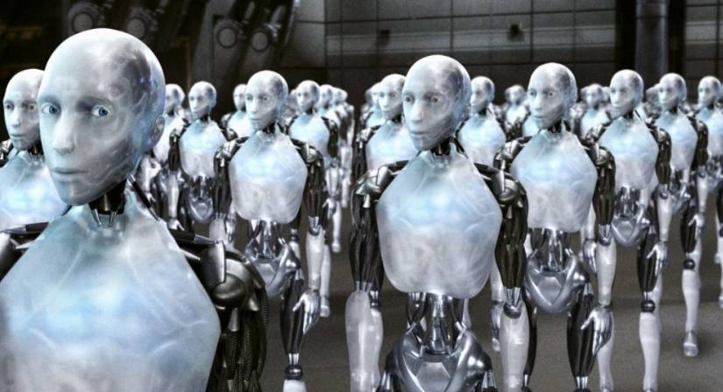
I, Robot

Slide 32

Robot and Human
What will robots become in the future?
Friends?
enemy?
Or just robot?
Technology is a queer thing. It brings you great gifts with one hand, and it stabs you in the back with the other.

