Slide 1

英语课标教学课件
选修7

Slide 2
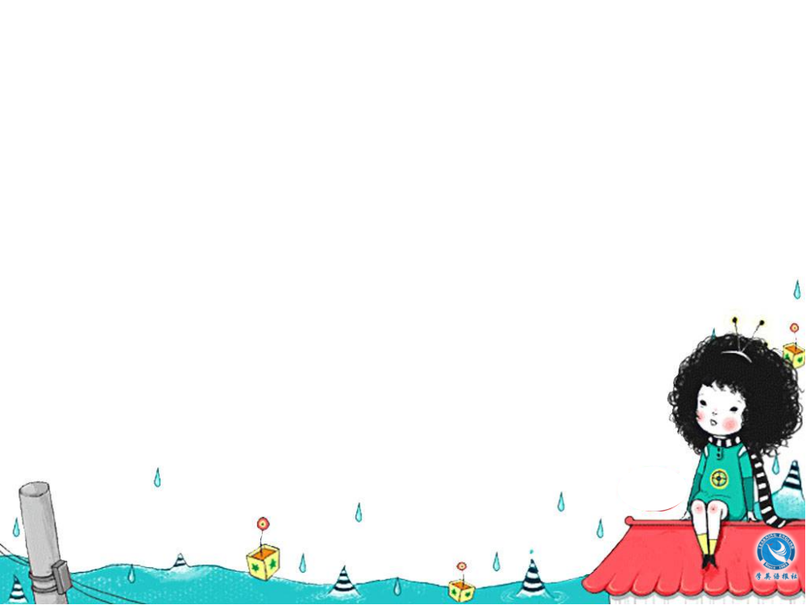
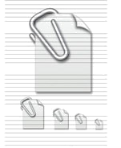
Unit 2 Robots
Listening
注: 另附 word 文档。
点击此处链接

Slide 3

Using Language
Listen to the text.
SATISFACTION GUARANTEED
Listen to Molly (M) and Kate (K) discussing the story “Satisfaction Guaranteed”.

Slide 4

Listen again and fill in the blanks.
love
M: Don’t you think that was a great _____
story, Kate?
K: No, not ______!
M: You didn’t? Well, I loved it. There was
so much _______ between Tony and
Claire.
K: Molly, that’s ________. Tony was just a
_________. Yes, maybe Claire fell in love
with him, but I don’t believe ______ can
feel emotion of any kind. That’s the
__________ between them and us.
really
emotion
rubbish
machine
robots
difference

Slide 5
M: Well, I _________. I think Tony loved
Claire. Remember he said to her that
he didn’t want to _____ her the next day,
and that he felt more than just the _____
to please her? Then he ______ her.
K: Yes, Molly, but that was just part of
Tony’s _____. They made him so he
couldn’t allow a human being to be ____.
He could see that Claire was hurting
herself by her _____ of confidence.
disagree
leave
wish
kissed
role
hurt
lack

Slide 6
So he tried to make her ____ good about
herself. It had _______ to do with emotion
– that was just how he was ______.
M: Yes Kate, but he did hurt Claire.
K: How?
M: He was so ______ to her that she fell in
love with him. So it must have hurt her
when he was _______ away.
K: True, true. I guess that’s why the
company had to ________ him … er …
the machine I mean!
feel
nothing
made
kind
taken
rebuild

Slide 7
M: Yes, such a _______ really. I’d like a
robot like Tony living at my _______.
Imagine a handsome man ______ only
purpose in life is to ________ you!
K: Actually, I suppose that was the
company’s greatest ________.
M: Er?
K: They made the robot look so much like
a _____ man, so it was bound to cause
_______!
M: Yes, you’re right.
shame
house
whose
please
mistake
real
trouble

Slide 8
Workbook-Listening
Listen to the text.
THE WORLD OF ROBOTS
Listen to radio presenter, Alan Dobson
(AD), talking to a science news reporter,
Emma Woods (EW), about robots in
today’s world.

Slide 9
Listen again and fill in the blanks.
AD: Now it’s time for our ______ chat
with the science news _________,
Emma Woods. Hi, Emma.
EW: Hi, Alan.
AD: So, what do you ______ for us today,
Emma?
EW: Well, Alan, I thought we’d have a
______ look at the world of robots.
AD: That’s an interesting _______.
weekly
reporter
have
quick
topic

Slide 10
EW: Well, we actually already use robots
in many _________ situations, but now
they’re also being _________ for use
around the house. Let me tell you
about a very clever carpet _______ that
can move from room to room cleaning
your house by _______. You can
programme it, so that it cleans when
you’re ______ and you can control it
from your _________ at the office.
industrial
developed
cleaner
itself
away
computer

Slide 11
AD: I wonder ________ it does a good job,
but I want one anyway!
EW: Well, Alan, you’d probably also
_____ a PaPeRo.
AD: A what?
EW: A PaPeRo. P-A-P-E-R-O. It’s an
egg-shaped ________ robot that you
can talk to.
AD: You’re kidding. You mean it can
__________ you?
whether
want
personal
understand

Slide 12
EW: That’s right. I’ve read that it
understands _____ phrases and speaks
more than ______ words. And it can
recognize ________ people.
AD: That’s amazing! So, what can it do?
EW: Well, it can check your _____. It can
help children do ________ on the
Internet for their homework, talk to
them about their day at ______, and
even ______ games with them.
650
3,000
different
email
research
school
play

Slide 13
AD: Unbelievable! Now, let’s move on to
other ______ of robots. You also
found out about a tiny robot ______,
didn’t you?
EW: That’s right, Alan. This wonderful
little robot weighs less than ___ grams
and has a _______. In the near future
it’ll be used to fly into __________ areas
and check if anyone is trapped ______.
types
plane
9
camera
dangerous
inside

Slide 14
AD: So it could _____ a lot of people’s lives.
EW: Yes, and, recently, a _______ chair has
been developed that the ________
believe will help people who can’t
walk to go up and down ______.
AD: Well Emma, thanks so much for
telling us a little ___ about the exciting
world of ______. Now what are you
going to talk about next week?
save
waking
makers
stairs
bit
robots

Slide 15
Workbook-Listening Task
Listen to Part 1.
ROBOT PETS
Amanda, Victoria and Jamie are reading about four robot pets and then discussing whether robot pets can be real pets.
A = Amanda V = Victoria J = Jamie

Slide 16
Listen again and fill in the blanks.
A: (reading) Aibo can walk, sit, ____ down
and wag its tail. It learns the name
you give it and can ______ when you
call it. It develops its own __________.
It can learn about ____ commands.
V: (reading) Furby likes being ______. At
first he speaks his _____ language, then
he gradually switches to _______ the
more time you spend with him. (not
reading) He looks like a big-eared _____.
Isn’t he so cute, Jamie?
lie
answer
personality
50
patted
own
English
bird

Slide 17
J: Well, Victoria, I think he looks _______.
I like these ones, _______. (reading)
Paro can open and close its _____ and
move its flippers. Tama _________ her
own name. She purrs when she’s
patted. That shows she’s ______, but if
you hit her she’ll give you an ______ hiss.
Gradually her behaviour ________ and
she develops her own personality.
strange
though
eyes
recognizes
happy
angry
changes

Slide 18

Listen to Part 2.

Slide 19
Listen again and fill in the blanks.
A: I don’t understand the point of a robot
____. Why wouldn’t you get a real one?
J: Well, you don’t have to ____ a robot dog
or take it for _____. And they don’t bark
or bite!
V: And it wouldn’t make your house _____!
A: Yeah, but it’s not real pet, is it? It’s a ___.
V: Well, Amanda, I must say Aibo and
Furby look like toys to me. At least Paro
and Tama look more like real ________.
pet
feed
walks
dirty
toy
animals

Slide 20
J: I don’t think it ________ whether the
robot looks like a real pet or not. If
someone thinks of the robot ____ a pet,
then it is a pet.
A: But Jamie, don’t you think it’s _____
if the person thinks of the robot as a
_____ pet?
J: No, I don’t think so, not if he gets
__________ from it.
matters
as
sad
real
enjoyment

Slide 21
A: Well, I don’t believe a robot can be a
true _______ even if it does develop its
own personality. I mean stroking a
dog or cat makes you feel good
_______ you’re making it happy.
You ______ make a robot “happy”.
V: But you can make Tama _______. It all
depends on how you ______ her.
friend
because
can’t
happy
treat

Slide 22
A: That’s true, ____ she’s programmed to
be like that.
J: Anyway, I think robot _____ would be
good kinds of pet for _______ who
cannot have a live pet or who can’t
_____ for one – like people who are
old, sick or ________.
but
pets
people
care
disabled

