Slide 1
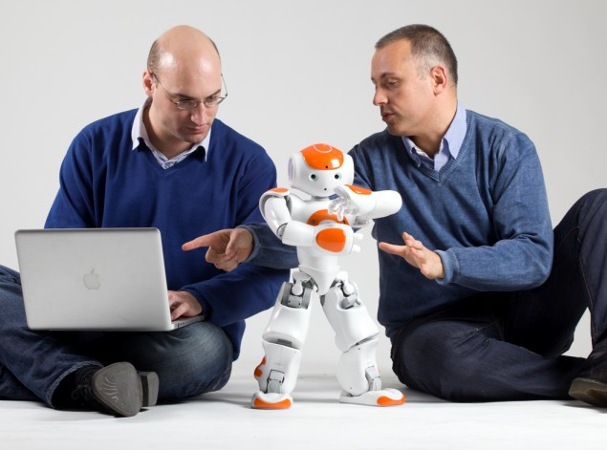
Unit 2
Robots

Slide 2

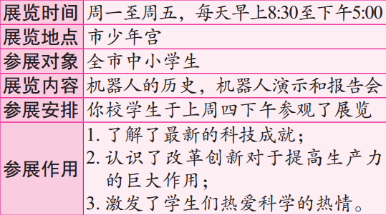
【写作任务】
你市少年宫于上周举行了一次机器人展览。下面是本次展览的相关情况：

Slide 3
【写作要求】
1. 作文应包括以下要点：(1) 展览的时间、
地点及开放对象；(2) 展览的内容及安排；(3) 参展的作用。
2. 只能使用5个句子表达全部内容。

Slide 4
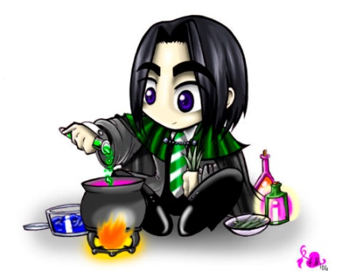
【写作分析与指导】
1. 写作思路：本题列出了三个要点，要点之间具有很强的逻辑性。在本文的写作过程中，我们应注意如下几点：(1) 合理使用简单句、并列句和复合句，长短结合；(2) 在文章中恰到好处地使用所学到的词汇、短语、句型及语法知识；(3) 根据句子间的逻辑关系，合理地使用关联词语

Slide 5

【写作分析与指导】
和过渡词语；(4) 陈述类似活动安排的文章时，如果不清楚或没必要说出动作的执行者，尽量采用被动句，这样更符合英语的表达习惯。另外，由于所陈述的事情发生在过去，因此文章的时态应以过去时态为主。

Slide 6
二、词句储备
1. 写作中可能使用的词语有：
(1) 机器人展览 ________________________
(2) 少年宫 ____________________
(3) 激励/激发 _________________
(4) 科学知识 ___________________
(5) 对……开放 _________________________
(6) 科技成就
____________________________________
(7) 改革，创新 _________________
(8) 引起兴趣 _____________________
robot exhibition/show
the Children’s Palace
stimulate
scientific knowledge
be open to
scientific and technological achievements
innovation
arouse one’s interest

Slide 7
(1) 为了激发青少年对科学的热情，帮助他们了解最新的科学技术，上周一至周五我市少年宫举办了机器人展览。
A robot exhibition was held from Monday to Friday last week in the Children’s Palace of our city in order to stimulate the youths’ interest in science as well as to help them learn about the latest science and technology.
(2)从早上八点半到下午五点展览对全市中小学生开放。
The exhibition was open to all the primary and middle school students of the whole city from 8:30 am to 5:00 pm.

Slide 8

(3) 整个活动包括机器人历史、机器人演示和报告会。
The whole program included the history of robots, the robot exhibition and a report.
(4)我们上周四下午参观了展览，了解了最新的科技成就。
We attended the exhibition last Thursday afternoon and learned about the latest scientific and technological achievements.

Slide 9
(5) 展览还帮助我们意识到了改革创新对于提高生产力的重要性，激发了我们对于科技的热爱。
The exhibition also helped us realize the importance of innovation in improving productivity and aroused our love of science and technology.

Slide 10

三、下笔成文
A robot exhibition was held from Monday to Friday last week in the Children’s Palace of our city in order to stimulate the youths’ interest in science as well as to help them learn about the latest science and technology. The exhibition was open to all the primary and middle school students of the whole city from 8:30 am to 5:00 pm. The whole program included

Slide 11
the history of robots, the robot exhibition and a report. The students in our school attended the exhibition last Thursday afternoon and learned about the latest scientific and technological achievements. In addition, the exhibition also helped us realize the importance of innovation in improving productivity and aroused our love of science and technology.

Slide 12
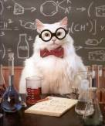
【点评】
这篇范文较好地完成了规定的写作任务：使用的语言正确、规范；要点完整；行文连贯。此外，本文恰到好处地使用了复合句、并列句和简单句，使得文章的结构错落有致，表现形式丰富多彩。另外，在句子之间较好地使用了过渡词语in addition，使句子的过渡显得非常自然。

