Slide 1

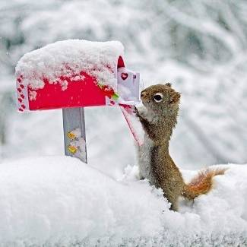
Unit 4 Reading
A LETTER HOME

Slide 2

Words Review
fortnight
roof
muddy
textbook
concept
bucket
weekly
bubble
relevant
n. 两星期
n. 屋顶；车顶
adj. 泥泞的；泥土般的
n. 教科书；课本
n. 观念；概念
n. 水桶；吊桶；提桶
adj. & adv. 每周（的）
vi. 起泡；沸腾；汩汩地流动
adj. 有关的；切题的

Slide 3
Words Review
remote
ridge
weed
hut
rectangle
rectangular
adjust
adj. 遥远的；偏僻的
n. 山脊；屋脊
n. 杂草；野草
vt. & vi. 除杂草
n. 棚屋；小屋
n. 矩形；长方形
adj. 长方形的；矩形的
vi. & vt. 调整；（使）适合

Slide 4
Words Review
platform
broom
tin
jar
sniff
participate
interpreter
grill
n. 台；平台；讲台；（火车站的）月台
n. 扫帚
n. 锡
n. 罐；广口瓶
vt. & vi. 嗅；闻；用鼻子吸
vi. 参与；参加
n. 作口译的人
n. 烤架；大平底锅
vt. 烧烤；炙烤

Slide 5
Words Review
leftover
evil
otherwise
privilege
paperwork
n. 剩余物；残留物；剩饭
adj. 剩余的
adj. 邪恶的
n. 邪恶；罪恶
conj. 否则；不然
adv. 用别的方法；其他方面
n. 特权；特别优待
n. 文书工作

Slide 6
Match
hear from …
(be) dying to
the other day
dry out
dry up
极想; 渴望
接到……的信
(指河流、井等)干涸
(使浸水等之物)完全变干;
干透
不久前的一天

Slide 7
(3) Answer the following questions.
1. Why did Jo send Rosemary some photos?
2. Why was the high school called a bush school?
3. Were the boys and villagers friendly to Jo?
4. Why was science the most challenging subject for Jo?
5. Why did the boys start jumping out of the windows?

Slide 8
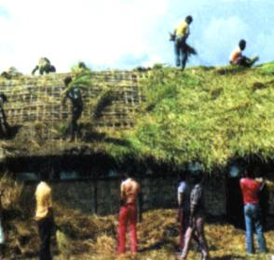
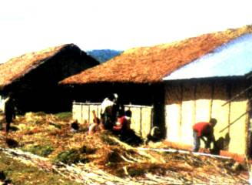
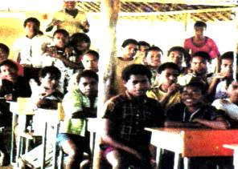
1. Why did Jo send Rosemary some photos?
It was difficult for Rosemary to imagine how hard life was in Jo’s school and village.
2. Why was the high school called a bush school?
The classrooms were made of bamboo and the roofs were made of grass.

Slide 9
3. Were the boys and villagers friendly to Jo?
Yes, they were.
There were lots of “good mornings” for Jo from the boys.
When Jo and Jean arrived at the village, Tombe’s mother started crying “ieee ieee” to welcome them. Jo and Jean shook hands with all the villagers.

Slide 10
4. Why was science the most challenging subject for Jo?
Her students had no concept of doing experiments and there was no equipment.
5. Why did the boys start jumping out of the windows?
The boys never came across anything like the bubbling mixture.

Slide 11
Jo is a young Australian woman who___________ (work) as a volunteer teacher in Papua New Guinea for two years. She writes a letter to tell Rosemary her _________ (teach) life in the high school. There is _____ electricity or water and even no textbooks ______! And her students have no concept of _________ experiments. She also tells Rosemary that she ___________to Tombe’s village with another teacher. The hut is dark inside so it takes time for their eyes ________. The only possessions that Jo can see ___ a few tin plates and cups and a couple of jars. She feels it is such a privilege ____________ a day with Tombe’s family.
has worked
teaching
no
either
Complete the passage with proper words,
which will help you retell the text.
doing
paid a visit
to adjust
are
to have spent

Slide 12
Great opportunities to help others seldom come, but small ones surround us every day.
--Sally Koch
Successful people are always looking for opportunities to help others. Unsuccessful people are always asking, “What’s in it for me?”
-- Brian Tracy
Giving back can be very good for you.

