Slide 1
The Attributive Clause (I)
(that, which, who, whose)

Slide 2


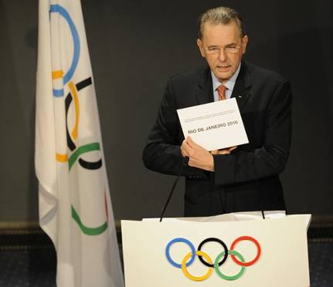

用合适的关系代词填空。
which / that
Rio de Janeiro is the city ___________ has got the chance to host the 2016 Olympic Games.
Notes:
“碰壁点拨式”教学法是素质教育的一种方式，这种教学法的基本模式是：编拟题组—练中碰壁—讲评点拨—巩固消化。该教学法以问题为载体，以训练为主线，目标导控，问题教学，先练后讲，碰壁点拨，反馈矫正。增强了学习的方向性、选择性及目标性，使学生在克服困难消除障碍的过程中发展自己的观察力、想象力和思维能力，使他们的智慧升华，创造思维得以开发。

Slide 3
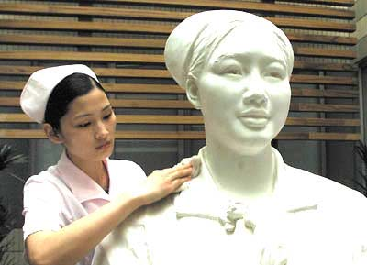
Ye Xin is a nurse __________ died in the
fight against SARS.
who / that

Slide 4
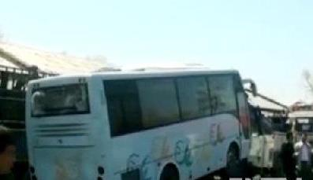
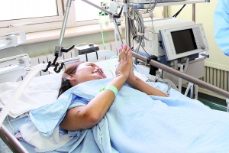
The courage and quick thinking of a young teacher _____ saved the lives of two students show how valuable teachers are to society.
who

Slide 5

Halloween is a day ______ is also called the eve of All Saints' Day.
which

Slide 6
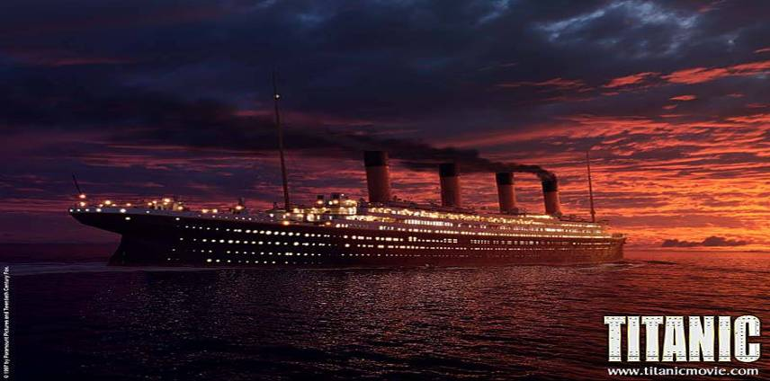
Titanic is the ship ___________ sank after
hitting an iceberg.
which / that

Slide 7
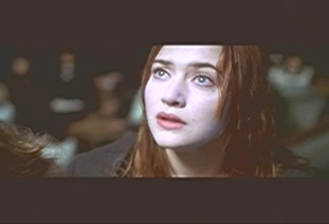
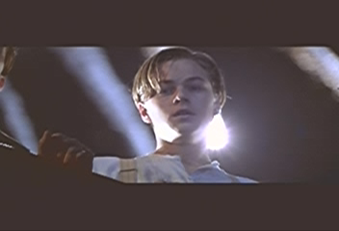
Rose and Jack are the lovers _____ met
on the ship.
who

Slide 8

1. There are many famous predictions
_____ never came true.
2. If you know anyone else ____ collects
them, please tell me.
3. It has all the normal attractions ____
you can find at an amusement park,
but it also has a theme.
4. The other day, my friends and I
talked about the rules _____ we have
in school.
that
who
that
that

Slide 9
5. I like music _____ I can sing along with.
6. Rosa likes music ______ is quiet and
gentle.
7. I love singers _____ write their own
music.
8. We prefer music _____ has great lyrics.
9. The strategies _____ he came up with
worked out fine.
10. As soon as he saw us, he picked up a
long pipe ______ was covered with
coins and opened one of the baskets.
that
that
who
that
that
which

Slide 10
11. A huge crack _____ was eight
kilometres long and thirty metres
wide cut across houses, roads and
canals.
12. The number of people _____ were
killed or injured reached more than
400,000.
that
who

Slide 11
13. Then, later that afternoon, another
big quake _______ was almost as
strong as the first one shook Tangshan.
14. The army organized teams to dig out
those _____ were trapped and to bury
the dead.
15. Workers built shelters for survivors
______ homes had been destroyed.
which
who
whose

Slide 12


定语从句
在复合句中，如作定语的是一个从句，该从句被称为定语从句。
Attributive Clauses
修饰the boy
定语从句
The boy who is wearing a black coat bought an iPod yesterday.
修饰evening
定语从句
Anyway, that evening, which I'll tell you more about later, I ended up staying at Rachel's place.

Slide 13
The man who lives next to us sells vegetables.
The man
who lives next to us
who
后
放置于名词之_____，修饰名词的从句
先行词
1.
连接作用
关系词
2.
在从句中充当成分

Slide 14
关系代词的用法
 | 指代内容 | 所做成分 | 是否可省略
that
which
who
whom
whose
人；物
主语,宾语
作宾语可省
物
主语,宾语
作宾语可省
人
主语,宾语
作宾语可省
人
宾语
可省
(人/物)的
定语
不可省

Slide 15
1. which指物，在定语从句中做主语或宾
语，做宾语时常可省略。
1) Football is a game which is liked by most boys.
2) He likes to read books which are written by foreign writers.
3) This is the pen (which) he bought yesterday.
4) The film (which) they went to see last night was not interesting at all.

Slide 16
2. that指人时，相当于who或whom；指
物时，相当于which。在定语从句中作
主语或宾语，作宾语时常可省略。
Where is the man that/whom I saw this
morning?
2) The person that/whom you introduced to me is very kind.
3) The season that/which comes after spring is summer.
4) Yesterday I received a letter that/which came from Australia.

Slide 17
3. who指人，作主语或宾语 (作宾语可省
略）
The boys who are playing football are
from Class One.
A person who steals things is called a
thief.
4. whom指人，作宾语 (作宾语可省略，如
介词提前则不能省)
The man (whom/who) I talked to is Mr.
Li.
The man to whom I talked is Mr. Li.

Slide 18
5. whose在定语从句中作定语，与后面的名
词为所属关系。 whose多指人，也可指
物，指物时可与of which互换使用。
1) He has a friend whose father is a doctor.
2) The classroom whose door is broken will
soon be repaired.
= The classroom the door of which is broken
will soon be repaired.
3) Do you like the book whose cover is yellow?
= Do you like the book the cover of which is
yellow?

Slide 19
Do you know the girl in our class?
Her hair is very short.
Do you know the girl whose hair is very short in our class?
He is the student.
I broke his pencil yesterday.
He is the student whose pencil I broke yesterday.

Slide 20

that和which在指物的情况下一般都可以互换，但在下列情况下，一般用that而不用which。
(1) 限制性定语从句中先行词为all, everything, anything, nothing, none, few, little, some等不定代词指物时。(something用that或which均可)
Have you taken down everything that Mr. Li said?
There seems to be nothing that is impossible to him in the world.

Slide 21
(2) There be句型中用that。
There is a book on the desk that belongs to Tom.
(3) 先行词被序数词或最高级修饰。
This is the first book (that) he has read.
This is the best film (that) I have ever seen.
This is the first time (that) I have been in Beijing.

Slide 22
(4) 先行词是who或which引导的主句中。
Who is the girl that drove the car?
Who that broke the window will be
punished?
Which is the T-shirt that fits me most?
Who is the man that is reading the newspaper over there?

Slide 23
(5) 当先行词既有人又有物。
They talked about the persons and things that they remembered at school.
Look at the man and his donkey that are walking up the street.
(6) 先行词被all, every, no, some, any, little, much, the only, the very, the last, just, right等修饰。
I’ve read all the books that are not mine.
This is the very book that belongs to him.

Slide 24
一般用which而不用that的情况。
(1) 紧跟介词作宾语
There are many trees under which they can have a rest.
(2) 在非限制性定语从句中
Football, which is a very popular game, is played all over the world.
(3) 作定语
He may be late, in which case, we should wait for him.

Slide 25
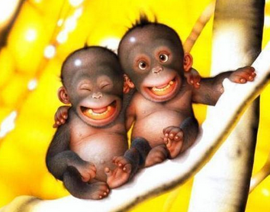
who和whom
who和whom都用于指代人，who往往可以代替在从句中担任宾格的whom，但who的前面不能有介词，如果带介词必须用whom，即“介词+whom”。

Slide 26
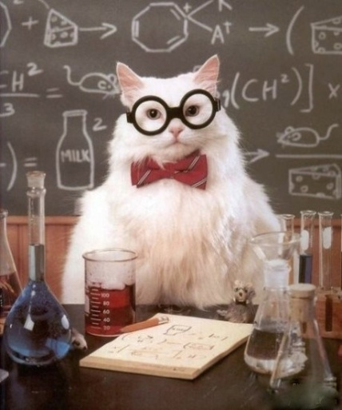
只用who不用that的情况
Anyone who laughs last laughs best.
No words are strong enough to express our thanks to those who worked hard to rescue survivors in the earthquake.
I met a girl in blue yesterday who grew up in western Yunnan province.
先行词是one, ones和anyone时
先行词是those时
当先行词有较长后置定语时

Slide 27

只用who不用that的情况
The boy that you met last night is the group leader who studies very hard.
There is a young man who wants to see your father.
一个句子中带有两个定语从句时，其中一个定语从句的关系代词是that，另一个用who。
在there be开头的句子中

Slide 28


Quiz I: Multiple choice.
1. That evening, ______ I will tell you
more about later, I ended up working
very late. (2012全国)
A. that B. which
C. what D. when
2. After the flooding, people were
suffering in that area, ______ urgently
needed clean water, medicine and
shelter to survive. (2012江苏)
A. which B. who
C. where D. what

Slide 29
3. The book tells stories of the
earthquake through the eyes of those
_____ lives were affected. (2013福建)
A. whose B. that
C. who D. which
4. Happiness and success often come to
those _____ are good at recognizing
their own strengths. (2013湖南)
A. whom B. who
C. what D. which

Slide 30
5. Finally he reached a lonely island
_____ was completely cut off from the
outside world. (2013山东)
A. when B. where
C. which D. whom

Slide 31
6. I borrowed the book Sherlock Holmes from the library last week, ____ my classmates recommended to me.
(2014北京)
A. who B. which
C. when D. Where

