Slide 1

for Senior 1
2016-2017学年度第35期总第671期
Santiago treats dogs with
love and respect (P4-5)

Slide 2
When I go to a new place the first thing I like to do is walk around the streets, to explore and get lost in the city. When I first arrived in Santiago, Chile, and took a walk around the city centre, one of the first things I noticed was how many stray dogs there were. The phrase “street dog” or “stray dog” is used to describe a dog with no home, who lives on the streets.
On every corner there was a sleeping dog. At every traffic light there was a dog waiting to cross. By every shop there was a dog waiting for food. At first I was nervous as I thought they might be aggressive (有攻击性的) or unfriendly. However, I have been here for more than a year now and every stray dog I have seen has been passive (顺从的), quiet and friendly.

Slide 3
The dogs are accepted and welcomed here in Chile. I have never seen a street dog being mistreated. In fact, they are often given food and water by the public. Some people even make jackets for the dogs or put out beds or kennels (狗舍) for them to sleep in.
The dogs do not have an easy life: they are often hungry, cold or injured. The government does not provide much care for these dogs.

Slide 4
Some people believe that the situation is getting out of control and that it is unacceptable to have so many dogs on the streets. The dogs can sometimes cause problems such as car accidents if they run into the road. There are an estimated (估计的) 2.5 million stray dogs in Chile and the canine (犬类的) population is growing faster than the human population. Many Chileans think that all the stray dogs should be sterilised (绝育的) so that they cannot breed (繁殖). Others think that the stray dog population should be culled (i.e. reducing the population by killing them精选; 挑选，剔除; 采，摘（花）).
The future of street dogs is uncertain but for now it looks like they are here to stay, with their population expanding (增长) year by year.

Slide 5
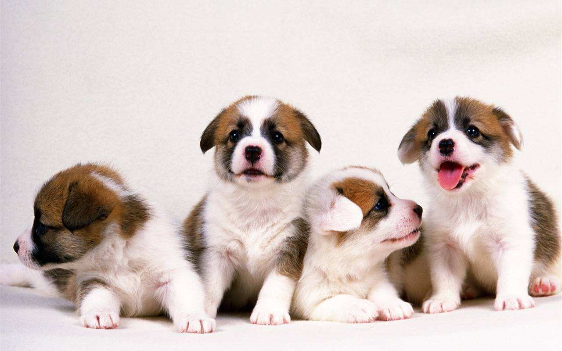
I. Warming up
Is it common to see dogs in your neighborhood?
What kind of life do the dogs live?

Slide 6
II. Reading
Skim the article quickly, divide it into three parts
and work out the main idea of each part.
Part 1 (Para.1- ___)
____________________________________________.
Part 2 (Para.__- ___)
_________________________________________.
Part 3 (Para.6) The future of the dogs is uncertain.
4
The stray dogs and their present situation in Chile
走失的; 无主的; 意外的;
5
Some people’s attitude towards the situation

Slide 7
II. Reading
Scanning Answer the following questions.
What is a stray dog?
2. What did the author think of the stray dogs at first? What did she find out later?
3. How are the stray dogs treated by the
local people? Can you give some examples?

Slide 8
II. Reading
Scanning Answer the following questions.
What is a stray dog?
What did the author think of the stray dogs at first? What did she find out later?
It is a dog with no home, who lives on the streets.
走失的; 无主的; 意外的;
At first the author thought they might be
aggressive or unfriendly. But later, she found that the stray dogs there are passive, quiet and friendly.

Slide 9
II. Reading
Scanning Answer the following questions.
3. How are the stray dogs treated by the
local people? Can you give some examples?
The dogs are accepted and welcomed in Chile.
They are often given food and water by the public.
Some people even make jackets for the dogs or
put out beds or kennels for them to sleep in.

Slide 10
II. Reading
Read paragraph 5 carefully and fill in the table.
Some people’s attitude
Reasons | 1. 2.
Suggestions | 1. 2.
The situation is getting out of control and it is unacceptable to have so many dogs on the streets.
The dogs can sometimes cause problems such as car accidents.
The population of the dogs is growing too fast.
All the stray dogs should be sterilised.
The stray dog population should be culled.

Slide 11
II. Reading
True or False.
I usually lose my way while walking around the streets in a new city.
2. The stray dogs in Chile are quiet and friendly.
3. The stray dogs lead an easy life in Chile.
F
第一段 get lost in the city 是沉浸于其中的意思。 陷入沉思: be lost in thought
陶醉于书中: be lost in a book
T
F

Slide 12
II. Reading
True or False.
4. There are more stray dogs than people in Chile.
5. There hasn’t been any plan for the future of stray dogs.
F
The canine population is growing faster than the human population.
T

Slide 13
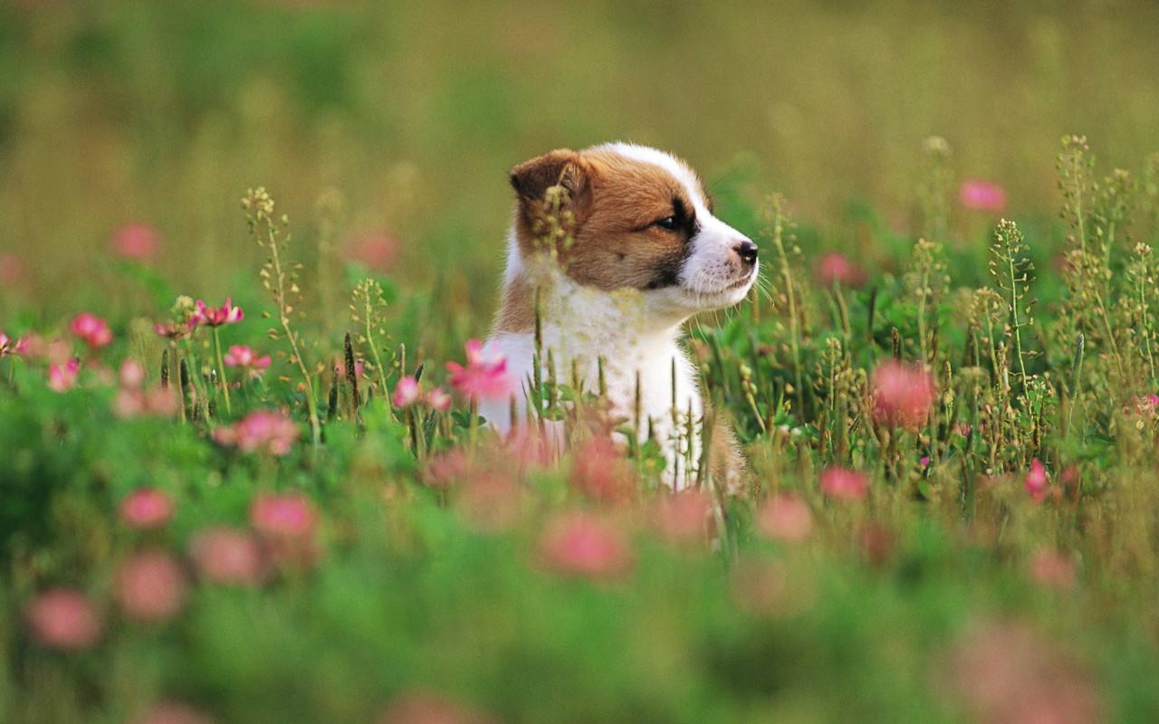
III. Discussion
Do you think that people should take action to control the population of stray dogs? Do you have any suggestions to help this problem?

