Slide 1
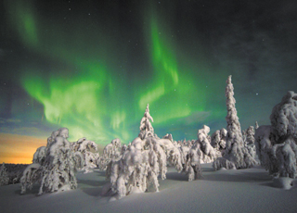
Land of quiet beauty
671 4-5

Slide 2
Lapland, in the northern part of Finland, has a famous resident (居民). He’s known to children all over the world, and he visits each of them once a year. You can probably guess that this man has a red coat, travels by reindeer and goes by the name of – you guessed it – Santa Claus.
In fact, Santa has an official office in Lapland where he greets visitors all year round. But as it happens, people know more about Santa than the country he comes from – a beautiful and fascinating place all on its own.
Finland is a nation of outstanding natural beauty. This year marks the 100th anniversary of its independence. Recently, Chinese President Xi Jinping made a state visit to Finland. He drew attention to the famous old man from Lapland, and to the beauty of his hosts’ country. Large parts of Finland are covered with forests and there are many rivers and lakes.

Slide 3
But the most famous feature of Finland’s geography isn’t on its land but in its sky. You may have heard of the “Aurora Borealis”, more familiarly known as the Northern Lights (极光). Finns and tourists from all over the world travel to the far north to see this amazing dance of light in the sky.
But what of the Finnish people themselves, and their society? There are relatively few Finns – just 5.5 million. The most populated part of the country is its capital, Helsinki. The economy (经济) of Finland was once dominated (主导) by forestry and metals, but now it is more service-based. It is a nation with a high standard of living.

Slide 4
Many people around the world admire the political and social arrangements in Finland. As with other Scandinavian countries, the Finns have a comprehensive (全面的) social security system and good health care. Finland is known for its low level of government corruption (腐败) and its high level of equality.
So now you know a little more about the part of the world that Santa comes from. Celebrating 100 years since its independence from Russia, it is developing a quiet but proud identity all of its own.

Slide 5
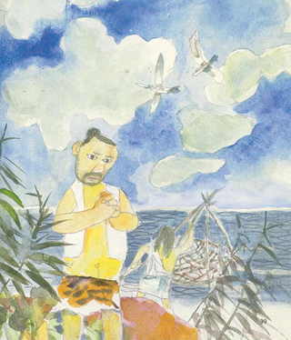
Mythology pictured
神话学; 神话（总称）; 虚构的事实; 错误的观点;

Slide 6
When talking about mythology (神话), chances are the names that first come to your mind are Zeus, Athena and Venus – the gods and goddesses of Greek and Roman mythology – instead of Pan Gu, Fu Xi and Nü Wa, characters from Chinese mythology.
This is why Shanghai made a plan to promote (宣传) Chinese mythology last January. And now, a series of picture books on the subject have just been released. They include the stories of Fu Xi, an ancient god who created the eight diagrams (阴阳八卦) and invented the fishing net, and Nü Wa, the goddess who saved the human race by repairing a leaking heaven.

Slide 7
“Chinese mythology is not overshadowed (使黯然失色) by that from other parts of the world. It is incomparable with its own value as the vessel (载体) of the spirit of our nation,” Sun Yong, vice chairman of the Shanghai Writers’ Association, told iFeng News.
Valued qualities
Take Fu Xi’s story as an example. When realizing that there was not enough food for everyone, Fu Xi, as the leader of his people, took inspiration from spider webs. He invented fishing nets to catch fish and provide food. Fu Xi was responsible, capable (能干的) and smart – qualities that Chinese people have always valued.
According to Shi Dawei, chairman of the Shanghai Literature and Art Association, the most difficult part of the job was to re-create the images (形象) of the gods and goddesses.

Slide 8
“They are often described as half-human-half-beast beings in ancient books. So it’s hard for artists to create loveable figures that are both faithful to (忠实于) the original stories and easily acceptable to modern readers,” he told iFeng News.
In fact, Fu Xi is usually shown as a creature with a human head and snake body. But in the new book, he is presented as an ordinary tribesman (部落男子) dressed in tiger skin.
According to Shi, many Chinese people understand Western cultures and traditions more than their own. “We need to build our own philosophical (哲学的) system and historical view to better tell stories about China,” he told news website The Paper.

