Slide 1

for Senior 1
2016-2017学年度第30期总第667期
Sound of world’s
cities (P1)

Slide 2
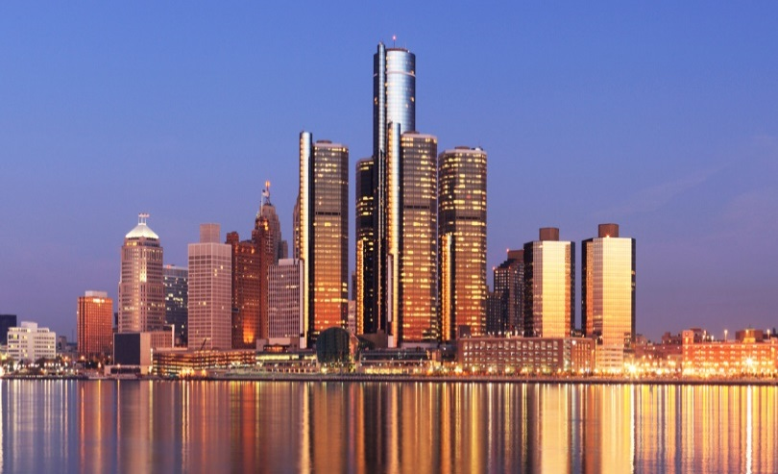

I. Warming up
How would you describe the city you live in?
Do you know the two cities? What are they famous for?
Detroit
Miami

Slide 3
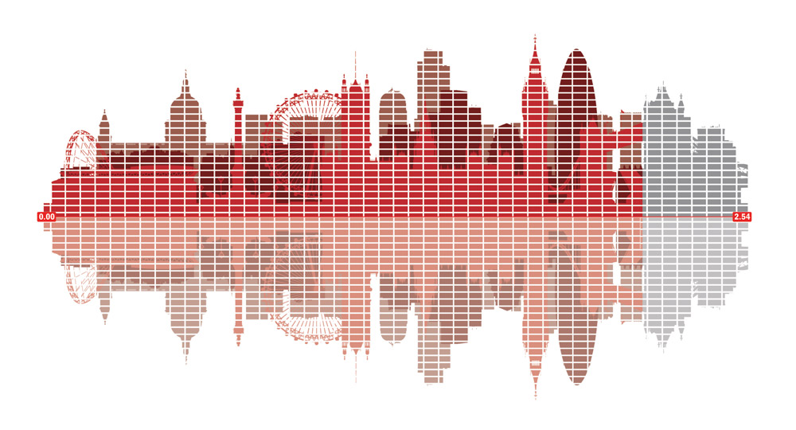
Speaking of the sound of a city, what comes to your mind first?
II. Pre-reading

Slide 4
III. While-reading
Scanning
Read the article and answer the following questions.
What drove Tod Machover to collect noises?
How many sound samples did Machover receive when making the symphony for Detroit?
The question of, “Can we listen to this place in a more sophisticated way?’’
15,000.

Slide 5
III. While-reading
Close Reading
Read the article, and try to divide it into different parts, then summarize the main idea of each part.
Possible answer:
Part 1 (Para. 1-3): To introduce Tod Machover’s project to turn everyday noises into classical music and explain what drove him to do so.
Part 2 (Para. 4-6): Two examples in Tod Machover’s project. What kinds of sounds were used to describe Detroit and Miami.
Part 3 (Para. 7-9): Machover also invited local people to offer recordings for his music composition.

Slide 6
III. While-reading
Close Reading
Read paragraph 4-6 again, and fill in the chart.
 | Detroit | Miami
Featured sounds and noises.
Noise of car engines.
Live music.
Noise of human activity.
The natural sound of the ocean and seabirds.
Dominant language-Spanish.

Slide 7
IV. Post-reading
Paraphrase
Paraphrase the following sentences.
What Machover wanted to do is to write a symphony not “for” the city, but “with” the city. (Para. 7)
“That all tells a very specific message, a first-hand message that would have been secondhand in any other way.”(Para. 9)

Slide 8
IV. Post-reading
1. What Machover wanted to do is to write a symphony not “for” the city, but “with” the city. (Para. 7)
Not only does Machover want to write a symphony for the city by himself, but he also wants local people to participate in the process of composing the symphony together with him.

Slide 9
IV. Post-reading
2. “That all tells a very specific message, a firsthand message that would have been secondhand in any other way.”(Para. 9)
The sounds collected from local people show the daily lives of the city in a more direct, unique and accurate way.

Slide 10
IV. Post-reading
Discussion
What do you think of Machover’s idea of composing a symphony for a city?
Are there any difference between using music and using pictures to show the image of a city? Which one do you prefer?

Slide 11
V. Homework
Speech
Tod Machover has chosen sounds and noises as a way to describe a city, so what about you? In what ways are you going to describe your city? Why? How do you plan to do that?
Prepare a speech within three minutes to talk about your idea, and share it with the class.

