Slide 2

for Senior 1
2016-2017学年度第29期总第666期
Young opinions heard(P1)

Slide 3
Two sessions － the National People’s Congress (NPC) and the Chinese People’s Political Consultative Conference (CPPCC) are two of the most important platforms (平台) for issues related to our daily lives to be discussed. But how do Chinese teenagers make their voices heard?
Just ask Shi Yiling, 16, of No 2 High School of East China Normal University. Her concerns about school bullying (欺凌) made her draft a proposal (起草一项提案), something she did together with around 20 other teenagers across the country. However, Shi and her teammates were not the only ones who had this chance. Another five proposals, which addressed a variety of issues, stood out in a Mock (模拟的) CPPCC competition held among Chinese teenagers in August 2016. Their ideas were even chosen to be sent to the CPPCC.

Slide 4
So just how do teenagers’ efforts (努力) reach the country’s biggest annual political event?
“Figuring out the issue of your concern is the first step for a good proposal,” said Wang Junyuan, 16, of Zhengzhou Foreign Language School. “Inspiration (启发) may come from our daily life, so try to take notice of every little thing in it.”
Wang turned her attention to books in China. She and her schoolmates found that their foreign language novels were smaller and lighter than Chinese ones, making them easier to carry around. Then an idea came into her head. Why not encourage these kind of “portable (便携的)” books in China? People could take the books out with them and read a few pages whenever they have time. Driven by her strong will, she and her five schoolmates began to research the idea.
.

Slide 5
Liu Haoran, 17, of Harbin No 3 Senior High School, also had an idea of his own. He wanted modern day technology to help senior citizens’ families feel less worried about them.
“I was inspired by Internet Plus, the idea proposed by Premier Li Keqiang, so our team applied the internet to dealing with the problem of supporting old people,” he said.
Liu suggested that medical workers upload data (数据) from elderly (年长的) patients’ physical examinations (体检) to a website or smartphone app. This idea makes it easier for the families of senior people to check up on their elderly relative, especially if they live apart.
“We are living in an age of Big Data. I hope to use technology to benefit our life,” said Liu.
The proposal drafted by the students will be submitted (提交) to the meetings by CPPCC members. The issues teenagers care about will be addressed and discussed. “Students’ proposals have gradually become a tradition since 2014. They even keep getting better year by year,” said Yang Jinsheng, a CPPCC member

Slide 6
for Senior 1
2016-2017学年度第29期总第666期
Sweden likes good time (P4)

Slide 7
I. Leading-in
1. What do you know about Scandinavia?
Scandinavia is a region in northern Europe.
The Scandinavian Peninsula (斯堪的纳维亚半岛) is the largest peninsula in Europe and it extends from above the Arctic Circle to the North and Baltic Seas(波罗地海). Scandinavia is a historical and geographical region covering much of Northern Europe.

Slide 8
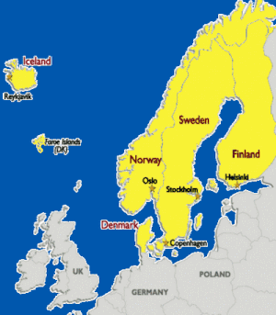
In the past, Scandinavia was defined as the three kingdoms that historically shared the Scandinavian Peninsula. Today, most define Scandinavia as a region which includes:
Denmark
Norway
Sweden
Finland and Iceland are generally included.
Greenland, however, is rarely included.
On this map, the countries of Scandinavia are highlighted in yellow.

Slide 9
II. Skimming
Read the article and complete the table.
Paras1-2 | Things that speaking of Scandinavia.
Paras3-4 | People there like to party, and are very .
Para 5 | The charming and Gothenburg, which is also a great place for .
Para 6 | Cities there are welcoming to visitors and are .
Para 7 | A comment on the relaxing atmosphere in Scandinavia.
come to mind
sociable
old-fashioned
music fans
tolerant

Slide 10
III. Scanning
Read the article and quickly find the answers to the following questions.
1. What are some impressions of Scandinavia?
2. Which cities mentioned are on the list of sociable cities?
3. What have the authorities of Gothenburg done to keep the city’s old-fashioned style?

Slide 11
1. What are some impressions of Scandinavia?
It’s a place with beautiful scenes of nature.
It’s famous for Anderson’s fairy tales.
It is cold, dark and a little gloomy there.
2. Which cities mentioned are at the list of sociable cities?
Gothenburg, Copenhagen, Stockholm, New York and Madrid.

Slide 12
3. What have the authorities of Gothenburg done to keep the city’s old-fashioned style?
The city’s authorities have preserved (保存) Gothenburg’s attractive wooden houses from the 19th century. Many of these have been made over into restaurants and coffee bars.

Slide 13
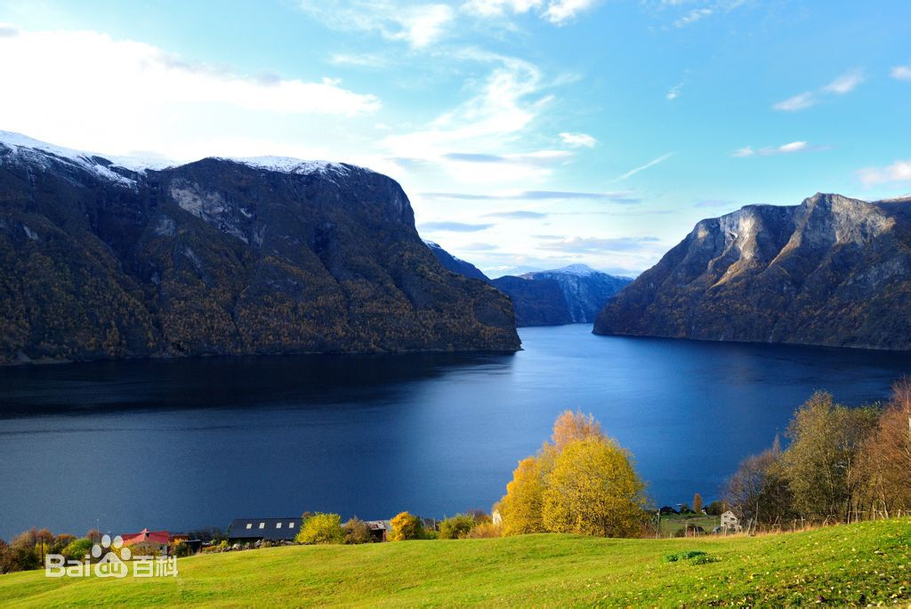

Norway’s fjords

Slide 14
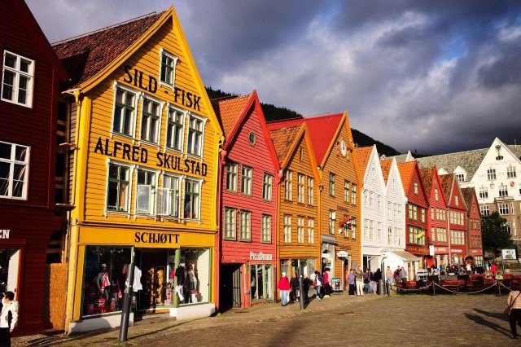
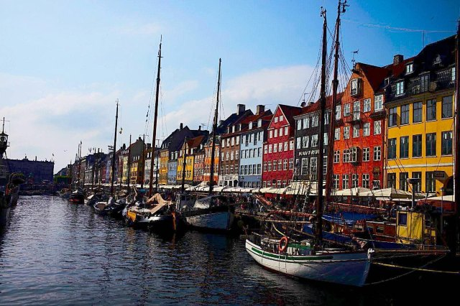
Copenhagen

Slide 15
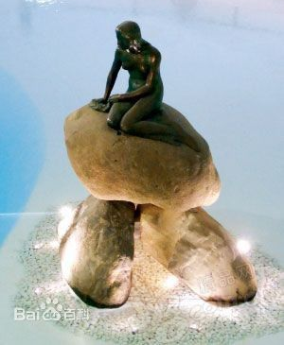
Statue (雕塑) of Anderson’s Little Mermaid

Slide 16
IV. Language study
Match the phrases with the explanations.
breathtaking
come to mind
preserve
make…over into
sociable
socialize
boast
cosy
take exception to
to enter one’s mind
extremely beautiful or amazing
friendly and enjoy being with other people
to spend time with other people in a friendly way
to take action to save or protect sth from damage or decay
to change sb/sth so that they look different or have a different use
comfortable and warm
to have something that is very good
be angry or upset because of sth.

Slide 17
Choose proper phrases and fill in the blanks.
imagine…as at the thought of
make…over into… boast welcoming
take exception to predictably
boasts
The city two excellent museums.
She gave him a warm, _________ smile.
Tom my offensive remark about Americans.
I was delighted seeing you again.
He didn’t quite dare to a real artist.
, no one was home when I called.
He has been a new man.
welcoming
took great exception to
at the thought of
imagine himself as
Predictably
made over into

Slide 18
V. Discussion
Choose a topic and discuss with your partners.
1. Which features of Scandinavian cities attracts you most, and why?
2. If you had a chance to go abroad, which country or city would you choose? Why would you want to go there?

