Slide 1

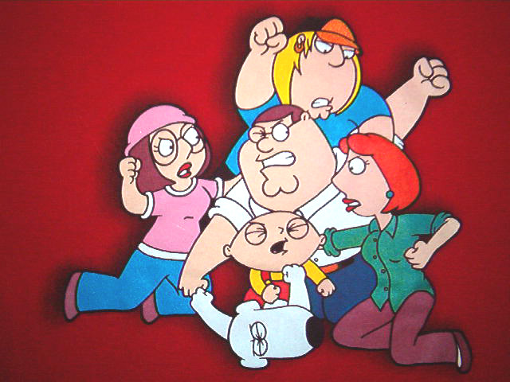
for Senior 1
2016-2017学年度第30期总第667期
Ending family fights (P6)

Slide 2



Have you ever had a fight with a family member? What caused the fight?
I. Pre-reading

Slide 3
What is the article mainly about?
II. Reading
It gives advice on dealing with family conflicts.

Slide 4

II. Reading
What can we learn from the first two paragraphs?
Family fights can be turned into something good. It may be a good chance for family members to become closer.

Slide 5
II. Reading
What does the writer advise us to do?
Put aside your needs, and give the other person some time to express his or her feelings.
Listen for the right information.
If the situation starts to get out of hand, it is wise to just calm down and leave the problem until later.

Slide 6
Look at some sentences and try to figure out the meanings of the underlined words.
III. Vocabulary
What if it could be different?
如果…将会怎么样？
In a short moment, emotions can be brought out…
使显现，使激发；产出，出版
E.g. He’s bringing out a new album next month.
E.g. The spices really bring out the flavor of the meat.

Slide 7
III. Vocabulary
So if you can put aside your needs for a few minutes, the situation will change quickly.
把…暂放一边
E.g. You must put aside your pride and call her.

Slide 8
III. Vocabulary
The best way to do this in emotional situations is to ignore most of what is said.
忽视，（故意对知道的事）置之不理
The telephone rang, but she ignored it.
近义词neglect ：疏忽;忽略；疏于照看
E.g. Many of these ideas have been neglected by modern historians.

Slide 9
Look at the sentences and pay attention to the structure of the sentences.
IV. Structure
In any fight, you have a need to be listened to.
But you always seem to forget that the person you’re fighting with has the same need to be listened to.

Slide 10
IV. Structure
注意介词不要省略。
There is nothing for us to worry about.
She is a very nice person to work with.
He has a lot of things to attend to.
他有许多事要管。

Slide 11
IV. Structure
Translate the sentences.
给我一把椅子坐。
Give me a chair to sit on.
他没有钢笔写字。
He has no pens to write with.
我得找一个大袋子来装这些东西。
I have to find a large bag to put these things in.

Slide 12

It is too small a room for us __________.
A. to live
B. to live in
C. living
D. living in
IV. Structure

Slide 13
No one likes ___; it makes you feel uncomfortable.
A. being stared
B. being stared at
C. glaring at
D. looking at
IV. Structure

Slide 14
What do you think of the author’s advice? Do you know of any other good ways to deal with a family fight? Share them with us.
V. Discussion

Slide 15
Family fights are never pleasant. Whether you are dealing with a loud sister or a stubborn mom or dad, the situation can be bad. At least that’s what we have learned to expect.
What if it could be different? What if family fights and conflicts (冲突) could be turned into opportunities to become closer? What if problems could be solved with everyone walking away feeling more deeply cared for and loved?u
Family fighting is, on one level, about power. Someone is telling someone else what to do. In a short moment, emotions can be brought out and the fight is on. You can go down that old road or you can try something different.

Slide 16
In any fight, you have a need to be listened to and understood. People raise their voices and shout at each other because they’re not being listened to. It’s totally unconscious (无意识的). You want your mom or dad to listen and understand. You want your brother or sister to listen and care. But you always seem to forget that the person you’re fighting with has the same need to be listened to. So if you can put aside your need for a few minutes, the situation will change quickly. Give the other person some time to express his or her feelings, and you will earn your turn to be listened to.
And while you are listening, you have to listen for the right information. The best way to do this in emotional situations is to ignore most of the words because many people can’t express what they are feeling with words alone, especially when they are upset.

Slide 17
But if the situation starts to get out of hand, it would be wise to just calm down and leave the problem until later because many fights happen at the wrong time. The situation will die down quickly, usually in less than 30 seconds. You can either move on to problem solving or reach an agreement to work on it at a better time.
This way, everyone will feel respected and listened to, even when there is conflict. Emotions will be understood and respected, and it will bring your family closer together.

