Slide 1
Unit 2 Reading

Slide 2
Ⅰ.阅读理解(根据Reading内容选择答案)
1．When Wang Peng thought “Nothing could be better”， he means ________.
A．his food and drink were the best
B．his food and drink were the worst
C．his food should have been improved
D．he could do nothing with his food and drink

Slide 3
2．Why did Wang Peng go into the newly­opened restaurant?
A．Because he was angry.
B．Because he was curious.
C．Because he wanted to blame its owner.
D．Because he wanted to ask for advice.

Slide 4
3．Wang Peng was amazed when he saw the menu of Yong Hui's restaurant because ________.
A．there were only raw vegetables and water served in Yong Hui's restaurant
B．there were more choices of food and drink served in Yong Hui's restaurant
C．the food and drink in Yong Hui's restaurant were more expensive than those in his restaurant
D．Yong Hui's menu gave customers more energy­giving food

Slide 5
4．Wang Peng suggested that they provide a combined menu because ________.
A．he liked Yong Hui
B．he didn't want to lose his customers
C．he thought his menu was better
D．this would provide a balanced diet

Slide 6
5．What can we learn from Wang Peng's research in the library?
A．Wang Peng's restaurant offered a balanced diet.
B．Yong Hui's restaurant offered a balanced diet.
C．Both of the restaurants offered a balanced diet.
D．Neither of the two restaurants offered a healthy diet.
答案 1.A 2.B 3.C 4.D 5.D

Slide 7
教材研读
一、重点单词熟记
1．________ n. 日常饮食→vi.节食
2．________ n．坚果；果仁
3．________ n. 肌肉；(食用)瘦肉
4．________ adj.给予保护的；保护的
5．________ n. 黄瓜
6．________ n. 茄子
7．________ vt.平衡；权衡→n.天平；平衡
8．________ adj. 烤制的→vt.&vi.烤；烘；烘烤
9．________ vi.变细；减肥→苗条的；纤细的

Slide 8
10．________ n. 好奇心
11．________ adj. 生的；未加工的
12．________ n. 谎话；谎言→vi.说谎
13．________ n. 顾客；消费者
14．________ n. 折扣
15．________ n．缺点；虚弱；弱点
16．________ n. 强项；长处；力量
答案 1.diet 2.nut 3.muscle 4.protective 5.cucumber 6.eggplant 7.balance 8.roast 9.slim 10.curiosity 11.raw 12.lie 13.customer 14.discount
15．weakness 16.strength

Slide 9
二、重点短语探究
1．balanced ________ 平衡膳食
2．ought ________ 应该；应当
3．lose ________ 体重减轻；减肥
4．get away ________ 被放过；(做坏事)不受惩罚
5．tell ________ lie 说谎
6．win________ 赢回；重新获得
答案 1.diet 2.to 3.weight 4.with 5.a 6.back

Slide 10
三、教材佳句背诵
1．“Nothing ________ ________ ________，” he thought.
“再没有比这些更好吃的了，”他想。
2．Something terrible ________ ________ ________ if Li Chang was not coming to eat in his restaurant as he always did.
要是李昌不像往常那样到他的店里来吃饭，那问题一定严重了。

Slide 11
3．He ________ ________ ________ Yong Hui getting away with telling people lies!
他可不能让雍慧哄骗人们却不受惩罚！
答案 ①could be better ②must have happened ③could not have

Slide 12
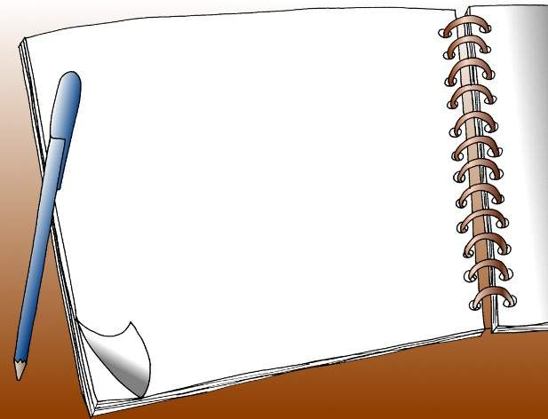
Word study

Slide 13
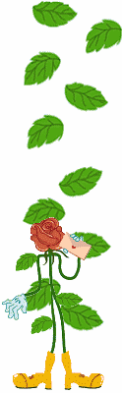
1. diet
She decided to go on a diet .
= lose weight
The patient can only have a low fat salt-free diet.
He is dieting .
=He is on a diet.

Slide 14
2. balance
Try to keep a balance between work and relaxation.
The boy keeps the seesaw in balance.
keep / lose one’s balance
Tom always tries to balance home life and career.
balanced diet

Slide 15
3. lose weight
put on / gain weight
It weighs 70 kg.
4. slim
She is trying to slim.
= lose weight
A diet will make you slim.
She lived on a slim income.

Slide 16
5. curiosity
Children show great curiosity about things around them.
The old wooden box is a curiosity.
Children are curious about things around them.
Children are curious to do different things.

Slide 17
6. raw
raw vegetables / materials
The newly-come teacher is still a bit raw.
7. get away with
He was lucky to get away with only a fine.
Do you think you can get away with it ?
How did she get away with cheating?

Slide 18
8. lie
Never tell a lie to the person who loves you.
Do tell a white lie to the person who loves you.
Tom always lies.
Please lie down and have a rest.
The problem lies in what you should next.
原形
词义
过去式
过去分词
现在分词
lie
躺，位于
lay
lain
lying
lie
撒谎
lied
lied
lying
lay
放，下蛋
laid
laid
lying

Slide 19
9. discount
We give a discount of 10% for cash.
The store discounted all its slow-selling goods.
10. strength
I don’t have the strength to go on walking.
English is my strength.
We want to strengthen our relationg with them.
strong

Slide 20
11. consult
I will do nothing without consulting you .
He went to town to consult his doctor.
He consulted his notebook while making his speech.
12. digest
Protein digests slowly.
I can’t digest milk.
I have digested the meaning of the book.
This is a digest of the week’s news.
digestion digestible

Slide 21
13. earn one’s / a living
= make one’s / a living
earn one’s fame
14. in debt
He is heavily in debt now.
He is out of debt now.
He has paid off his debt now.

Slide 22
15. glare
The teacher glared at the you.
The sun glared on the ice.
He has to wear the sunglass because of the glare of the sun.
glare stare glance glimpse
glimpse
1. I only caught a _______ of him . 2. He _______ at the word trying to remember what it meant. 3. she _______ down the list of names but couldn’t find hers. 4. The police just stood there _______ at the thief without saying a word.
stared
glanced
glared

Slide 23
16. limit
We must limit ourselves to one cake a day.
I have reached the limit of my patience.
Our energy is limited.
17. benefit
The company will bring us a lot of benefit.
We can benefit a lot from the company.
The company is beneficial to us.
= be of benefit

Slide 24
18. combine
The new teaching method combines education with pleasure.
combination
19. cut down
Cut down the article to 1000 words.
cut in cut off cut up cut through
1. She kept _________ our conversation. 2. they want to _______ a large forest in the area. 3. the army was called in to ___________ the fallen trees on the road. 4. He was badly _______ in the fight. 5. Our water supply has been ________.
cuttin in
cut down
cut through
cut up
cut off

Slide 25
Difficult points

Slide 26
【辨析】diet/food
易混词 | 辨析 | 例句
diet | 指的是日常饮食，特定饮食。尤其指维持健康的定质定量的营养饮食。常用作可数名词，和a连用。 | She had a stomach trouble and had to follow a strict diet.她的胃不好，必须遵守严格的饮食规定。
food | 是食物的总称。凡是可以充饥的有营养的东西都可以称作food。常作不可数名词，但表示食物的种类时为可数名词。 | Man must have food to eat and clothes to wear.人类必须吃饭穿衣。

Slide 27

Find out the usage of important words.
diet n. 日常饮食；v.节食
1. He is dieting to lose weight.
phrases:
v.节食
2. All of us ought to have a balanced
diet in our daily life.
be/go on a diet（节食）
have a balanced diet （有均衡的饮食）
keep a balanced diet （保持均衡的饮食）
n. 日常饮食
3. Some young girls are on a diet to
lose weight.
n. 节食
4. Proper diets and exercise are both
important for health.
n. 日常饮食

Slide 28


Practice
1. Many people come to realize that they
should go on ____ balanced diet and make
____ room in their day of exercise.
（2007江西）
A. a; 不填 B. the; a
C. the; the D. 不填;a
2. 这一饮食的缺点是包含了太多的脂肪和糖分，优点是有很多能提供能量的食品。 (diet; strength; weakness)
The weakness of this diet is that it contains too much fat and sugar, while the strength is that it contains a lot of food providing energy.

Slide 29
Find out the usage of important words.
benefit n.& v. 利益 好处
beneficial adj.有益的
1. The students can benefit from the sports.
v. 受益
2. Doing some sports is of benefit to the students.
be beneficial to 对…有益
n. 利益；好处
be of benefit to 对…有益
3. For the benefit of our health, we should do
some sports.
benefit from 从…中受益
n. 利益；好处
for the benefit of 为…的利益
4. Doing some sports is beneficial to us.
adj. 有益的；有利的

Slide 30
Practice
科学家说吃胡萝卜对眼睛有好处。(benefit)
① Scientists say that eating carrots is ________
___ eyes.
beneficial
to
of
②Scientists say that eating carrots is ___
________ ___eyes.
benefit
to
benefit
③Scientists say that we can _______
_____eating carrots.
from
④_____ ____ _______ ___ our eyes, we can eat carrots according to what the scientists say.
For
the
benefit
of

Slide 31
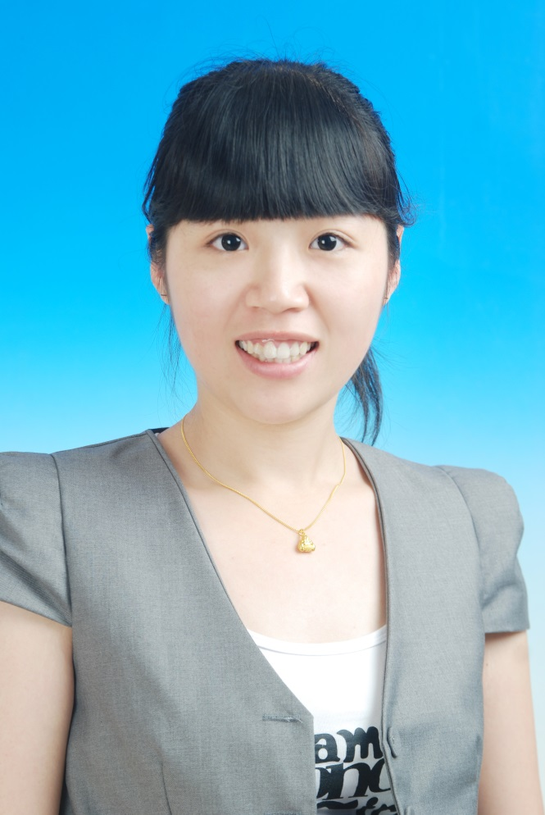
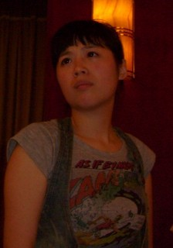

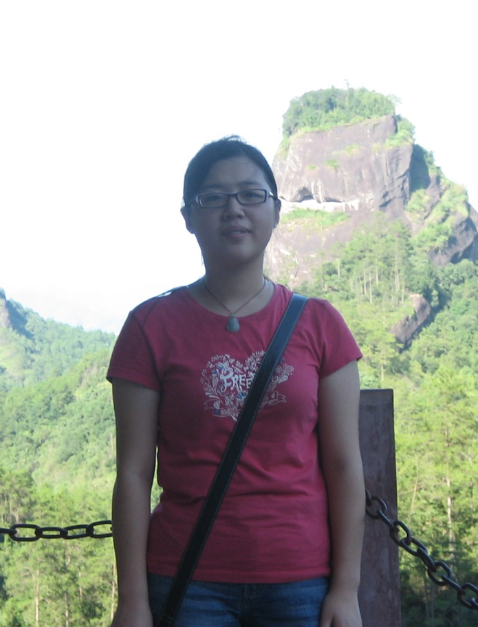
Name: Yvonne
Problem: 1. I like eating very much,
especially fried food and
snacks;
2. I feel frustrated for I
have been putting on
weight.
Suggestions?
1. I would strongly advise you
to …
2. I think you ought to…
3. It might be a good idea to …
4. It will be much better if you…
5. …

Slide 32
Tips on a healthy diet
Fill in the blanks
The key to healthy eating is not to ban any foods but to ________what you eat.
Here are some tips to a balanced ____. First, rice and noodles , some _____________ food can be eaten as part of every meal. Second, there are ____ many vitamins in fruits and vegetables that these should be taken in every day. Also, ______ (eat) enough meat, one can build up his ________ and keep himself ________ and healthy.
In a word, a balanced diet is of _________ to our health. If we _________ health with a balanced diet, we will be _____of energy every day.
balance
diet
energy-giving
so
eating
strength
energetic
benefit
combine
full

Slide 33
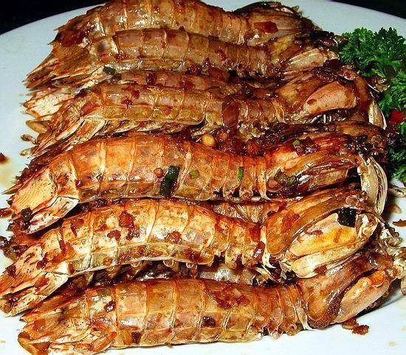
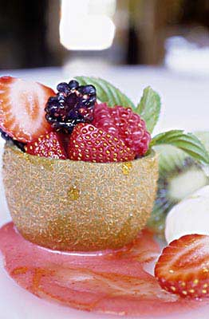
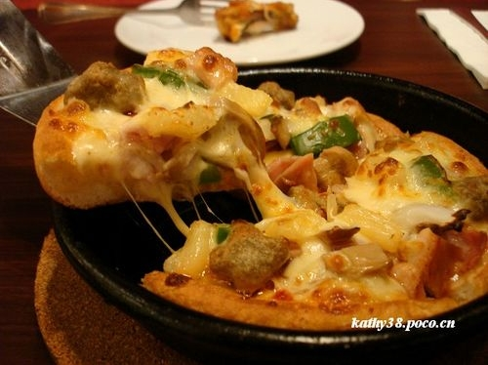
Party time
1、Design a menu for me. Think about
what should go into the menu.
2、Why do you choose these dishes?

Slide 34

Homework
1、Finish the exercises in the paper
2、Do a survey: In what way can we
build ourselves healthy?

Slide 35
【辨析】 consult/look up
易混词 | 辨析 | 例句
consult | 相当于refer to或turn to，后面接查询的工具 | I have to consult my lawyer about the matter.关于这个问题我得咨询律师的意见。
look up | 后面接需查询的问题或内容 | When you meet with any new word, you'd better look up the word in the dictionary.当你遇到新词时，你最好在词典里查一下。

Slide 36
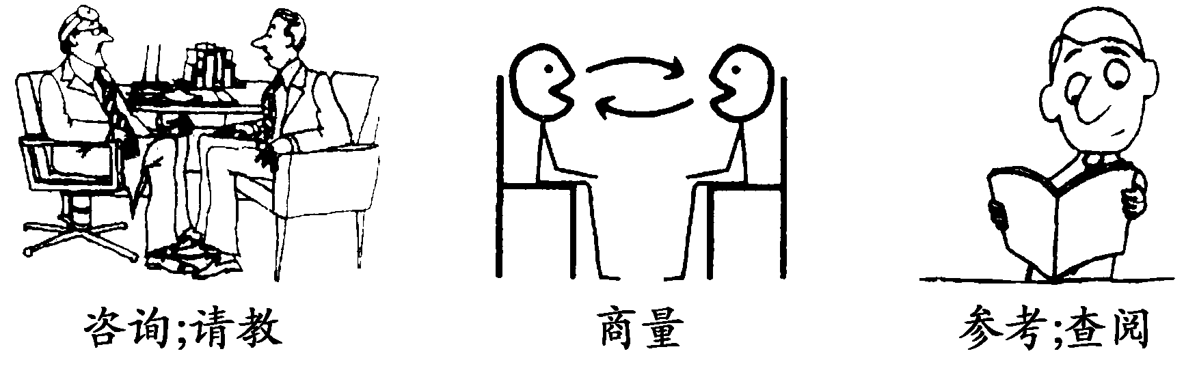
【助记】

Slide 37
【典例剖析】
He ________ a number of books about the subject in the library before he gave his speech.
A．referred B．looked into
C．consulted D．looked up
解析 考查动词及短语意义。句意：在演讲前他在图书馆查阅了大量关于这门学科的图书。根据“查阅”后面的宾语可知用动词consult。refer to“查阅”；look into“调查”；consult“查阅”；look up“查找”。
答案 C

Slide 38
【即境活用】
完成句子
①我建议对于这件事请教一下律师。
I suggest he ________ ________ ________ ________ the matter.
②这个地名你可以查一下词典。
You can ________ ________ ________ for the place names.
③我采取行动之前一定和你商量。
I'll do nothing ________ ________ you.
答案 ①consult a lawyer about ②consult the dictionary
③without consulting

Slide 39
【典例剖析】
Do not undertake strong exercise for a few hours after a meal to allow food to ________.
A．digest B．eat C．drink D．dry
解析 考查动词。句意：饭后几个小时不要从事剧烈运动，以便食物能够消化。根据“饭后”的生活经验可知此处意思为“消化”。
答案 A

Slide 40
【即境活用】
完成句子
①营养在慢慢吸收。
Protein ________ ________.
②这是这次会议的概要。
This is ________ ________ ________ the meeting.
答案 ①digests slowly ②a digest of

Slide 41
【辨析】 energy/force/power/strength
易混词 | 辨析 | 例句
energy | 多指人的“精力；活力”，还可指物理学中的“能量”。 | His work seems to lack energy.他的工作似乎缺乏干劲。
force | 指“势力；武力；暴力”，“军队，部队”，也指物理学中的“力”。 | Force can never destroy right.暴力绝不能摧毁正义。

Slide 42
power | 普通用词，多指“动力；能力；权力”等。 | He longed for unlimited power.他渴望有无限的权力。
strength | 常指“人的力气，体力”或“毅力；意志力”。也指“优点，长处”。 | You are my source of strength.你是我力量的源泉。

Slide 43
【典例剖析】
—Why do you choose to work in an international travel agency?
—Well, you know, English is my ________. So it is my best choice.
A．strength B．talent
C．ability D．skill

Slide 44
解析 考查名词词义辨析。句意：——你为什么选择在国际旅行社工作？——噢，你知道，英语是我的强项。因此这是我的最佳选择。strength“强项；长处”；talent“天资；才能”；ability“能力；力量”；skill“技能；擅长”。
答案 A

Slide 45
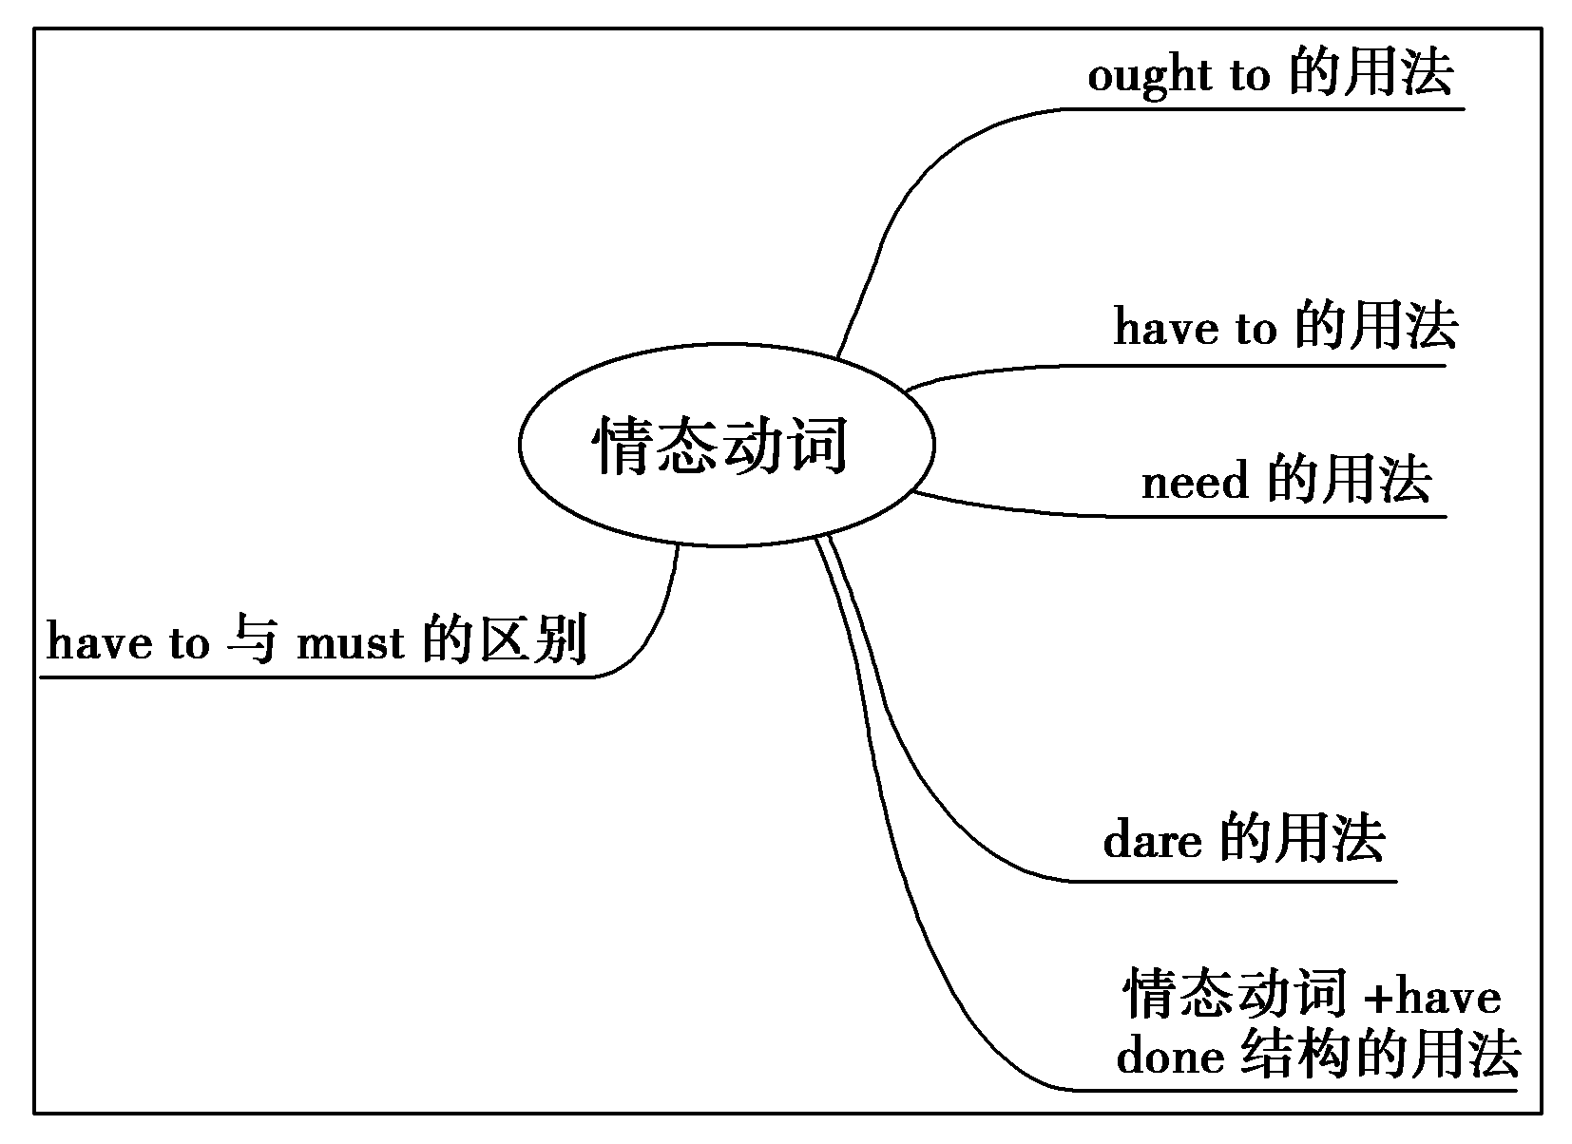
语法导图

Slide 46
知能精解
一、基本用法
1．ought to的用法
(1)表示责任和义务，意为“应该”，与should同义。
You ought to be more careful when you cross the road next time.下次过马路时，你应该更小心些。
You ought to work harder than your brother.
你应该比你哥哥学习更努力。

Slide 47
【点津】 ought to的否定形式为ought not to(oughtn't to)，一般疑问形式是将ought提至句首，其否定答语通常用don't have to或needn't。
—Ought he to see the doctor?
——他该去看医生吗？
—Yes, he ought to./No, he doesn't have to.
——是的，他该去。/不，他不必去。
You ought not to make this kind of mistake again.
你不应该再犯这种错误了。

Slide 48
(2)表示可能性，一般指较大的可能性，意为“按道理应该”。
If he started at six, he ought to be here now.
要是他六点就出发的话，这会儿该到这里了。

Slide 49
2．have to的用法
have to 意为“不得不”，有时态、人称和数的变化，其否定形式和疑问形式需要借助于助动词do。
His mother is ill. He has to stay at home to look after her.
他妈妈病了，他得待在家里照顾她。
【点津】
(1)have to 侧重客观需要，有时态、人称和数的变化；must强调说话人的主观看法。
(2)have to的否定式为don't have to，表示“没有义务或没有必要做某事”，意为“不必”，常可以回答用must提问的一般疑问句。而must的否定式mustn't表示“禁止”。

Slide 50
3．need的用法
(1)need作情态动词时，后跟动词原形，表示“需要，有必要”，无人称和数的变化，多用于否定句、疑问句或条件句中。
You needn't go there now.你现在不必去那儿。
Need I go there now？我现在需要去那儿吗？
【点津】 由need引导的一般疑问句的肯定回答常用must或have to，否定回答常用needn't。
— Need I hand in my paper now?
——我现在需要交上论文吗？
—Yes, you must./No, you needn't.
——是的，你必须。/不，你不需要。

Slide 51
(2)作为实义动词，同其他实义动词一样，可用于各种句式，有时态、人称、数的变化，构成否定句和疑问句时要借助于助动词do。
You need to be careful.
你得小心些。
You don't need to be so worried.
你不必如此担心。
【点津】 当need作“需要”讲时，其后跟不定式的被动形式相当于跟v.­ing的主动形式，在这一点上，与want和require作“需要”讲时一样。
The house needs/wants/requires repairing/to be repaired.
这所房子需要修葺。

Slide 52
4．dare的用法
(1)dare既可以作实义动词，也可以作情态动词。作情态动词时多用于疑问句、否定句、条件状语从句以及表示怀疑的名词性从句中，表示“敢……”。
I dare not walk through the wood at night.
夜间我不敢在小树林里走。
(2)dare作实义动词时，在否定句中不定式符号to也可以省略。
The children don't dare (to) make a sound while their parents are sleeping.
孩子们在父母睡觉时不敢弄出一点声音。

Slide 53
5．情态动词＋have done结构的用法
(1)must＋have done表示对过去发生事情所作出的合理或确有把握的推测，“想必/准是/一定……”，只用于肯定句中，在否定句或疑问句中通常被can/can't＋have done代替。
From what you said, she must have told you all about it.
从你所说的来看，她一定把一切都告诉你了。

Slide 54
(2)can have done一般用于疑问句和否定句中，用于表示对过去所发生事情的推测。could have done用于肯定句时，表示“可能已经做过某事”或“本有能力做某事而未做”。
Mr Smith can't have gone to Beijing, for I saw him in the library just now.
史密斯先生不可能去北京了，我刚才还在图书馆看见他了。
(3)should (ought to) have done表示“过去本应该做某事而(实际上)没有做”，含有责备或遗憾的语气；其否定形式表示某种行为不该发生却发生了。
You should have done more exercise before.
以前你应该多进行锻炼的。

Slide 55
(4)need have done表示“本需要做而实际未做“；needn't have done表示“本不必做某事而实际做了”。
You need have done it instead of him yesterday.
昨天你本需要代替他做那件事的。
(5)may/might have done表示对过去发生的事情的推测，意思是“也许已经做了某事，可能已经做了某事”，多用在肯定句中，用might时表示语气更加不肯定。
You might have read about it in the papers.
你可能已经在报上看过这个消息了。

Slide 56
二、have to 与 must 的区别
1．两者都可意为“必须”、“应该”，但 have to 表示客观的需要，而 must 表示说话人主观上的看法，即主观上的必要。
2．have to 有人称、数和时态的变化，而 must 只有一种形式。
He had to look after his sister yesterday.
昨天他必须照顾他的妹妹。
3．在否定结构中，don't have to 表示“不必”，mustn't 表示“禁止”、“不许”。
You don't have to tell him about it.
你不必把此事告诉他。

Slide 57
4．在回答 must 的一般疑问句时，肯定式常用 must，表示 “必须”，否定式常用 need not (needn't)或 don't have to，表示“不必”。
—Must I be home before nine o'clock?
——我必须九点之前回家吗？
—Yes, you must./No, you needn't(you don't have to)．
——是的，必须的。/不，不必。

Slide 58
【典例剖析】
①You ________ buy a gift, but you can if you want to.
A．must B．mustn't
C．have to D．don't have to
解析 考查情态动词的用法。句意：你没有必要买礼物，但如果你想买的话，你也可以买。don't have to意为“没有必要”，符合语境。故选D。
答案 D

Slide 59
②It's quite warm here; we ________ turn the heating on yet.
A．couldn't B．mustn't
C．needn't D．wouldn't
解析 考查情态动词。句意：这里相当暖和，我们没有必要还开着暖气。needn't“不必”；couldn't“不能”；mustn't“禁止”；wouldn't“不肯；不会”。根据句意可知选C项。
答案 C

Slide 60
③We ________ the difficulty together, but why didn't you tell me?
A．should face B．might face
C．could have faced D．must have faced
解析 考查情态动词。句意：我们本可以共同面对困难，可你为什么不告诉我呢？后半句用的是一般过去时，由此可知前半句是对过去情况的推测，所以用“情态动词＋have done”形式。could have done表示“过去本可以做某事，而实际上却没有做”，符合句意。
答案 C

Slide 61
④They ________ have arrived at lunchtime but their flight was delayed.
A．will B．can
C．must D．should
解析 考查情态动词。句意：他们本该午饭时到达，但他们的航班推迟了。will have done“将来可以完成”；can have done“可能做过……”，表示对过去行为的怀疑，用于疑问句；must have done“一定做过某事”，表示对过去事情的肯定推测；should have done“本来应该做某事，而实际没做”。but their flight was delayed 这样的结果，说明他们本来该到达却没有到达，因此选D。
答案 D

Slide 62
⑤Mark ________ have hurried.After driving at top speed, he arrived half an hour early.
A．needn't B．wouldn't
C．mustn't D．couldn't
解析 考查情态动词。句意：迈克本来不必那么匆忙的。这么高速驾驶之后，他提前半个小时到达了。根据后面的语境，提前半个小时到达，说明Mark本来不必那么匆忙，所以用needn't have done结构，表示“本来不必做某事而实际上做了”。
答案 A

Slide 63
知能精练
I. 完成句子
1．我们应当更加认真地对待作业。
We ________ ________ be more careful with our homework.
2．弟弟病得很厉害，我只得半夜把医生请来。
My brother was badly ill, so I ________ ________ call the doctor at midnight.
3．你不许把这件事告诉他。
You ________ tell him about it.

Slide 64
4．——他需要这么快就走吗？
——他不必走。
—Need he go so soon?
—He ________ go.
5．她想要什么，只需说一声就行。
If she wants anything, she ________ only ask.
6．她本不必亲自来——打个电话来就足够了。
She ________ ________________ in person—a call would have been enough.
7．他们不需要担心它。一切将会很好。
They ________ worry about it. Everything will be better.

Slide 65
8．三个月前，我丈夫在另一个城市找到了一份新工作，所以我们不得不再次搬家。
Three months ago my husband got a new job in another city, so we ________ ________ move again.
9．——今天我一定要上交我的练习书吗？
——不，你不需要交。
—________ I hand in my exercise book today?
—No, you don't have to.
10．昨天晚上她本不需要到车站见他面，但是她去了。
She ________ have gone to the station to meet him last night, but she did.

Slide 66
答案 1.ought to 2.had to 3.mustn't 4.needn't
5．need 6.needn't have come 7.needn't 8.had to
9．Must 10.needn't

Slide 67
Difficult Points in Grammar

Slide 68

need / dare
情态动词 (+动词原形)
行为动词
1.无人称和数的变化;
多用于肯定句;
(sb.) need to do
dare to do
need to be done
need doing
need
2.尤其用于：
*否定句及疑问句中;
*在if/whether之后;
.
*或与hardly, never,
no one, nobody连用;
dare
3.常以needn’t 和daren’t
的形式出现;
4.dare有其过去时dared.

Slide 69
注意对need问句的回答:
--Need I finish the work today?
--Yes, ________________.
No, ________________.
No, ________________.
you must
you needn’t
you don’t have to
needn’t 对其它情态动词的回答:
--Shall I tell John about it?
--No, you _____________________.
--Must we do it now?
--No, you _____________________.
needn’t (don’t have to)
needn’t (don’t have to)

Slide 70
dare可用实意动词和情态动词，用作情态动词时，意思是“敢”，其后接动词原形，通常只用于否定句或疑问句以及if或whether之后，一般不用于肯定句。如：
Dare you tell her the truth？
你敢告诉她事实真相吗？
I don’t know whether he dare try.
我不知他是否敢试一试。
I daren’t ask her for a rise.
我不敢要求她加薪。

Slide 71
dare用作实意动词时意为“敢于”，可以有各种词形变化，可用于各类句型（肯定句、否定句、疑问句及各类从句等），其后多接带 to 的不定式，有时 to 也可省去（尤其是在否定句或疑问句），可用于非谓语形式，完成时态等。如：
We must dare to think, speak and act.
我们必须敢想、敢说、敢做。
I wonder how he dares (to) say such things.
我纳闷他怎么竟敢说出这样的话来。

Slide 72
dare的过去式问题
情态动词dare可以有过去式dared，但也可以直接用dare表示过去式，或后接动词完
成式。如：
That was why he dared do so.
那就是他为什么敢这样做的原因。
Mother dare(d) not tell father she‘d given away his old jacket.
母亲不敢告诉父亲她把他的旧上衣送人了。
dare后通常不接动词的进行式。

Slide 73
判断正误:
Nobody need to be afraid of catching
the disease.
Nobody need be afraid of catching
the disease.
These dishes need be cleaned carefully.
These dishes need to be cleaned carefully.
These dishes need cleaning carefully.

Slide 74
How dare you say such a thing?
How dare you to say such a thing?
He daren’t to speak English before such
a crowd, did he?
He daren’t speak English before such a
crowd, dare he?

Slide 75
表示推测——情态动词的重要用法
情态动词 | 对将来 | 对现在 | 对过去
肯定的 推测
可能的 推测
+ V. 常见
must be
+ V./+ be
doing
+ have done
must
+ V.
+ V./+ be doing
+ have + done
may/might
可以用not表示“可能不”

Slide 76
情态动词 | 对将来 | 对现在 | 对过去
否定的 推测
疑问的 推测
+V.
+ V./+ be
doing
+ have done
can’t/
couldn’t
+ V.
+ V./+ be
doing
+ have done
can/could

Slide 77
在不表示推测的情态动词中, 我们要注意以下方面的问题:
1. 表示能力、许可的情态动词的用法。
2. 表示否定的情态动词的用法。
3. shall 和 will 的多种意义的区别。
4. 情态动词短语的使用。
5. 虚拟语气中情态动词的使用。

Slide 78

1. 表示能力、许可的情态动词的用法。
表示能力: can, could, be able to
be able to 能用于各种时态。
can / could 只能表示现在或过去的能力。
was / were able to 设法做成某事
相当于 managed to do sth.
succeeded in doing sth.

Slide 79
表示许可: may / might, can / could
might, could 比较委婉, 一般多用于疑
问句。
can, may 表达的语言比较随便。
在以could, might 表示征询对方意见
或表示请求时，回答应相应使用can,
may。

Slide 80
2. 表示否定的情态动词的用法:
部分情态动词的否定式是情态动词中的考点之一。
mustn’t 不准; 禁止
needn’t 没必要 ( = don’t have to )
can’t 不能; 不可能
may not 不可以; 可能不
shouldn’t 不应该 ( = ought not to )

Slide 81
不同的“肯定”程度可按下列层次排列：
He is at home. (事实)
He must be at home.（非常肯定的推断）
He could be at home.（很可能）
He ought to be at home.（很可能）
He may be at home.（仅仅可能而已）
He might be at home.（或许, 非常不确定）
He couldn’t be at home.（很可能不在家）
He can’t be at home.（一定不在家）
He isn't at home.（事实）

Slide 82
3. 情态动词shall, will 的多种意义:
shall / will+ 动词原形:
均可表示将来。 过去时为 should, would。
shall 可表示必须、命令、警告或征询意见。
will 可表示意愿、常出现的动作、在疑问句中表示请求和建议。

Slide 83
4. 情态动词短语的使用:
would like to do… would rather do…
would rather + 从句 would prefer to do...
had better do...
5. 用于虚拟语气的情态动词:
should might could would needn’t ought to

Slide 84
Practice 1: 高考考题专练
1. I thought you _____like something to read, so I have brought you some books.
A. may B. might C. would D. must
2. Where is my pen? I ____it.
A. might lose B. would have lost
C. should have lost D. must have lost
3. I didn’t hear the phone. I ___asleep
A. must be B. must have been
C. should be D. should have been
B
D
B

Slide 85
4. ---There were already five people in the car,
but they managed to take me as well.
----It ____a comfortable journey
A. can’t be B. shouldn’t be
C. mustn’t have been D. couldn’t have been
5. It’s nearly seven o’clock . Jack ___be here at
any moment.
A. must B. need C. should D. could
D
C

Slide 86
6. ---Did the train arrive in time?
----No. It _______ two hours ago.
A. must have arrived B. ought to have arrived
C. must arrive D. ought to arrive
7. "Must I drive to his house and pick up the
children?"
"No, ."
A. you shouldn't B. you might not
C. you needn't D. you mustn't
B
C

Slide 87
8. We didn't see Tom at the meeting yesterday.
He it.
A. mustn't have attended
B. cannot have attended
C. needn't have attended
D. would have not attended
B
9. There is someone knocking at the door.
it be Tom?
A. can B. must C. should D. ought to
A

Slide 88
10. Two years ago, my husband bought me a bicycle.
If you live in town, it is often faster than a car
and you worry about parking.
A. must not B. may not
C. should not D. don't have to
D
11. You _____ such a long composition. The teacher only asked for 300 words. You have written 600.
A. mustn’t have written B. couldn’t have written
C. needn’t have written D. do not have to write
C

