Slide 1

Unit 2

Slide 2
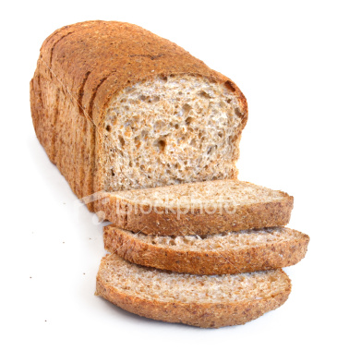
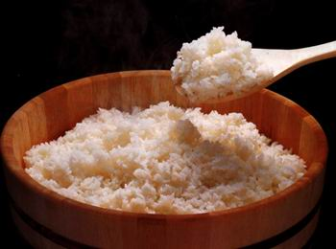
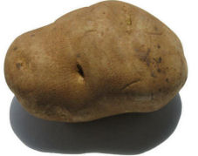
Breads & Cereals Group
Examples:
various breads, rice, porridge, noodles, dumplings, spaghetti, potatoes
Nutrition:
Carbohydrate
Function on human body:
give 60~70% of the energy

Slide 3
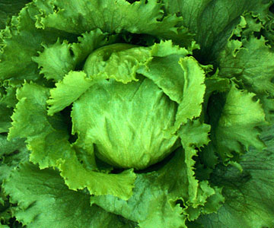

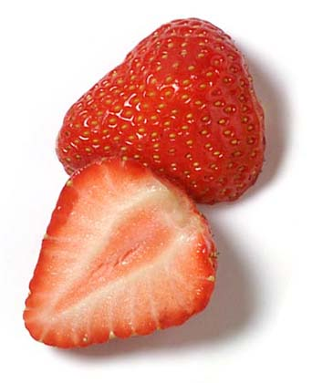
Vegetable & Fruit Group
Examples:
beans, peas, cucumbers, eggplants, peppers, mushrooms, peaches, lemons, apples...
Nutrition:
various vitamins & fibre
Function on human body:
Protect our body from diseases

Slide 4

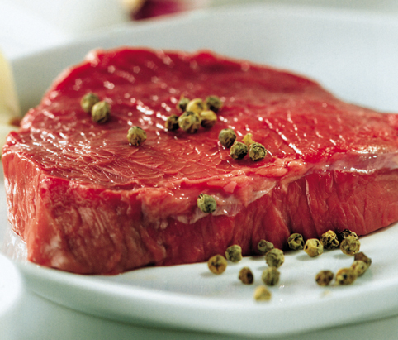
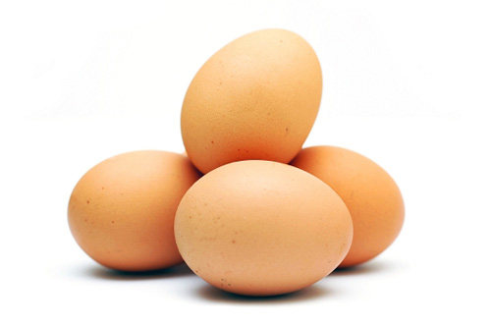
Milk & Meat Group
Examples:
milk, cheese, yogurt, eggs, mutton, fish, pork, beef
Nutrition:
protein
Function on human body:
Help grow bones & muscles,
build up our body

Slide 5

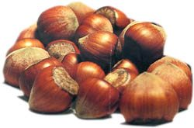
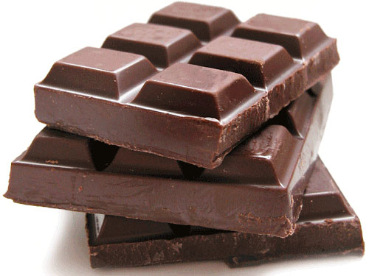
Sweets, Oils & Fats Group
Examples:
Candies, cakes, cookies,chocolates, butter, ice cream, oils, nuts...
Nutrition:
High in calorie, rich in sugar & fat
Function on human body:
Provide energy

Slide 6
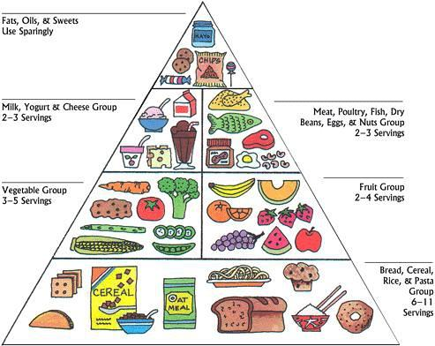
The Food Pyramid: A Healthy & Balanced Diet
Take a variety of foods
The amount from each group should vary
the higher in the pyramid, the less

Slide 7


Evaluate nutritional value in 2 combos:

Slide 8
The mushroom & Chicken with Rice Combo
Ingredients:
mushroom, chicken / lean pork soup / lettuce / rice
Way of cooking
strir-fry, steam
Healthy or not?

