Slide 1
Unit 3 word study & reading

Slide 2
【填一填➡激活思维】选词填空(scene/scenery/view/sight)。
①She had a marvelous ____ of the mountain from her
bedroom window.
②What impressed me most about the movie were the ______ filmed in New York.
③Would you like to enjoy the beautiful _______ in this
district with me?
④Every year thousands of tourists visit Pompeii, Italy to see
the famous _____.
view
scenes
scenery
sights

Slide 3
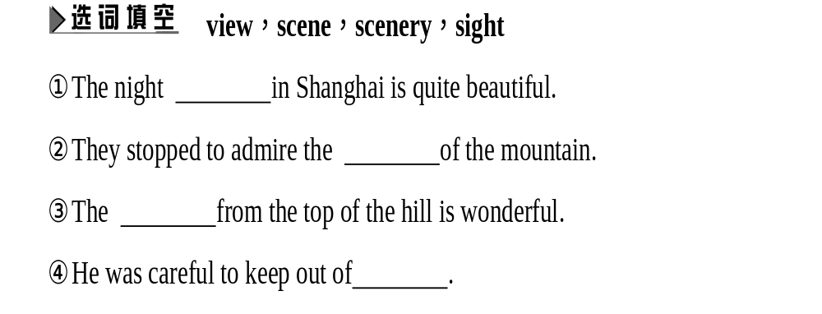
❺Seeing the happy of the children playing in the park, I’m full of joy and confidence in the future of our country.
A. sight B. view C. look D. scene

Slide 4
1
2
3
4
5
6
7
8
9
活学活用
完成句子
1)When he (到场),everything came to an end.
2)They are carrying out some deals done
(在后台).
3)We have (为……做好准备) the coming difficulty.
选词填空:view,scene,scenery,sight
4)There is a lovely from this window.
5)Guilin is famous for its beautiful .
6)There is a happy of boys and girls playing on the playground.
came on the scene
behind the scenes
set the scene for
view
scenery
scene

Slide 5
1
2
3
4
5
6
7
8
9
sights
7)The Summer Palace is one of the of China.
8)On the top of the tower,you will have a good of the whole town.
9)The happy of children playing in the garden disappeared and it was quiet again.
view
scene

Slide 6
【辨一辨➡明晰异同】
scene | 指“一眼可以浏览的风景”, 多包括其中的人物、动作和行为
scenery | 更侧重“景色”之意, 即从“美”的角度去看山林、峡谷、田野、湖泊等优美的自然景色
view | 常指在远处或高处, 以人的角度看到的scenery的一部分
sight | “风景, 名胜”, 常用复数形式, 指“人文景观”

Slide 7
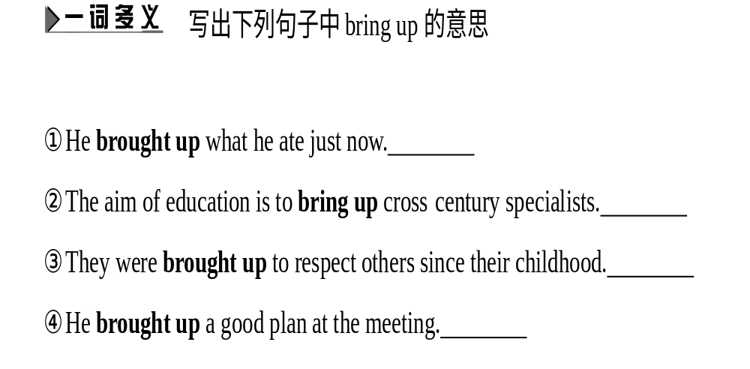

Slide 8
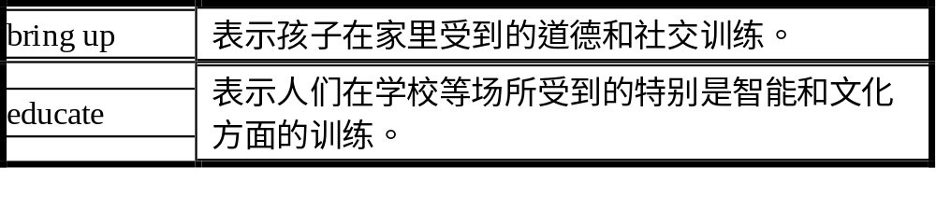
He brought the matter up in the conference.
他在会上提出了这个问题。
He was so sick that he brought up everything he had eaten.
他非常恶心,把吃的东西都吐了出来。
1)辨析:bring up和educate

Slide 9
1
2
3
4
5
6
7
8
9
归纳:bring down 打倒;降低;击落
bring about 使发生;致使
bring back 拿回来;使回忆起来;使恢复
bring out 使显示;出版;生产;说出
bring in 生产;挣(钱);介绍;引进
活学活用
用bring的相关短语填空
1)Born into a family with three brothers,David was
to value the sense of sharing.
2)Experts were to advise the government.
3)He aimed,fired and the horse.
4)The company is a new sports car.
brought up
brought in
brought down
bringing out

Slide 10
1
2
3
4
5
6
7
8
9
bring back
5)A rocket can information which we could never get in any other way.
6)I don’t clearly remember who the question but I clearly remember it a heated discussion.
7)To my surprise,at yesterday’s meeting he again
the plan that didn’t sound reasonable.
brought up
brought about
brought up

Slide 11
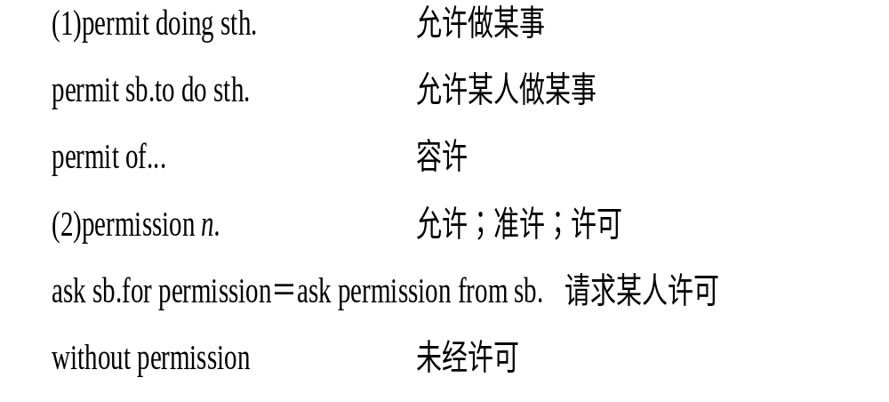

permit

Slide 12
1)辨析:permit,allow和let
permit 表示“允许,许可”时语气较强,有赋予权利之意,常用于法律、规章、制度等方面,比 allow 正式,含有积极地、从正面“允许”的意义。如:
They don’t permit you to smoke here.
他们不允许你在这儿抽烟。
allow指“并不反对”或“不加阻止”,偏重“默许”或“听任”,含义较消极。如:
Each passenger is allowed to take twenty-five kilograms of luggage.
每位旅客允许携带二十五千克重的行李。

Slide 13
1
2
3
4
5
6
7
8
9
let是三个词中最不正式的,较口语化,其语意最弱,指“给予可能或同意”,有时含“难以阻止或限制”之意。 如:
Let him wait.让他等一等。
2)permission n.允许,批准
with/without sb’s permission经过/未经过某人许可

Slide 14
1
2
3
4
5
6
7
8
9
活学活用
语法填空
1)Passengers are permitted (carry) only one piece of hand luggage onto the plane.
2)If you want to go into that factory,you need a (permission).
3)Stay awake! You should know that it isn’t (permit) to sleep in class.
4)Many shop owners don’t permit (park) cars in front of their shops.
5)Weather (permit),we will go camping this weekend.
to carry
permit
permitted
parking
permitting

Slide 15
spot
归纳:on the spot 马上;立刻;在现场
be spotted with 被……点缀
put sb on the spot 使某人为难
2)派生词:spotted adj. 有斑点的;spotless adj. 极整洁的
活学活用
完成句子
1)事故发生时,他们正在现场。
When the accident happened,they were .
2)他发现他的朋友正在远处和某个人交谈。
He someone in the distance.
3)闪烁的星星点缀着夜空。
The night sky twinkling stars.
4)我正要离开,门铃响了。
I the doorbell rang.
on the spot
spotted his friend talking with
is spotted with
was about to leave when

Slide 16
1
2
3
4
5
6
7
8
9
5)我们都认为这本书已经丢了时,书找到了。
Just as we all thought it ,the book was found.
翻译句子
6)不要放弃你现在正在做的事情。
7)我绝不会让你为难。
had been given up for lost
答案:Don’t give up what you are doing now.
答案:I will never put you on the spot.

Slide 17
chance
1
2
3
4
5
Well,we’ll have to take a chance.
哦,我们得冒点风险。
考点take a chance冒险;碰运气
I don’t want to take a chance to run a business.
我不想冒险去做生意。
You will take a chance of being fired.你将冒着被解雇的危险。
Let’s take a chance on the weather and hold the party outdoors.
我们在天气方面碰碰运气,在户外举办聚会吧。
归纳:take a chance 后既可以接动词不定式,也可以接of being done; take a chance也常和介词on连用。

Slide 18
1
2
3
4
5
1)同义词组:take chances
2)chance重点用法归纳:
It was in the park that I saw her by chance.
我是在公园里偶然看见她的。
Please tell us if you,by any chance,know it.
如果你碰巧知道这件事情,请告诉我们。
I will go there on the chance of seeing them.
我将去那儿,希望能看见他们。
Chances are that he’s already known the truth.
他很可能已经知道真相。
Give me a chance,please.请给我一次机会吧。
He has a chance of winning the match.他可能赢得这次比赛。

Slide 19
1
2
3
4
5
归纳:by chance偶然
by any chance万一(碰巧)
on the chance of希望
Chances are that ...很可能……
give sb a chance给某人一次机会
have a chance of (doing) sth有可能做某事
活学活用
语法填空
1)I learned to take (chance) and not to be afraid of failure.
2)She stepped on my foot by (chance),making me angry.
3) (chance) are that I will see her.
4)Let’s go to the downtown and take our (chance).
a chance/chances
chance
Chances
chance

Slide 20
1
2
3
4
5
翻译句子
5)我们一定不要冒险。
6)让我们在这次足球赛上碰碰运气吧。
7)李明很可能在家。
答案:We mustn’t take a chance./We mustn’t take chances.
答案:Let’s take a chance on the football match.
答案:Chances are that Li Ming is at home.

Slide 21
辨析:as for和as to
1)as for 用以转换话题:在有前文的情况下,as for总是出现在下文的句首,用来引出另外一方或者新的谈话内容,但与前文内容也有一定的联系,起到补充前文又突出后文的作用,使之与前文形成对照,译作“至于”。as for还可以用来表示讲话人对某人或某物持有“轻蔑”或“冷淡”的态度,讲话时要重读引出的词语并在其后稍作停顿,以示强调,口气上带有嘲讽意味,译作汉语的“至于……嘛”。

Slide 22
2)as to 表示涉及某点,常放于句中,表示“关于……方面”“有关……之事”,但为了突出要提及的人或事之时,也可将as to置于句首,以示强调。但只涉及内容,而不涉及讲话人的态度。as to引出的内容都是前文曾经提到过的或者谈话双方都有所了解的,表示“说到”。用于提出问题时,as to必须位于句中,前面出现的大都是表达某种心理活动的动词、形容词或名词,其后接“wh-从句”等表示“在……的问题上”“就……问题来讲”。as to还有“按照”“根据”的含义,引出做事的依据,而as for则无此意。
The thief was caught by the police.As for the stolen jewels, they were found in a dustbin.
小偷已被警察抓住。至于被偷的珠宝,也在一个垃圾箱里找到了。
I have no doubts as to your ability.关于你的能力我毫不怀疑。
We sorted the eggs as to size and colour.
我们按照大小和颜色给鸡蛋分类。

Slide 23
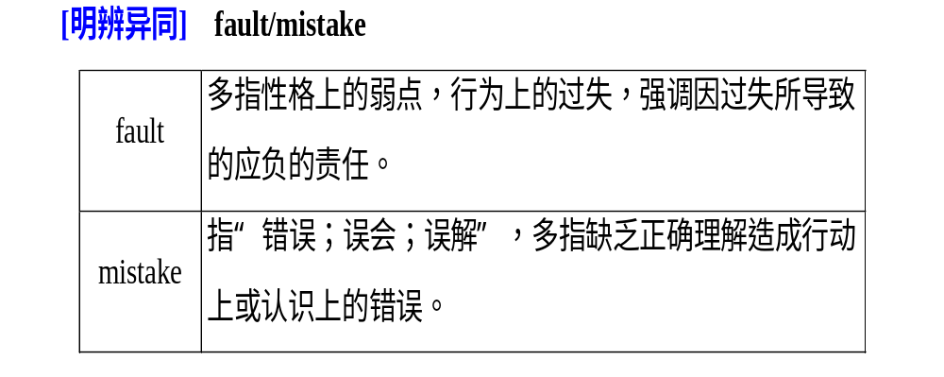

Slide 24
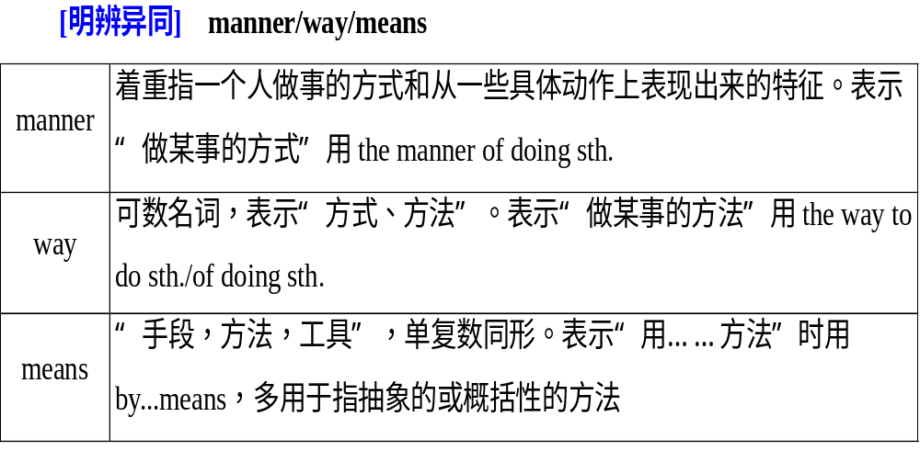

Slide 25
1
2
3
4
5
6
7
8
9
考点二account vi.& vt.认为;说明;总计有
n. 说明;理由;计算;账目
He accounted himself (to be) lucky.他自认为很幸运。
It accounts for 25 percent of all traffic accidents.
它占所有交通事故的百分之二十五。
The boss gave us a detailed account of the plan.
关于这项计划,老板给我们做了详尽的说明。
I got angry on this account.
由于这个缘故,我生气了。
He is good at accounts.
他擅长计算。
Do you want to know about accounts?
你想了解账目的情况吗?

Slide 26
1
2
3
4
5
6
7
8
9
阅读下列句子,归纳account的相关短语
On no account will I give up.
我决不放弃。
I will go to see you this Sunday on any account.
这个周日我无论如何都去看你。
We can’t go to play football on account of the heavy rain.
由于下大雨,我们不能去踢足球了。
Please take my request into account.
请考虑一下我的请求。
He has opened a bank account.
他已经开了一个银行账户。

Slide 27
1
2
3
4
5
6
7
8
9
归纳:on no account 决不;切勿(放在句首时,句子要倒装)
on any account无论如何
on account of 因为;由于
take account of sth/take sth into account考虑;体谅
open a bank account 开一个银行账户
活学活用
用account的适当形式填空
1)The agency has lost several of its most important .
2)This is a particular of the accident.
3)He has been asked for his conduct.
4)A man is innocent until he is proved guilty.
accounts
account
to account
accounted

Slide 28
1
2
3
4
5
6
7
8
9
完成句子
5)Some people believe that human activities (是……的原因) the global warming.
6)I was absent from school (由于) illness.
7) (决不) should the soldiers be blamed for what happened.
account for
on account of
On no account

Slide 29
1
2
3
4
5
6
7
8
9
8.I went to the American embassy to seek help,but ...
我去美国大使馆求助,但是……
考点seek(sought;sought) vt.& vi.寻找;探索;寻求
They were seeking jobs.
他们在找工作。
We sought long and hard but found no answer.
我们作了长期的艰苦探索,但没有找到答案。
He sought vainly for the answer.
他寻求答案,但毫无结果。

Slide 30
1
2
3
4
5
6
7
8
9
【高考典句】(2015·重庆高考)Besides,businesses seek to appeal to customers’ senses.
而且,商业总是会寻求迎合顾客的感官。
Please seek out what you like.
请挑出你喜欢的东西。
归纳:seek for的意义是“寻找;追求;探索”;seek to do sth的意义是“试图做某事”;seek out的意义是“找出;搜出;挑出”。

Slide 31
1
2
3
4
5
6
7
8
9
活学活用
语法填空
1)He is (seek) for wealth and power.
2)Terrified every day,he decides (seek) the aid of a psychiatrist(精神病医生).
3)Always he (seek) someone to whom he could talk without caution.
翻译句子
4)你应该就这件事情寻求妈妈的建议。
5)他们试图误导我们。
seeking
to seek
sought
You should seek advice from Mother on the matter.
They seek to mislead us.

Slide 32
1
2
3
4
5
6
7
8
9
9.On the contrary,in fact.事实上,正好相反。
考点on the contrary与此相反;正相反
—You’re quite free now,I think.
我想你现在一定有空。
—On the contrary,I have tons of things to do!
正相反,我有一大堆事情要做!
1)contrary作“反面,相反的东西”讲时,多和the连用。
2)contrary有时可用作可数名词。如:
Hot and cold are contraries.热和冷相反。

Slide 33
1
2
3
4
5
6
7
8
9
3)辨析:on the contrary和to the contrary
on the contrary “恰恰相反”,指对上文关系的转折。如:
On the contrary,we are not going to the park.
正好相反,我们不打算去公园。
to the contrary “相反地”,是对事物的评判。如:
I will come on Monday unless you write to the contrary.
我将于星期一来,除非你写信叫我别来。
4)be contrary to 与……相反
His opinion is contrary to mine.
他的看法与我的看法相反。

Slide 34
1
2
3
4
5
6
7
8
9
活学活用
选词填空:on the contrary,to the contrary,be contrary to
1)I know nothing .
2)The result expectation.
3)—You seem to be interested in writing.
—What? ,I’m getting tired of it.
语法填空
4)His view about how to increase sales of products is contrary
mine.
5)The car isn’t expensive; the contrary,it is very cheap.
to the contrary
is contrary to
On the contrary
to
on

Slide 35
Reading 1

Slide 36
一
二
三
四
三、阅读THE MILLION POUND BANK NOTE,回答下列问题
1.Why did the two brothers give a million pound bank note to Henry Adams?
A.To see whether a man could survive a month with it.
B.To help the poor young man live a happy life in London.
C.To see if a man lost in London likes it.
D.To make sure no one is hungry in London.
答案:A

Slide 37
一
二
三
四
2.Where did Henry come from?
A.London.
B.Washington.
C.San Francisco.
D.New York.
3.How did Henry arrive in England?
A.A ship took him there.
B.A plane took him there.
C.A train took him there.
D.A bus took him there.
答案:C
答案:A

Slide 38
一
二
三
四
4.How did Henry feel when he was talking with the two brothers?
A.Interested.
B.Hungry.
C.Pleased.
D.Tired.
5.What’s Henry’s promise?
A.He wouldn’t come back to the two brothers until 2 o’clock.
B.He wouldn’t use the money in the letter after 2 o’clock.
C.He would give the money back to the two brothers before 2 o’clock.
D.He wouldn’t open the letter until 2 o’clock.
答案:B
答案:D

Slide 39
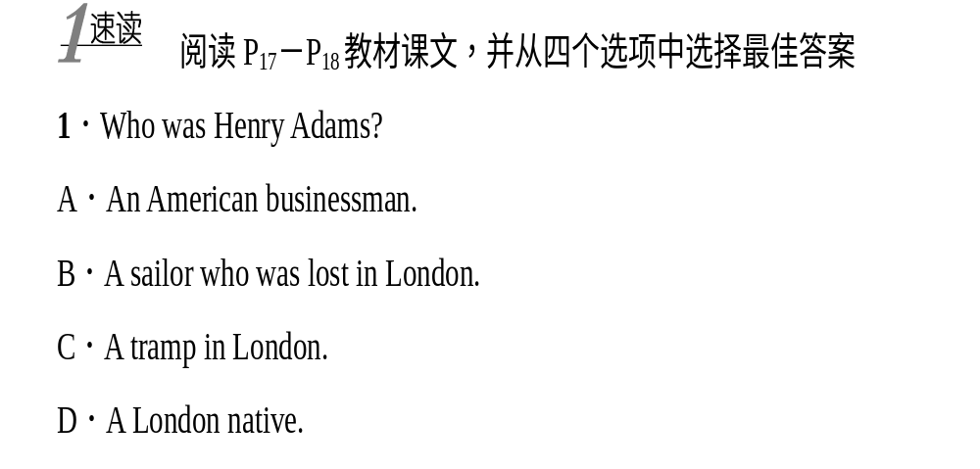

Slide 40
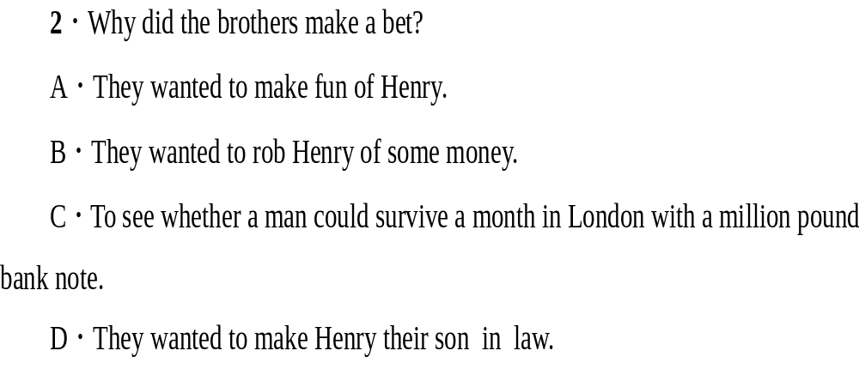

Slide 41
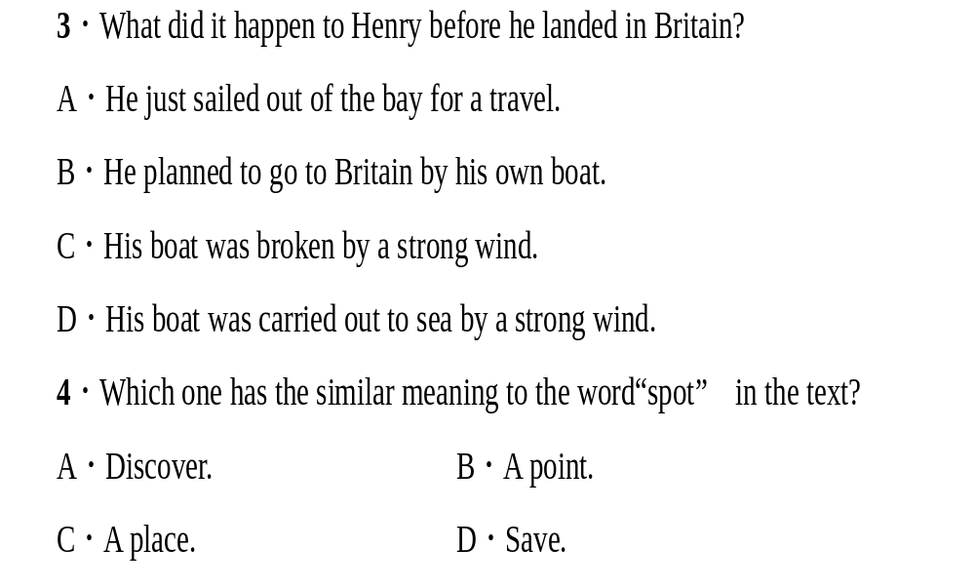

Slide 42
