Slide 1
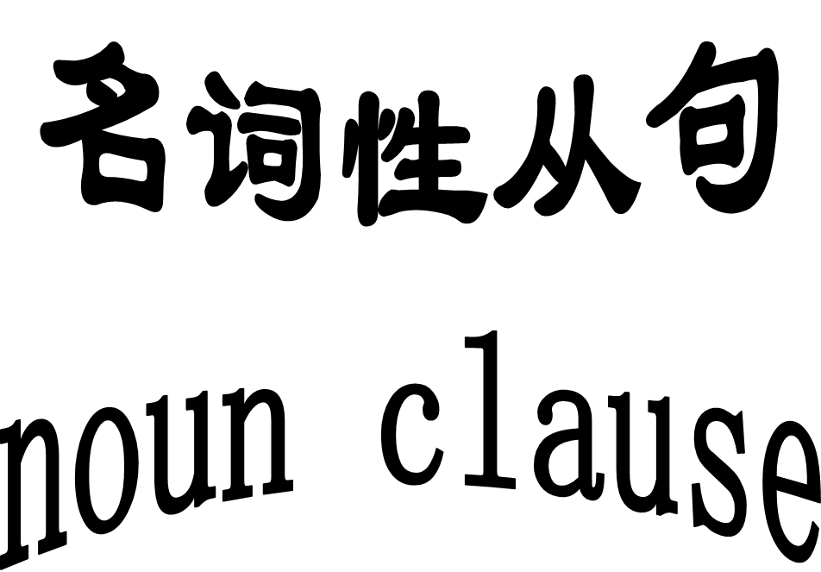

Slide 2
1. (2008山东)____ was most important to her was her family.
A. it B. this C. What D. as
2. (2009北京，31）At first he hated the new job but decided to give himself a few months to see _____it got any better.
A.When B. how C. why D. if
3. (2006全国I,23）See the flags on top of the building?
That was _____ we did this morning.
A. When B. which C. where D. what
4. (2009浙江，12）Is there any possibility _____ you could pick me up at the airport?
---No problem.
A. When B. that C. whether D. what
☆
主语从句
☆
宾语从句
表语从句
☆
同位语从句
☆

Slide 3
I. 名词性从句的引导词：
连接词 ：that、if、whether
2. 连接代词 ：who、 whom 、whose、 what、
which、~ever
3. 连接副词： when、 where、why、how

Slide 4
注意: 区别if 与whether
1. I don’t know __________ I’ll
be free tomorrow.
2. I don’t know _______ or not
I’ll be free tomorrow.
3. The question is _______ this
book is worth writing.
whether / if
whether
whether

Slide 5
5. It depends on _______ we will
have enough money.
6. _______ they can do it matters
little to us.
7. _____ you are not free tomorrow,
I’ll go without you.
whether
Whether
If

Slide 6

归纳
请你归纳
只能使用whether 的情况：
a. 主语从句并在句首
b. 表语从句
c. 同位语从句
e. 介词后的宾语从句
f. 直接加动词不定式只能用whether （to do）
g whether or not 直接连用时不用if

Slide 7
高考题选萃
1. ____ the 2000 Olympic Games will be
held in Beijing is not known yet.
A. Whenever B. If
C.Whether D. That
2. _____ we’ll go camping tomorrow
depends on the weather.
A. If B. Whether
C. That D. Where
☆
There is no doubt____ he will win the first place .
that
that 表肯定意义
whether表疑问
☆

Slide 8
that 与 what 的区别
What he said makes me happy.
That a new teacher will come is true .
that 只起连接作用，无意义，在从句中不充当任
何成分, 且在宾语从句中有时可省。 what 既起连接作用, 又在从句中作 主语, 宾语, 表
语 (且在名词性从句中只有what可作表语）

Slide 9
That
1. _______ he said so made us angry .
_______ he said at the meeting made us angry.
2. A computer can only do_________ you have
instructed it to do. （01全国）
3. 中国不再是过去的样子了。
4. A modern city has been set up in ______ was a
wasteland ten years ago. （04天津）
A. what B. which C. that D. where
What
what
China is no longer ______ it used to be .
what
☆

Slide 10

主语从句
1. That he will succeed is certain .
2. Whether he will go there is not known .
3. What he said is not true .
4. Where he hid the money is to be found out .
5. Whoever comes is welcome.
请思考？

Slide 11
注意点
1).主语从句一律用陈述句语序,即主语在前,谓语在后.
例: 误: When will he come is not known.
正: When he will come is not known.
2).连接词that在从句中无实际意义,但不能省略.
例: 误: He will not come to the meeting
this evening is true.
正: That he will not come to the meeting this evening is true.

Slide 12
3).whoever, whatever, whichever等词可以引导主语从句, 但no matter who, no matter what 等不能.
Whoever breaks the school rules must be punished.
试比较：Whoever breaks the schools rules, he must be punished.
=No matter who breaks the school rules, he must be punished.
让步状语从句

Slide 13
1.__________ was said here must be
kept secret.
2._______ we need is more time.
3._______ has taken away my bag is
unknown.
4.__________ breaks the law will be
punished.
Whatever
What
Who
Anyone who
Whoever

Slide 14
考点 ４ ：it作形式主语(主从) , 形式宾语（宾从）
it 作形式主语
1.他犯了那样一个错误真是遗憾。
___________________________ is a pity .
2.他来不来不重要。
________________________doesn’t matter.
That he made such a mistake
It is a pity that…
Whether he will come or not
It doesn’t matter whether…

Slide 15
Can you understand them?
It is reported/ thought/said/predicted that…
It is clear/necessary/certain that…
It is a pity/a shame/an honor that…
It doesn’t matter whether…
It seems/appears that…
It happens that…

Slide 16
1.______ he wants is a book.
2. ______ he wants to go there is obvious.
3.The result is ______ we won the game.
4.This is _____ we want to know.
5.Is _____ he told us true ?
6.We should pay attention to ______ the teacher is
saying.
7. I have no doubt _____ he will come.
8. I have no idea _____ he did that afternoon.
What
That
that
what
what
what
that
what

Slide 17
挑战高考
1)（2008浙江) ____ want to stay in a hotel has to pay their own way.
A). anyone B). the one C). whoever D). who
2) ____ he said at the meeting astonished everybody present. ( 93)
A).What B). That C). The fact D). The matter
3)（2006浙江） ____is our belief that improvements in health care will lead to a stronger,more prosperous economy.
A). As B). That C). this D). It

Slide 18
用适当的连接词填空
why
1. I wondered _______ you were so angry.
2. It all depends on _______ they will support us .
3. I can’t imagine _______made him act like that.
4 . I’m delighted _______I have passed the exam.
5. I find it necessary _______ we should do the homework.
whether
what
that
that
宾语从句
请思考？

Slide 19
二.宾语从句
1.宾语从句的引导词:
宾语从句的连接词与引导主语从句的连接词相同.
2.注意点
1) 宾语从句一律用陈述句的语序.
2) 引导宾语从句的连词that也无实际意义,多数
情况下可以省略.
3) whether和if都可以引导宾语从句
但: (1) 当whether后紧跟or not时, 不用if
例: I don’t know _______I will stay or not.
(2) 介词后面的宾语从句不能用if
例: I worry about __________ I hurt her feeling.
whether
whether

Slide 20
4) that在宾语从句中的省略与保留
(1).在主+谓+it(形式宾语)+宾补+that从句
(真正宾语) 的句型中不省略.
例: We must make it clear that we
mean what we say.
(2).由连词and连接的两个由that引导的宾语从句中, 第二个that 不省略.
例: He told me （that ）he would come
and that he would come on time.

Slide 21
5）it 作形式宾语
make /find/ feel / consider / think it + adj / n + that… / to do…
it 指代后面从句所叙述的内容,常用 like/dislike/love/hate/appreciate/make+it + if 或when从句
I hate it when people laugh at the disabled .

Slide 22
it
1. I’ve got to make clear that he told a lie.
I like ___ in the autumn when the
weather is clear and bright. (2004 )
A. this B. that C. it D. one
3. 他发现很难使别人理解他.
He found
_________________________________.
it
it difficult to make himself understood

Slide 23
挑战高考
1)（2005山东，26)The shopkeeper didn’t want to sell for ____ he thought was not enough.
A). where B). How C). what D). which
2) (2006全国I，16) ---what did your parents think about your decision?
---They always let me do ____I think I should.
A). when B). that C). how D). what

Slide 24
Translation
问题是我们是否可以信任他。
我建议买台大电脑。
whether we can rely on him.
The question is
My suggestion is
that we( should)buy a big computer.
表语从句
请思考？

Slide 25
2.注意点
1) 表语从句一律用陈述句的语序.
2) 表语从句的引导词that无实际意义,但不能省略.
3) 表语从句只能用whether,而不能用if 引导.
4) 不要使用 The reason … is because that … 句型,
应使用 The reason… is that… 或 This / it /that/
is because…等句型.
例如: 今天早上他迟到的原因是因为路上行人太多.
误: The reason why he was late this morning is because that there was a lot of traffic on the road.
正: The reason why he was late this morning is that there was a lot of traffic on the road.
或:He was late this morning. That was because there was a lot of traffic on the road.

Slide 26
真题荟萃
1. (2009江西，33）The fact has worried many scientists____ the earth is becoming warmer and warmer these years.
A). what B). which
C). though D). that
2. (2009辽宁，29）Do you have any idea ____ is actually going on in the classroom?
A). that B). what
C).as D). which

Slide 27
同位语从句
1）The fact that he was killed made us surprised.
2）I have no idea when he will be back.
3）We heard the news that our team had won.
4）Can you find the answer to the question what was wrong with the computer?
5）He made a suggestion that we (should) read some original English literature works.

Slide 28
1.同位语从句的引导词: that ,whether, how , when, where, why等引导。
that引导的同位语从句前面的名词常见的有:
idea, fact, news, belief, thought, doubt, suggestion; proof, message, order, conclusion, desire, theory, truth, word 等.
2.同位语从句和定语从句的区别:
如果that作从句中的某一成分, 则是定语从句, 如果that不作从句中的任何成分, 则是同位语从句.
例: (1) I had no idea that it was so late. (主系表
结构, that 不作从句中的成分, 同位语从句)
(2) I still remember the place that we visited
last year. (主谓宾结构, that作从句中的宾
语,定语从句)

Slide 29
判断：定语从句 , 同位语从句
1.The fact that Great Britain is made up of three countries
is still unknown to many.
同位语从句
2.The news that is spreading around the airport is coming.
定语从句
3.The suggestion that students should learn something practical is worth considering.
同位语从句
4.We expressed the hope that they had expressed.
5. We expressed the hope that they would come
to China again.
定语从句
同位语从句

Slide 30
注意问题:语序
从句一定用陈述语序
1. The photographs will show you
_______．（MET89）
A. what does our village look like
B. what our village looks like
C. how does our village look like
D. how our village looks like

Slide 31
高考链接
1.(09四川8 ). News came from the school office _____ Xiao Lin had been admitted to Beijing University.
A. which B. what C. that D. where
2.(09天津9 ). It is obvious to the students ______ they should get well prepared for their future.
A. as B. which C. whether D. that
3.(06上海)One advantage of playing the guitar is ______ it can give you a great deal of pleasure.
A. how B. why C. that D. when
同位语从句
主语从句
表语从句

Slide 32
4.(上海01年春季）What the doctors really doubt is ____ my mother will recover from the serious disease soon．
A. when B. how C whether D. why
6.(96 NMET ) _______we’ll go camping tomorrow depends on the weather.
A. If B. Whether C. That D. Where
表语从句
主语从句

Slide 33
7.(2000NMET) ________she couldn’t understand was ______ fewer and fewer students showed interest in her lessons.
A. That; what B. What; why
C. What; because D. Why; that
8.(09湖南) She is very dear to us. We have been prepared to do it takes to save her life.
A.whichever B.however C whatever D.whoever
9.(09海南) Could I speak to is in charge of International Sales please?
A. who B. what C. whoever D. whatever
主语从句
宾语从句
宾语从句

Slide 34
10.(96 NMET) _______ we can’t get seems better than ________ we have.
A. What; what B. What; that
C. That; that D. That; what
11.(07 全国卷II) ____ matters most in learning English is enough practice.
A. What B. Why C. Where D. Which
12.(08天津卷） The last time we had great fun was _____we were visiting the Water Park.
A. where B. how C. when D. why
主语从句
主语从句
表语从句

Slide 35
Translation:
1.我们还不能确定他是否能够成功.
2.真奇怪，他竟没有看出自己的缺点.
3.我们听到了我们队获胜这个好消息.
4.我对他告诉我的这个消息很感兴趣.
5.那就是你错的地方。
We are not sure if he will succeed .
It is strange that he should have failed to see his own shortcomings.
We heard the news that our team had won
I’m interested in the news he told me.
This is where you are wrong.

Slide 36
1. was that the factory had very strict rules. (impress)
给我印象最深的是这家工厂有非常严格的规定。
2. Nowadays young people just can’t live without the Internet; they depend on it for _________________________ . (need)
现在的年轻人离开互联网就无法生活, 不管他们需要什么信息他们都会通过互联网来获取。
3. The reason why people carry umbrellas in hot summer days is ________________________ the hot sun may be harmful to the skin. (expose)
在炎热的夏天, 人们带伞是因为暴露在烈日下可能对皮肤有害。
What impressed me most
whatever information they need
that being exposed to

Slide 37
4.这个老师正全力阐明让学生困惑的地方。(clarify; confuse)
The teacher was making every effort to clarify what confused the students.
5.站在瑜伽球上需要很好的平衡感。(take; Swiss Ball)
A great sense of balance is what it takes to stand on a Swiss Ball.
6.一个社会的稳定取决于该社会对人们的极端行为如何作出回应。 (stability ;respond)
The stability of a society depends on how it responds to the extremes of human behavior.
7.对海伦来说, 无论大卫说什么听起来都是对的。
Whatever David says sounds right to Helen.

