Slide 1
Break 短语练习

Slide 2
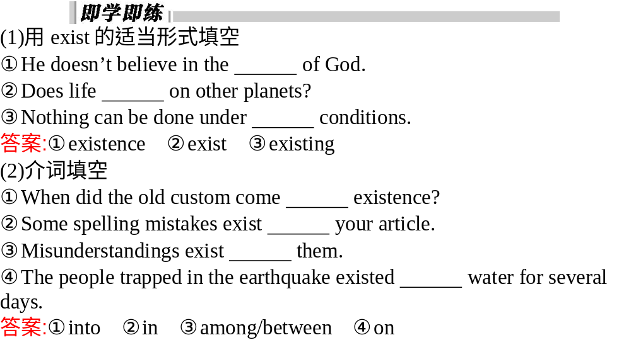
基础导练
文本感知
导学互动

Slide 3
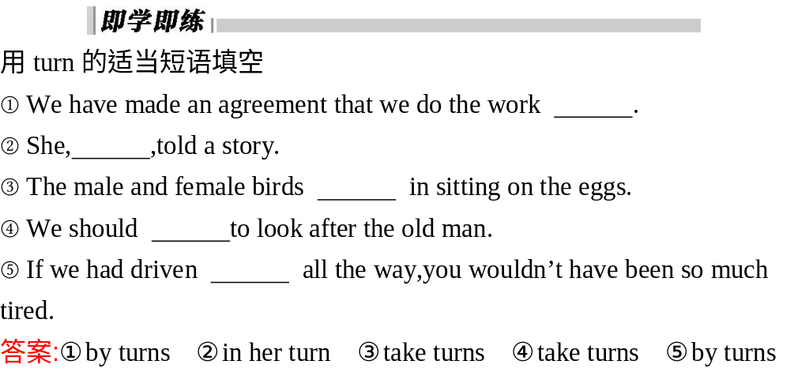
基础导练
文本感知
导学互动

Slide 4
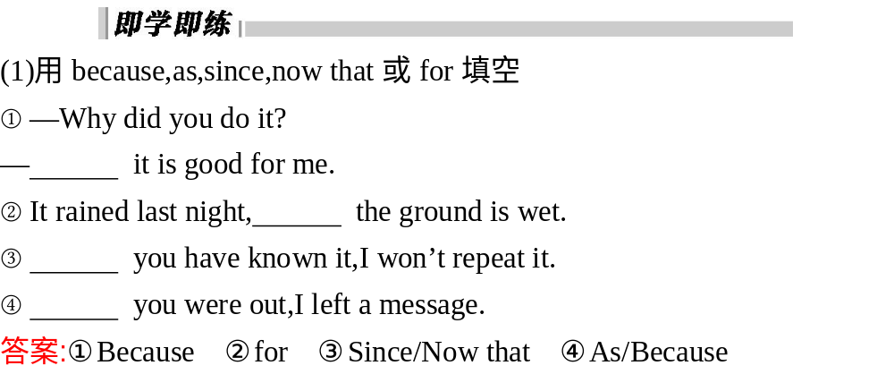
基础导练
文本感知
导学互动

Slide 5
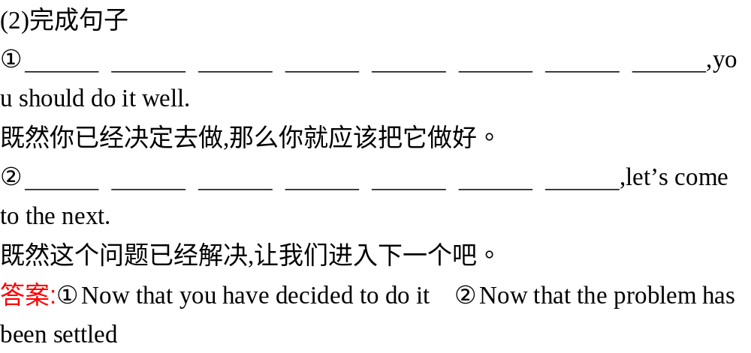
基础导练
文本感知
导学互动

Slide 6
要 点
讲 与 练
即学即练
用break构成的词语完成下列句子。
(1)He predicted that war would______________in the next few years.
(2)You must__________________such bad habits.
(3)Her health________________under the pressure of work.
(4)Burglars(小偷) ________________while we were away on holiday.
break out
broke away from
broke down
had broken in

Slide 7
要 点
讲 与 练
(5)The thieves planned to ________________a bank.
(6)She ________________ a piece of chocolate and gave it to me.
(7)Don't__________________when the adventurer is telling his own story.
(8)The band finally ________________ because of lack of money.
5．watch out for...(p.31) 注意
break into
broke off
break in
broke up

Slide 8
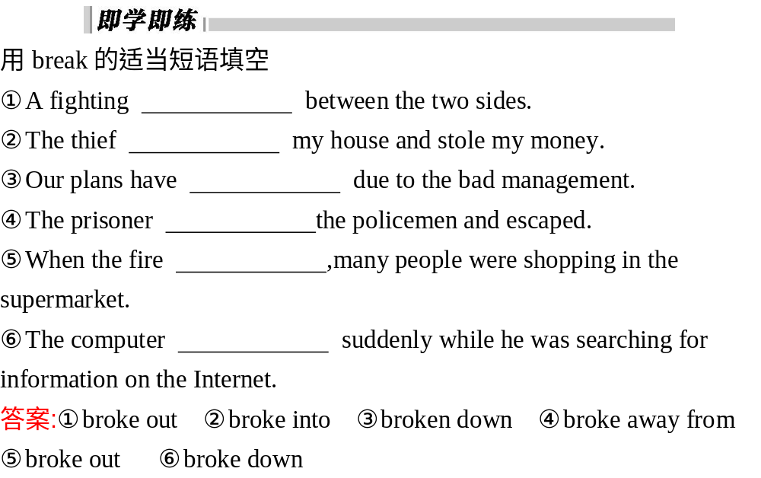
基础导练
文本感知
导学互动

Slide 9
要 点
讲 与 练
即学即练
用上述句型完成下列句子。
(1)这把尺子是那把的三倍那么长。
_________________________________________________________________________________________________________________
(2)到的学生是我们预计的五倍。
________________________________________________________________________
This ruler is three times as long as that one.
＝This ruler is two times longer than that one.
＝This ruler is three times the length of that one.
There are five times as many students as we expected.

Slide 10

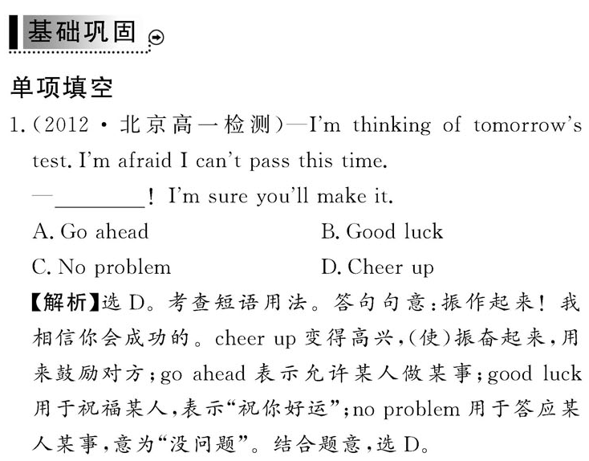

Slide 12
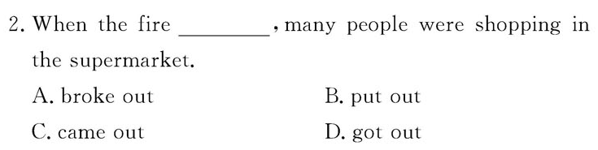
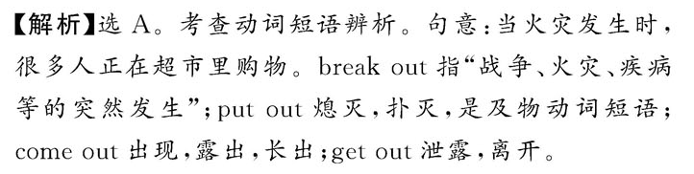

Slide 13
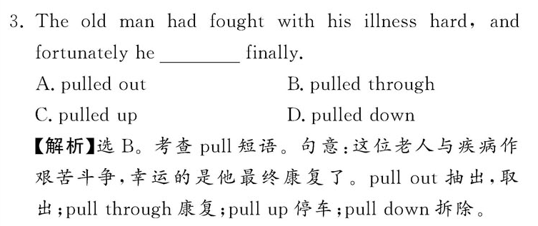

Slide 14
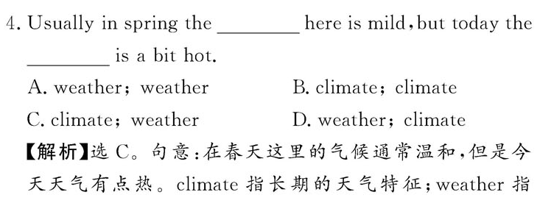

Slide 15
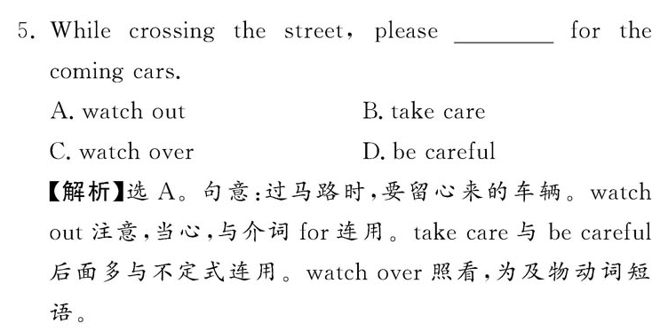

Slide 16
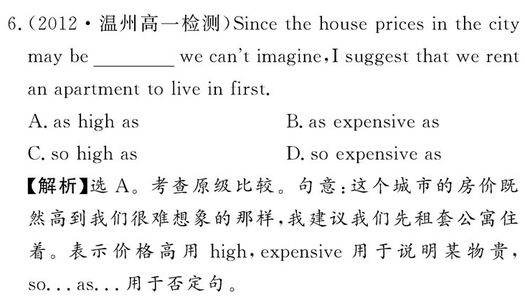

Slide 17
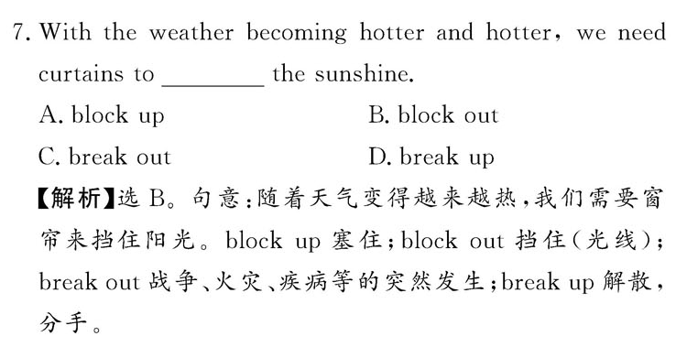

Slide 18
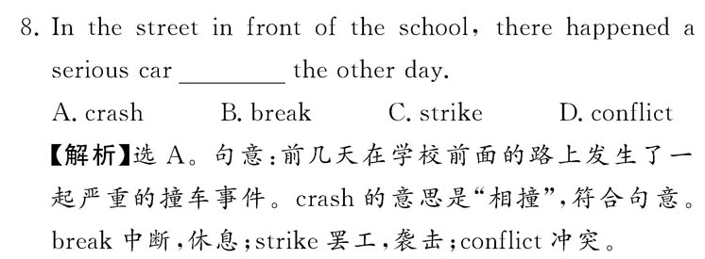

Slide 19
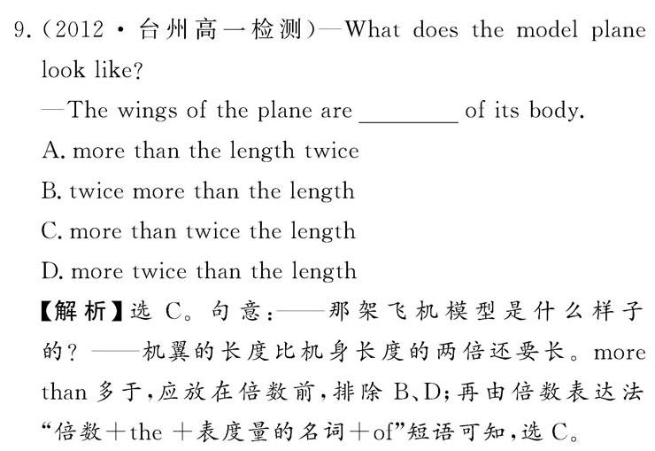

Slide 20
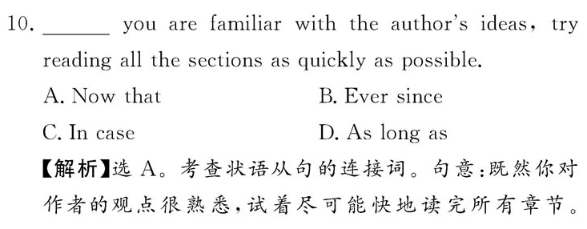


Slide 21
