Slide 1
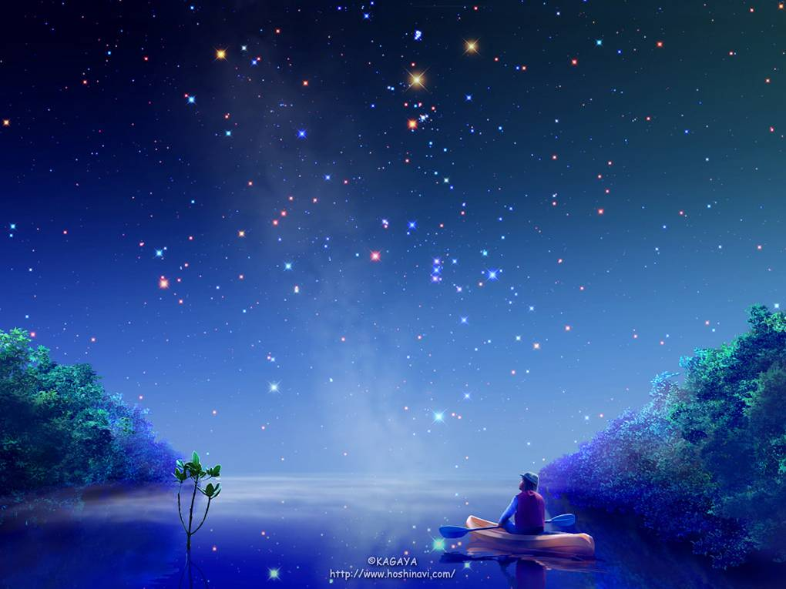


Unit 4
Period 2: Language Points

Slide 2
短语梳理与句子考点分析和翻译

Slide 3
1. 根据广泛被接受的理论
2. 宇宙以“大爆炸”开始
3. 四面八方
4.不确定它会变成什么
5. 沉降成为固体球
6. 它的形状是否会持续仍不清楚
7. 它们及时产生了碳。
8. 更重要的是随着地球冷却，水开始在它表面出现。
1. according to a widely accepted theory
2. The universe began with a “Big Bang”.
3. in all directions
4. What it was to become was uncertain.
5. settle down into a solid globe
6.It is not clear whether the shape would last or not.
7. They were in time to produce carbon.
8. What is even more important is that as the earth cool down,water began to appear on its surface.

Slide 4
1. 使大海充满氧气
2. 各种各样的鱼
3. 通过下蛋繁殖后代
4. 存在在地球上
5. 使哺乳动物的增长成为可能
6. 生小孩
7. 轮到他们
8. 防止热量从地球散发到太空
1. fill the oceans and seas with oxygen
2. all sorts of fish
3. produce young by laying eggs
4. exist on the earth
5. Make it possible the rise of mammals
6. give birth to young babies
7. in their turn
8. prevent heat from escaping from the earth into space

Slide 5


（分析句子结构并翻译成中文）
【课文考点点拨】
1. What it was to become was uncertain until between 4.5 and 3.8 billion years ago when the dust settled into a solid globe.
What is even more important is that as the earth cooled down, water began to appear on its surface.
① _____ was most important to her, she told me, was her family.
A. It B. This C. What D. As
② ______ is known to us all is that the 2008 Olympic Games will take place in Beijing.
A. It B. What C. As D. Which
③. ___________________（使大家吃惊的是）is that he didn’t come to the meeting.
④. ___________ （他所做的）added to our difficulty.
What surprised me
What he had done

Slide 6
2 地球猛烈的爆炸喷出了烈火和岩石，最终产生了碳、氮气、水蒸气和其他多种气体，从而形成了地球的大气层。
3.水对于生命的发展会起关键作用，这一点在当时并不明显。
4.很多科学家相信，由于地球上长期有水存在，使地球得以把有害气体和酸性物质溶解在海洋里
The earth exploded loudly ___fire and rock. They were in time _____(produce)carbon, nitrogen, water vapour and other gases, _____were to make the earth’s atmosphere.
with
to produce
which
It
___was not immediately obvious that water was to be fundamental ___the development of life.
to
continued
What
____many scientists believes is that the____ (continue)presence of water allowed the earth to dissolve harmful gases and acids ___the oceans and seas.
into

Slide 7
课文句子中的考点以及短语单词学习
第一二段
accepted
1. However, according to a widely_____(accept) theory, the universe began _____a “Big Bang” _____threw matter in ______ directions
2 The earth became so violent that it was not clear _____the shape would last or not.
3 They were in time to produce carbon, nitrogen, water vapour and _____gases, ____were to make the earth’s atmosphere
with
that
all
whether
other
which

Slide 8
1. However, according to a widely accepted theory, the universe began with a “Big Bang” that threw matter in all directions.
theory n. 理论；原理
theoretical adj. 理论的；假设的
theoretically adv. 理论地；理论上
【相关短语】
in theory 理论上
= theoretically
in practice在实践中；实际上
= practically

Slide 9
begin with=start with：“以……开始”.
1) to begin with=to start with 以…为起点; 开始(做)
这两个词组都可以单独使用,表示“首先; 第一; 起初; 最初”。
e.g.首先, 我一点也不喜欢他。
To begin/start with, I couldn’t like him at all.

Slide 10
(L.2) … a “Big Bang” that threw matter
in all directions.
=in every direction/directions? 朝四面八方
译：The enemies ran away in all directions.
敌人四处逃窜。
拓展：
① I’m terrible with directions: __________
② a sense of direction: _______
③ 在某人的指导下: ______ one’s direction
我是路痴
方向感
under

Slide 11
2. (L.6) What it was to become was uncertain…
be to do
be + doing:_________ be + done:__________
联想
正在…
被动
be to do sth.
= A. be going to 计划
B. must, should 命令，义务
C. can 可能性
D. if…be to do, 表假设
1) No one is to leave this building without permission.
2) Such books are to be found in the library.
3) Their daughter is to get married soon.
4) If I were to do it, I would do it well.

Slide 12

1.This film _____ this Sunday.
A. is going to show B. is showing
C. is to be showed D. will have been show
2.The students were told that they ____ at the school gate at
2：00 the following afternoon.
A. met B. will meet C. were to meet D. were met
3.In such dry weather，the flowers will have to be watered if they _________.
A. have survived B. are to survive
C. would survive D. will survive

Slide 13
3. The earth became so violent that it was not clear whether the shape would last or not.
1) violent 猛烈的，激烈的
violently adv. 猛然地，激烈地
violence n. 暴力；激烈；
a violent storm 一场猛烈的暴风雨
a violent movie 一部暴力电影
一部充满色情与暴力的电影
a film( that is) full of sex and violence

Slide 14
4. (L.10) It exploded loudly with fire and rock.
【探究】
① The bomb exploded in Iraq last night.
② The children exploded into/with laughter.
③ The city's population has exploded in the last few years.
【拓展】adj. explosive 爆炸性的
n. explosion 爆炸
Unemployment became an _________ issue (一个爆炸性问题).
the theory of population __________: 人口大爆炸理论
v. 爆炸，炸开
v.（指感情）迸发 (=burst into…)
v.（指人口）突然或迅速增加
explosive
explosion

Slide 15

5. (L.10) They were in time to produce carbon, nitrogen, water vapour and other gases, which were to make the earth’s atmosphere.
in time:
① 最终/迟早(=finally/sooner or later)
译: 我迟早会回来的.
I’ll come back in time.
② 及时；不迟(=not late)
A. 她会及时回来准备晚餐.
She will be back ____ _____ _____ prepare dinner.
B. 你认为我们能及时赶上火车吗?
Do you think we can get there __ ____ ____ the train?
翻译: 我来得及去上学。(in two ways)
be in time to do sth.
in
time
to
be in time for sth.
in
time
for

Slide 16
拓展：与time相关的短语:
on time __________
at times __________
in no time ___________
once upon a time __________
kill time ______________
准时
有时;偶尔
立刻；马上
从前
消磨时间

Slide 17
5. (L.13)…which were to make the earth’s atmosphere.
① 大气层
② 会谈在友好的气氛下进行。
The talk was conducted ____ ___ _______
__________.
in
a
friendly
atmosphere

Slide 18
第三四段
1 Water had also appeared on other planets like Mars but, ____(like)the earth, it had disappeared
____(late)
2 The continued _____(present) of water allowed the earth to dissolve harmful gases and acids into oceans and seas.
3 This produced a chain reaction_____ made it possible for life to develop.
4 They produced young _____(general) by laying eggs.
unlike
later.
presence
which
generally

Slide 19
1. Water had also appeared on other planets like Mars but, unlike the earth, it had disappeared later.
unlike prep. 和…不同，不像
dislike vt. 不喜欢，厌恶
n. 嫌恶，反感，不喜爱
dislike sb./sth. 不喜欢某人/某物
dislike doing sth. 不喜欢/厌恶做某事
likes and dislikes 喜欢与不喜欢，好恶

Slide 20
2. (L.22) The continued presence of water allowed the earth to dissolve harmful gases and acids into oceans and seas.
harmful adj. ___________
e.g. Smoking is harmful to your health.
=Smoking _____ _____ _____ your health.
【拓展】
① harmless __________
联想：useless，helpless, homeless, …
② There is no harm in reading more books.
有害的
does
harm
to
无害的
There is no harm in doing sth.:做某事没有坏处

Slide 21

7. (L.25) This produced a chain reaction which made it possible for life to develop.
译:这产生了________，使生命的发展________.
注: make it + adj. + (for sb.) to do sth.: 使得(某人)做某事…
(形式宾语) (真正的宾语)
连锁反应
成为可能
BBG Learning Machine
learn English
easy
students
BBG learning machine makes it easy for students to learn English.

Slide 22
组长让我们有可能一起合作。
The group leader
____________________________________.
老师让他们更容易地明白那个问题。
The teacher ________________________________________________.
make it possible for us to work together
made it easy for them to understand
the question

Slide 23
D
① The foreign Minister said, “_____ our hope that the two
sides will work towards peace. ” (2004BJ)
A. This is B. There is C. That is D. It is
② I like ____ in the autumn when the weather is clear and
bright. (NMET2004)
A. this B. that C. it D. one
③ Why don’t you bring ___ to his attention that you are too
busy to do it?
A. this B. that C. what D. it
④ Was it at the school ____ was named after a hero _____
he spent his childhood?
A. which ; that B. where; where
C. that; where D. which; where
C
D

Slide 24
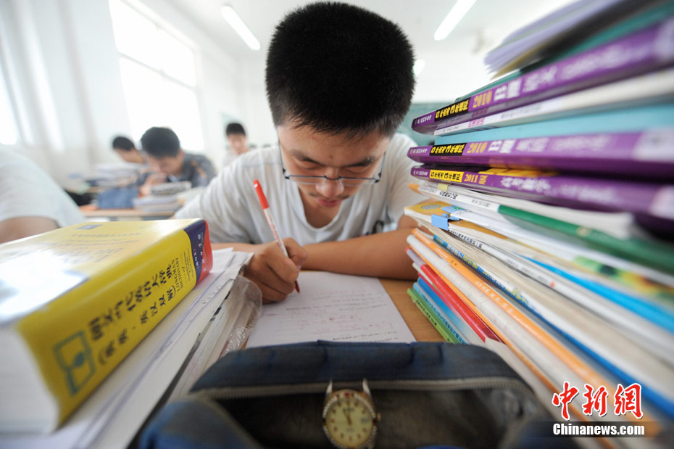
8. (L.30) They multiplied and filled the oceans and seas with oxygen.
multiply: v.
①乘: 2 multiplied by 4 is 8.
②增加(=increase)
③ Mosquitoes multiply rapidly in summer.
自从我们读高中以后
作业就已经成倍增加了
high school
homework
multiply
Our homework have multiplied since we came to high school.
繁殖

Slide 25
vt. 使增加/繁殖/相乘
vi. 乘；繁殖；增加
multi-= many
Multicultural
多元文化的;
Multicoloured
多色彩的
multinational
多国的;
multimedia
多媒体

Slide 26
9. (L.39) They produced young generally by laying eggs.
它们一般是通过孵蛋而繁衍后代的.
复习：“lie/lie/lay”的各种形式
动词原形 | 过去式 | 过去分词 | 现在分词 | 第三人称 单数
lie (说谎)
lie (躺)
lay (下蛋)
(lied; lied; lying) lies
(lay; lain; lying) lies
(laid; laid; laying) lays
He laid his books on the desk.

Slide 27
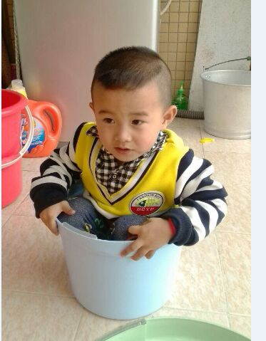
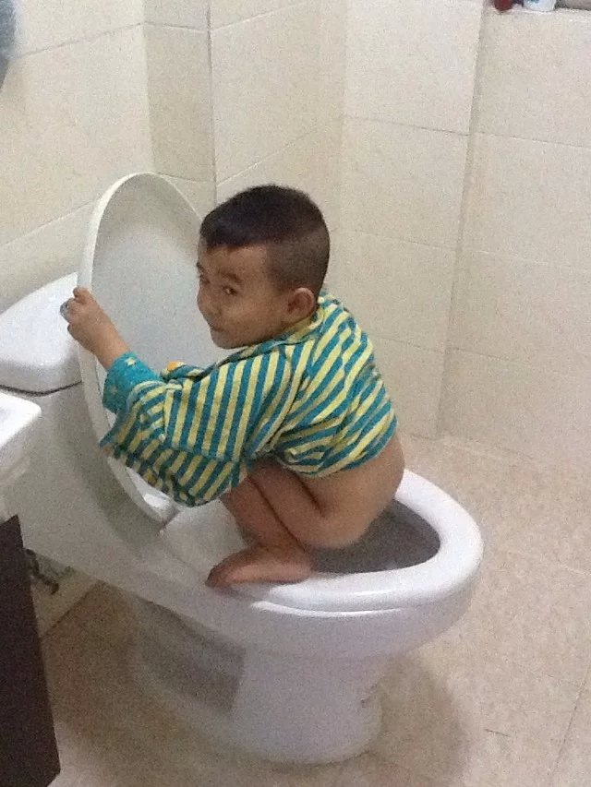
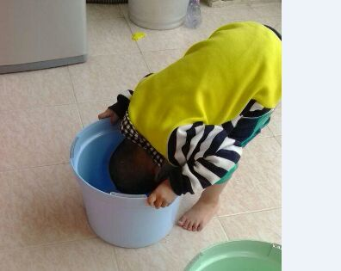
The naughty boy ___ to me that the hen that ___ there just now had ___ two eggs the day before.
lied
lay
laid

Slide 28
10. (L.40) They laid eggs too and existed on the earth for more than 140 million years.
exist: v.
① Could life exist in the desert? _________
② There exists a beautiful garden in our School.
= There ______ a beautiful garden in our School.
【拓展】
n. existence:存在
搭配: come into existence = come into being 开始存在、成立
译: When did this world come into existence?
Attention：exist 不用进行时态！
存在
is
There exist = There be (某处存在…/有…)
different -- difference (n.) 课本P.28 confident – confidence (n.)
联想

Slide 29
11. (L.41) Why they suddenly disappeared still remains a mystery.
remain用法小结：
1) remain作系动词(看作“be”理解),意为“仍然；依旧”
① Peter成为了一个经理，而Jack仍然是个工人。
Peter became a manager, but Jack remained ___ ________.
② 尽管外面很冷，房间里还是那么暖和。
Though it is cold outside, the room remained ______.
③ 他不得不继续住在医院，直到身体好转。
He had to remain _____ ________ until he was better.
④ 虽然我们三番五次地请她坐下，她还是站着。
Though we repeatedly asked her to sit down, she remained ___________.
⑤ 他们仍然被锁在房间里。
They remained __________ in the room.
remain + n.作表语
a worker
remain + adj.作表语
warm
remain +介词短语 作表语
in hospital
standing
remain + 分词作表语 (doing表主动；done表被动)
locked

Slide 30
2) remain作vi(不及物动词)
① 表示“留下；剩下”
e.g. They went, but I remained.
② 表示某事“尚待、有待于以后被处置”，后加“to be done.”
e.g. One problem remains _______________(solve).
e.g. That remains ________________(prove).
3) remains: n. 表示“遗迹；剩余物”
e.g. The remains of the supper were taken away.
4）remaining: adj. “剩余的” (=left)
译: 剩余的钱
____________
____________
to be solved
to be proved
remaining 放在n.前；left放在n.后，都表示“剩余的”

Slide 31
Having a trip abroad is certainly good for the old couple, but it remains _______ whether they will enjoy it.
A. to see B. to be seen C. seeing D. seen
2. The lady said she would buy a gift for her daughter with the_______.
A. 20 dollars remained B. 20 dollars to remain
C. remained 20 dollars D. remaining 20 dollars
3. It was already past midnight and only three young men _______ in the teahouse.
A. left B. remained C. delayed D. deserted
4. Please remain _______ until the plane has come to a complete stop.
A. to seat B. to be seated C. seating D. seated

Slide 32
第五段
their
1 Thus, they have, in _____turn, become ____most important animals on the planet.
2 They are putting too much carbon dioxide into the atmosphere,____ prevents heat from escaping from the earth.
3_______life will continue on the earth for millions of years to come will depend on (whether this problem can_________(solve).
the
which
Whether
(
)
be solved

Slide 33
12. (L.46) Thus, they have, in their turn, become the most important animals on the planet.
in one’s turn: 依次，轮流
译: When it is in my turn, I am too excited to speak.
【拓展】
in turn: 依次；反过来 (≠ in return--作为回报)
take turns to do/doing sth.: 轮流做某事
turn ______: 调小音量；拒绝
turn ______: 调大音量；出现
turn ______: (使)…变成敌人
down
up
against

Slide 34
【即时演练】用 “up/ down/ in /against” 填空
① The help we give to others will ____ turn give ourselves pleasure.
② He said that he would die than to turn _______ his country.
③ He tried to join the army but was turned ______ because of poor health.
④My boss hasn’t turned ___ - I hope he isn’t ill.
in
against
down
up

Slide 35
13. (L.48) …,which prevents heat from escaping from the earth.
prevent sb. (from) doing sth.:阻止某人做某事
= stop sb. (from) doing sth.
= keep sb. from doing sth.
注: keep sb. from doing sth.中from不可省略,
但在被动中, from都不可省。
Ex:
① We must prevent them from making trouble.
② You should prevent the child from injuring himself.

Slide 36
① In order to keep the children ___ swimming in the river, Mr. Smith kept them ___ staying home all day.
from; from B. from; 不填
不填; from D. 不填；不填
② Some measures should be taken to __ the soil ____.
prevent; to wash away
stop; being washed away
keep; to wash away
keep; washing away
B
B

Slide 37
14. (L.50) (Whether life will continue on the earth for millions of years to come) will depend on (whether this problem can be solved).
depend on: 依靠,取决于…
① You can’t depend on others to help you.
② All living things depend on the sun for their growth.
【拓展】
That depends.
It depends.
It all depends.
口语
“看情况”

Slide 38
即时演练
①我们都靠你来做决定了．
We’ll all ______________ to make a decision.
②明天是否能开校运会取决于天气．
Whether to hold the sports meeting or not will _______________________.
③Tell him what you want to say; he’s a man to ____.
A. count B. believe C. trust D. depend
解析:
count on sb.
believe in sb.
depend on sb.
trust (in) sb.
depend on you
depends on the weather
C
同义
“相信/信赖某人”

Slide 39

THANK Y0U!

