Slide 1
Unit 5 reading

Slide 2
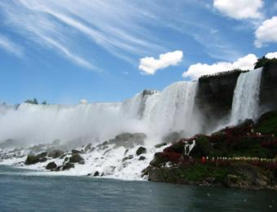
Reading
A Trip on “The True North”

Slide 3
Skimming
Skim the passage and then answer the following questions:
1) What is the passage mainly about?
It is about _____ of two girls; and it tells us some information about ______.
2) What is “The True North”?
The True North is a name of
_____________________.
a trip
Canada
the cross-Canada train

Slide 4
Read the text quickly and quietly to fill in the blanks and match the main idea of the 3 parts
Part 1
Para___
Part 2
Para___
Part 3
Paras____
What they really saw and felt after boarding the train
brief introduction of their trip
Their chat on their way to the station
1
2
3-5

Slide 5
Scanning
Scan the passage and find out characters, places and their travelling route.
Characters:
Places:
Route:
Li Daiyu liu Qian and Danny Lin
Vancouver; the Rocky Mountains; Calgary; a wheat-growing province; Thunder Bay; The Great Lakes; Toronto
Draw a travelling route on the map on P33

Slide 6

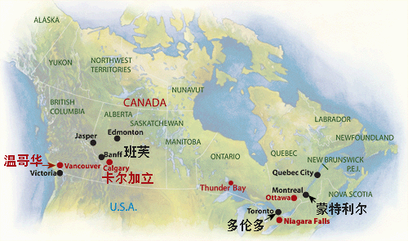
5,500km
Rocky Mountains
Atlantic Ocean
Pacific Ocean

Slide 7
Answer questions according to the passage.
1. Which continent are the cousins crossing?
They are crossing North America.

Slide 8
2. Why are they not flying directly to the Atlantic coast?
They are not flying directly to the Atlantic Coast because they want to take the train from west to east across Canada./ They want to see Canada./ They want to travel across Canada.

Slide 9
3. Why is the population of Vancouver growing so rapidly?
The population of Vancouver is growing so rapidly because it is beautiful.

Slide 10
4. What happens at the Calgary Stampede?
At the Calgary Stampede cowboys compete in riding wild horses for thousands of dollars.
5. How are ocean ships able to reach the centre of Canada?
Ships are able to reach the centre of Canada because they can follow the St Lawrence River and the Great Lakes.

Slide 11
6. What are some of Canada’s greatest natural resources?
Canada has water from its lakes and rivers and wood from its forests.

Slide 12
Basic facts about Canada
Distance from east to west coast: 5,500km
Oceans on east and west coasts: Atlantic Ocean-east; Pacific Ocean-west
Population: slightly over 30 million
Where most Canadians live: within a few hundred kilometers of the USA border
Location of largest fresh water supply: the Great Lakes

Slide 13
Key point about Vancouver:
Canada’s warmest part/Canada’s most beautiful city/some of the oldest and most beautiful forests in the world
Key point about Calgary:
famous for the Calgary Stampede
Key point about Thunder Bay:
busy port city at the top of the Great Lakes

Slide 14
If someday you go to Canada, where will you go? Why?
I am most interested in the part about Calgary. I hope to visit Calgary someday and see the Calgary Stampede. I love animals, and I think it will be very interesting to see cowboys who have a gift for riding wild horses.

Slide 15
一
二
三
四
三、阅读A TRIP ON “THE TRUE NORTH”,回答下列问题
1.Why were Li Daiyu and Liu Qian excited?
A.Because they could take a plane to Canada.
B.Because they could take a train in Canada.
C.Because they could cross the whole continent.
D.Because they could meet their friend.
2.Where was Danny Lin waiting for Li Daiyu and Liu Qian?
A.At the train station.
B.At the train station in Vancouver.
C.At the airport in Montreal.
D.At the airport in Vancouver.
答案:C
答案:D

Slide 16
一
二
三
四
3.According to the passage,how long does it take to cross Canada?
A.Two days.
B.Three days.
C.Four days.
D.Five or more than five days.
4.Where does the coast with the oldest and most beautiful forests in the world lie?
A.South of Vancouver.
B.North of Vancouver.
C.East of Vancouver.
D.West of Vancouver.
答案:D
答案:B

Slide 17
一
二
三
四
5.Which of the following statements about Canada is TRUE?
A.Canada has the largest amount of fresh water in the world.
B.Canada is empty within a few hundred kilometres of the USA border.
C.Canada is 55,000 kilometres from coast to coast.
D.All the Canadians have a gift for riding wild horses.
答案:A

Slide 18
一
二
三
四
四、根据课文内容填空
Li Daiyu and her cousin Liu Qian were on a trip to Canada 1.
(visit)their cousins.They decided to fly to Vancouver and then take the train from west to east across Canada.
Vancouver is Canada’s most beautiful city,2.
(surround)by mountains and the Pacific Ocean.3.
the train,the cousins settled 4. in their seats.When they crossed the Rocky Mountains,they managed to catch sight of some mountain goats and even a grizzly bear and an eagle.In Calgary,they learned that cowboys,many of whom had a 5.
for riding wild horses,came from all over the world to compete in the Stampede.
to visit
surrounded
Aboard
down
gift

Slide 19
一
二
三
四
days’
After two 6. (day)travel,the girls began to realize that Canada is quite empty.At school,they had learned that most Canadians live 7. a few hundred kilometres of the USA border,and that Canada’s population is only 8. (slight)over thirty million,but now they were 9. (amaze)to see such an empty country.
That night 10. they slept,the train rushed southward towards Toronto.
within
slightly
amazed
as

