Slide 1


Reading
COMMUNICATION:
NO PROBLEM?

Slide 2
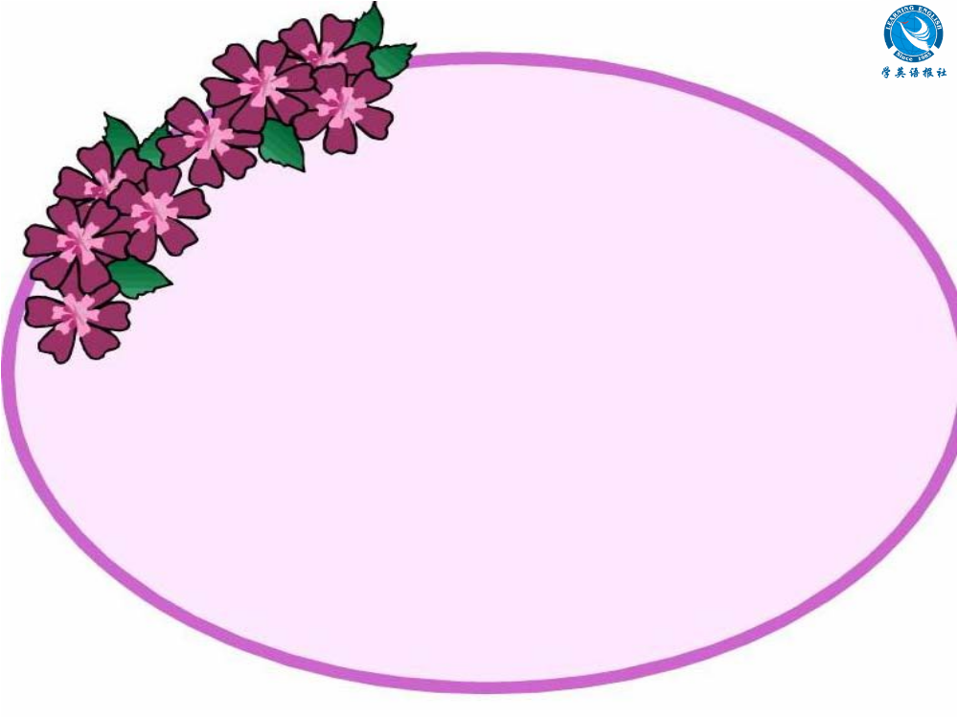
Skimming for general idea

Slide 3




Skimming
Reading Comprehension I
Choose the best answer.
Which is the main idea of the text?
A. What good or bad body language is.
B. Foreigners should follow the customs
of the country where they are visiting.
C. Some examples of cultural body language in greeting people and the importance to learn body language.
D. An unforgettable experience that the author had.

Slide 4
What is the author’s attitude towards body language?
A. optimistic and disapproving
B. interested but suspicious
C. dissatisfied and objective
D. open-minded and tolerant
Which of the following best shows the structure of the text?
①
②
①
①
①
A.
B.
C.
D.
②
③
④
③
④
②
③
④
②
③
④
⑤
⑤
⑤
⑤

Slide 5
Skimming
Reading Comprehension II
Match the main idea of each part.
Part 1.
Different people have different
body language.
(Para.1)
Part 2.
(Para. 2~3)
Summary of body language.
Part 3.
Meet the visitors at the airport.
(Para. 4)
People from different countries express greetings in different ways.
Part 4.
(Para. 5)

Slide 6

Scanning for specific information

Slide 7



Scanning
Reading Comprehension III
Englishmen often stand close to
others or touch strangers as soon
as they meet.
2. Most people around the world now
greet each other by kissing.
3. Japanese will bow to others as
greeting.

Slide 8
4. Some body languages in some
countries are good while some
countries’ body language are bad.
5. People from Jordan will move very
close to you as you introduce
yourself to them.

Slide 9
Scanning
Reading Comprehension IV
How do different international
students behave when they greet
people? Complete the chart with
information from the passage.

Slide 10
Name | Description | Body Language | To Whom
Tony Garcia |  |  | everyone
 |  | no touching
 | man from Japan
man from
Colombia
kiss on the
cheek
Julia
Smith
woman from
Britain
everyone
Akira
Nagata
bowing
everyone

Slide 11
Name | Description | Body Language | To Whom
George Cook
 |  |  | to men to women
 |  | shake hands and kiss twice on each cheek
man from
Canada
shaking
hands
everyone
Ahmed
Aziz
man from
Jordan
shaking
hands
nodding
Darlene
Coulon
woman
from
France
people she
knows

Slide 12
Scanning
Reading Comprehension V
Answer the following questions.
1 Is the author of this passage male or female? How do you know?
The author is male. Ahmed Aziz will not
shake hands with women, but he shakes
hands with the author.

Slide 13
2 What were the two mistakes that the author noticed?
He noticed that the Colombian man kissed
the British woman, but in her culture, a
kiss from a stranger is not acceptable. He
also noticed that the Japanese man bowed
just as the Canadian man started to
shake hands, so one man’s nose touched
the other man’s hand.

Slide 14
3 Who seemed to prefer to keep more physical distance from others? Who seemed to prefer closer physical distance?
The British woman, Julia, and probably
the Canadian man, George, seemed to
prefer to keep more physical distance
from others. The Colombian man, Tony,
and the Jordanian man, Ahmed, seemed
to prefer closer physical distance.

Slide 15
4 Did any students have similar greeting customs? If so, which ones?
Yes. Tony from Colombia and Darlene
from France had a similar greeting
custom – a kiss. George from Canada
and Ahmed from Jordan also had a
similar greeting custom – a handshake,
but Ahmed shakes hands only with men.

Slide 16
5 “When in Rome, do as the Romans do.” What do you think this famous saying means?
This saying means that when we are in
a certain place, we should follow the
customs of the people who live in that
place, not our own customs.

