Slide 1

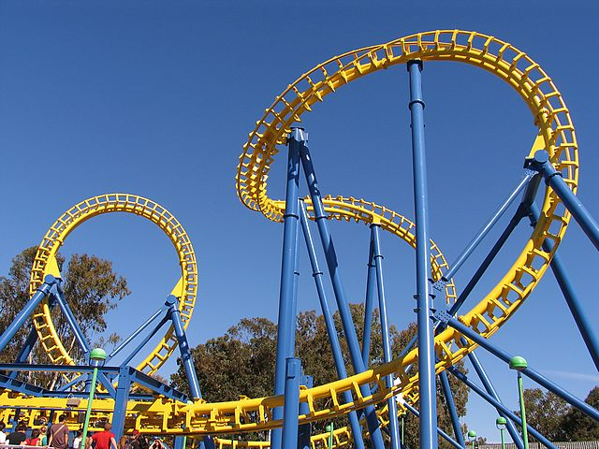
roller coaster

Slide 2
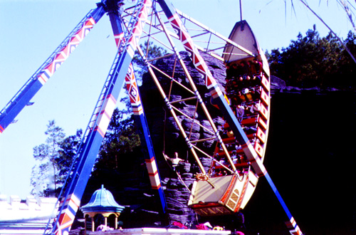
pirate ship

Slide 3
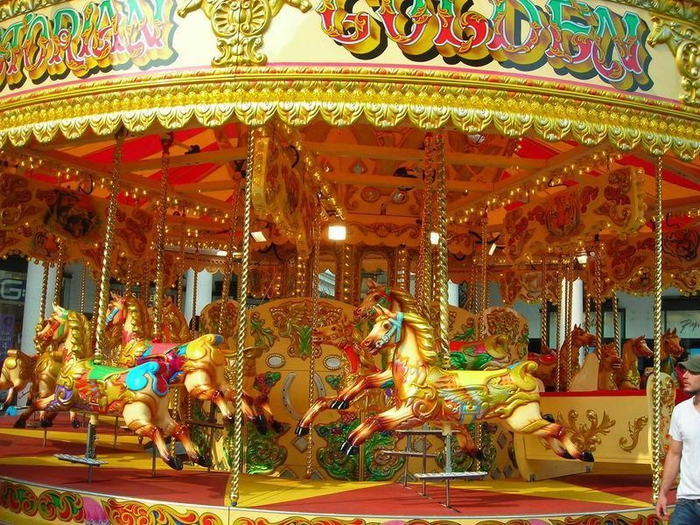
merry-go-round

Slide 4
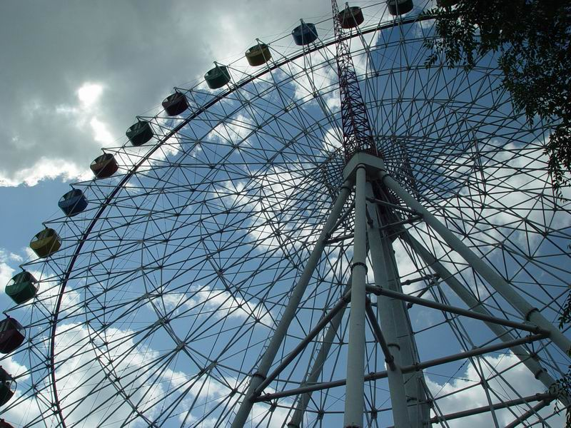
ferris wheel

Slide 5
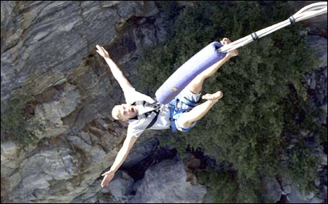
bungee jumping

Slide 6
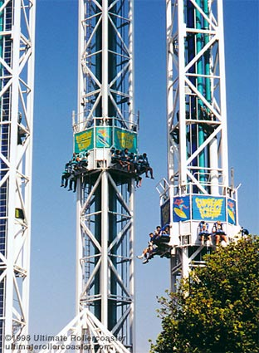
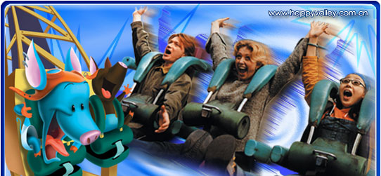

free-fall drop

Slide 7
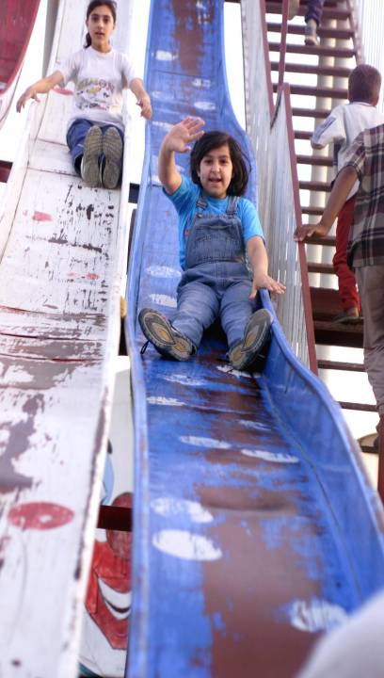
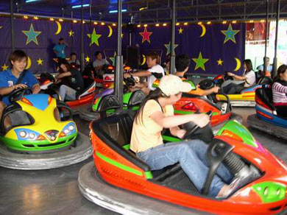
slide
bumper car

Slide 8

What are the three purposes of
the theme parks? Give examples.
to educate
to entertain
purpose
to make profits

Slide 9
to entertain
There are many rides to go on and shows to see.
to educate
Visitors can learn about history,
cultures and science.
to make profits
Admission fees are charged, extra payment is required for rides and shows, and souvenirs and brand-name items are sold.

Slide 10

The oldest and the most popular theme
park in the world is ____________.
Disneyland
In the Disneyland, people can not only enjoy the exciting activities there, but also get close to the life-size cartoon characters like the Mickey Mouse and Donald Duck, which appear in some of Walt Disney’s famous cartoon films.

Slide 11

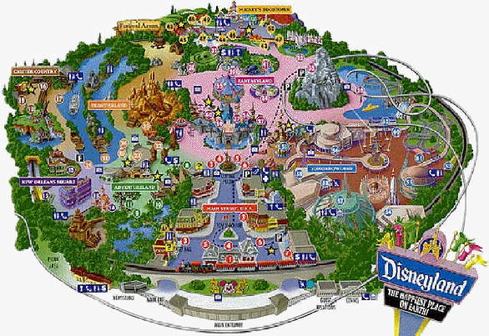

Slide 12
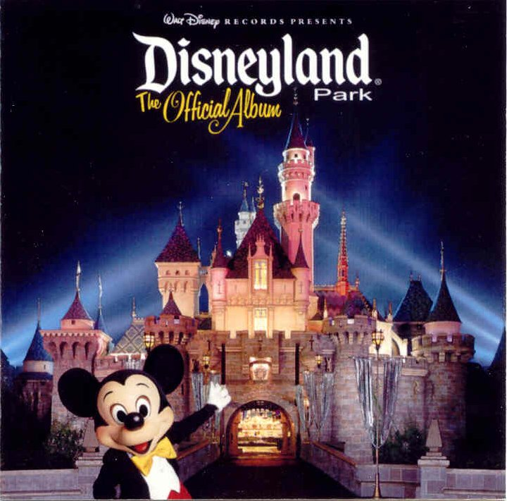
Welcome

Slide 13
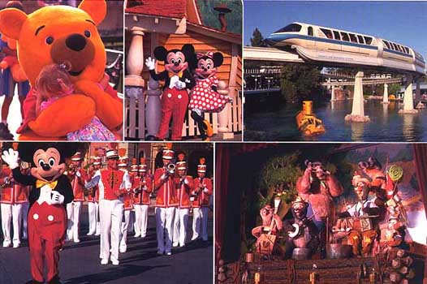

Slide 14
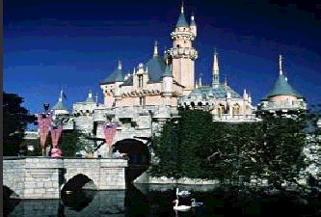
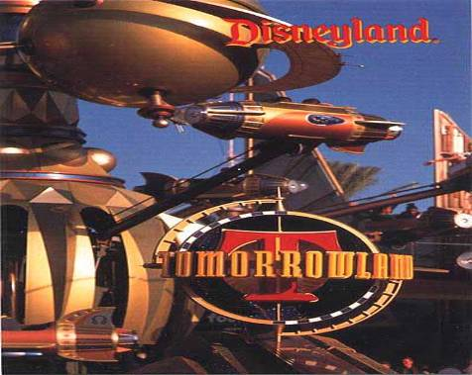
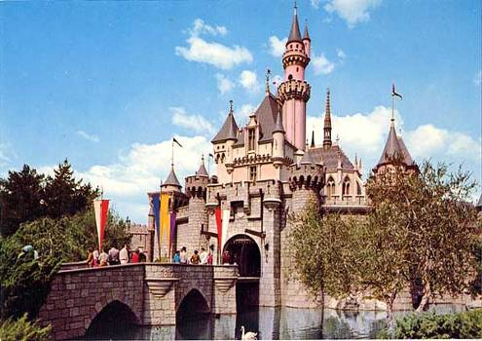
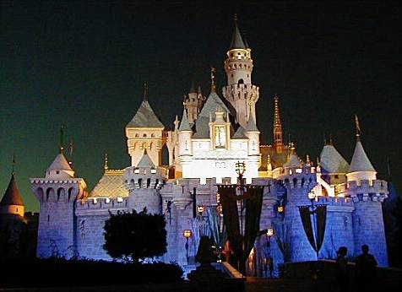

Slide 15
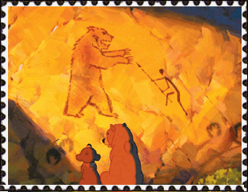
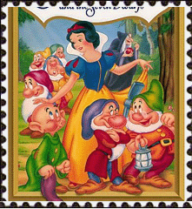
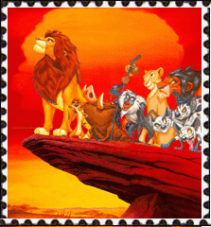
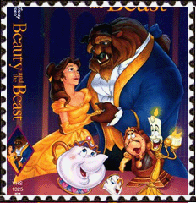
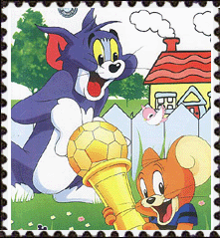

Slide 16

There are many kinds of theme parks in China.
Would you name some theme parks you know?

Slide 17
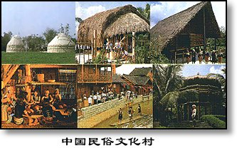
China Folk Culture Village

Slide 18
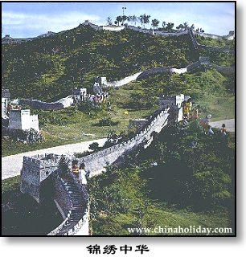
Shenzhen Splendid China

Slide 19
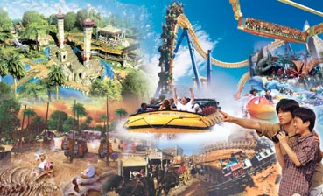
Happy Valley

Slide 20
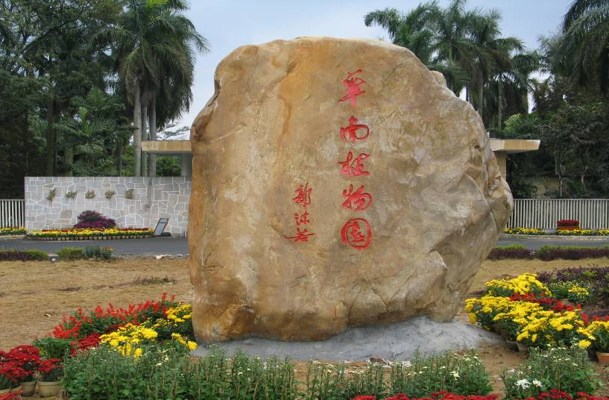
South China Botanical

