Slide 1
donation 2. mention
reunite 4. contact
5. inconvenience 6. motivate
7. financial motivation 8. greed
9. admiration 10. conversation
11. exhausted 12. approach v
13. Stream 14. deserve
15. Pretend 16. impress
17. Concerned 18. threaten
19. Surround 20. achievement

Slide 2

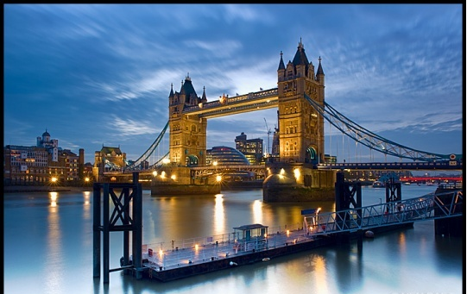
Unit 2
The United Kingdom

Slide 3

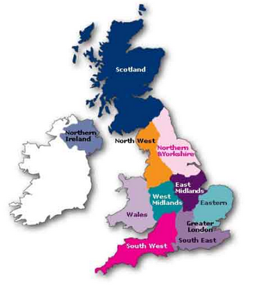
Unit 2 Reading
PUZZLES IN GEOGRAPHY

Slide 4

Mind Map
Para. 1
Introduce the topic
How the UK came into being
Para. 2
Part 1 about the UK
How the four countries work together
Para. 3
Para. 4
The geographical division of England, the similarities and differences
Part 2
about England
Para. 5-6
The cultural importance of London
Part 3
about London

Slide 5
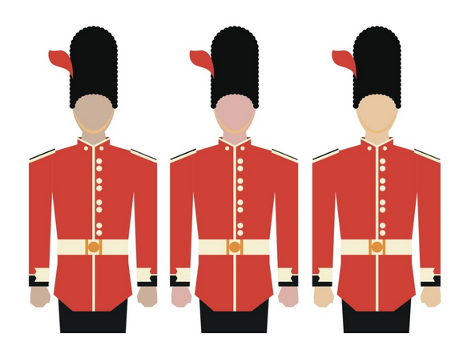
Do you know the differences among Great Britain, United Kingdom and England?

Slide 6
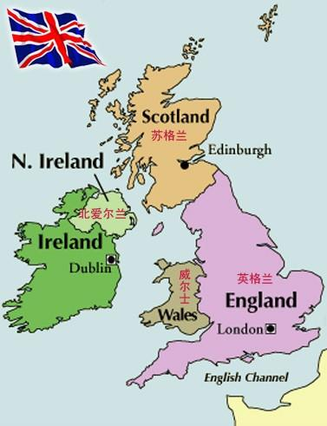
How did UK come into being?
Great Britain
Union Jack
★
Do the four countries always work together? Give some examples. Do they have different institutions? Give some examples.
  Northern Ireland joined with England, Wales and Scotland to become the UK in the early 20th century.
England and Wales were joined to Scotland in the 17th century.
First there was England.
Wales was linked to England in the 13th century.
Notes:
分析篇章结构,概括段落大意. 第一部分,通过几幅地图可以演示联合王国的形成过程.

Slide 7

★
The four countries do work together in some areas
(e.g. the currency and international relations)
★
They still have different institutions.
e.g. Northern Ireland, England and Scotland have different educational and legal systems as well as different football teams for competitions like the World Cup!

Slide 8

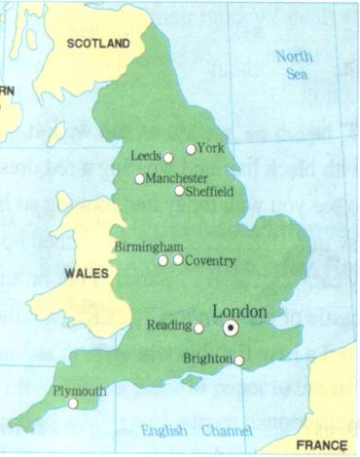
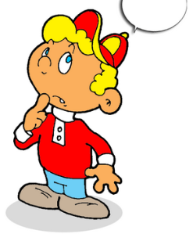
most of industrial cities
North
Midlands
South of England
York ,Leeds,
Manchester, Sheffield
The 3 zones of England
England can be divided into 3 main areas. Do you know what they are?
Birmingham,
Coventry
Reading, London,
Brighton, Plymouth
most of the population

Slide 9

Where is the centre of culture in the UK?
Give some examples.
It’s London. London has a lot of historical treasures. For example, it has the oldest port built by the Romans in the first century, the oldest building begun by the Anglo-Saxons in the 1060s and the oldest castle constructed by later Norman rulers in 1066.

Slide 10

The invaders’ influence on England
The Romans—
Anglo-Saxons—
Vikings—
Normans—
towns and roads
language and government
vocabulary and place-names of the North of England
castles and new words for food

