Slide 1

必修3

Slide 2

本课时主要是针对阅读材料中重点词汇、短语和句型的解释，教师可根据学生的预习情况来选择性讲解。为了引导学生自主学习，自行查找相关资料学习新单词，这里只针对部分词汇进行解释。
教师讲解时，建议采用归纳法，如尽可能多的呈现一些相关例句，或让学生从已学课文中找相应例句，引导学生试着从所观察到的语言现象中总结出词汇的意思和用法。

Slide 3

1. in memory of
= to the memory of sb. 纪念；追念
She set up an educational fund in memory
of her mother.
她为了纪念她母亲而设立了一个教育基金会。
We named the lake Rebecca in memory of
her.
为了纪念她, 我们把这个湖命名为“丽贝卡”。

Slide 4



Choose the best answer.
practice
Mr. Gates is now ______ the company.
If you have any questions, you can dial
the number.
in memory of B. in charge of
C. in place of D. in search of

Slide 5
盛装打扮；化妆打扮
2. dress up
Children love dressing up in Halloween.
We are supposed to dress up as movie characters for the party.
我们在晚会上要装扮得像电影中的角色。
dress
v. 穿着；打扮
She always dresses in blue.
她总穿着蓝衣服。

Slide 6
[辨析] put on, dress, wear
1) put on着重于“穿”这一动作，即由没穿到
穿这一过程的完成，意为“穿上”。如：
Please put on your new coat.
请穿上你的新大衣。
2) wear强调“穿着”这一状态，也可表示“戴
着”。如：
He’s wearing a white shirt.
他穿着一件白衬衫。

Slide 7
3) dress既可表示动作，又可表示状态，常由
人作宾语，意为“给……穿衣服”。如：
Could you dress the child for me?
你能不能替我给小孩穿上衣服?
当表示自己穿衣服时，一般用“get dressed
(=dress oneself)”. 如：
He cannot get dressed (=dress himself).
他不会自己穿衣服。

Slide 8
Choose the best answer.
practice
The mother told her daughter to ______
herself in her nicest dress.
wear C. have on
B. put on D. dress

Slide 9
n. 诡计；恶作剧；窍门
3. trick
This is another trick I encourage you to try.这是我鼓励你试一下的另一个技巧。
vt. 欺骗；诈骗
Her partner tried to trick her out of her money.
她的合伙人企图骗走她的钱。
play a trick on sb.
We played a trick on them and they fell right into it.
我们设了个圈套, 他们就正好中计。
搞恶作剧；诈骗；开玩笑

Slide 10
Translate the following sentences.
practice
The first of April is commonly known
as April Fools' Day, and it is
customarily on this day to play a trick
on a friend.
4月1日是大家都知道的“愚人节”。 这
一天通常可以拿朋友开玩笑。
2. 不要捉弄那个可怜的小男孩。
Don't play a trick on that poor little boy.

Slide 11
n. 奖；奖品；奖学金
4. award
Mary got an award and was able to finish her study.
The award for this year's best actress went to Meryl Streep.
本年度最佳女演员的得奖者是梅里尔·斯特里普。
vt. 授予；判定
award sb. sth. = award sth. to sb.
The judges awarded both teams equal points.

Slide 12
Choose the best answer.
practice
The prizes this year have been _______ to five students for their outstanding work.
A. rewarded B. awarded
C. shown D. suggested

Slide 13
5. look forward to (介词) + n / v-ing
I’m looking forward to his coming.
I’m familiar with his work and look forward to hearing his views on literary and artistic creation.
我熟悉他的作品，并期待他能就文艺创作问题发表自己的见解。
期望；期待；盼望

Slide 14
Choose the best answer.
practice
We’ve just moved into a bigger house and there’s a lot to do. Let’s _____ it.
(2010福建)
A. keep up with B. do away with
C. get down to D. look forward to

Slide 15
6. as though
as though = as if 似乎，好像
He looked at me as though I were mad.
他那样看着我，好像我是个疯子。
He treats his elder sister as though she
were a stranger.
他待他姐姐如陌生人。
She spoke to me as though she knew me.
她和我说话的神情，好像她早就认识我
似的。

Slide 16
as though引导方式状语从句，意为“好像，正如……”谓语动词多用虚拟语气。
比如：
He said that as though he had seen it.
他说的好像他亲眼看到的一样。
He behaves as though he owned the house.
他的样子好像他拥有这个房子。

Slide 17
Choose the best answer.
practice
— Look at those clouds!
— Don’t worry. ______ it rains, we’ll
still have a great time. (2012北京)
Even if B. As though
C. In case D. If only

Slide 18
重点句型
Most ancient festivals would celebrate the
end of cold weather, planting in spring and harvest in autumn.
“情态动词would+动词原形”表示过去的
习惯、习性和倾向等，常译为“总是……”。如：

Slide 19
Whenever I went to see her, my grandmother would treat me with some delicious sweets.
不管我什么时候去看她，我的外祖母总是用一些好吃的糖果来招待我。
【辨析】
“would+动词原形”与“used to+动词原形”
1. “would+动词原形”表示过去有时、偶
尔、经常或反复的动作，不能表示过去

Slide 20
的状态，常与now and then, always, every day, often等时间状语连用，往往带有一定的感情色彩，含有“有意的”、“自愿的”等含义，它所表示的行为现在是否发生，并不清楚。
2. “used to+动词原形”既可以表示过去经
常或反复的动作，也可以表示过去经常
存在的状态，但这些动作或状态现在都
已经停止，不能与now and then, always,
every day, often等时间状语连用。

Slide 21
选词填空：would, used to
practice
There ________ be a private school in
what is now a factory.
2. My friend _________ shout at me
whenever he couldn’t find his pen.
used to
would

Slide 22

Tips for teacher
Let the word fly 板块是帮助学生学习一些一词多义、熟词生义的词汇。通过此环节，学生可以对一些常见词的用法、意思有一个全面的了解。在翻译过程中体会词汇使用的丰富多彩。

Slide 23



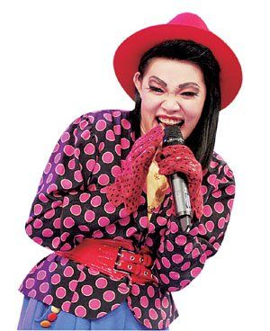
Let the word fly
Never bend your head. Always hold it high. Look the world straight in the eye.
~~~ Helen Keller
不要低垂着头。你要昂起头来，正视这个世界。
hold住

Slide 24
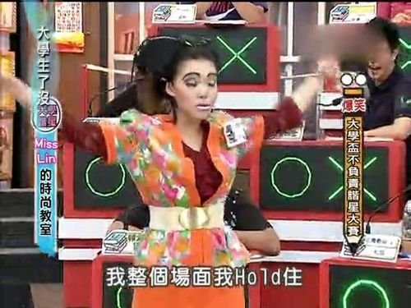

hold

Slide 25
hold
及物动词 vt.
He held a knife in his hand.
他手里握着一把刀。
握着
The roof was held up by pillars.
屋顶由柱子支撑着。
托住；支承
She held herself erect.
她把身子挺直。
使保持某种姿态等
The highjackers held two women hostage.
劫机者扣留两名妇女作人质。
拘留，扣留

Slide 26
Jim was able to hold back his anger and avoid a fight.
抑制，约束
吉姆忍住了怒气，避免了一场斗殴。
He holds much property in the town.
他在镇上拥有很多地产。
拥有，握有，持有
The box can hold all my clothes.
这箱子能装下我的全部衣服。
容纳；包含
She holds the same view.
她持有同样的看法。
认为；持有(见解等)

Slide 27
They will hold a meeting to discuss this problem tomorrow.
他们明天将开会讨论这个问题。
举行
不及物动词 vi.
I hope this beautiful weather will hold.
我希望这种好天气将持续下去。
持续，保持
My decision still holds.
我的决定仍然有效。
有效，适用
名词 n.
He's got a good hold of his subject.
他很好地掌握了自己的学科。
掌握；支配(力)

Slide 28

活学活用
从上面给出的例句中我们可以看到hold的含义很丰富，不仅仅表示一般的“握”。大家还知道哪些与hold相关的口语表达或短语呢？请选择几个
进行造句或对话练习。

Slide 29
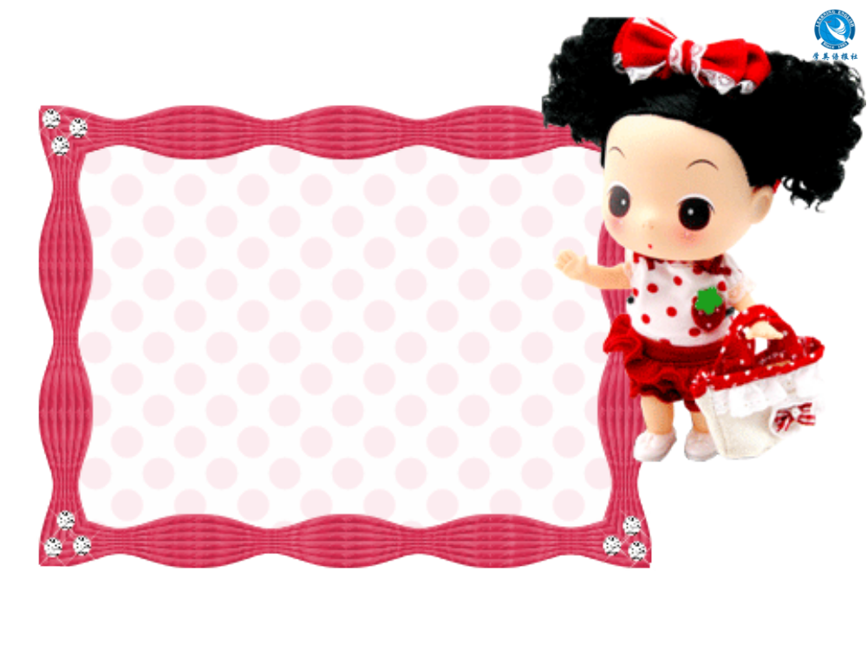


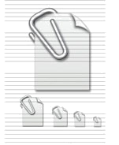
注: 另附 word 文档。
点击此处链接
Individual activity

Slide 30
I. Choose the best answer.
John is very ______ —— if he promises to do something he’ll do it. (2009浙江)
A. independent B. confident
C. reliable D. flexible
You are old enough to _____ your own living. (2011辽宁)
A. win B. gain
C. take D. earn

Slide 31
II. Complete the following sentences with
proper words.
1. Don’t send the man any money — it
might be a ________ (诡计).
2. Mexico gained its in___________ from
Spain in l821.
3. Each morning, a group of elderly women
______ (聚集) at the park singing songs.
4. Many of his ideas have g______ popular
support.
5. “I think I’d like something less
e________,” said the old man.
trick
dependence
gather
ained
nergetic

Slide 32
6. The timely ________ (arrive) of the
teacher prevented the situation from
becoming worse.
7. It is my ______ (believe) that we will find
a cure for cancer in the next ten years.
8. A wedding is an occasion for c_________.
9. She has been __________ (award) a
scholarship to study at Harvard.
10. We ________(钦佩) him for his
righteousness (正直).
arrival
belief
elebration
awarded
admire

Slide 33
III. Translate the following sentences.
people would starve
At that time _________________ (人们就
会挨饿) if food was difficult to find,
especially during the cold winter months.
2. For the Japanese festival Obon, ______
______________________ (人们要扫墓)
and light incense ____________ (纪念)
their ancestors.
3. At the Spring Festival in China, people eat
dumplings, fish and meat and may ____
___________________ (给孩子们压岁钱).
people
should go to clean graves
in memory of
give
children lucky money

Slide 34
4. Several days later, the rich man ________
_______________ (决定去捉弄) Avanty.
5. The girls all ________________________
(打扮好去参加) the New Year’s party.
6. My mother nursed me ________________
__________ (三天三夜).
7. He likes to talk big __________________
_______________ (就仿佛他是一位要人
似的).
decided
to play a trick on
dressed up to take part in
day and night for
three days
as though he was an
important person

Slide 35
8. We _______________________________
(期待着春天的到来).
9. Let’s ____________ (玩得开心) friends
and do some shopping!
10. We have enough _____________ (引以
为豪).
look forward to the return of spring
have fun with
to be proud of

Slide 36

Thank you!

