Slide 1
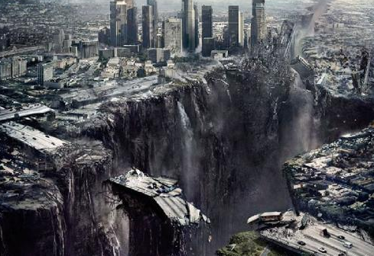
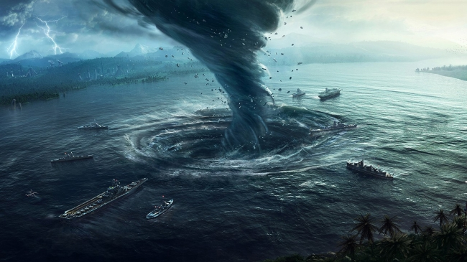
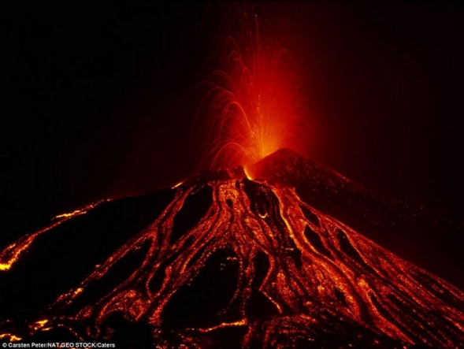
The power of nature

Slide 2
Hurricane
Typhoon
Tornado
Cyclone
Snowstorm
The power of nature
Sandstorm
Landslide
Hailstorm
Volcano
Flood
Tsunami
Earthquake

Slide 3
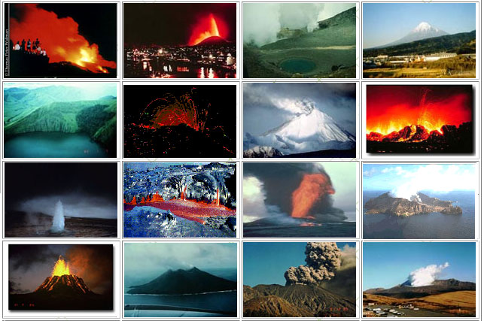
Have you ever seen a volcano?

Slide 4
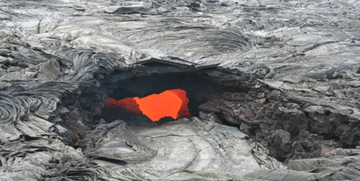
The Kilauea volcano
The Kilauea volcano in Hawaii is perhaps the most active volcano in the world; it is recorded that there’s an eruption almost every four years.

Slide 5
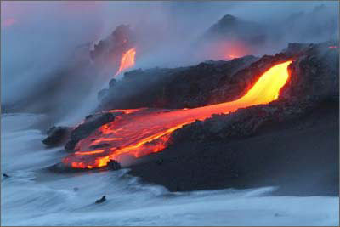
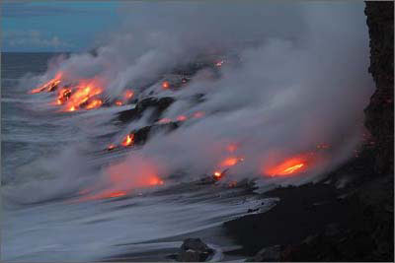
2004年6月2日，夏威夷的基拉韦厄活火山(Kilauea caldera)喷出熔岩。

Slide 6
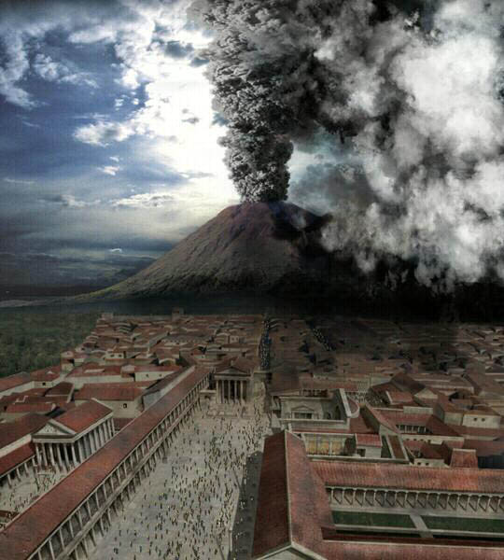
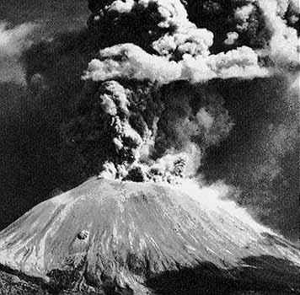
维苏威火山 (Vesuvius)，意大利乃至全世界最著名的火山之一，海拔高度1281米。 维苏威火山在历史上多次喷发，最为著名的一次是公元79年的大规模喷发，灼热的火山碎屑流毁灭了当时极为繁华的拥有2万人口的庞贝古城。

Slide 7
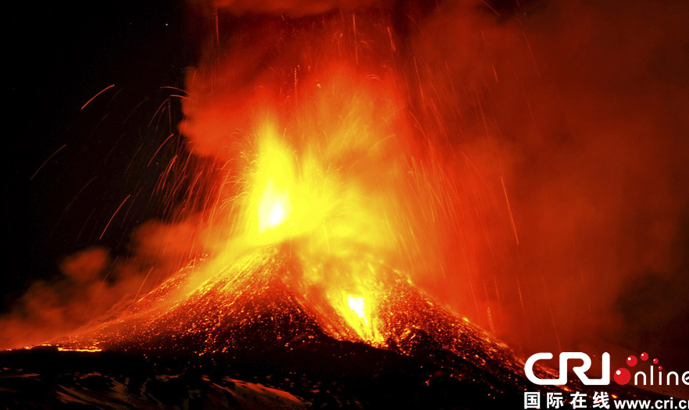
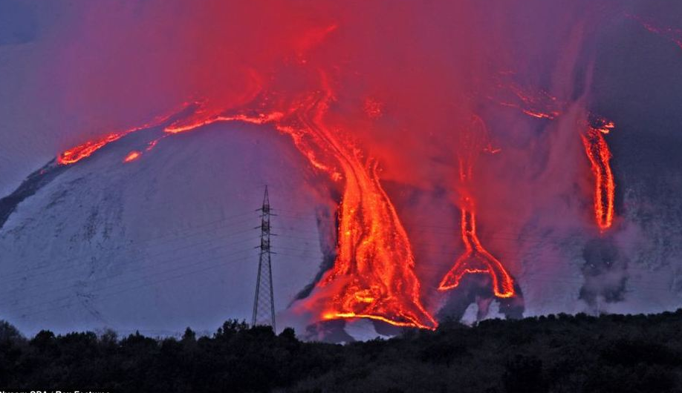
埃特纳火山，意大利西西里岛东岸活火山。其名来自希腊语Atine（意为“我燃烧了”）。为欧洲最高活火山。海拔3,200公尺以上，和其他活火山一样，其高度各个时期变化不同。2013年11月16日，埃特纳火山再次爆发，喷发出大量红色的岩浆。

Slide 8
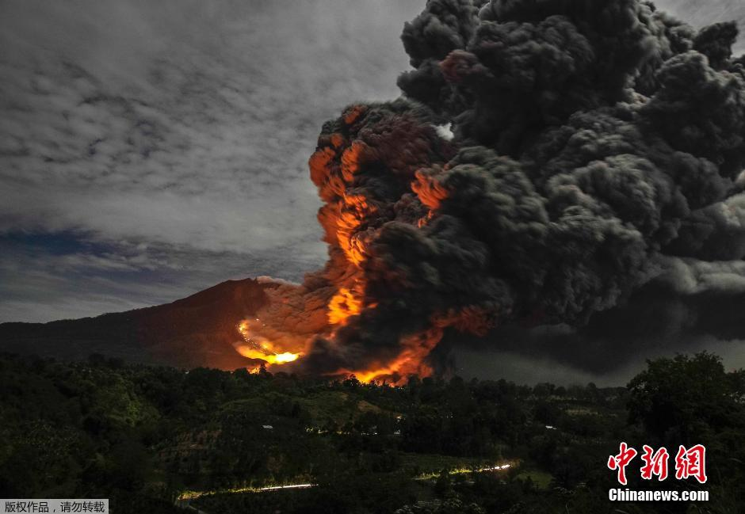
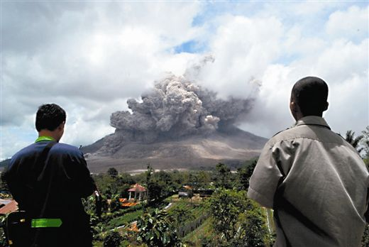
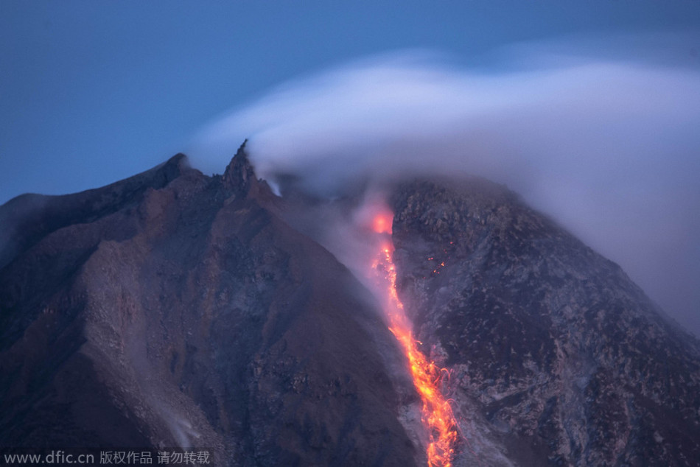
当地时间2014年10月6日，位于印尼苏门答腊岛卡罗区的锡纳朋火山喷发。当地政府称，受锡纳朋火山喷发影响，火山周围区域的数百居民被转移安置。锡纳朋火山位于印尼北苏门答腊省卡罗县境内，是印尼129座活火山之一，今年2月份的一次喷发造成17人丧生。图为当地居民眺望锡纳朋火山喷出浓烟和火山灰。

Slide 9
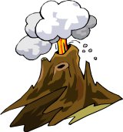
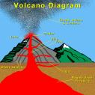
Ash cloud/volcanic ash
Crater
volcano eruption
Lava
Boiling rock erupts from the crater;
the lava flows slowly down the mountain.
Magma chamber

Slide 10
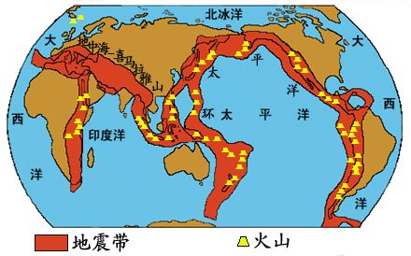
Where is it most possible for a
volcano to erupt?
Near the oceans.

Slide 11
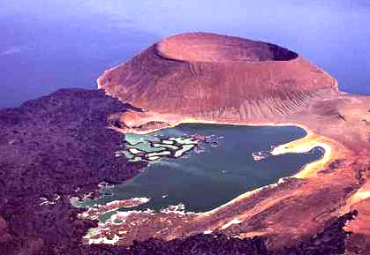
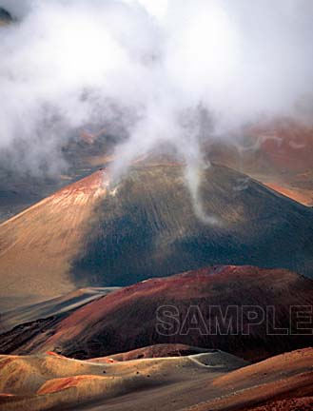
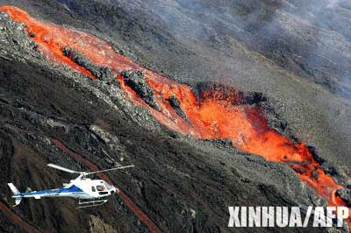
3. What types of volcanoes do you know?
An extinct volcano
A dormant volcano
An active volcano

Slide 12

Using Language
Listen to Part 1.
Listen to three volcanologists talking
about their most frightening experience.

Slide 13

Listen again and fill in the blanks.
Part 1
Hi, I’m Jane Small. I’ve been a volcanologist for ____ years, but I can still remember my first visit ______ a crater. We were on top of an ______ volcano in Alaska. The experienced ________ of our group went immediately to the _____ of the crater. I was so ________ and couldn’t
five
inside
active
members
edge
anxious

Slide 14
move at first. After a while I _______ myself to join the others. Then I got the _______ to bend over the boiling lava and collect a _______. I became so excited that I forgot my ______. After that, I was never so frightened again but I’m always ________.
forced
courage
sample
fear
careful

Slide 15

Listen to Part 2.

Slide 16
Listen again and fill in the blanks.
Part 2
Hello, I’m Frank Gore. I’ve been studying volcanoes for almost ____ years. My most frightening experience was while _______ over a volcano in Hawaii. ________, the clouds came down really low and our _____ couldn’t tell where we were. We flew down _____ the clouds
ten
flying
Suddenly
pilot
below

Slide 17
very close to the volcano. We flew ________ the fiery red lava below and the thick _______ clouds above. I felt very ________ and had to force myself not to ______. I had never felt so happy as I landed ______.
between
dark
nervous
panic
safely

Slide 18
Listen to Part 3.

Slide 19
Listen again and fill in the blanks.
Part 3
Good morning! I’m Sarah Tang. I’ve been _________ volcanoes for over ________ years. I’ll never forget the __________ experience I had on a volcano in New Zealand. I was _______ the crater taking
measurements. Suddenly the _______ under my feet began to tremble.
examining
twenty
amazing
down
ground

Slide 20
The trembling got stronger and stronger
and after a minute some _____ blew out of the ground. That’s when I realized that the volcano was ______. Believe me I was trembling as _____ as the ground, and was ________ too! At first I was afraid that the volcano would ______ while I was still inside it! After that I became ______ by the experience and forgot to be __________.
steam
active
much
sweating
erupt
excited
frightened

