Slide 1


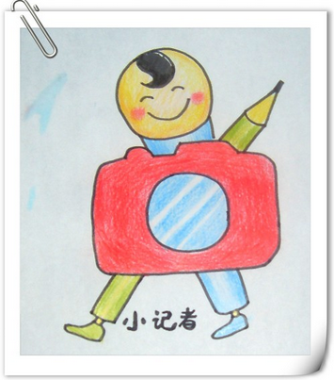
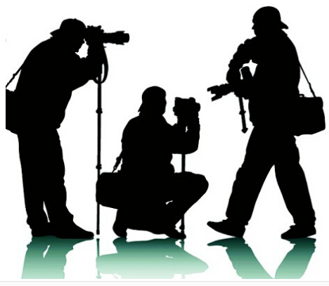
Unit 4
Making the news

Slide 2
Introduction
The separation of powers:
Executive (government and police)
Legislative (parliament)
Judicial (court)
What is the fourth power?

Slide 3
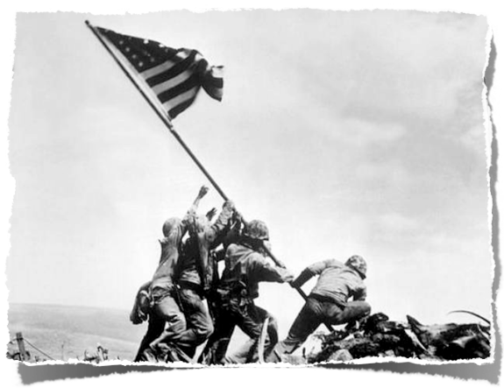
News Media

Slide 4
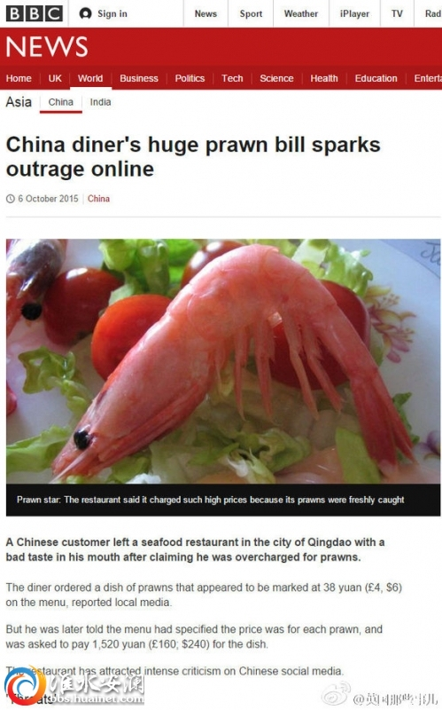

Slide 5
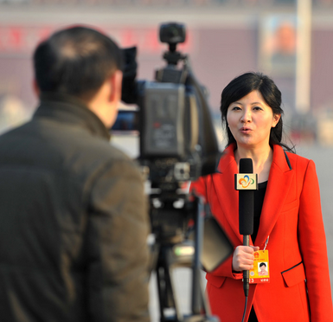
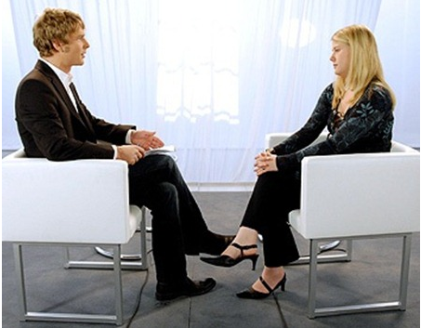
What do they do?
reporter/journalist

Slide 6
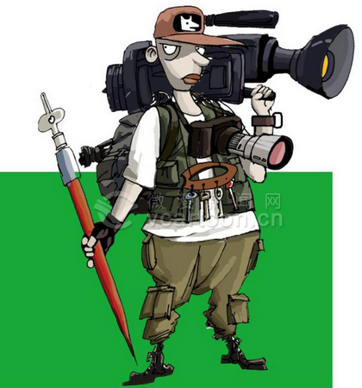
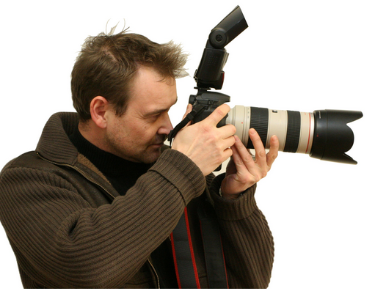
photographer

Slide 7
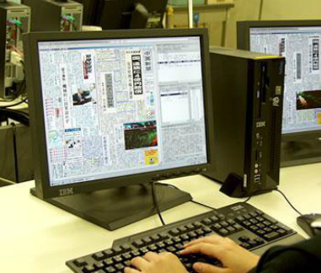
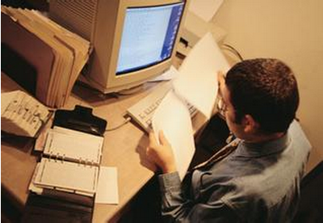
editor

Slide 8
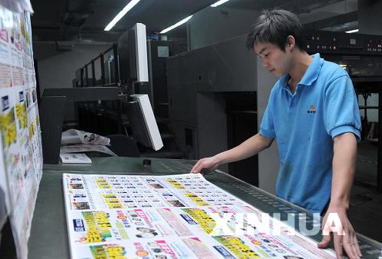
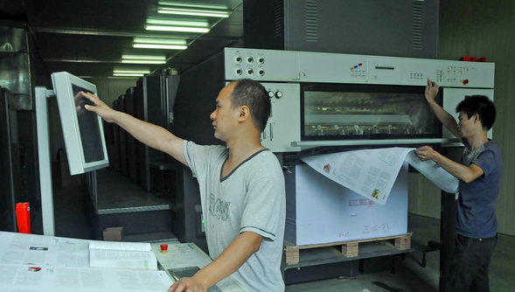
printer

Slide 9
Different kinds of jobs needed for making newspapers
journalist 记者
designer 排版员
painter 美术编辑
printer 印刷员
critic 评论员
cartoonist 漫画师
chief editor 主编
deputy editor 副主编
sub-editor 助理编辑
editor 编辑
photographer 摄影师
correspondent 通讯员

Slide 10
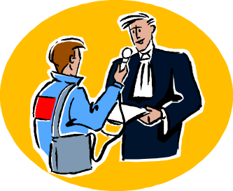
Discuss in pairs and fill in the chart below.
Types of jobs | What it involves
journalist
editor
finding out news and telling
people about it in
newspaper or on TV/radio
making sure the writing is clear, concise and accurate; checking facts

Slide 11
photographer
taking photographs of important people or events
designer
laying out the articles and photographs
printer
printing the newspaper

Slide 12
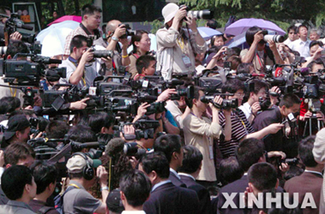
Do you know how to make the news? What is the process?

Slide 13
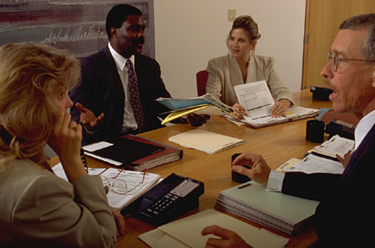
Every morning the newspaper chief editor holds a meeting with the journalists to discuss the main events.

Slide 14
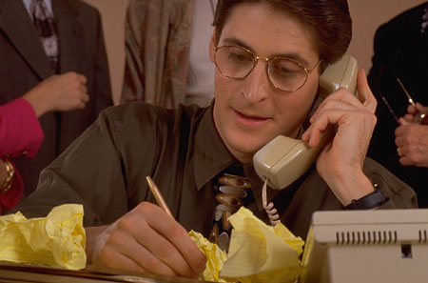
Reporters are sent to do face-to-face interviews or do telephone interviews.

Slide 15
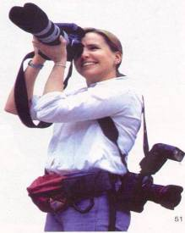
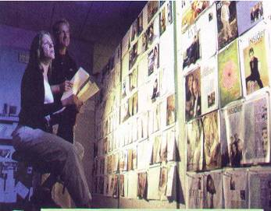
Photographers are sent to take the pictures.
Doing one’s homework — looking up information they need.

Slide 16
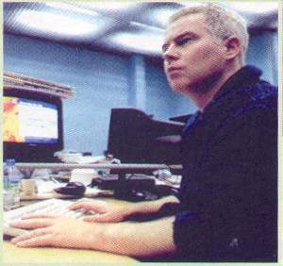
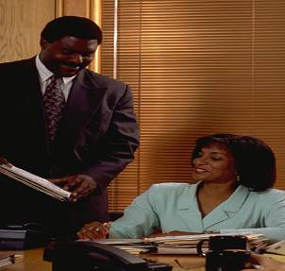
Reporters type their stories into the computer.
The stories are quickly handed to the editor.

Slide 17
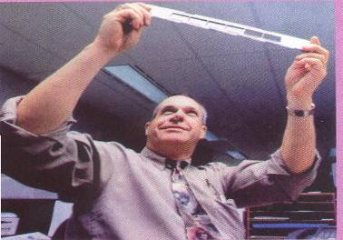
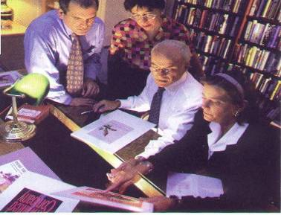
Photos are quickly developed.
Editors decide which picture should be used and read some stories and make any necessary changes.

Slide 18
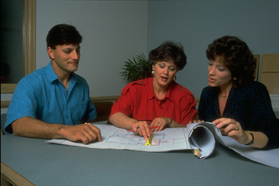
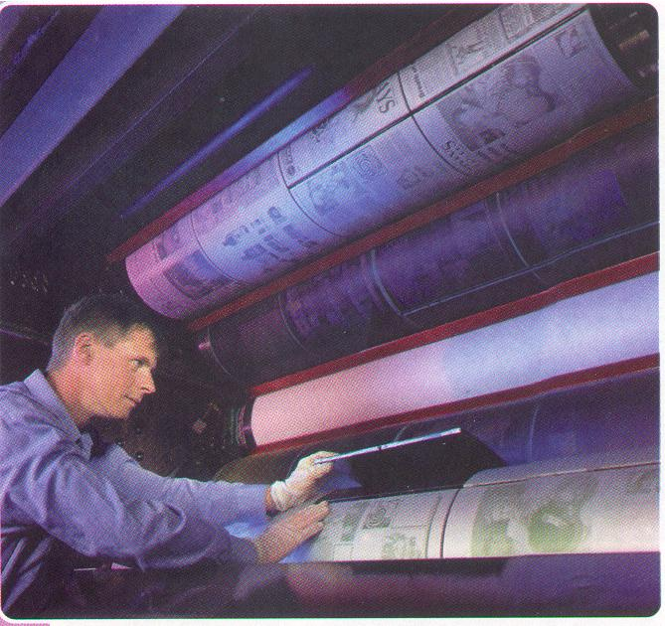
Editors write the headlines for each story and check that there is enough space.
Newspapers are printed on fast-moving printing machines.

Slide 19
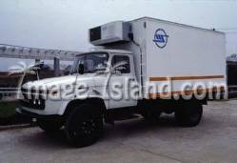
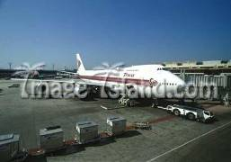
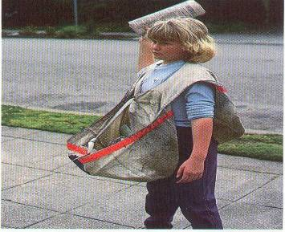
Newspapers are delivered by train or plane.
Newspapers are sent to every home.

Slide 20
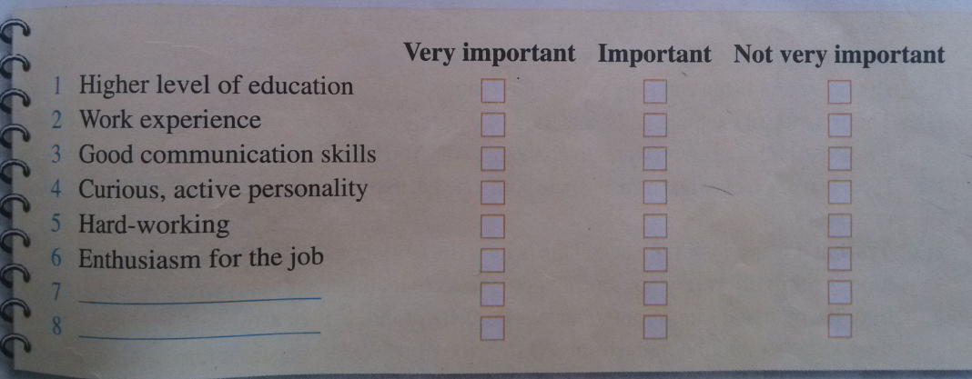
p25 1
What are the qualities a good journalist needs to have? Discuss in groups and tick the boxes below. Please add more qualities if you like.

