Slide 1
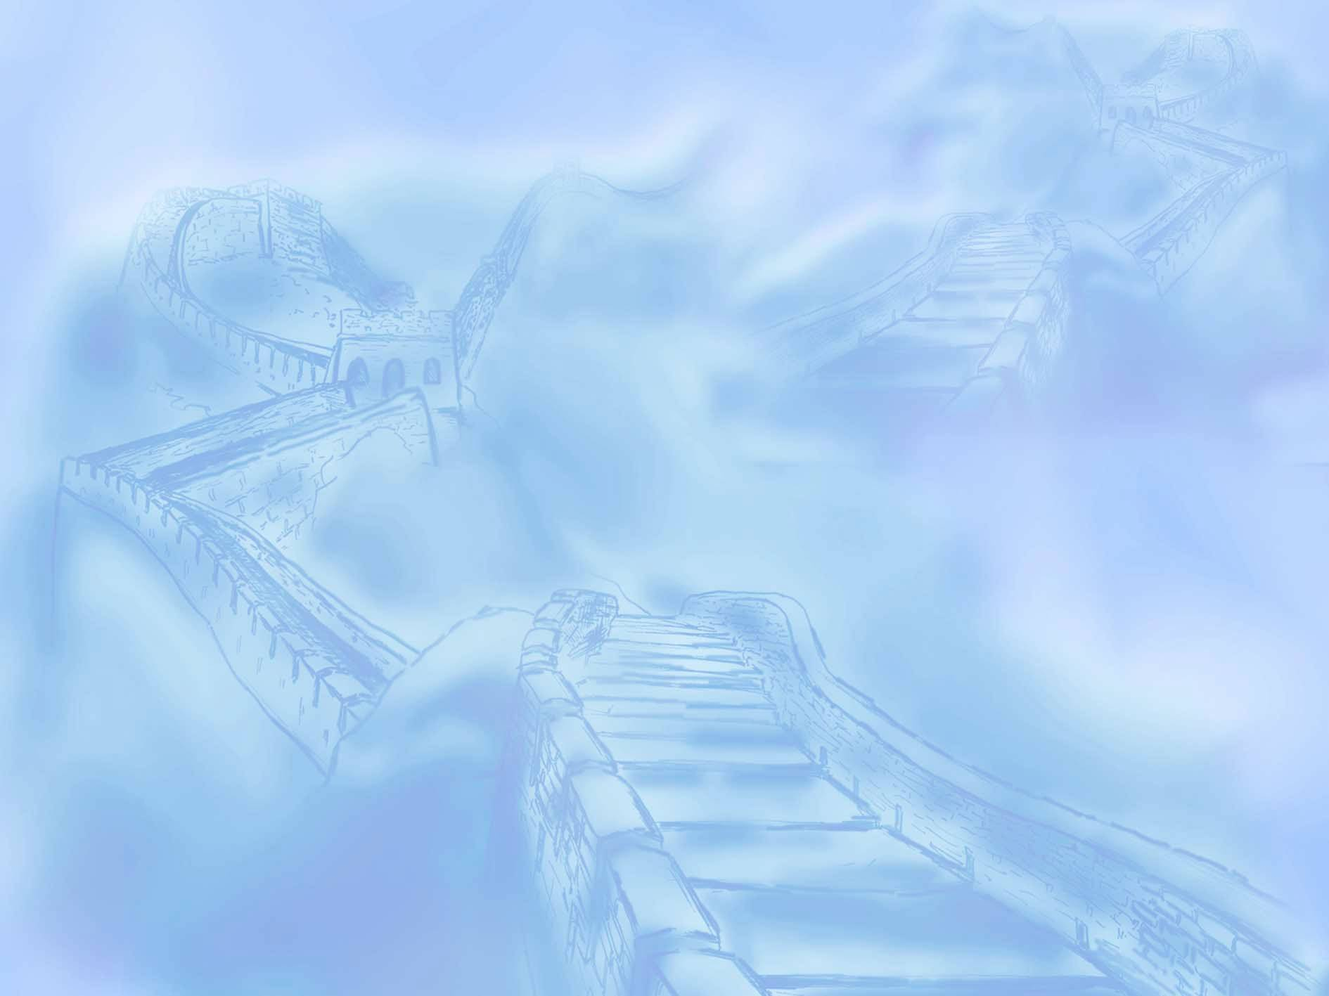
倒装句
句装倒
inversions
英语句子的自然顺序是主语在前,谓语在后（主语+谓语）。把谓语动词放在主语之前（谓语+主语）,就叫倒装结构。如果全部谓语放在主语之前, 叫全部倒装; 如果只把助动词或be 动词放在主语之前就叫部分倒装。

Slide 2
基本语序（natural order）：
主语+谓语+宾语（subject + predicate+ object）
I love English.
完全倒装 (full inversion)
谓语+主语
Here came the headmaster.
部分倒装 (partial inversion)
助动词/情态动词+ 主语 + 动词
Nerve will I forgive you.

Slide 3

一、完全倒装
1. There be结构。另外,在此结构中可以用来代替be动词的动词有:exist, seem, happen, appear, live, stand等。
There stood a dog before him.
There exist different opinions on this question.
例题:
________ a beautiful palace ________ the foot of the hill.
A. There stand; at B. There stands; under
C. Stands there; under D. There stands; at

Slide 4
Once there lived a king who cared more about new clothes than anything else
There stands a high mountain in the middle of the woods.
There exist some misunderstandings between them
There seems no need to wait longer.
There appear to be many unexplored matters.
There happened to be a taxi at the roadside.

Slide 5
2 (1).在以here、there、now、then等副词开头的句子里。 句式：副词＋vi＋名词主语
“Here, There, Now, Then + come (或be,go,lie,run) + 主语" 结构。
Here comes the old lady!
Then came the hour we had been looking forward to.
Now comes your turn.
Here comes the bus.
There goes the bell.
There goes the last train.
Then followed eight years of the Anti-Japanese War.
Thus ended the Second World War .
如果主语是人称代词,主语和谓语语序不变，不用倒装。
如:Here you are.
There she comes.

Slide 6
(2). 表示方向的副词out, in, up, down等置于句首,要用全部倒装。如果主语是人称代词,就不用倒装。如:
In came Mr. White.
Up went the arrow into the air.
Away went the boy.
Out rushed the students
Down came the hammer and out flew the sparks

Slide 7

3.当表示地点的介词词组(如on the wall, under the tree, in front of the house, in the middle of the room等)在句首时。
句式：介词短语＋vi＋主语（必须是名词）
如：At the foot of the hill lies a beautiful lake.
East of the lake lie two towns.
Under the tree was lying a wounded soldier.
By either side of the river grow a lot of apple trees .
At the top of the mountain stands a temple .
Among the goods are Christmas trees, flowers and toys.
注意：在上述句子中，如果主语为人称代词，则主、谓不需要倒装。
In he came and back he went again.

Slide 8

4.谓语是be, 表语提前时，整个句子需倒装，即：“表语 + 系动词 + 主语”。 进行时态也可这样。
eg. 1)Present at the meeting are some famous scientists.
2)Gone are the days when we used the foreign oil.
Seated on the ground are a group of young people.
3)Hanging on the wall is Tom's Jacket.
Lying on the floor was a boy.
Standing beside the desk was a teacher.
Walking at the head of the line was our teacher.
4)Such is Mr. Smith.
Such is human nature.

Slide 9
巩固练习 单项填空
1.Out _____, with a stick in his hand.
A. did he rush B. rushed he C. he rushed D. he did rush
2.In front of the farmhouse ______.
A. lay a peasant boy B. laid a peasant boy
C. a peasant lay D. did a peasant boy lie
3. —Where is your brother? —There ______.
A. he is coming B. he comes C. comes he D. does he come
4.Nearby _____ in which they had spent their summer vacation.
A. was two houses B. two houses were
C. were two houses D. are two houses
5. Look,________.
A. here the bus comes B. here is the bus coming
C. here comes the bus D. here the bus is coming
he rushed
lay a peasant boy
he comes
were two houses
here is the bus coming

Slide 10
巩固练习 单项填空
6.On the wall ______ two large pictures.
A. hangs B. hang C. hanged D. are hanging
7.Such ______ the results of the experiments.
A. is B. was C. are D. as be
8.In _______ and the lesson began.
A. he came B. came he C. he comes D. comes he
9. Hearing the cat coming, off_____.
A. fled all the mice B. away fled the mice
C. all the mice fled away D. fleeing all the mice
10. —Where is Kate? —Look，_____, she is at the school gate.
A. there she is B. there is she
C. here you are D. here it is
hang
are
he comes
fled all the mice
there she is

Slide 11

二、部分倒装
部分倒装是把be动词、情态动词、助动词放到主语之前。如果句子中没有这些词,要在主语之前加助动词do / does / did等,而把原来的谓语动词变成原形放在主语之后。

Slide 12
否定词或半否定词(never ,little ,seldom ,not ,nowhere ,scarcely ,few ,by no means ,at no time, in no case )位于句首,应部分倒装
1.Never have I been there . Hardly/ Scarcely can I remember him.
2.Little did I know about it . Rarely did he lie.
3.Seldom did she come late to school .
4.Not a single mistake did he make .
5.By no means should you buy that kind of car .
In no way can you go out school without permission.
In no case can you copy others’ homework.
At no time should you give up studying.
6.Nowhere else can you find such a beautiful park .

Slide 13
以not until ,no sooner …than , neither…nor, hardly …when ,not only …but also 所引导的状语放在句首时,需要部分倒装
1.Not until 10’clock will the library open .
2.No sooner had I gone out than he came to see me .
3.Hardly had the train arrived when I ran to meet my friend.
4.Not only does she speak English but also she follows the British way of life .
5. Neither do I know her name，nor does he.

Slide 14


1) Hardly ____ the airport when the plane took off.
A. I had arrived at B. had I arrived
C. had I reached D. I had got to
2) —Have you ever seen anything like that before?
—No, _____ anything like that before.
A. I never have seen B. never I have seen C. never have I seen D. I have seen
3) She is not fond of cooking, ____ I.
A. so am B. nor am C. neither D. nor do

Slide 15
2. Only + 状语（副词/ 介词短语/ 状语从句），位于句首 ,要部分倒装。
Only by this means is it possible to explain it.
Only in this way, can we solve the problem.
Only then did I realize the importance of math. Only when the war was over in 1918 was he able to get
happily back to work.
Only if you ask many questions, will you acquire all
the information.
注意：① 在only＋状语从句＋主句结构中，主句倒装， 但从句用正常语序。
②only修饰主语，不倒装。
Only his brother was right .

Slide 16
3.So\such…that 句型中，以so\such 开头的句子中，主句要部分倒装
1.So loudly did he speak that even people in the next room could hear him .
2.So small were the words that he could hardly see them .
3.Such an interesting film was it that we were all deeply moved .
5.So polite is the boy that everyone likes him.
6.Such a polite boy is he that everyone likes him.

Slide 17
4、as/ though (虽然，尽管）引导的让步状语从句。
句式：名词\形容词\副词\动词\分词+as\though+主语+其他
如:
Although I am ugly, I am gentle.
Ugly as I am, I am gentle.
Though he is a child, he has to make a living.
Child as he is, he has to make a living.
注意：从句的表语是名词，其名词前不加任何冠词

Slide 18


5.用于So/neither (nor) + be ( have, 助动词或情态动词) + 主语+其他的句子
He has been to Beijing. So have I.
Tom can’t answer the question. Neither /Nor can I .
I have never been to Guangzhou University, neither/ nor has he.

Slide 19
6.在虚拟语气条件句中从句谓语动词有were, had, should等词，可将if 省略，把 were, had, should 移到主语之前，采取部分倒装。
（1）If I were you, I would work hard.
Were I you, I would work hard.
（2) If it should rain tomorrow, we would put off our meeting.
Should it rain tomorrow, we would put
off our meeting
注意：我们可以说Were it not...或者Had it not been..., 但不可以说Weren’ t it... 或者hadn’t it been...

Slide 20
7.句首是表频率的副词及短语（often, well, many a time, now and again,, once a week, now and then, every other day 等) 开头的句子中,要用部分倒装结构。
如: Many a time has John given me good advice.
Often have we made that test.
题： Many a time ________ swimming alone.
A. the boy went B. went the boy
C. did the boy go D. did go the boy

Slide 21

8,在某些表示祝愿的句型中
如：May you all be happy.
Long live China!

Slide 22
1._________ forget the days when he lived in the countryside .
A.Never I shall B.Never shall I
C.I never shall D.Never do I shall
2.Little ____ to get such a warm welcome .
A.did I expect B.I expected
C.I did expect D.was I expect
3._________ ,I would have phoned you .
A.If I know it B.Had I known it
C.If I knew it D.Did I know it
4.Not until he had taken to them __________ he had been wrong .
A.did he realized B.he realized
C.did he realized D.he didn’t realize

Slide 23
5.I’ve not been to Shanghai. _________.
A. Neither has my wife B. Neither hasn’t my wife
C. Nor is my wife D. My wife hasn’t, too.
6.“Do you know Jim quarreled with his brother?” “I don’t know, ________.”
A. nor don’t I care B. nor do I care
C. I don’t’ care neither D. I don’t care also
7. There ______ life on the moon.
A. has not B. has not any C. is not D. is no
8.Now _____ your turn to recite the text.
A. there is B. there comes C. comes D. has come

Slide 24
9._______, Mother will wait for him to have dinner together.
A. However late is he B. However late he is
C. However is he late D. However he is late
. 10.——David has made great progress recently.
——_________, and _________.
A. So he has; so you have B. So he has; so have you
C. So has he; so have you D. So has he; so you have
. 11.Not a single song _____ at yesterday’s party.
A. she sang B. sang she C. did she sing D. she did sing

