Slide 1
Unit 5
First Aid

Slide 2


What is first aid?
First aid is a temporary form of help given to someone who suddenly falls ill or gets injured before a doctor can be found.

Slide 3
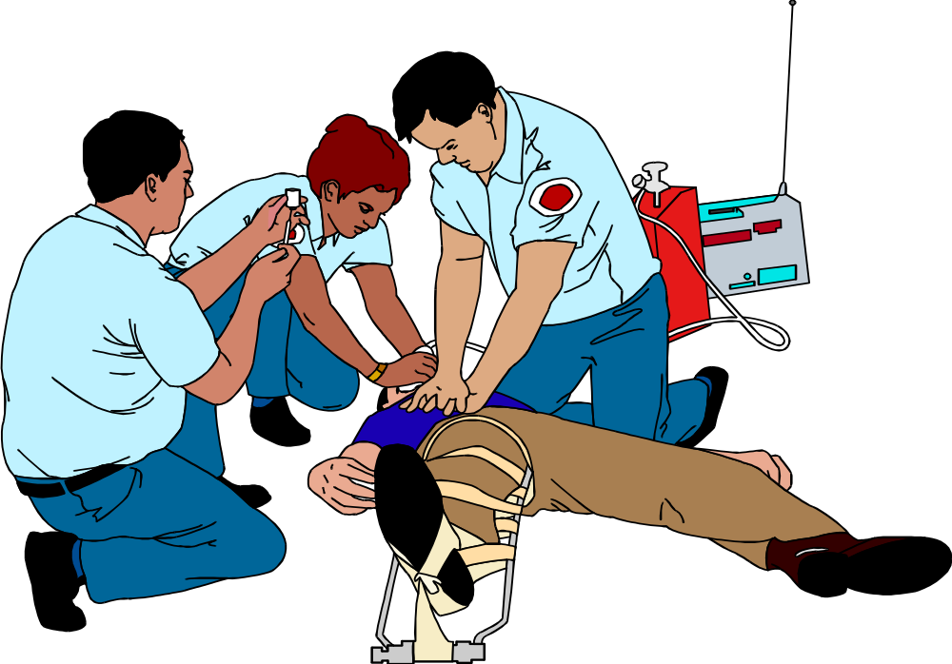

First Aid Quiz

Slide 4
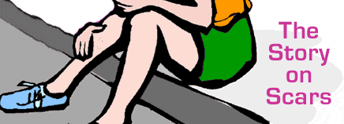

The best way to treat a sprained ankle is to __________.
A. put an ice pack on your ankle
B. put a heating pad (垫子) around your
ankle
C. keep on walking and jumping

Slide 5
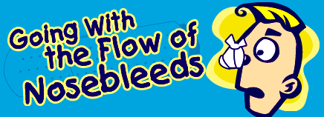
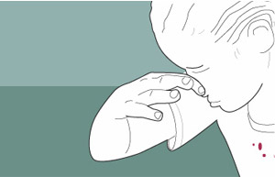
2. If you get a nosebleed, gently let your
head back to stop the bleeding.
A. True.
B. False.
This may make blood run down the throat and induce vomiting.

Slide 6
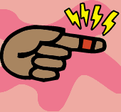
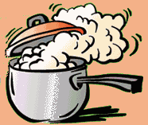
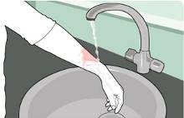
3. To treat a burn, you should _______.
A. rub (擦) some butter on it
B. hold the burnt part under cold
running water
C. put salt on the burnt part

Slide 7
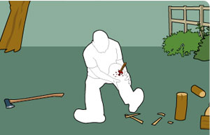
4. What will you do first for the casualty
(伤者)?
A. Remove the wood from his leg as
soon as possible.
B. Stop the bleeding
C. Get him to hospital straight away

Slide 8
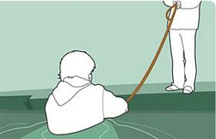
5. If someone is drowning and calling for
help, which of the following is your priorities?
A. Jump in the water to rescue them.
B. Throw them a line from the bank.
C. Wait for an ambulance to arrive.
Jumping in the water to rescue them may put you at risk. You should throw them a line from a bank as this ensures that you don't become a casualty yourself.

Slide 9

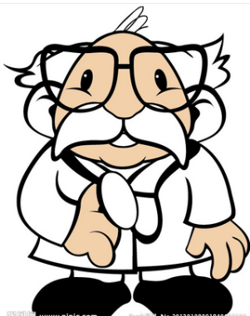
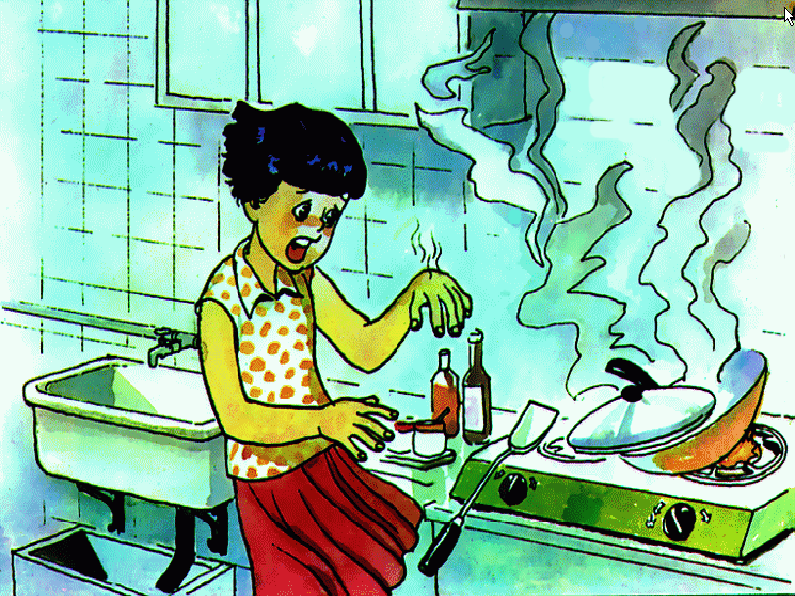
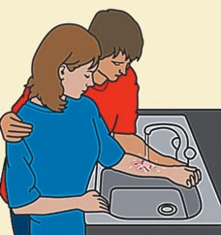
Unit 5 Reading
FIRST AID FOR BURNS

Slide 10
1.the functions of the skin
2.how we get burns
3.the three types of burns
4.the symptoms of burns
5.what to do if someone gets burned

Slide 11


Functions of skin
1.Act as ________
1.Keep us ___________.
2.Prevent us from __________.
3.Give us the ____________.
a barrier
warm or cool
losing water
sense of touch
www.themegallery.com

Slide 12
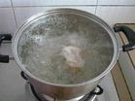
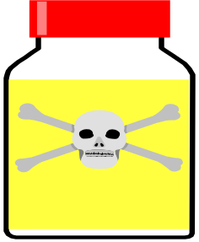
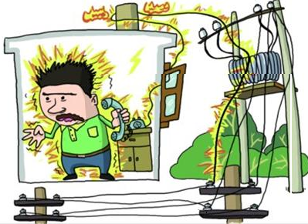


Causes of burns
hot liquids
steam
chemicals
radiation
electricity
www.themegallery.com

Slide 13



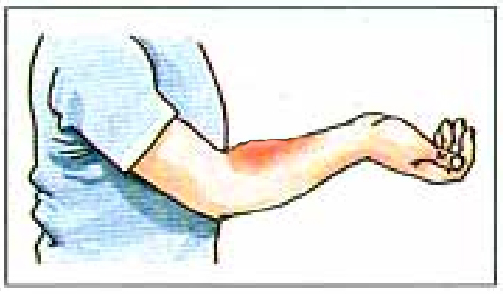


Types
Characteristics of burns
first degree burns
black, white,
charred
A
the top and the second layer
second degree burns
red, swollen
blisters,
top layer
B
third degree burns
mildly swollen
C
all the three layers

Slide 14
First aid treatment
Dos
________ clothing and jewellery near the burn.
_____ burns immediately with cool but not icy water.
______ cool, clean wet cloths on the burns.
____ the burned area gently.
Take off
Cool
Place
Dry

Slide 15
Dos
5. ______ the burned area with a dry
clean bandage.
6. If burns are on arms or legs, _____ the
burned area ______ than the heart, if
possible. If burns are on the face, the
victim should ______.
7. _____ the victim ___ the doctor or
hospital at once, if the injuries are
second or third degree burns.
Cover
keep
higher
sit up
Get
to

Slide 16
Don'ts
Do not _______ the clothing that is
stuck to the burns.
2. Do not cool the burns with _____ water.
3. Do not put cold water on _____ degree burns.
4. Do not ____ the burns, it will break the blisters.
5. Do not ____ butter, oil, ointment on burns.
remove
icy
third
rub
put

Slide 17
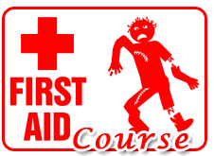
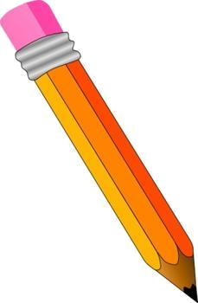
Solving problems

Slide 18

Sam knocked over a kettle full of boiling water onto his legs. His legs became red, swollen and covered with blisters.
Mrs. Black’s sleeve(袖子) caught fire while she was cooking. Her arm looked terrible but it didn’t hurt. The skin was charred.
How to deal with the situations?

Slide 19
完形填空：
Seventeen-year-old teenager, John Janson, was honoured at the Lifesaver Awards last night in Rivertown for giving lifesaving first aid on his neighbour after a shocking knife attack.
John was presented with his __1___ at a ceremony which recognized the bravery of ten people who had saved the life of another.
John was studying in his room ___2__ he heard screaming. When he and his father __3__ outside, a man ran __4__ the scene. They discovered that Anne Slade, mother of three, had been stabbed ___5___with a knife.
A. reward B. award C. prize D. Payment
A. when B. as C. while D. Meanwhile
A. wandered B. went C. rushed D. Followed
A. into B. out C. from D. Around
A. unexpectedly B. worriedly C. repeatedly D. excitedly

Slide 20
She was lying in her front garden bleeding very heavily. Her hands had almost been cut __6__.
__7__ was John's quick action and knowledge of first aid that saved Ms Slade's life. He immediately asked a number of nearby people for bandages, ___8__ when nobody could put their hands on any, his father got some tea towels and tape from their house. John used these to treat the most severe injuries to Ms Slade's hands. He slowed the bleeding by pressing to the wounds ___9__ the police and ambulance arrived.
6. A. out B. down C. off D. in
7. A. there B. this C. it D. that
8. A. so B. but C. therefore D. thus
9. A. until B. while C. when D. after

Slide 21
"I'm proud of what I did but I was just doing what I'd been __10___," John said. John had taken part in the Young Lifesaver Scheme at his high school. When congratulating John, Mr Alan Southerton, Director of the Young Lifesaver Scheme said, "There is no _11__ that John's quick thinking and the first aid___12___he learned at school saved Ms Slade's life. It shows that a knowledge of first aid can make a real difference."
Before _____ their awards last night, John and the nine ____ Life Savers attended a special ______ yesterday hosted by the Prime Minister.
A. arranged B. informed C. taught D. ordered
A. wonder B. question C. doubt D. excuse
A. methods B. solutions C. skills D. treats
A. fetching B. receiving C. carrying D. showing
A. another B. others C. other D. the other
A. acceptance B. meeting C. interview D. reception

Slide 22
语法填空： John was presented 1 his award at a ceremony which recognized the bravery of ten people who had saved the life of another. John was studying in the room 2 he heard screaming. When he and his father rushed outside, a man ran from 3 scene. They discovered that Anne Slade, mother of three, had been cut 4 (repeat) with a knife. She was lying in her front garden 5 (bleed) very heavily. Her hands had almost been cut 6 . It was John’s quick action and knowledge that saved Ms Slade’s life. He immediately asked many people 7 bandages, but when nobody could put 8 hands on any, his father got some tea towels and tape from their house. John used these to treat the most severe injuries to Ms Slade’s hands. He slowed the bleeding by applying pressure 9 the wounds until the police and the ambulance arrived. “I’m proud of what I did, but I was just doing what I 10 (teach),” John said.

