Slide 1
Unit 5 The power of nature
——大自然的力量

Slide 2
[高频短语]
1．_________________ 前往
2．_______________ 匆匆看一遍
3．_______________ 由……到……不等
4．____________ 生产;产生
5．____________________ 与……相比
6．_________________ 保护……免受……伤害
7．___________________ 被委派为……
8．______________________ 全部焚毁
9．___________________ 即将做某事;马上就要做某事
10．__________查阅,参考,指的是
make one’s way
glance through
vary from...to...
give birth to
be compared with...
protect...from...
be appointed as...
burn to the ground
be about to do sth.
refer to

Slide 3
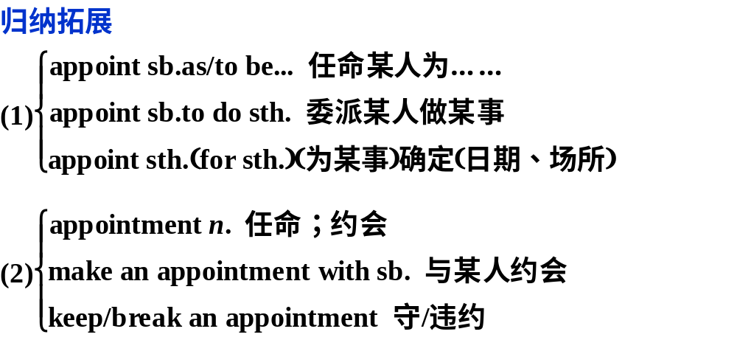
考点串讲讲练互动
[单词精研]
1.appoint vt. 约定;指定(时间、地点等),任命;委任
(牛津P₈₂)They have appointed a new headmaster at my son’s school. 我儿子读书的学校任命了一位新校长。

Slide 4
①It is out of question that he will be appointed Chief Engineer of the railway.
毫无疑问,他将被任命为那条铁路的总工程师。
②I have the pleasure of announcing the news that she has been appointed as the new Sales Manager at Head Office.
我很高兴地宣布这个消息,她已被任命为总公司的新的销
售经理。
③(牛津P₈₂)She made an appointment for her son to see the doctor.她为儿子约定了看医生的时间。

Slide 5
2.suit n. 一套外衣;套装 vt. 适合;使适宜
(牛津P₂₀₂₂)If you want to go by bus, that suits me fine.
要是你想坐公共汽车,那对我也合适。
归纳拓展
(1)suit sb. 适合某人
suit one’s needs 适合需要
(2)a suit of clothes 一套衣服
(3)suitable adj. 适当的;相配的
be suitable for sb./sth. 适合于某人/某物
be suitable to do sth. 适合做某事

Slide 6
①A good teacher suits his lesson to the age of his pupils.
一位优秀的老师应使他讲的课适合学生的年龄。
②I asked a young lady if she had seen a little boy in a grey suit.我问一位年轻女子她是否看见一个穿灰色外套的小男孩。
③kind of accommodation offers an independent lifestyle and is more suitable for the long­stay student.这种住宿方式提供独立的生活方式,它更适合于长期居住的学生。

Slide 7
[易混辨析] suit,match,fit
suit | 多指合乎需要、口味、性格、条件、地位、场合、颜色、款式等。
match | 多指色调、形状、性质等方面的搭配。
fit | 多指大小、形状的合适。

Slide 8
[巧思妙解]
用suit,match,fit填空
(1)Her shoes ____________ her dress;they look very well together.
(2)It is almost impossible to find a time that __________ everybody.
(3)The colour of this pair of shoes __________ me very well,but it doesn’t fit me.
match
suits
suits

Slide 9
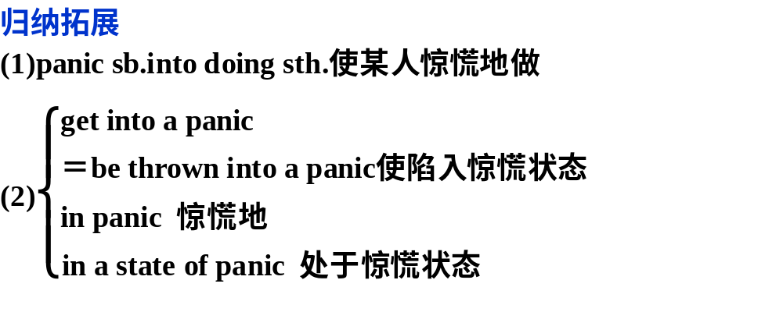
3.panic vi.& vt.(使人或动物)受惊;惊慌(过去式与过去分词都为panicked;现在分词为panicking) n. 惊慌;恐慌
(教材P₃₈)I felt very nervous and had to force myself not to panic. 我非常紧张,不得不强迫自己不要惊慌。

Slide 10
①Shoppers are panicked into buying things they don’t need.购物者因恐慌,抢购一些他们并不需要的东西。
②I panicked when I saw smoke coming out of the engine.
我看见发动机冒烟时,吓得手足无措．
③She got into a real panic when she thought she’d lost the ticket.她十分惊慌,以为自己已把入场券丢了。
④The audience were thrown into a panic when the fire started.一发生火灾,观众顿时陷入一片慌乱之中。

Slide 11
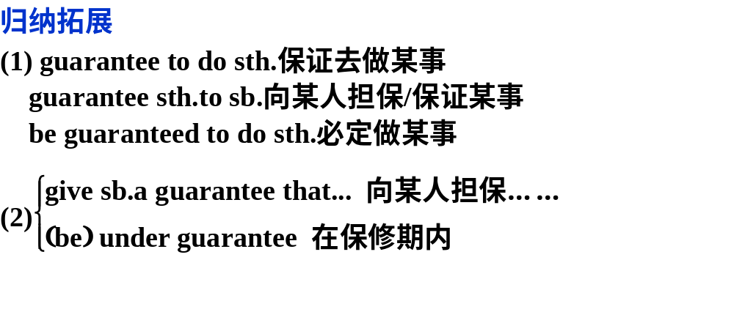
4.guarantee vt. 保证……免受损失或伤害;担保
n. 保证;保证书
(朗文P₉₁₉)Even if you complete your training,I can’t guarantee you a job.
即使你接受完培训,我也不能担保你会有工作。

Slide 12
①(朗文P₉₁₉)The plan would guarantee health care to all Americans.
这项计划将保证所有美国人都能享受医疗保健服务。
②(朗文P₉₁₉)Going out with friends is guaranteed to cheer you up.和朋友一起出去玩肯定会让你高兴起来。
③(朗文P₉₁₉)Can you give me a guarantee that the work will be finished on time?
你能向我保证工作会按时完成吗？

Slide 13
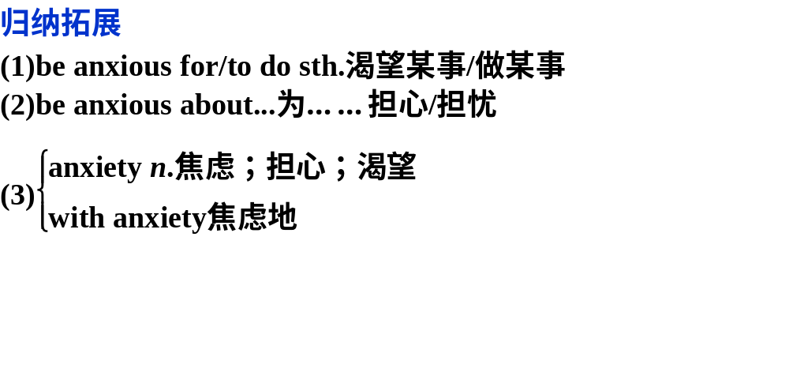
5.anxious adj.忧虑的,不安的
(教材P₃₈)I was so anxious and couldn’t move at first.
我非常担心,一开始吓得动弹不得。

Slide 14
①My mother always gets a bit anxious if we don’t arrive when we say we will.如果我们不能在我们所说的时间到达,母亲总是有点焦虑。
②(牛津P₇₅)She was anxious to finish school and get a job.她渴望毕业找份工作。
③I felt anxious about/was anxious about his safety when I heard the news of the train accident.
当我听到火车事故的消息时,我很担心他的安全。
④(牛津P₇₅)If you are worried about your health, share your anxieties with your doctor.
你要是担心自己的健康,就把自己的忧虑告诉医生吧。

Slide 15
[跟踪训练]
Ⅰ.完成句子
1．Small business owners ________________ (惶恐不安)over whether they will survive.
2．Buying a train ticket two days ahead of time will usually ___________________________(保证你有个好座位)．
3．We must ________________________(任命一位新老师)at once to the mountain school.
are in a panic
guarantee you a good seat
appoint a new teacher

Slide 16
4．It is reported that there are plenty of graduates ________________(渴求工作)．
5．It’s still________________(在保修期内),so the company will have it repaired.
6．—How about eight o’clock outside the cinema?
—That________(适合)me fine.
anxious for work
under guarantee
suits

Slide 17
1 . Tommy, run！Be quick！The house is on fire！” the mother
shouted, with __________ clearly in her voice.
A．anger B．rudeness C．regret D．Panic
2. He’s been working hard and has made great progress in his field.
—No wonder he was ______ president of the local hospital so soon.
A．appointed B．Claimed C．classified D．rewarded
3.—Lucy, read this book. I _______that you’ll be fond of it.
—OK. I’ll read it after I have finished my homework.
A．order B．Guarantee C．prove D. reveal
4．As far as I know, you can’t ________him in the knowledge of wild plants.
A. fit B. match C. suit D. get
5．He wants very much to go to college, but he is ________ about
not passing the entrance examination.
A．eager B．anxious C．patient D. worrying

Slide 18
[短语精释]
1.make one’s way 前往;获得成功
(教材P₃₅)It was not easy to walk in these suits, but we slowly made our way to the edge of the crater and looked down into the red, boiling centre.
穿着这些衣服走起路来实在不容易,但我们还是缓缓往火山口的边缘走去,并且向下看到了红红的沸腾的中央。

Slide 19
归纳拓展
fight one’s way 奋力前进
lose one’s way 迷路
feel one’s way 摸索前进
force one’s way 强行前进;挤出去
push one’s way 挤出来

Slide 20
①The passengers on the bus watched with sympathy as Susan made her way carefully up the steps.
当苏珊小心走上楼梯时,车上的乘客们都同情地看着她。
②We managed to make our way through the excited crowd.我们奋力地从激动的人群中挤了出来。
③I’m glad that he makes his way in his career.
我很高兴他在事业上有所进步。
④He felt his way across the room when the lights went out.当灯熄灭时他摸索着走过房间。

Slide 21
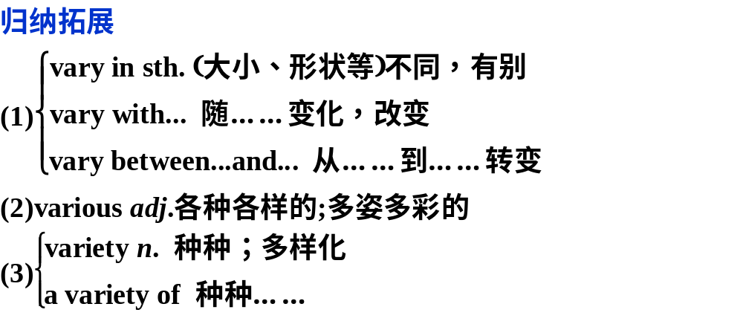
2.vary from...to... 由……到……不等
(教材P₃₉)The land varies in height from 700 metres above sea level to over 2,000 metres and is home to a great diversity of rare plants and animals. 这里地面的高度由海拔700米到2 000多米不等,是多种多样的珍稀动植物的生长地。

Slide 22
1.That her health varies from good to rather weak worries her
family a lot.她的身体有时很好,有时又比较虚弱, 这让家人很是
担忧。
2.Tail meat can be purchased fresh or frozen, with prices varying
with the time of season and supply.
市场上有新鲜或冷冻的尾肉可供购买,价格随季节和供应情况而
变动。
3.It is obvious that the hopes, goals, fears and desires vary
widely between men and women, between the rich and the poor.
4.Some guests arrived late at the party for a variety of/various
reasons.

Slide 23
[跟踪训练]
Ⅰ.完成句子
1．Finally she turned round and,slowly began to________________(前往)back towards the house.
2．The famous hotel on the corner had__________________
_______________(全部焚毁)before police arrived.
3．There was no moonlight outside.They had to__________________________(在黑暗中摸索)．
4．Opinions on this matter ___________________________
(人人观点不一)．
5．Many a large business __________________(已被建立) from a smaller one.
make her way
been burnt down
to the ground
feel their way in the dark
vary from person to person
has been built up

Slide 24
[典型句式]
1．现在分词的完成时作状语
①___________________ and evaluated the information, I help other scientists to predict where lava from the volcano will flow next and how fast.
收集和评估这些信息之后,我就帮助其他科学家一起预测熔岩接着将往何处流,流速是多少。
②__________________ volcanoes now for many years,I am still amazed at their beauty as well as their potential to cause great damage.我现在已经从事火山研究多年了,但我仍然惊羡于它们的美丽以及它们潜在的巨大破坏性。
Having collected
Having studied

Slide 25
2．be about to...when...正要做……这时……
I _________________go back to sleep _________suddenly my bedroom became as bright as day.
我刚要再睡,突然我的卧室亮如白昼。
3．“being ＋ 名词”型的独立主格结构
The other two climbed down into the crater to collect some lava for later study,but this_________________________,
I stayed at the top and watched them.
另外两人爬下火山口去收集供日后研究用的岩浆,我是第一次经历这样的事,所以留在山顶上观察他们。
was about to
when
being my first experience

Slide 26
4．it is/was said that...据说……
_____________this boy, who had a great gift for languages and persuasion, is the father of the Manchu people.
据说这个男孩就是满族人的祖先,他具有语言天赋和很强的说服力。
5．compared with/to与……相比
Have you ever considered how weak humans are _______________a volcano, hurricane or earthquake？
你有没有想过,与火山、飓风和地震相比起来,人类是多么软弱呢？
It is said that
compared with

Slide 27
归纳拓展
It is thought that... 人们认为……
It is believed that... 人们相信……
It is hoped that... 人们希望……
It is reported that... 据报道……
It is well-known that... 众所周知……
It is generally considered that... 大家认为……
It is supposed that... 据推测

Slide 28
2.(教材P₃₄)Having collected and evaluated the information, I help other scientists to predict where lava from the volcano will flow next and how fast.
[句法分析]
having collected and evaluated the information是现在分词的完成式在句中作状语,表明从句动作发生在主句动作之前。
①Having answered the teacher’s questions, she sat down and felt much more relaxed.
回答完老师的问题后,她坐下来,感到轻松多了。
②______(separate)from other continents for millions of years, Australia has many plants and animals not found anywhere else in the world.
由于与其他的大洲分离了几百万年了,澳大利亚有许多在世界上其他地方都找不到的动植物。

Slide 29
③ _____(give)better attention, the flowers could have grown better.要是照看得好一点,这些花会长得更好。
④_____(see) the photo, he couldn’t help thinking of his good old days.看到那张照片,他禁不住想起了美好的往昔。

Slide 30
3.(教材P₃₅)The other two climbed down into the crater to collect some lava for later study, but this being my first experience, I stayed at the top and watched them.
另外两人攀下火山口去收集供日后研究用的岩浆,我是第一次经历这样的事,所以留在山顶上观察他们。
[句法分析]
this being my first experience 是独立主格结构。其主要的构成方式如下：
(1)独立分词结构：名称或代词主格＋分词
①He was listening attentively in class, his eyes ____(fix) on the blackboard.他上课专心听讲,眼睛紧盯着黑板。
②The guide ____(lead) the way, we had no trouble getting out of the forest.向导领着路,我们毫不费力地走出了森林。

Slide 31
1．________in a new country, I was scared and feeling pretty anxious.
A．For the first time B．I was the first time
C．Being the first time D．This being my first time
2． The old woman sat alone in the room, in which there wasn’t much furniture, eyes ________on the opposite wall.
A．fixed B．fixing
C．had been fixed D．were fixing
3． Nuclear radiation is said ________ the biggest health challenge in Japanese Earthquake over the last year.
A．being B．to be
C．to have been D．that it is
4．It is often ________that human beings are naturally equipped to speak.
A．said B．to say
C．saying D．being said

