Slide 1


Module 6
Old and New

Slide 2
Introduction
Review Geographical terms
continent island lake
mountain river sea
plain ocean coast
equator desert range
channel strait basin

Slide 3
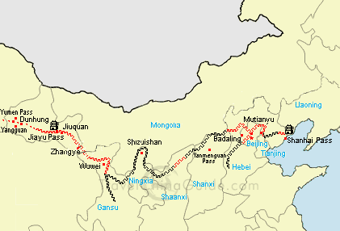
The Great Wall

Slide 4
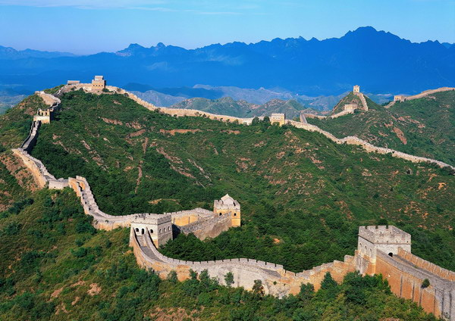

Slide 5
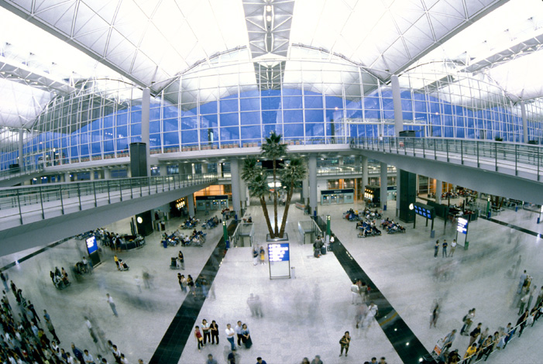
Hong Kong International Airport

Slide 6
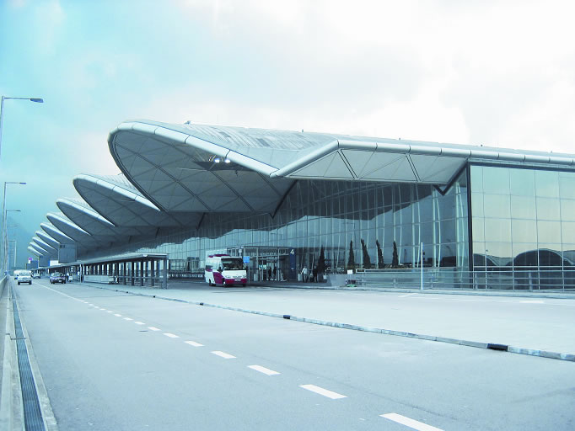

Slide 7
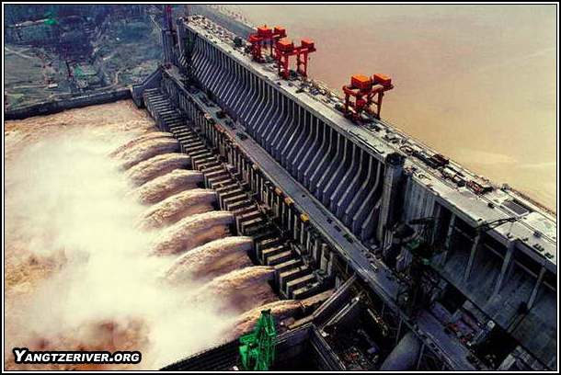
The Three Gorges Dam

Slide 8
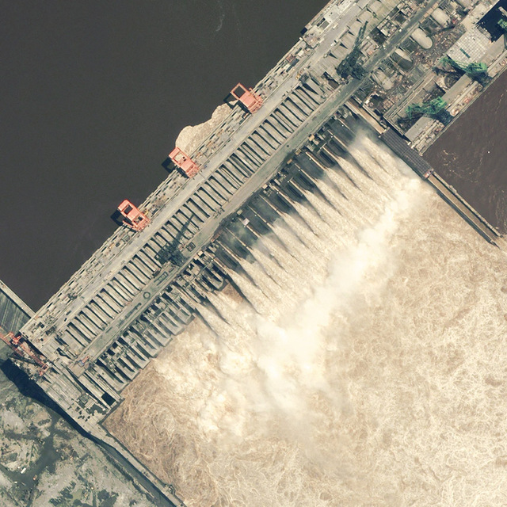

Slide 9
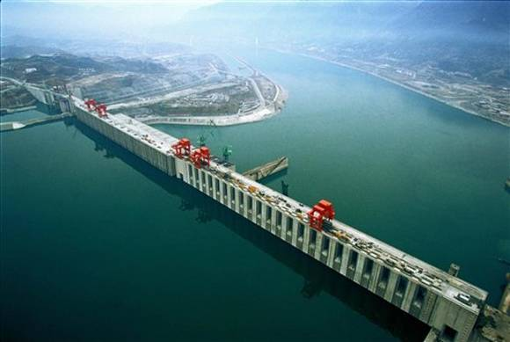

Slide 10
Words Preview
bulletin
canal
civil
cliff
dam
engineering
n.小型报刊，短新闻
n.运河
adj.民用的，国内的
n.悬崖，峭壁
n.坝，堤，水闸
n.(土木)工程

Slide 11
Words Preview
gorge
hydro-electric
reservoir
structure
terminal
date
accommodate
n.峡谷
adj.水力发电的
n.水库
n.建筑物，结构
n.(机场的)集散站
vi.始于
vt.容纳(乘客等)

Slide 12
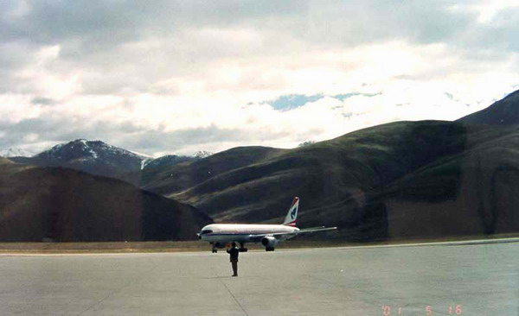
airport：a wide piece of flat land where planes can take off and land

Slide 13
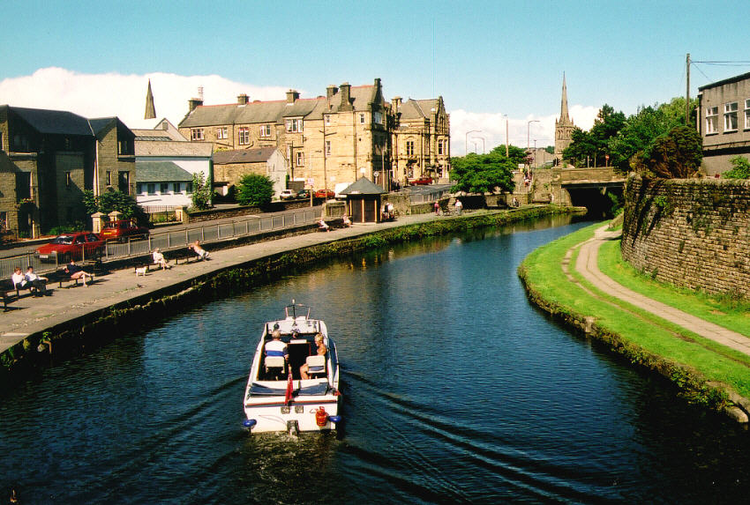
A canal is man-made river, made to allow water to flow from one area to another area. e.g. the Panama canal

Slide 14
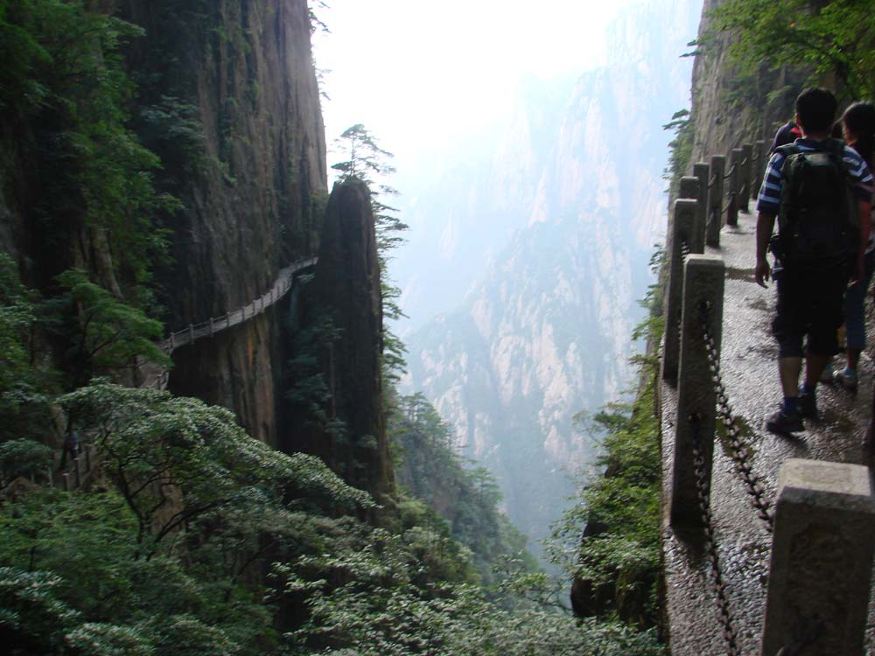
cliff：A high, steep, or overhanging face of a mountain

Slide 15
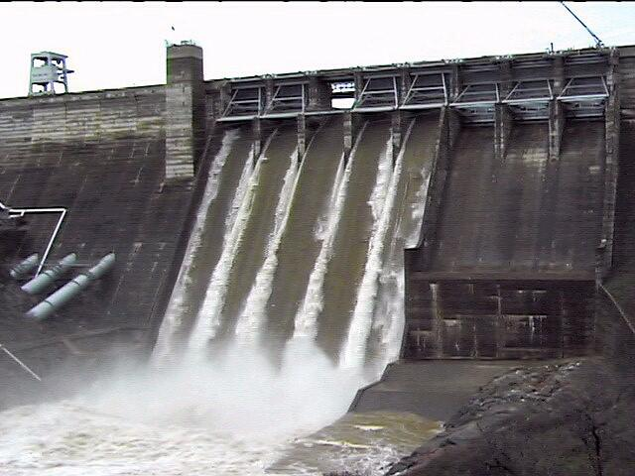
dam： A barrier(障碍物) built across a river to control the flow or raise the level of water

Slide 16
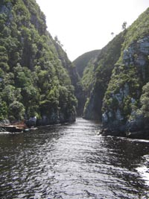
A gorge is a deep, narrow passage
with steep (陡峭的) rocky sides.

Slide 17
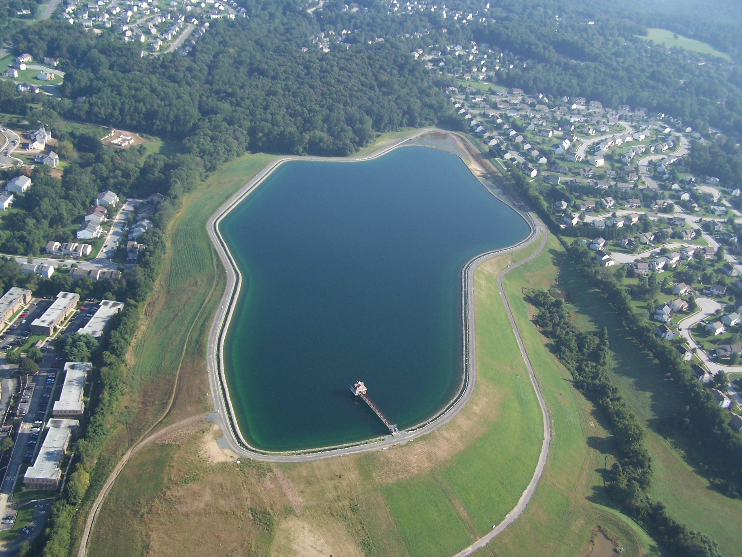
reservoir：A natural or artificial pond or lake used for storing and controlling water

Slide 18
Words Preview
carving
construction
relic
site
Buddhist
generate
harness
n.雕刻品
n.建筑，建设
n.遗迹，遗物
n.场所，遗址
n.佛教徒
vt.发(电)
vt.利用，将(自然力) 变成动力
Pre-reading

Slide 19
Words Preview
historical
narrow
poem
submerge
global
watchtower
remove
adj.历史的
adj.狭窄的
n.诗，诗歌
vt.浸入水中，淹没
adj.全球的
n.望台
vt.迁移，搬迁

Slide 20
1
Check the meaning of these words.
carvings construction relic site temple
Carvings are made by animals. ( )
Construction is another word for building. ( )
×
√

Slide 21
4 Relics are things that were make in the last 100 years. ( )
5 Site is another word for location. ( )
6 A temple is a place of great importance to Buddhists. ( )
×
√
√

Slide 22
2
Check the meaning of these words.
dream (v) energy generate harness historical narrow poem power power station submerge suggest

Slide 23
1 Mao Zedong wrote a poem in which he dreamed of “walls of stone…” Did Mao Zedong actually see the walls of stone?
2 The power of the Yangtze River has been harnessed by the Three Gorges Dam. Does this mean that the power can be used or not?
No, he didn't.
It means the power can be used.

Slide 24
3 Sun Yat-sen first suggested the idea in 1919. Did Sun Yat-sen think of the idea himself or hear it from someone else?
4 About 800historical relics have been submerged. Is it possible to see the relics now that they have been submerged?
He thought of it himself.
No, it isn't.

Slide 25
Type of writing | An exposition
Para. 1
Para. 2
Mao Zedong’s dream has come true.
The Three Gorged Dam has been built to control flooding and provide hydro- electric power for the central region of China.
Reading

Slide 26
Sun Yat- sen first suggested the idea of a dam across the Yangtze River in 1919.
Para. 3
Para. 4
Para. 5
The reservoir has flooded 2 cities, 11 counties, 140 towns and more than 4,000 villages.
The Three Gorges area is one of the most beautiful areas of China and the project has flooded some of China’s most famous historical sites.

Slide 27
Post-reading
3
was the Three Gorges Dam built
1 Why _____________________________? To control flooding and provide hydroelectric power.
2 How high __________? Two hundred meters.
3 How ______________? One and a half kilometers.
is the dam
wide is the dam

Slide 28
4 Who _____________________________________________________? Sun Yat-sen.
5 How much ________________________________________? Three quarters.
6 How many ________________________________________? Four thousand.
first suggested the idea of a dam across the Yangtze River
of China's energy is produced by burning goal
villages were flooded when the dam was built

Slide 29
True or False
Mao Zedong once dreamed that there would be a great dam to harness the power of the Yangtze River. ( )
The Three Gorges Dam will provide enough hydro-electric power for the whole country. ( )
The dam will generate a lot of electricity causing much less air pollution. ( )
A large number of histrorical relics have been damaged because of the dam. ( )
T
F
T
F

Slide 30
Mao Zedong wrote a poem _______ he dreamed of “walls of stone to _________ clouds and rain till a smooth lake rises in the narrow gorges”. Now his dream has _________. The Three Gorges Dam, _____ is the biggest construction project in China ____ the Great Wall and the Grand Canal, has been completed now. The dam is nearly 200 metres ____ and 1.5 kilometres ____.
in which
hold back
come ture
which
since
high
wide

Slide 31
Sun Yat-sen, ____ was the leader of the 1911 Revolution, first ________ the idea of a dam ______ the Yangtze River in 1919. Three quarters of China’s energy is produced by _______ coal.
_____________ burning coal causes serious air pollution and increases ______ warming.
who
suggested
across
burning
Unfortunately
global

Slide 32
Today the Three Gorges reservoir has ________ many places. Over a million people ______ lived in the region have moved from their homes. Now they’re _____________ a happy new life in different areas.
flooded
who
living/ leading

Slide 33
At the same time the Three Gorges project has flooded some famous historical sites. ________ the Qu Yuan Temple, and the Moya Cliff carvings. A good many historical relics have been __________. Some of them are being ________ and some are being _______ museums.
including
submerged
removed
put into

Slide 34
Discussion
What are the advantages and disadvantages of the Three Gorges Dam?

Slide 35
Homework
Write down your opinion about the Three Gorges Dam

