Slide 1

Module 6
Old and New

Slide 2



WRITING
1
Read the email and answer the questions.
1 Does the writer of the email live in Zigui County?
2 Why did she want to visit the region?
3 What had changed since the last time she was there?
No, She doesn't.
Because it is where her grandparents had lived
The area had been flooded because of the Three Gorges Dam.

Slide 3
LISTENING
1
Listen and tick the subjects that you hear.
a film about a clam a map of China the Yangtze River the Grand Canal students from Vietnam the Great Wall of China
√
√
√
√

Slide 4
2
Listen again and make a note of the information.
Egypt
1 Where is the dam in the film?
2 What is the name of the book with maps of China?
3 What time of year did the woman visit the Three Gorges Dam?
4 Who organised the visit of the Vietnamese students?
Maps of the World
December
The government

Slide 5
3
Complete these sentences from the conversation,using the words who or that / which,or nothing at all.
that/which
1 I've got a book here ___________ has lots of maps of China.
2 We took a boat ___________went up the Yangtze River.
3 I'm writing an email to some piople _______I met on the boat.
4 They were on a visit ___ organised by the government
5 I spoke to a man, _____ said there were 25 American students in the group.
that/which
who
/
who

Slide 6
PRONUNCIATION
Read the sentences and underline the relative clauses.

Slide 7
1 The tallest building that I have seen is the Empire State Building in New York.
2 The Grand Canal, which is the world's oldest and longest canal, was built in the fifth century BC.
3 The Three Gorges Dam is a hydro-electric project which has brought an end to the danger of flooding.
4 There is a boat which takes you all the way along the Yangtze River.
5 The river,which is the third longest in the world, is an absolutely beautiful place to visit.

Slide 8
FUNCTION AND EVERYDAY ENGLISH
Strong adjectives
1
Match the adjectives on the left with the strong adjectives on the right.

Slide 9
good
nice
hot
big
cold
surprised
pleased
silly
interesting
tired
freezing
delighted
fascinating
exhausted
ridiculous
boiling
astonished
excellent
enormous
wonderful

Slide 10
2
Complete these conversations.
A: Is it a big dam?
B: Big-it's absolutely_________!
A: Was it an interesting film?
B: Interesting? It was absolutely ____________!
A: Was it a nice trip?
B:Nice? It was absolutely____________!
enormous
fascinating
wonderful

Slide 11
3
Complete these conversations with other adjectives from the list in activity 1.
A: Were you pleased with your visit to the Three Gorges Dam?
B: Pleased? I was _____________!
B: Was it cold when you were on the boat?
B: Cold? It was _________!
A: Were you surprised to see so many American students?
B: Surprised?_______________!
delighted
freezing
I was astonished

Slide 12
CULTURAL CORNER
Read about the passage and answer these questions.
1 For how long was the Empire State Building the tallest building in the world?
2 Why do you think there are so many tall buildings in the world now?
For 41 years
Open, not enough space in cities, so you have to build up.

Slide 13
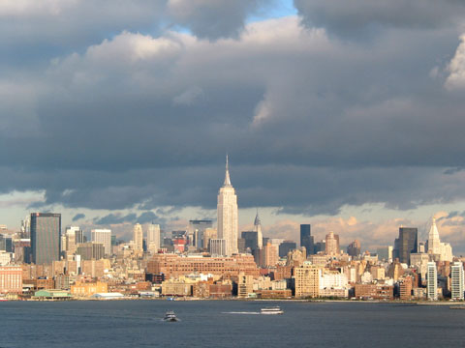
The Empire State Building, New York

Slide 14
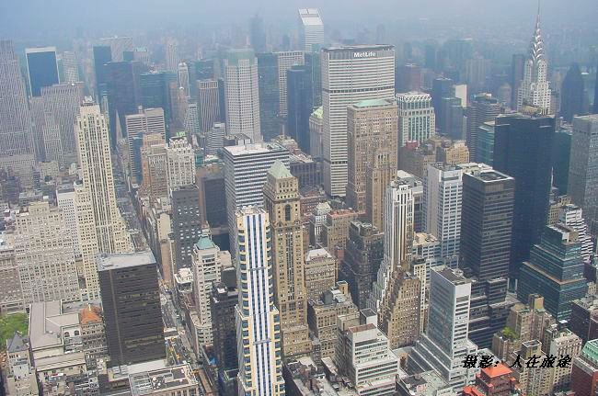

Slide 15
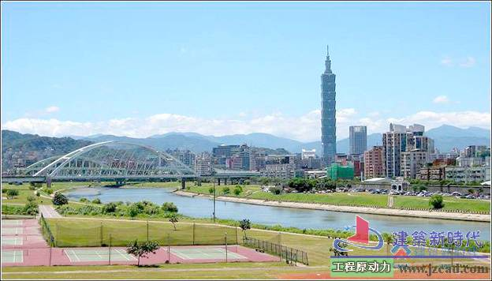
Taipei 101

Slide 16
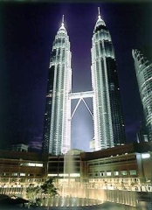
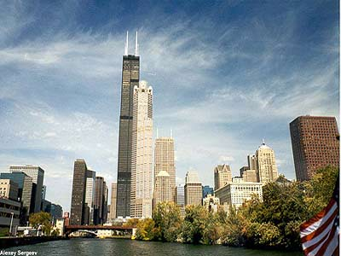
Sears Tower
Petronas Tower

Slide 17
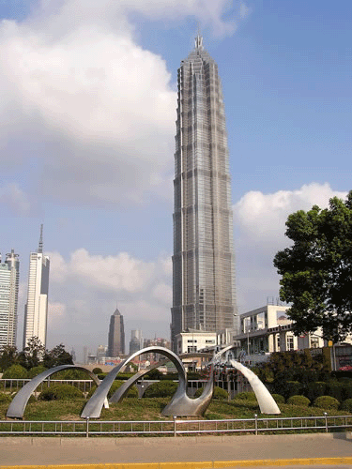
Jin Mao Building in Shanghai

Slide 18
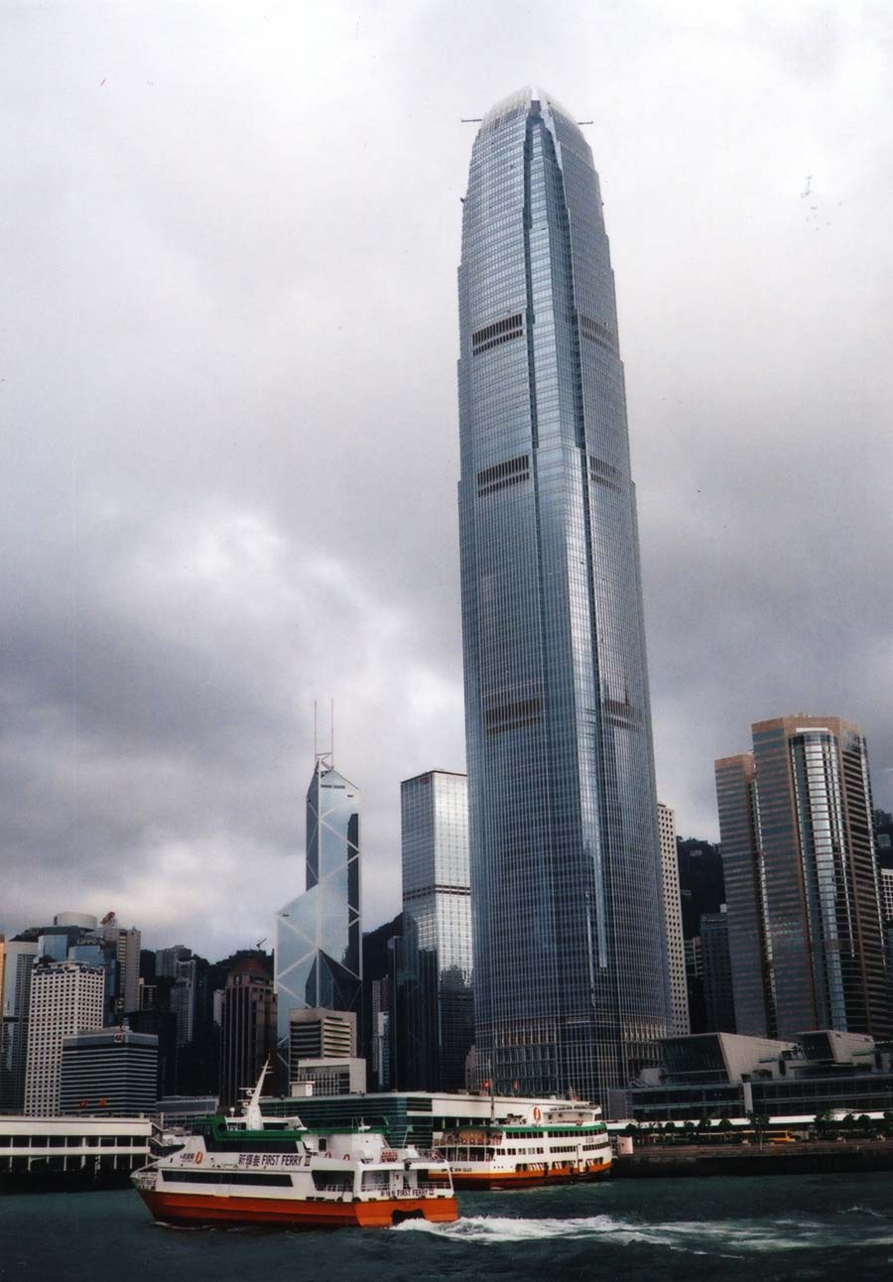
International Finance Centre in Hong Kong

Slide 19
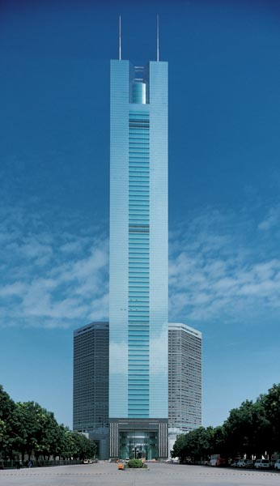
CITIC Plaza

Slide 20
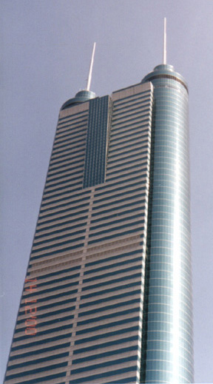
Shun Hing Square

Slide 21
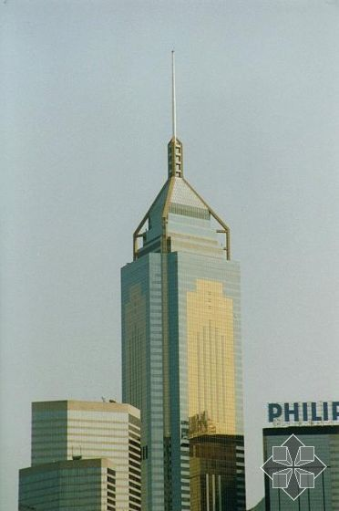
Central Plaza

Slide 22

Task
Write an email to a friend about a visit to a place which has changed since your last visit.

