Slide 1
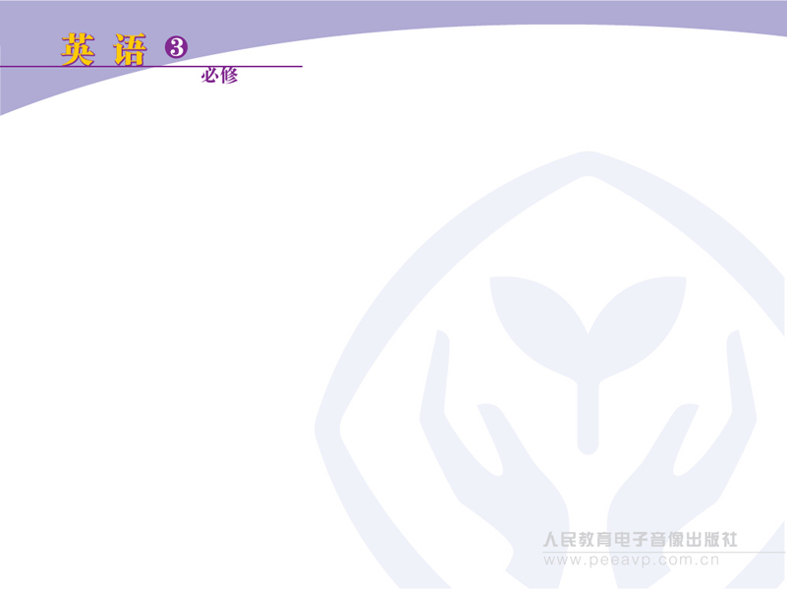
Unit 1 Festivals around the world
Reading

Slide 2
Skimming
Look at the title of the reading passage, and the pictures in it, and work in pairs to predict the content of the passage.
Answer:
1. The names of the festivals and celebrations in the world.
2. The times when the festivals take place.
3. What people celebrate.
4. what people do in the festivals.

Slide 3
Scanning
Scan the reading passage and then fill in the following chart.

Slide 4
Kinds of
Festivals
Festivals
to Honour
People
Festivals of the Dead
Harvest
Festivals
Spring
Festivals

Slide 5
Festivals of
the Dead
Obon
Day of the
Dead
Halloween
(some western
countries)
(Japan)
(Mexico)

Slide 6
Festivals
to Honour
People
Festival to
Honour
Gandhi
Dragon Boat
Festival
Colunbus
Day
(China)
(USA)
(India)

Slide 7
Harvest
Festivals
Thanksgiving
Day
Mid-Autumn
Festivals
(European and other countries)
(China and Japan)

Slide 8
Spring
Festivals
Spring
Festival
Easter and
related holidays
Cherry
Blossom
Festival
(China)
(some western
countries)
(Japan)

