Slide 1
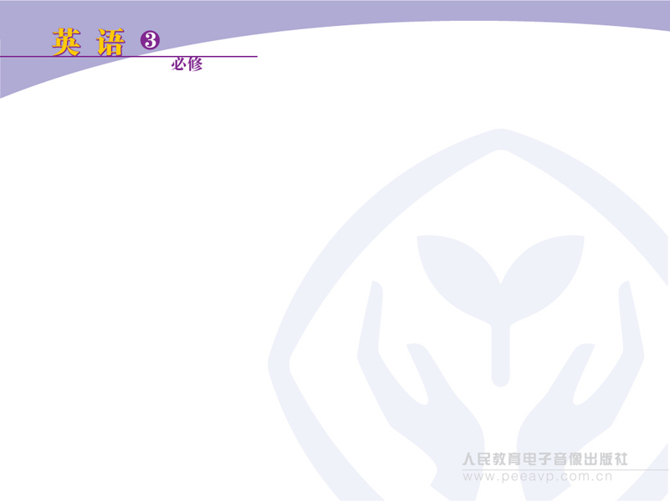
Unit 1 Festivals around the world
Speaking

Slide 2
Could you tell me……
1. How did you spend your winter holidays?
2. How did you feel?

Slide 3
Four students in a group. Discuss the time, celebrations and significance of Spring Festival. You can refer to the following questions.
Discussion
1. When does it usually take place?
2. How do people celebrate?
3. Why?

Slide 4
red packet
firecracker
food
work
date
visit
fruit
new clothes
SPRING
FESTIVAL
dumpling
singing
fun
dancing
memory
watching TV

Slide 5
Fill in the following form.
Festival | Time of year/date | What it celebrates | What people do
give and eat mooncakes;
watch the full moon with family and friends
the beauty of the full moon, harvest, time with family
and friends
Mid-Autumn Festival
autumn/fall

Slide 6
Festival | Time of year/date | What it celebrates | What people do
give money in red envelopes to children; see dragon dances; eat fish, prawns and dumplings; visit family members
the end of winter, arrival of spring, Lunar New Year, reunion with family and relatives
Spring
Festival
January/
February

Slide 7
Festival | Time of year/date | What it celebrates | What people do
 |  | the founding of the People’s Republic of China in1949
visit family or go to other parts of China; go shopping
National
Day
October
1st

Slide 8
Festival | Time of year/date | What it celebrates | What people do
eat zongzi; watch dragon-boat
races; throw rice wrapped in reed leaves into water in memory of Qu Yuan; put herbs on doorways for good health
the fifth day of the fifth month in lunar calendar
in memory of the beloved poet Qu Yuan who died in 278 BC
Dragon Boat Festival/Duanwu Festival

Slide 9
Festival | Time of year/date | What it celebrates | What people do
honour the dead and satisfy the ancestors
sweep the tombs; give flowers
Tomb Sweeping Day
5th April

Slide 10
What do festivals mean?
Festivals are meant to celebrate important events or to honour people at a particular time.

Slide 11
National Day
New Year’s Day
Spring Festival
Army Day
Fathers’ Day
May Day
Mid-Autumn
Festival
Christmas
FESTIVAL
Teachers’ Day
Childrens’ Day
Dragon Boat
Festival
Mothers’ Day

