Slide 1

Unit 2 Healthy eating
Reading

Slide 2
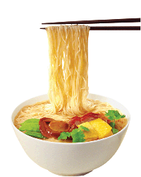
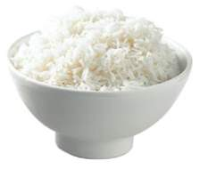
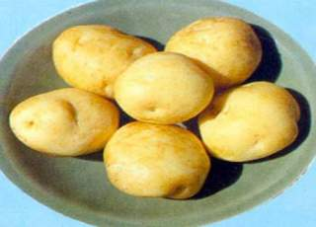
What’s the English for this food?
rice
noodles
potatoes

Slide 3


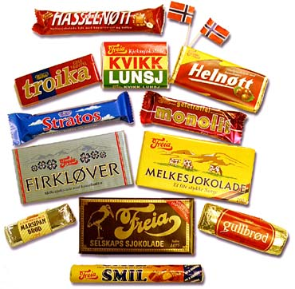
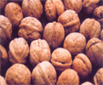
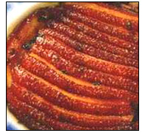
What’s the English for this food?
chocolate
cream
butter
nuts
meat

Slide 4

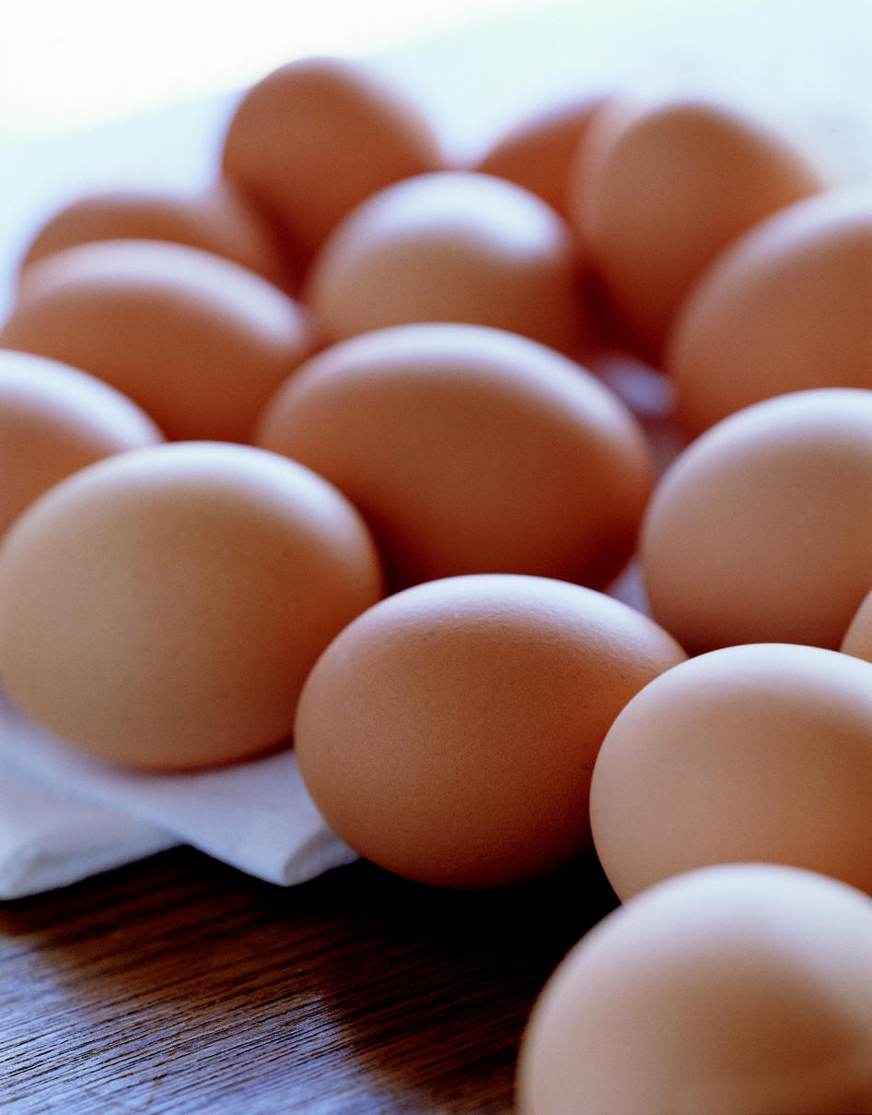
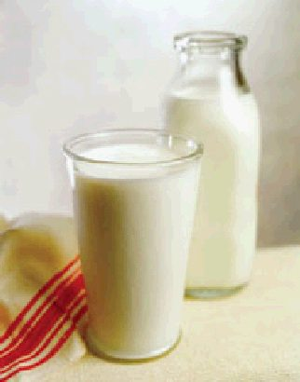
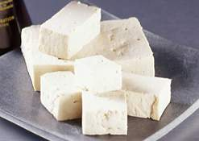
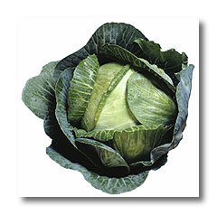
What’s the English for this food?
eggs
milk
cheese
cabbage
tofu

Slide 5



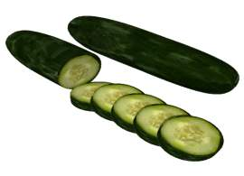
What’s the English for this food?
peas
oil
mushrooms
cucumbers

Slide 6
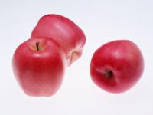


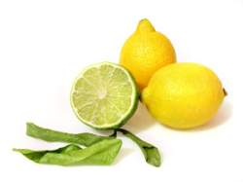
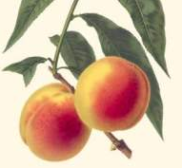
What’s the English for this food?
apples
oranges
peaches
lemons

Slide 7
Pre-reading
Food groups
Food that provides energy ( eg, energy-giving food) | Food that helps grow bones and muscles ( eg, body-giving food) | Food that helps the body fight diseases ( eg, protective food)
most vegetables (eg, beans, peas, cucumber, eggplant, peppers, mushrooms, cabbages) and fruit (eg, apples, peaches, oranges, lemons)
rice noodles spaghetti bread potatoes chocolate butter cream oils nuts
meat eggs milk cheese tofu

Slide 8
Pre-reading
Questions
1. Which food do you usually eat?
2. Which food do you like best?
3. Do you eat the three kinds of food every day?
4. Do you think you eat a balanced diet?

Slide 9
Pre-reading
Discuss in groups
What should you have every day?
 | Breakfast | Lunch | Supper
Food that you should eat

Slide 10
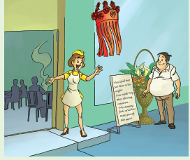
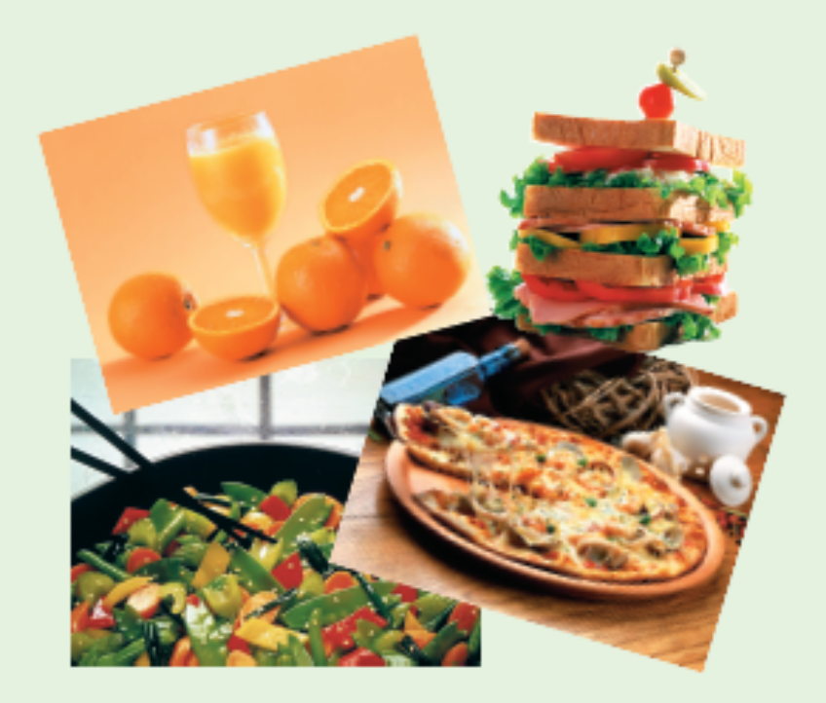

Slide 11
While-reading
How many parts can the passage be divided into? Write down each main idea.
Wang Peng is worried because his restaurant is not as full as it usually is.
He follows his friend to a newly opened restaurant which is very popular.
Worried, he does some research to win his customers back.
Part 1
Part 2
Part 3

Slide 12
Suggested answers to Exercise 2
1. Li Chang always came to his restaurant so if
he did not, it meant that something serious
had happened to stop him.
2. He did not want Yong Hui to tell lies and
people to believe her.
3. If he gave his customers cheaper prices and advertised the benefits of his menu, perhaps his customers would return.

Slide 13
Answer Key for Exercise 3
1. Enough protective food
2. plenty of energy-giving food
3. enough energy-giving food
4. plenty of protective food

Slide 14
Post-reading
分组讨论Comprehending中的练习5
1. What do you think Wang Peng will provide to win his customers back?
Why?
2. How do you think the story will end?

Slide 15
Homework
1. Read the text aloud.
2. Write out a passage on any of the topics.
What do you think Wang Peng will provide
to win his customers back? Why?
2) How do you think the story will end?
3) Write out the general idea of the text in
your own words.

