Slide 1

Unit 3 The Million Pound Bank-Note
Listening & speaking

Slide 2
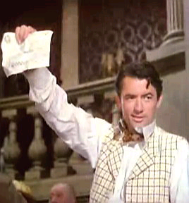
After reading the letter from the brothers, Henry puts it back into his coat pocket. Then he notices that his coat is worn out. So he finds a tailor’s shop and goes in to get a new coat.

Slide 3
In pairs make a dialogue for Act II,
Scene 1 using the following information.

Slide 4
Henry goes into a shop and tells the sales man that he wants a new coat.
The salesman shows him a cheap coat downstairs.
Henry doubts if he should take it.
The salesman persuades him to buy it.
Henry agrees, but explains that he can’t pay him right now as he has no change.
Henry shows him the million pound bank note.

Slide 5
Use the following expressions to help you.

Slide 6
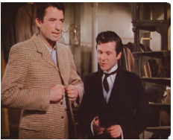
I’d like to have…
Do you have any…?
Can you show me…, please?
How much is it/are they?
I’ll take it.
I’m looking for…
Do you have any other…?
May I try it on?
Well, I’ll think about it.
Just have a look. That’s it.
May/Can I help you?
What can I do for you?
What about this one?
Did you find everything OK?
Is that everything?
That’s all we have.

Slide 7
Listening
In pairs discuss what you think will happen in the tailor’s shop, after Henry shows the salesman and the owner the bank note.

Slide 8
Listen to the tape and answer these questions in groups.

Slide 9
1. Why doesn't the sales man give Henry his change right away?
2. Is the owner really angry at the salesman or does he just pretend to be angry?
3. Is Henry glad to get more than one coat?
4. Henry tell the owner that he is moving. Give two reasons why the owner is not surprised to hear this news.
5. What does the owner offer to do for Henry?
Why?

Slide 10
Make a list
Make a list of all the changes that Henry has made to his life. For example: new clothes.
Discuss with your partner what difference you think this will make to the way people treat him.
What do you think will happen if he falls in love?

Slide 11
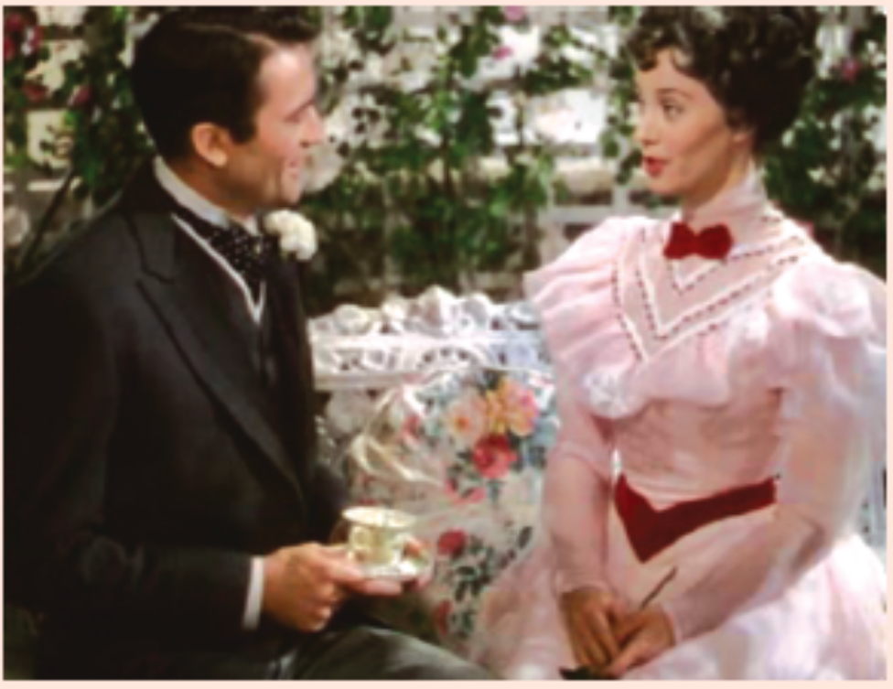
Listen to Act II, Scene 3
Write down the main idea.

Slide 12
Make notes
Listen to the tape again. Make notes as you listen and check your answer with your partner.

Slide 13
Fill in the table
The things Portia knows about Henry | Henry’s response

Slide 14
Fill in the table
The things Portia knows about Henry | Henry’s response
He is rich. | He denies it.
Everybody in London is talking about him. | He does not understand why.
The American ambassador is his friends. | He agrees.

Slide 15
Pre-reading
Before you move on to the reading task, discuss the following questions in pairs.
What will Henry and Portia tell each other about themselves?
What will they keep a secret from each other?

Slide 16
Read the text
Find the result of every character.
Henry
Oliver
Roderick
Portia

Slide 17
Henry: became rich, returned the bank
note and married Portia
Oliver: got the note back and won the bet
Roderick: lost the bet
Portia: daughter of Oliver, married
Henry

Slide 18
Recall the whole story
Use your own words to retell the story.

Slide 19
Homework
Projects
5 students in a group select one of the projects that you like to do.
Surf the internet to find more about Mark Twain and write a report about this writer including his writing characteristic.

Slide 20
If you are a reporter of a newspaper, you want to report the anecdotes about the “millionaire”, what would you write about him and how would you design your heading to attract readers? Write your report.
What changes happen to the restaurant after Henry’s first dinner there? Write an article about it and give your reasons.

