Slide 1
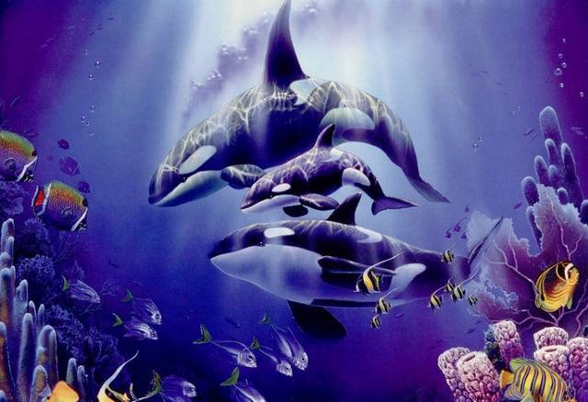
Unit 3 Reading
OLD TOM
THE KILLER WHALE

Slide 2

1. To understand the passage about killer whale
1. To summarize the main idea of the passage
2. To understand the relationship between Old Tom and the whalers
3. To learn to use some words, expressions and patterns in the passage

Slide 3


Skimming for general idea

Slide 4
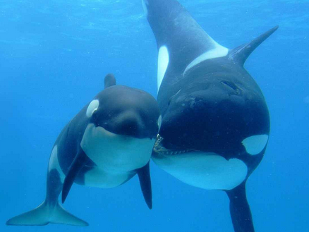
The passage is about two anecdotes,
what are they?
1. Old Tom helped the whalers to hunt the whales.
2. Old Tom protected the whaler from the shark.

Slide 5
Scanning for specific information

Slide 6

1. _______was 16 when he went to work at the whaling station.
2. ________ ordered Clancy to go to the boat as there was a whale out there in the bay.
3. _________ was swimming by the boat, showing the whalers the way.
4. _______ told Clancy that they would return the next day to bring in the body of the whale.
5. _______ was carried by the waves further and further away from the whalers.
6. _______ knew that Old Tom would protect James.
Clancy
George
Old Tom
(1)Find a name from
the passage to complete
each of the following sentences.
Jack
James
Red

Slide 7
1. What evidence was there that Old Tom
was helping the whalers out?
2. What other animals did the author
compare the killer whales with? Why do
you think the killer whales behaved like
this?
3. Why did George think that the killer
whales worked as a team?
4. Why did the whalers allow the killer
whales to drag the whale away?
5. How did Old Tom help James? Why do
you think he did this?
(3)Discuss these questions in groups.
P21 2

Slide 8
Reference answers
1. What evidence was there that Old Tom
was helping the whalers out?
2. What other animals did the author
compare the killer whales with? Why
do you think the killer whales behaved
like this?
Old Tom let the whalers know that
there was a baleen whale nearby; he
showed them the way to the whale.
Dogs. Because they knew that,
together with the whalers, they would soon
kill the baleen whale and get a good feed.

Slide 9
3. Why did George think that the killer
whales worked as a team?
Because he could see that some of the
killers were throwing themselves on top
of the whale’s blow-hole while others
were preventing it from diving or
fleeing out to sea.

Slide 10
4. Why did the whalers allow the killer
whales to drag the whale away?
5. How did Old Tom help James? Why do
you think he did this?
Because they knew the killer whales
would leave the rest of the body to them.
Old Tom prevented James from
drowning. Old Tom wanted to help his
human friends.

Slide 11
accident | James was ________ the boat.
situation | 1. The sea was _____ that day and it was _____ to handle the boat. The ____ were carrying James further and further away. 2. Suddenly there was ______ over there.
James’ feeling | He was _____ of being abandoned.
Tom’s help | 1. Old Tom won’t let it ____ James. 2. James was firmly _______ in the water by Old Tom.
result | James was _________ into the boat.
(4)Read the second
anecdote and fill in
the blanks.

Slide 12
accident | James was ___________ the boat.
situation | 1. The sea was _______ that day and it was _______ to handle the boat. The waves were _______________________________________. 2. Suddenly there was ______ over there.
washed off
rough
difficult
carrying James further and
further away
a shark

Slide 13
James’ feeling | He _______________ being abandoned.
Tom’s help | 1. Old Tom won’t __________ James. 2. James was firmly _________ in the water by Old Tom.
result | James was __________ into the boat.
was terrified of
let it near
held up
pulled back

Slide 14

(5)Choose the right answer.
1. What does “an enormous animal” in para 2 refer to?
a killer whale B. a whale
C. a kind of fish D. not mentioned
2. Old Tom threw itself out of the water and then crashed down in order to _______.
A. breathe in more air B. catch the whale
C. communicate with other killers
D. give the whalers the information about the whale

Slide 15
3. By writing anecdote 2 the writer
wanted us to know _____.
James was washed off the boat
It’s very dangerous to hunt in the sea
It was Old Tom who saved James
Killer whales will protect people in the sea
4. What does “terrified” mean in para. 15?
A. satisfied B. afraid
C. surprised D. annoyed

Slide 16
5. Which of the following might be true?
The author was for banning (禁止)
whaling (捕鲸).
B. The author was against banning
whaling.
C. Whaling was not banned at the
beginning of the 20th century.
D. The author thought it was Old Tom’s
duty to protect James.

Slide 17

Discussion
The last whaling station in Australia
closed in 1978. Whales are now an
endangered species and protected by
an international ban, but some countries
oppose the ban. In groups discuss the
reasons for and against banning
whaling.

Slide 18
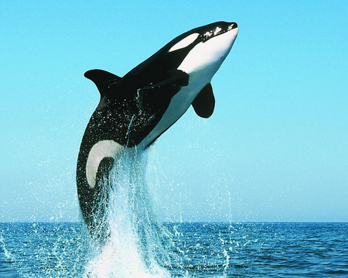

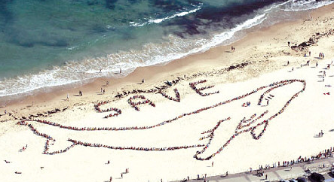
No trading, no killing.

