Slide 1

英语课标教学课件
选修7

Slide 2
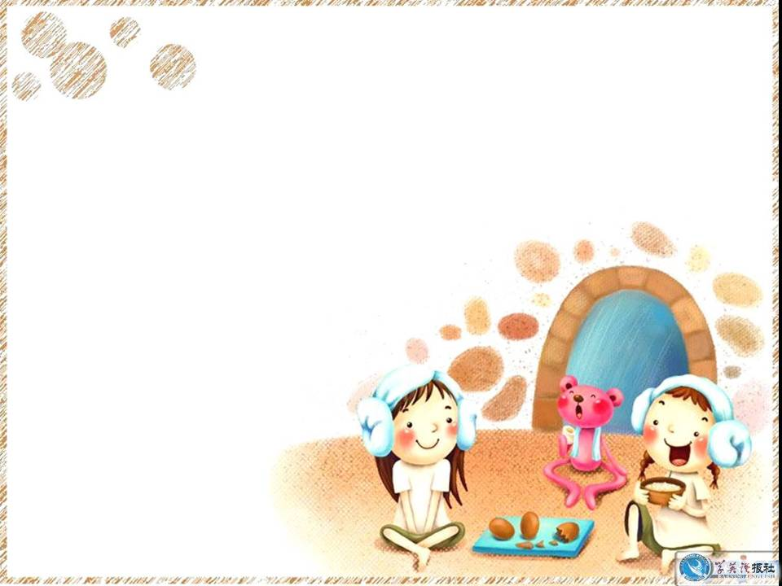
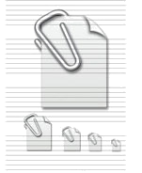
Unit 3 Under the sea
Listening
注: 另附 word 文档。
点击此处链接

Slide 3
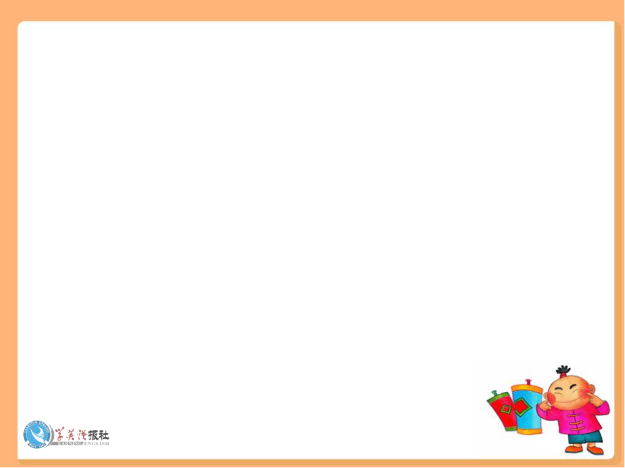

Using Language
Listen to Dialogue 1.
COMPLAINING ABOUT
A WHALE WATCHING TOUR
A = Angela T = Tour Guide

Slide 4


Listen again and fill in the blanks.
Dialogue 1
A: Excuse me.
T: Yes, how can I help you?
A: I’m sorry but we weren’t very happy
with the _____.
T: Oh, what was the _________?
A: Well, it was so _____ we couldn’t go
outside … I know we heard the _______
and saw them on the videocamera and
that was great, but we really _______ to
tour
problem
wet
whales
wanted

Slide 5
stand outside and watch the whales
from there. My _____ kids are very
disappointed.
T: I’m sorry, but we can’t control the
________ and you did see whales.
A: Well, I’m afraid that’s not good ______.
I’d like to talk to the ________.
T: I’m sure that won’t do you any good. I
know he’ll ______ with me. The fact is
that you _____ see whales. (fading out)
two
weather
enough
manager
agree
did

Slide 6

Listen to Dialogue 2.

Slide 7
Listen again and fill in the blanks.
T: Goodbye, I hoped you ________ the
tour, sir.
A: Yes, the whales were ________ but I’m
feeling very annoyed.
T: Really? (in a surprised voice)
A: Yes. You see. I’ve _______ my flight. If
I’d known the boat was going to be late
back, I wouldn’t have ______.
enjoyed
awesome
missed
come

Slide 8
T: Yes, I __________, but we had a problem
with the boat at the _____ minute that we
needed to fix. The ________ of our
passengers is very important to us. So,
I’m afraid we couldn’t _____ starting late.
A: Yes, but you should’ve checked if there
was anyone like me who _______ to be
back by midday. Anyway, I’d like a
_______, please.
T: Well, I can refund half the fare.
understand
last
safety
avoid
needed
refund

Slide 9
A: I’m sorry but that’s not good enough.
I now have to make another _______
booking and I have ____ idea whether
there’ll be any seats _________. I’d
like a _____ refund.
T: Well, that’s not ____ to me, but I’ll go
and talk to the manager.
A: Thanks.
airline
no
available
full
up

Slide 10
T: (music to indicate a few minutes
passing) Mr Langton, I’m terribly
sorry that we’ve ______ problems for
you. Of course, we’ll give you a _____
refund. Just come into the ______ with
me.
A: Thank you.
caused
full
office

Slide 11
Listen to Dialogue 3.

Slide 12
Listen again and fill in the blanks.
S: Excuse me, the tour wasn’t what my
________ and I had expected and we’d
like a refund please.
T: You weren’t ________ with the tour?
S: Well, we really loved _______ the bird
life … and the _________ and seals …
but we saw only one whale and that one
was too far ______ to see properly. And
we really came on the tour to _____ the
whales.
husband
satisfied
seeing
dolphins
away
see

Slide 13
T: Ah ha, I see. I tell you what, why don’t
you and your husband come back for a
tour on _______ day? Free of charge, of
course.
S: I’m afraid that’s ____ good for us as
we’re visitors to this area and we’re
_______ tomorrow morning.
T: Well, in that case, we’ll _______ half
your fares.
another
no
leaving
return

Slide 14
S: Well, actually, we’d like a full refund.
T: I’m sorry … if you read the _________,
we say that we’ll refund HALF the
_____.
S: Ok, thanks.
T: You’re welcome.
brochure
fare

Slide 15
Workbook-Listening
Listen to News report 1.
NEWS REPORTS:
SHARK ATTACKS

Slide 16
Listen again and fill in the blanks.
News report 1
A man is __________ at home after being attacked by a shark while standing in about 50 cm of water at Seal Rocks in New South Wales at _______ yesterday. He received cuts to his ____ and ____. A hospital spokesman
said the injuries were not _______ and the man was not admitted to hospital.
recovering
sunset
leg
foot
serious

Slide 17
Listen to News report 2.

Slide 18
Listen again and fill in the blanks.
News report 2
In Hawaii, a shark bit off the ____ arm of a ___-year-old surfer while she was on her ______ in clear water. Betty Hamilton lost her left arm just ______ the shoulder. Tom Hamilton said his _________ was resting comfortably in hospital.
left
13
board
below
daughter

Slide 19
Listen to News report 3.

Slide 20
Listen again and fill in the blanks.
News report 3
A 30-year-old man was _________ by a 2-metre shark while snorkelling this morning off the North Queensland ______. He was bitten on the ____ side of his body and ______ arm and has been taken by air to hospital.
attacked
coast
left
upper

Slide 21
Listen to News report 4.

Slide 22
Listen again and fill in the blanks.
News report 4
A man has been killed in a shark attack at ______ am this morning in shallow water at a popular city ______ in Perth. Scores of witnesses watched as the ____-metre shark attacked ___-year-old Ken Crew, tearing off his leg. He had been swimming with _______ at the time. Crew was pulled to the shore on a surf ski but _____ soon afterwards. The area is being searched but the shark, believed to be a great ______, will not be hunted down.
6:30
beach
5.8
49
friends
died
white

Slide 23
Listen to News report 5.

Slide 24
Listen again and fill in the blanks.
News report 5
A _____ has been attacked and killed by a _____ white shark off the South Australian coast. Paul Buckland, ____, was attacked
on Tuesday as he was coming to the ______ after diving for shellfish. Buckland yelled for help as he was being held in the shark’s _______, according to police.
diver
great
23
surface
mouth

Slide 25
His friend, Shannon Jenzen, _____ to pull Buckland into their boat, but the shark attacked again from ________, taking a leg and large part of his body. Buckland bled to death ________ after.
tried
behind
shortly

Slide 26
Workbook-Listening Task
Listen to the text.
Listen to Jordan Davies (J) interviewing the shark expert Don James (D).

Slide 27
Listen again and fill in the blanks.
J: Don, why do the words “shark attack”
________ so many people?
D: Because shark attacks get a lot of
________, especially when they result
in _______ injuries. So many people
think that there are _________ of
sharks waiting in the sea to attack
them.
J: Are they ______ to think that?
frighten
attention
terrible
hundreds
right

Slide 28
D: No, not at all. The ________ of being
bitten by a shark is extremely _______.
Throughout the world we know of
only a _____ people who were killed by
sharks each year. Now think of the
millions of swimmers, _________,
snorkellers and divers that go into
the sea! It really _______ that sharks
are _____ interested in attacking us.
J: Really?
chance
small
few
surfers
shows
not

Slide 29
D: Yes. The ______ is that it’s the sharks
that need to be _________. While only
a few people are killed by sharks,
________ of sharks are killed by us
each year.
J: Goodness, that’s a _____ number! So
how are so many killed?
D: A lot are killed by ________ fishing
technology. Although it’s aimed at
catching ______ fish, sharks are often
caught at the same time. But sometimes
truth
protected
millions
huge
modern
other

Slide 30
they are caught on purpose. Shark fin
_____ is so popular in some Asian
countries that many sharks are killed
____ their fins.
J: That’s terrible!
D: It is _______. As a result, the variety
of shark species and their __________
are decreasing at a serious rate. In
fact, some species are ______ to being
endangered. And the shark’s biology
doesn’t help much _______.
soup
for
indeed
populations
close
either

Slide 31
J: What do you mean by that?
D: Well, I’ll give you an _______. Female
Great White Sharks do not give _____
until they are about ____ years old; the
young take about 14 _______ to develop
before they are born; and they only
have 7 to 9 _______. So shark
populations grow at a ______ rate.
J: OK, so what should we do?
example
birth
15
months
young
slow

Slide 32
D: I think ____________ around the
world should take action. They
should _______ fishing for sharks and
protect the most endangered species.
Otherwise they will die _____. Sharks
have been on this planet for ______
million years and it would be terrible
if they _________ because of us.
J: Yes, indeed it would.
governments
reduce
out
400
disappear

