Slide 1



Sharing

Slide 2

【写作任务】
你和一些同学参加了一次活动。请根据下面信息用英语写一篇短文。
【写作要求】
1. 作文要包括如下要点：(1) 交待活动参与者及活动的时间和地点；(2) 活动内容；(3) 你的体会。
2. 只能用5个句子表达全部信息。

Slide 3
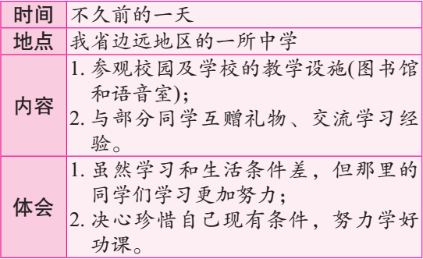

Slide 4

【写作分析与指导】
1. 写作分析：本题给出了三个要点。这些要点的排列逻辑性很强。在本文的写作过程中，我们应注意如下几点：(1)合理使用简单句、并列句和复合句，长短结合。(2)在文章中恰到好处地使用所学到的词汇、短语、句型及语法知识。(3)根据句子间的逻辑关系，合理地使用关联词语和

Slide 5

【写作分析与指导】
过渡词汇，使上下文的过渡更加自然。(4)学会整合信息，将多个信息融合在一个句子内，以减少句子的数量，表达更多的信息。(5)本文陈述的事情发生在过去，因此文章的时态应以过去时为主。

Slide 6
二、词句储备
1. 写作中可能使用的词语有：
(1) 不久前的一天 _______________________
(2) 边远地区 ____________________
(3) 教学设施 _________________
(4) 交流，交换 ___________________
(5) 意识到 _______________________
(6) 珍惜 _________________________
the other day
remote areas
teaching facilities
exchange
come to realize
value/treasure

Slide 7
(1)不久前的一天，我们参观了我省偏远地区的一所中学。
The other day we paid a visit to a senior high school in the remote area of our province.
(2)我们参观了校园，图书馆和语音室。
We looked around the schoolyard and made a visit to the school library and the language lab.

Slide 8

(3)我们与那所学校的部分学生交换了礼物，然后交流了学习经验。
We exchanged our gifts with some students of that school and then we exchanged our learning experience.
(4)尽管他们的教学设施和生活环境不如我们，但他们学习更加努力。
I came to realize that they work much harder than us though their teaching facilities are in bad condition and their surroundings are not comfortable.

Slide 9
(5) 我决心好好地珍惜我们的条件，努力学习功课。
I am determined to value what I have and learn my lessons well.

Slide 10

三、下笔成文
The other day we paid a visit to a senior high school in the remote area of our province. As soon as we arrived, we looked around the schoolyard and made a visit to the school library and the language lab. After that we exchanged our gifts with some students of the school and then we exchanged our learning

Slide 11
experience. Through these activities, I came to realize that they work much harder than us though their teaching facilities are in bad and their surroundings are not comfortable. Therefore, I am determined to value what I have and learn my lessons well.

Slide 12

【点评】
这篇范文较好地完成了规定的写作任务：使用的语言正确、规范；要点完整；行文连贯。此外，本文恰到好处地使用了复合句和并列句，使得文章的结构错落有致，表现形式丰富多彩。此外，根据文章的需要，适当增加细节或过渡词语是本文的一大特色，如先后出现的as soon as we arrived, after that, through these activities, therefore等。

