Slide 1


英语课标教学课件
选修7

Slide 2

单元影视
Beyond Borders is a 2003 romantic-drama film about aid workers, directed by Martin Campbell and starring Angelina Jolie and Clive Owen.
The movie takes place in three different time periods. The first one is in London in 1984. Sarah Jordan (Jolie) is an American living a luxurious (奢侈的) life with her new British husband, Henry Bauford (Linus Roache).

Slide 3
At a fancy wedding reception hosted by Henry’s father Lawrence (Timothy West), a rebel doctor named Nick Callahan (Clive Owen) bursts in with a little Ethiopian boy and protests (抗议) the cut in funds for the relief camps where he works in Africa that were being funded by Lawrence. Sarah feels sorry for Nick’s plight (境况), so she decides to visit his latest camp in Ethiopia.

Slide 4
She meets Nick’s associates there, including his less dramatic partner, Elliott Hauser (Noah Emmerich). She also tries to save an Ethiopian boy and her mother. Nick regards her help as just a rich woman wanting to unburden (卸去……的负担) her guilt at first, but eventually sees her actual compassion
(同情). Compared to Nick and Elliot, her
stay there is relatively (相对地) short, but
she becomes more involved in humani-
tarian aid (人道主义援助) via the U.N.

Slide 5
Next, we jump to 1989. We’re back in London, and Sarah has a son with Henry, but her marriage is in trouble. Elliot comes to visit her hoping that she might put a U.N. stamp on a shipment of supplies into a Cambodian refugee camp. She not only does that, but she insists on tagging along (紧跟) with them on the mission. While in Cambodia, love with Nick blooms and a tragic event happens with someone else.

Slide 6
Finally, we jump to 1995. We’re in London again, Sarah has her son and now a daughter, and her marriage to Henry seems to have mended. Her TV anchor sister, Charlotte (Teri Polo), finds out that Nick is missing somewhere in Chechnya due to his involvement with covert (隐密的) CIA operative named Jan Steiger (Yorick van Wageningen.) Against Henry’s wishes, she sets out to find him, because she still loves him and she has a secret to tell him. When trying to save Nick, Sarah steps on a land mine (地雷) and died.

Slide 7


Audio & Visual

Slide 8

Listening for details
注: 另附 word 文档。
点击此处链接
— …, I'm still short about 8,000.
— But, Sarah, this isn't how it's _____. You
don't go ...
— Henry, Henry. I've ________________.
— Well, then ____ the money, do charitable
work, ________, but don't go roaring off
to some godforsaken hole in Africa just
to salve your conscience. It's just too ...
— Too what?
done
made up my mind
send
whatever

Slide 9
— Well, it's not the most _________ way to
deal with this situation.
— Well, maybe I don't want to grow up.
— Fine. Fine. If that's what you _____ …
— It is.
— Then fine. I'll help you ____ the money.
— Thank you.
— I'll talk to Dad. He knows __________.
Mind you, Ethiopia is a bit ... It'll be fine.
It'll be fine. We'll find the ______.
grown-up
want
find
everybody
money

Slide 10
— Come with me.
— Honey, ______ I could ...
— You can't?
— No, it's not that. You know me, I'm not
made for that ____ of thing. I'm a ____
boy. I need four _____ and a ____.
_______, I've got meetings up to here
for the next ______. You ______ go.
You've got the right _______.
even if
kind
city
walls
bed
Besides
month
should
attitude

Slide 11
sounds
— Listen, I know this ______ like Little
Miss Bleeding Heart and all that ... I
just, I don't _____. I know I'm being
crazy and _______ you crazy, and of
course I __________ you can't come,
but ... you meet me ___ the plane? You
_____ me off the plane?
— Of course I'll meet you off the _____.
care
driving
understand
off
meet
plane

Slide 12
years
— Three _____ and no ____, not a drop.
That, and ___. People leave their ______,
they walk for many days. We only have
ten camps on the south ____. Too many
people, not _____________. Measles (麻
疹), you know measles?
— Yes, of course.
— We ____ more people to measles and
diarrhea (痢疾). Many ___, no vaccine
(疫苗).
— We brought some vaccines ...
rain
war
homes
side
enough camps
lose
die

Slide 13
everywhere
— Also cholera (霍乱), __________. We dig
very deep now for good _____. Starvation
everywhere, _____ is everywhere.
— You _____ English very well.
— Missionaries ______ me.
— Yeah? So are you _______? Do you
have a ________?
— Man? Bullshit. I need no man. They beg
to ______ me, many times, but I _____
truck. Lazy man, good-for-nothing.
water
death
speak
teach
married
husband
marry
drive

Slide 14
I'm too old now anyway. No man in my
village want woman over ___.
— In my tribe, it’s ___. Stop. Stop the
_____. Stop. Stop!
— Abraha! Abraha! Abraha ...
— Is this your ____? This your son?
— Abraha ... Abraha? Ab-Ab ...
— No ____. We go. Too dangerous to stop.
We go now. Is a _____. Child and
mother, both a waste. ______ baby
woman.
18
30
truck
son
baby
waste
Stupid

Slide 15
Sentences appreciation
If he revives, call the nurse. If he doesn't, at least he'll have someone with him when he dies.
如果他活下来了，就叫护士来。如果他没有醒过来，那至少他死的时候有人陪伴在他的身边。

Slide 16
I wonder. Do we all know where we belong? And if we do, in our hearts, why do we so often do nothing about it? There must be more to this life, a purpose for us all, a place to belong.
我怀疑我们都知道自己属于哪里吗？如果我们心中的答案是肯定的，那为什么我们总是不为它做点什么呢？生命一定有更多的意义，我们每个人都有一个使命，一个可以归属的地方。

Slide 17
They don't thank you like they thank you here 'cause here they feel everything，straight from God. There's no drugs, there's no painkillers. It's the weirdest, purest thing — suffering. And when you've seen that kind of courage in a little child, how could you ever want to do anything but just take them in your arm?

Slide 18
他们不会用这里的方式来感谢你，因为在这里他们感受一切，直接来自上帝的东西。没有药物，没有止痛药。不可思议的最纯粹的事情——苦难。当你从一个孩子身上看到那种勇气时，你怎么能抑制将他们抱入怀中的冲动？

Slide 19
No one else comes here, so what do you want me to do? You want me to watch thousands of kids die of measles 'cause I wouldn't bend the rules? Is that a price worth paying? Or am I actually killing more than I save? You seriously believe that I don't worry about that? That I don't think about that every minute of every day? What's worse? You tell me. You tell me what I should do.

Slide 20
没有其他人来这里，那么你想让我做什么？你要我看着数以万计的孩子死于麻疹就因为我没有屈服于规则之下？你觉得那值得么？或者我真的杀的人比救的人多？你真的认为我不担心？我没有每时每刻都考虑这个问题？还能有什么更糟的？你告诉我。你告诉我我该怎么做。

Slide 21
Ladies and gentlemen, I feel very nervous to be standing in front of you today. I also feel very honored … I pray for those who survive him who continue his work without certainty or security wherever they may be in this world.
女士们、先生们，今天站在你们面前我感到很紧张，同样我也感到非常荣幸。……我为那些在不安全情况下仍继续工作的人祈祷，无论他们在世界上的哪一个地方。

Slide 22

注: 另附 word 文档。
点击此处链接
Listen and sing
Don't Give Up
In this proud land we ________ strong
We were wanted all along
I was taught to fight, taught to win
I never thought I could ____
No fight left or so it seems
I am a man whose ________ have all deserted
grew up
fail
dreams

Slide 23
changed
I've ________ my face, I've changed my name
But no one wants you when you ____
Don't give up
'cos you have _______
Don't give up
You're not _______ yet
Don't give up
I know you can ______ it good
Though I saw it all _______
______ thought I could be affected
lose
friends
beaten
make
around
Never

Slide 24
last
Thought that we'd be the ____ to go
It is so _______ the way things turn
Drove the night toward my home
The place that I was ____, on the lakeside
As daylight broke, I saw the ______
The trees had burned down to the ______
Don't give up
You still have ___
Don't give up
We don't need much of ________
strange
born
earth
ground
us
anything

Slide 25
Don't give up
'cause ___________ there's a place
Where we _______
Rest your _____
You worry too much
It's going to be _______
When times get rough
You can fall _____ on us
Don't give up
Please don't give up
'Got to _____ out of here
somewhere
belong
head
alright
back
walk

Slide 26
anymore
I can't take ________
Going to stand on that ______
_____ my eyes down below
Whatever may _____
And whatever may ____
That river's ________
That river's flowing
Moved on to _______ town
Tried hard to settle down
For every ____, so many men
So many men no-one ______
bridge
Keep
come
go
flowing
another
job
needs

Slide 27
Don't give up
'Cause you have friends
Don't give up
You're not the _____ one
Don't give up
You still _____ us
Don't give up
We're _______ of who you are
Don't give up
'Cause I ______ there's the a place
where we ______
only
have
proud
believe
belong

Slide 28
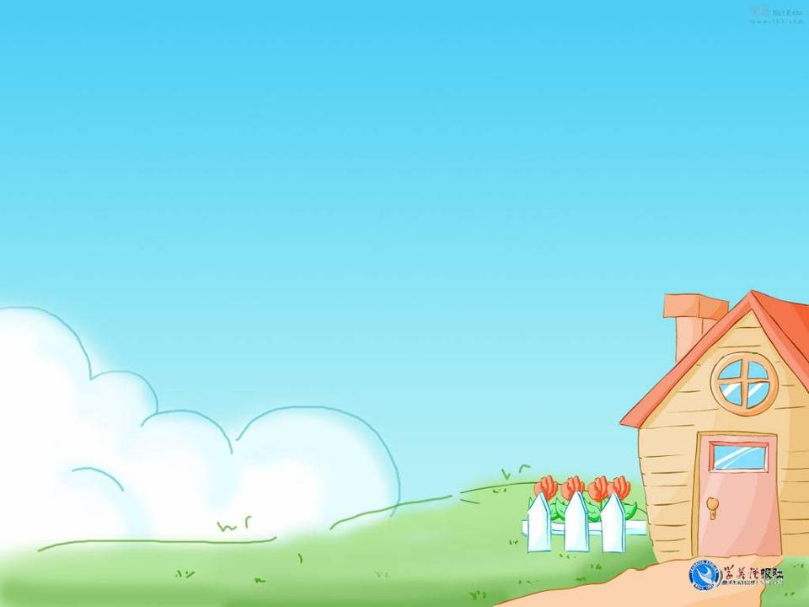
Thank you!

