Slide 1

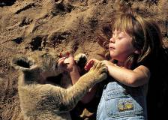




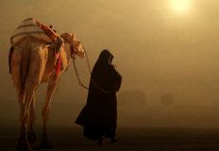

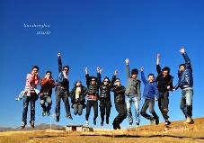
Unit 5
Traveling abroad

Slide 2

To consider several aspects of foreign travel
To consider the advantages and disadvantages of studying in a foreign country and to predict any difficulties a foreign student might face

Slide 3








Around the world
Nowadays, more and more Chinese go abroad to visit different countries and learn about cultures. Why do people enjoy traveling and experiencing other cultures?

Slide 4
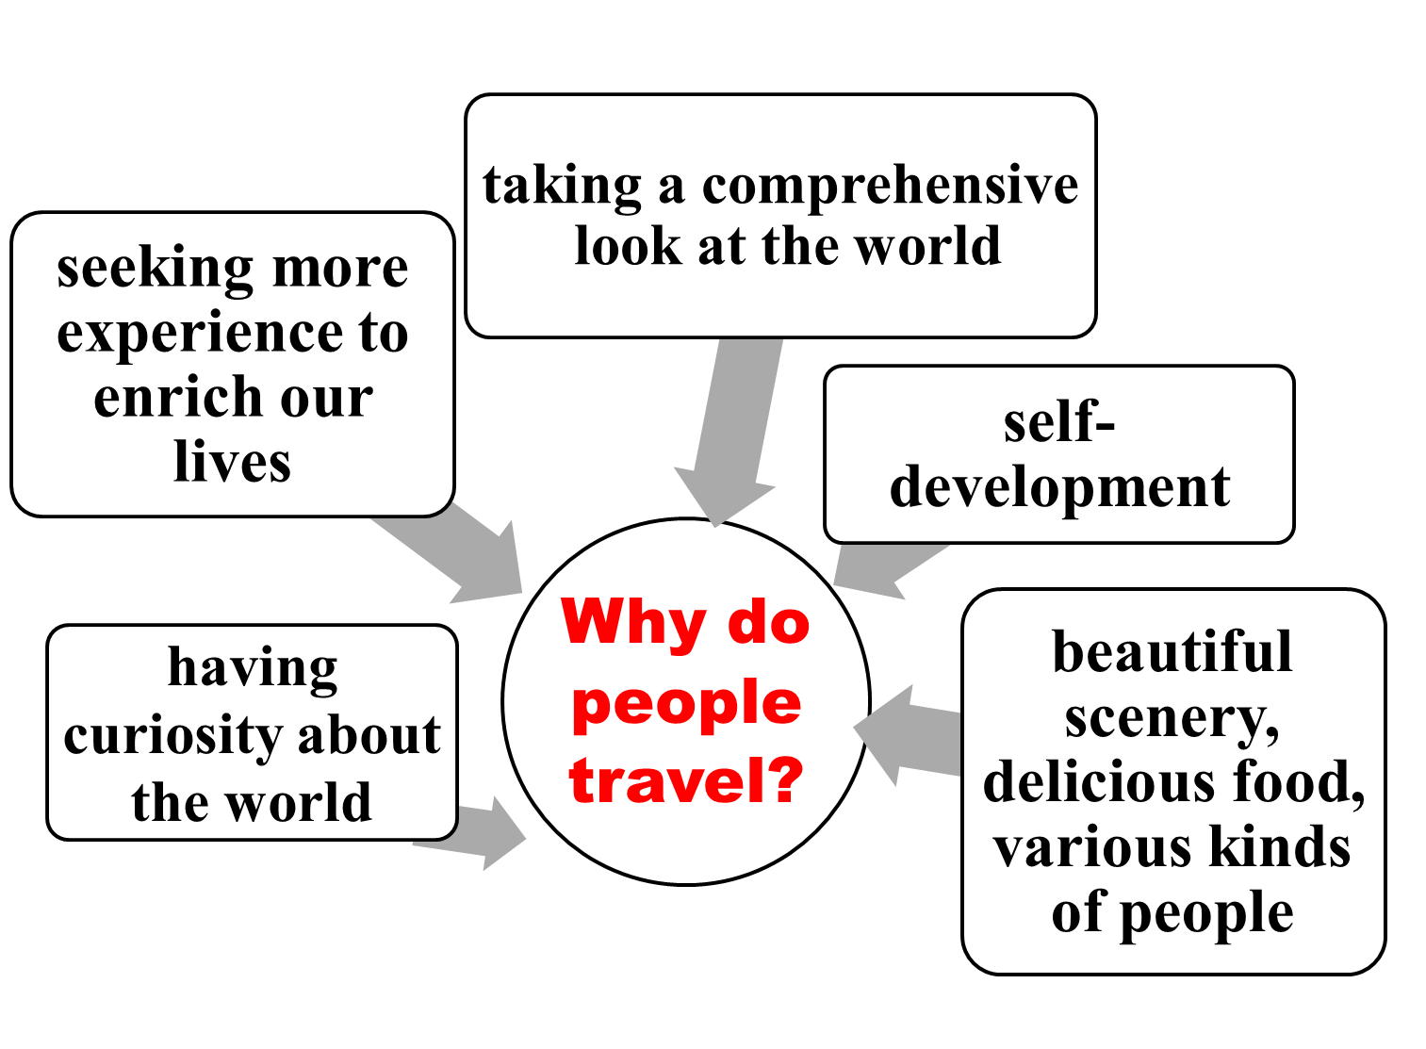





…

Slide 5

What should we take into account before we decide to travel abroad?
money
ID card
making plans
transportation
travel abroad
local conditions and customs
applying
for a visa
accommodation
weather
…

Slide 6

1. How difficult do you think it is to adjust to the customs of another country?
2. Do you know anyone who has spent some time in another country? What did they find that was similar to or different from our country?

Slide 7

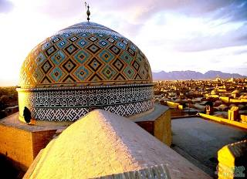
伊朗禁忌：莫议论婴儿的眼睛
中国人夸婴儿总爱说：“看这对水灵灵的大眼睛”。到伊朗您可千万别议论婴儿的眼睛，伊朗人对婴儿眼睛最敏感，来客若出言语不慎，双亲会出钱让人挖掉婴儿的“邪眼”。
customs in different countries

Slide 8
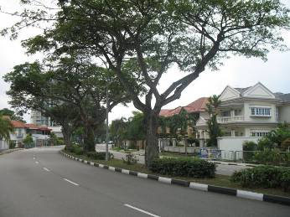
新加坡
新加坡政府致力于保持清洁，乱丢垃圾初犯处以罚金一千元；累犯处两千元，依最新修订之惩治乱丢垃圾条例，新加坡全面禁售、禁食口香糖，口香糖为最难清除之垃圾之一。

Slide 9

印度
左手不洁。去印度或中东旅游，吃饭和接拿东西，只能用右手，绝对不能用左手。因为这些国家的人一般是用左手洗澡，上厕所，左手是不洁净的。
在印度，头歪到一边是表示“yes”。他们表示赞同时，总是先把头往左右轻轻地斜一下脖子，然后立刻恢复原状，令人以为是“不要”或“不愿意”，其实是表示“知道了”或“好的”。

Slide 10

东南亚：绝不可骑在佛像上拍照
在东南亚的佛教国家，旅客如果对寺庙、佛像、和尚等做出轻率的行动，被视为“罪恶滔天”。有些不明利害的观光客，曾经由于跨坐在佛像上大拍纪念照而被刑罚。对想带回去的佛像纪念品，也不可放置地上。

Slide 11

If your friend will travel abroad, what suggestions will you give to him?

Slide 12



Possible suggestions:
1 Read some books about a new country
2 Take your passport
3 Take a dictionary if necessary
4 Take a tourist map and a map of the country which you will travel around
Take enough money and your
traveller's cheque
6 Take a camera
Take some medicine for stomach
and other illnesses
8 Take some articles of clothing

Slide 13



Discussion
1. Have you ever considered studying in a foreign country? Why or why not?
2. What are the advantages and disadvantages of studying in a foreign country?

Slide 14
Advantages
fun to live in a new country
help us to be independent
would be easier to learn a foreign language
easier to learn advanced knowledge and technology
learn a lot about local customs and broaden our views
relax and get rid of anxiety
have many new experiences

Slide 15
Disadvantages
Language barrier in the first few months will be a problem for some students.
The overseas students’ families will cost a lot of money.
The overseas students who have weak self-control may give in to some certain kinds of bad temptations so that they spend much less time and effort on their major goal – study.
The competition among all the overseas students can be tremendous.
Long time being apart from their families may cause several mental problems or even illnesses.

Slide 16

The world is getting smaller and smaller. We have more and more opportunities to travel and study in a foreign country.
Travelling helps us learn a lot about local customs and broaden our views. Besides, it is relaxing and we can get rid of our anxiety and stress.
Overseas study will help you develop skills and give you experiences a classroom setting will never provide. It's an opportunity to discover new strengths and abilities, conquer new challenges, and solve new problems.

Slide 17
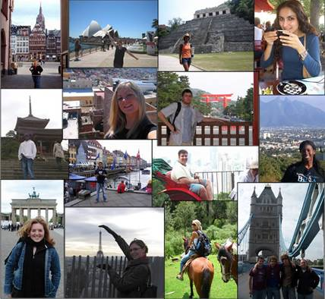
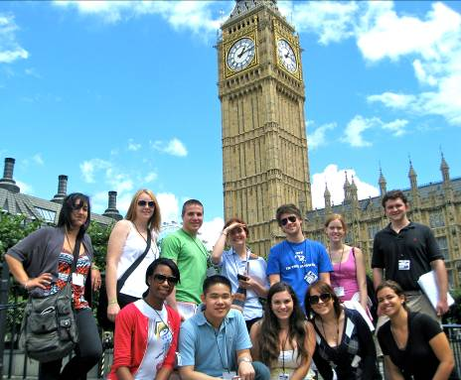


Slide 18

Homework
1. look up the new words and expressions of the reading passage in the dictionary.
2. Preview the Reading:
KEEP IT UP, XIE LEI
Chinese student fitting in well

