Slide 1
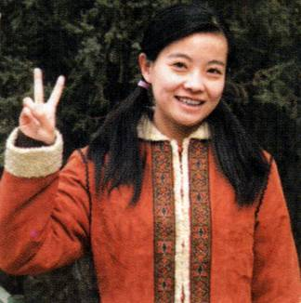


KEEP IT UP, XIE LEI
Chinese student fitting in well
Unit 5 Reading

Slide 2

Words Review
motherland
visa
queue
cafeteria
lecture
qualification
preparation
recommend
shopkeeper
n. 祖国
n. 签证
n. 队列；行列 vi. 排队
n. 自助食堂；自助餐厅
n. & vi. 演讲；讲课
n. 资格；资历
n. 准备；预备
vt. 推荐；建议
n. 店主

Slide 3
Words Review
idiom
comfort
substitute
academic
requirement
essay
tutor
revise
n. 习语；成语
n. 舒适；安慰 vt. 安慰
n. 代替者；代用品
vt. 用……代替……
adj. 学校的；学术的
n. 需要；要求
n. 文章；散文
n. 导师；助教；家庭教师
vt. 复查；修正；复习

Slide 4
Words Review
revision
draft
numb
acknowledge
contradict
autonomous
occupy
enterprise
n. 复查；修正；复习
n. 草稿；草案 vt. 草拟；起草
adj. 麻木的；失去知觉的
vt. 承认；确认；答谢
vt. 反驳；驳斥
adj. 自主的；自治的；独立的
vt. 占用；占领；占据
n. 事业；事业心

Slide 5
Match
adjust to
keep it up
fit in
as far as one
is concerned
be occupied with
保持优秀成绩；
继续干下去
适应；调节
忙着做……；
忙于某事物
相适应；相融合
就……而言

Slide 6
Xie Lei’s problems | Your solutions
understanding
and using everyday English
listening to the radio
or watching television
to become accustomed
to everyday English
2. reaching the
academic
requirements of
a Western
university
2. asking your tutor for
advice before you
start your academic
writing
3. making new
friends
3. joining a lot of
university societies

Slide 7
(2) Answer these questions.
1. Why is Xie Lei doing a preparation
course first?
2. Why did Xie Lei feel like a child when
she first arrived in England?
3. Which two types of people have helped Xie Lei most since she came to England?
4. Why has Xie Lei decided to join a
few clubs?

Slide 8
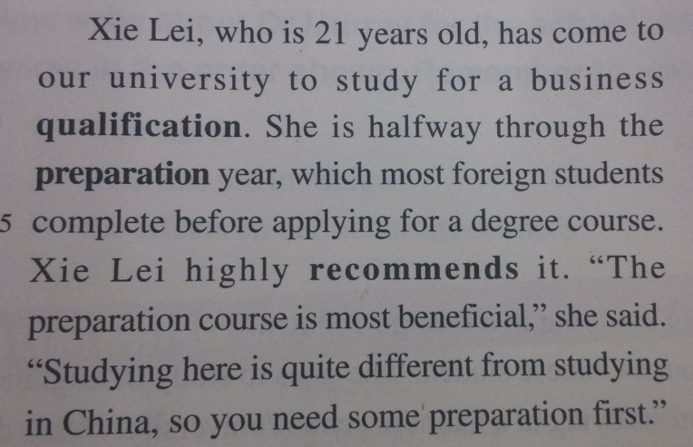
1. Why is Xie Lei doing a preparation
course first?
Because studying in England is different from studying in China and she needs to learn about these differences and improve her English.

Slide 9
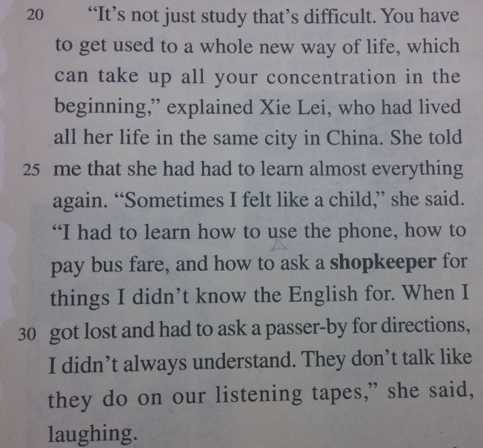
2. Why did Xie Lei feel like a child when
she first arrived in England?
Because she had to learn how to do everyday things like using a telephone, paying on a bus, finding her way around a strange city; understanding English as spoken in real life; learning how to write essays acceptable to her British lecturer.

Slide 10
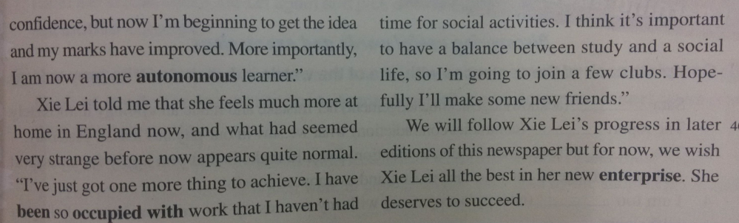
3. Which two types of people have helped Xie Lei most since she came to England?
Xie Lei’s host family and her teachers.
4. Why has Xie Lei decided to join a few
clubs?
Because she thinks it’s important to have a balance between study and a social life, and she wants to make new friends.

Slide 11
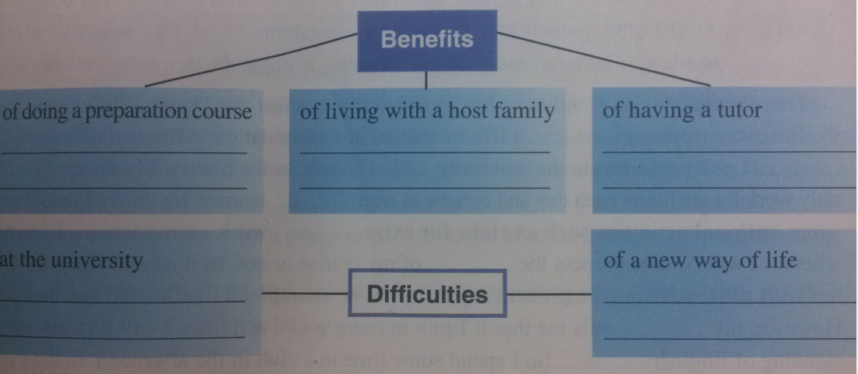
P39 2
(3) Fill in the diagram below.

Slide 12
Benefits
of doing a
preparation course
_____________________________
_____________________________
_____________________________
_____________________________
1. to learn how to fulfil Western
academic requirements
2. to get used to a new way of life and improve her English

Slide 13
Benefits
of living with a host family
____________________________
_____________________________
_____________________________
_____________________________
1. to learn more about everyday life and customs
2. to have people explain things not understood

Slide 14
Benefits
of having a tutor
____________________________
_____________________________
_____________________________
____________________________
——————————————
1. to explain about why you cannot use other people’s work without acknowledging it
2. to encourage you to express your own ideas with reasons

Slide 15
Difficulties
at the university
____________________________
_____________________________
_____________________________
_____________________________
1. learning to read widely and analyse the texts
2. expressing one’s own opinion with reasons

Slide 16
Difficulties
of a new way of life
____________________________
____________________________
___________________________
1. finding a balance between study
and a social life
2. making new friends

Slide 17
Xie Lei boarded a plane for London six months ago to study ____ a business qualification. She is now halfway through the preparation year. ________________, she had to learn almost everything again. She lives with a _____ family, ______ gives her the chance to learn more about the new culture. Xie Lei’s preparation course is helping her to __________ (适应) the academic requirements of a western university. She wrote her first essay to her tutor, but she only got ___ E. Her tutor said she couldn’t write what other people ___________ (say) without acknowledging them. Besides, _____ other people thought was not the important thing. Now she has got used to the life and she feels ___________________ and is going to join a few university clubs __________ have a balance between study and a social life.
for
At the beginning
host
which
Complete the passage with proper words,
which will help you retell the text.
get used to
an
had said
what
much more at home
in order to

