Slide 2
1. that---where 2. but 去掉 3. had---have
4. honest---honesty 5. or ---and
6. using—used 7. dream---dream of
8. the---a 9. our---his 10. stead---steadily

Slide 3
Inversion

Slide 4

“Only +状语”放句首
否定意义的词放句首
省略if 的虚拟语气
Adj/n./v.+as/though+主语+谓语

Slide 5
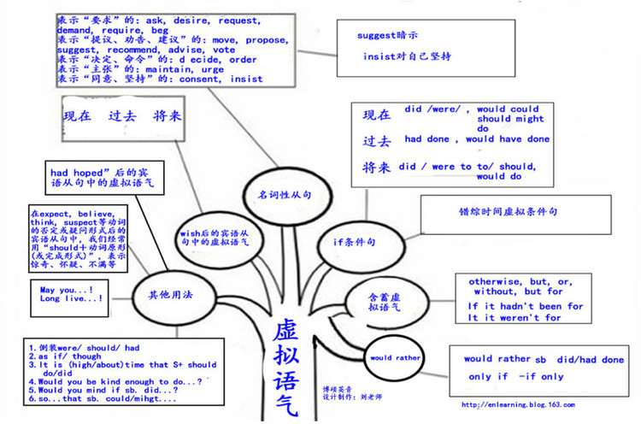
表示“建议”，”命令”，”要求”的词
suggest, advise propose, recommend
order, demand, require, command insist
Suggest 表“暗示”“表明”
Insist 表坚持认为 （已经发生）
现在 did
过去 had done
将来 would/could do
现在 did/were
would/ could /should/ might do
过去 had done
would/ could /should/ might have done
将来 did/were to do/had done
would/ could /should/ might do
did /should do
名词性从句
Wish/if only
错综虚拟语气
If 条件句
Otherwise, without
But for
If hadn’t been for
If it were not for
It is high/about time that
含蓄虚拟语气
Would rather that
Would rather that
did/had done

Slide 6
Mind Map
1. 用于there be (stand/lie/exist/live)
2. 表示地点的介词短语位于句首时。
全部倒装
3. 表语（分词/形容词）置于句首时
倒装
1、“Only+状语”位于句首时
2、否定意义的词位于句首时
3、as引导的让步状语从句
部分倒装
4、在省去if的虚拟条件从句 中
5. So/such …that…结构中，so/such 置于句首

Slide 7


倒装句种类
1、整个_____在_____前的句子，叫完全倒装。
谓语
主语
部分谓语
2、_______（情态动词、助动词、连系动词）提前到______前的句子，叫部分倒装句。
主语
高考倒装句的考法：
主要放在写作中考查。能提高句子的灵活度，提升写作档次。

Slide 8



1. A little girl stood in the rain.
In the rain stood a little girl.

Slide 9
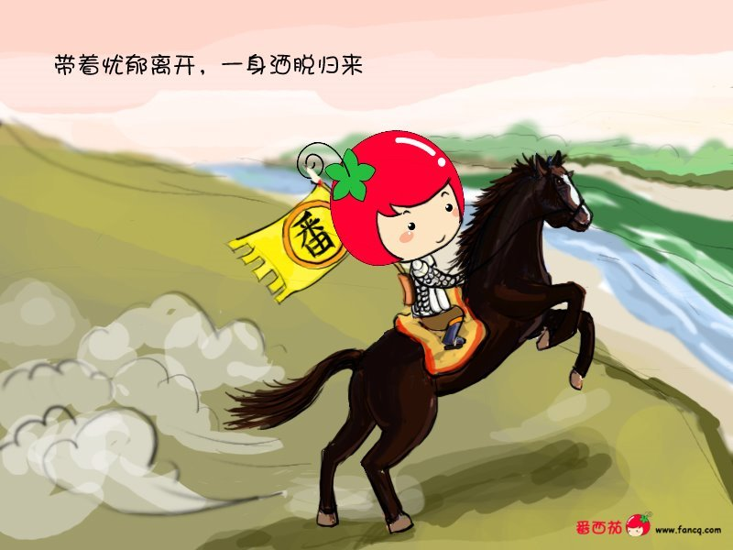
2. The boy rode away.
Away rode the boy.

Slide 10
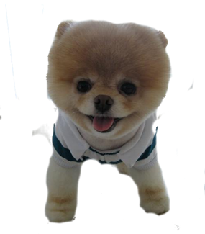
3. Your dog runs here.
Here runs your dog.

Slide 11
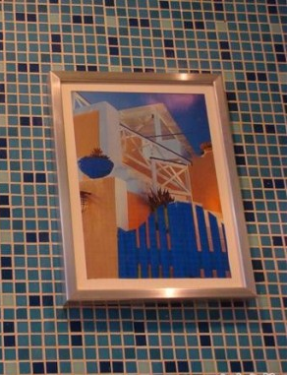
4. A picture hangs on the wall.
On the wall hangs a picture.

Slide 12


1. In the rain stood a little girl.
2. Away rode the boy.
3. Here runs your dog.
4. On the wall hangs a picture.
全部倒装：把谓语全部提到主语之前,
即…… + 谓语 + 主语

Slide 13
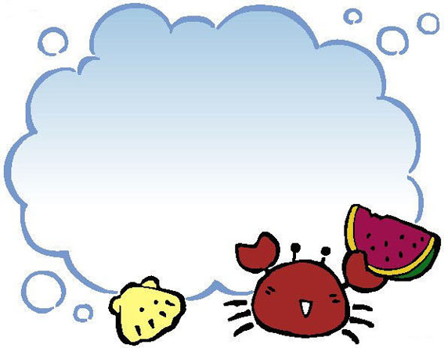
全部倒装运用情况

Slide 14

1. 用于 there be 句型．在此结构中可以用exist, lie, live, stand等代替be。
There stood a temple on the top of the
mountain.
There lay a winding brook in front of an
old house.

Slide 15
2.当表示地点方位词在句首时
e.g. East of the lake lie two towns.
Inside was an exhibition of the most up-
to-date inventions of the 31st century.
They arrived at a farmhouse, in front of which sat a small boy.
为了强调状语，或为了上下文紧密衔接

Slide 16
The door opened and in came Mr. White.
The door opened and in she came.
如果主语是
人称代词
则不用倒装
Here comes the car.
Here it comes.
On hearing the shot, away flew the bird.
On hearing the shot, away it flew.

Slide 17

3. 分词/adj+主语+谓语
Standing beside the desk was a middle-aged teacher.
Written on the blackboard are the names of those who were late yesterday.
Gone are the days when we are enslaved.
Present at the meeting are ten famous writers.
为了保持句子结构平衡, 避免头重脚轻。

Slide 18



我绝不会再做这个了。
I shall never do this again.
2.只有用这种方法你才能学好英语 。
You can learn English well only in this way.
3.这个问题太简单了,我能解决。
The problem is so easy that I can work it out.
Never shall I do this again.
Only in this way can you learn English well.
So easy is the problem that I can work it out.

Slide 19
1.Never shall I do this again.
2.Only in this way can you learn English well.
3.So easy is the problem that I can work it out.
部分倒装:把助动词, 情态动词, 系动词放在
主语之前，即: 助动词/情态动词/系动词 +
主语 + 谓语 + 剩下的部分。

Slide 20
部分倒装运用情况

Slide 21

重点+难点
状语
1. Only + _____ (副词, 介词短语或从句) 放在句首时,主句应该使用部分倒装。
Only when you listen to me carefully
can you understand my meaning .
Only then did he realize his mistakes.
Only in this way can you learn math well.

Slide 22
重点+难点
2. 含有否定意义的副词或连词，如never, hardly, seldom, little, at no time, not until, no/not, rarely 等放在句首时。
eg：Not a single mistake did I make.
Never before have I seen such beautiful scenery.
Seldom does he go to school late.
Not only should we not be afraid of
difficulties, but also we should try our best to overcome them.
译：我们不仅不应该害怕困难,而且我们还要尽力克服它们。

Slide 23

Hardly/scarcely … when …, No sooner … than …
一……就……
过去完成时(had done)
1. He cares little about what others think.
Little ___________ about what others think.
2. I had no sooner set off than it began to rain.
No sooner ___________ than it began to rain.
一般过去时(did)
does he care
had I set off
3. I had hardly reached the bus stop when the
bus started.
Hardly ____________the bus stop when the
bus started.
had I reached

Slide 24

3. 在so/such … that结构中, so或such引导的
部分放在句首时，主句应部分倒装。
(1)He spoke so loudly that
even people in the next room
could hear him.
(2)So loudly did he speak that
even people in the next room
could hear him.
(3) They made so much noise that I couldn’t be absorbed in the work.

Slide 25
4. 省去if的虚拟句，句子需要倒装。且谓语动词中需含有were, had, should
If Mark had invited me, I would have been glad to come.
Had Mark invited me, I would have been glad to come.
If I were you, I would try my best.
Were I you, I would try my best.

Slide 26
5. 用于形容词（名词/动词）+ as/though
的让步状语从句中
Proud as they are, they are afraid to see us.
Child as he is, he knows a lot.
Try hard as they would, they could not lift the box.

Slide 27
Translation
只有用这种办法我们才能更加自信。
2. 只有通过努力工作我们才能取得进步。
3. 时间是如此珍贵，经不起我们浪费。
Only in this way can we gain more confidence.
Only by working hard can we make great progress in English learning.
So precious is the time that we can’t afford to waste it.

Slide 28
4. 中国将永远不会成为第一个使用核武器(never, nuclear weapons)的国家。
Never will China be the first to use nuclear weapons.
5. 不但他本人对英语感兴趣，他的学生也渐渐对英语产生了兴趣。。(not only…but also; be interested in)
Not only is he interested in English, but also his students get interested in it.
6. 直到太阳下山他才回家。（not until）
Not until the sun set did he go home.
7. 虽然他还是个小孩，他懂的东西很多。(as)
Child as he is, he knows a lot .
8. 山脚下有一个约300人的村庄。

Slide 29
1. how---what 2. chose---choose
3. had---take—taking 4. but---and
5. world----the world 6. your—our
7. knowledges---knowledge
8. can---should 或去掉
9. thought---think 10. many---much

Slide 30
第一行：year—years
第二行：worse—worst; At the first—At first
第三行：by yourself—by myself; think such—think so
第四行：tell me—told me
第五行：freely—free; by wear—by wearing
第六行：leaving home to college—leaving home for college
第七行：whenever need help—whenever I need help

Slide 31
21-25 CABBA 26-30 BAADC
31-35 BCCDD 36-40 BCDGE
41-45 CBDAC 46-50 BDADB
51-55 CADBA 56-60 CBDAC

Slide 32
61.latest 62. known 63. have done
64. to make 65. without 66. whose
67. But 68. an 69. slightly
70. arms

Slide 33
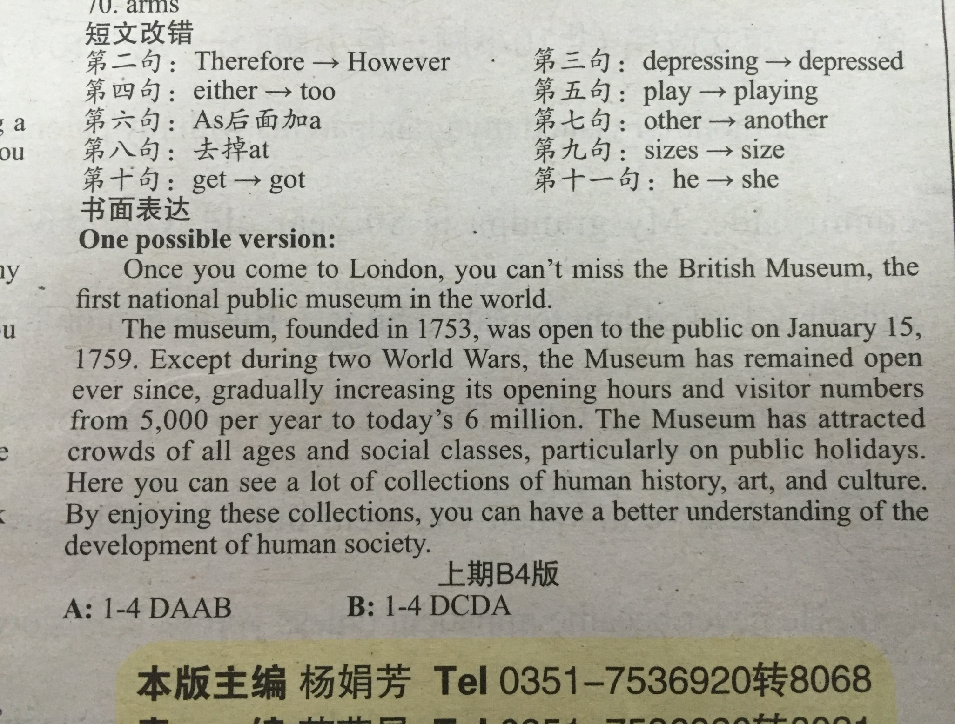

Slide 34
Mind Map
1. 用于there be (stand/lie/exist/live)
2. 表示地点的介词短语位于句首时。
全部倒装
3. 表语（分词/形容词）置于句首时
倒装
1、“Only+状语”位于句首时
2、否定意义的词位于句首时
3、as引导的让步状语从句
部分倒装
4、在省去if的虚拟条件从句 中
5. So/such …that…结构中，so/such 置于句首

Slide 35
表示“建议””命令” ”要求” “主张”的词
suggest, advise propose, recommend
order, demand, require, command insist
maintain
Suggest 表“暗示”“表明”
Insist 表坚持认为 （已经发生）
现在 did
过去 had done
将来 would/could do
现在 did/were
would/ could /should/ might do
过去 had done
would/ could /should/ might have done
将来 did/were to do/had done
would/ could /should/ might do
did /should do
名词性从句
Wish/if only
错综虚拟语气
If 条件句
Otherwise, without
But for
If hadn’t been for
If it were not for
It is high/about time that
含蓄虚拟语气
Would rather that
Would rather that
did/had done

