Slide 1

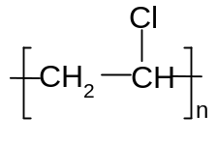
脂肪族化合物的转化关系
HOCH₂CH₂OH
BrCH₂CH₂Br
CH₃CH₃
CH₂＝CH₂
CH≡CH
CH₂＝CHCl
CH₃CH₂Br
CH₃CH₂OH
CH₃CHO
CH₃COOH
CH₃CH₂ONa
C₂H₅OC₂H₅
CH₃COOC₂H₅

