Slide 1


Using Language
Listen to the text.

Slide 2


Listen again and fill in the blanks.
Dear Lisa,
There is nothing _______ with you and this boy being friends and _________ together. Of course a boy and a girl can be good friends. Ending your _________ with this boy would be a _______ thing to do. You would _____ a good friend and ________ to study with.
wrong
studying
friendship
stupid
lose
someone

Slide 3
__________ like to gossip, and they often see something that isn’t ____. Perhaps your classmates cannot __________ your friendship with this boy. That’s no reason to stop it. My ______ is to ignore your __________. That way you will show them that you are more _________ than they are.
Yours,
Miss Wang
Teenagers
real
understand
advice
classmates
grown-up

Slide 4

Workbook-Listening
Listen to Part 1.

Slide 5

Listen again and fill in the blanks.
Leslie Clark, a __________ from Vancouver, arrives in China to do some ________. Her company sells ______. During her ____ she meets many Chinese people. Most of them are very kind to her. A few of them ______ her to dinners with ________ food and drink.
Canadian
business
buses
stay
invite
delicious

Slide 6
They take her to __________ places and
to a mountain in the ___________.
Some people even invite her to be a ______ in their homes. Leslie is asked whether she thinks the Chinese are ________. “Yes,” she says, “I think Chinese people are very friendly.”
interesting
countryside
guest
friendly

Slide 7

Listen to Part 2.

Slide 8
Listen again and fill in the blanks.
When she gets on the _____ to fly home, another Canadian asks her, “So, did you make any _______ in China?” Leslie replies, “Yes, I made some good friends. Of course they are ________ friends. No one can become a _____ friend when you see them for such a _____ time. I think some of them really liked me ____ others may have been trying to be my friends for their own _______.
plane
friends
business
close
short
but
reasons

Slide 9

Workbook-Listening Task
Listen to the text.

Slide 10
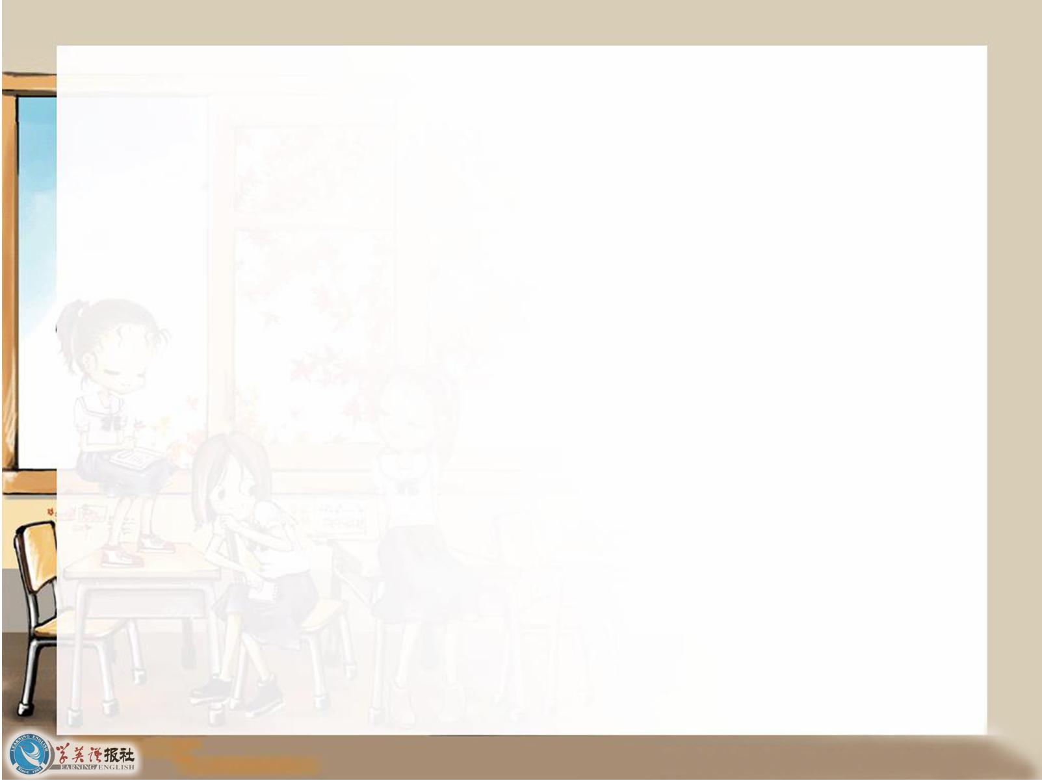
Listen again and fill in the blanks.
One ________ evening I talked to Daddy about my _________ with Peter. Daddy said, “I think you must be ______, Anne. We live very _____ together here.” Then
on _______ morning he called me and we talked about it again. He said, “Anne, I’ve ________ about what you told me.
Saturday
friendship
careful
close
Sunday
thought

Slide 11
I think you should not talk to him _____ so often. This is a special ________. If you were outside you could see many _____ boys and girls. You could do all _____ of other things. But here you are together all the time and if you want to ___ ____ you can’t. In fact you see each other 24 hours a day. What happens if you _______?”
alone
situation
other
kinds
get away
quarrel

Slide 12
I did not _____ ____ him and continued to talk to Peter every evening. A few days _____ Daddy showed he was not _______ with me. He had thought that after our ____ I would not go _______ every evening. He was ___________ that I had not followed
his advice.
agree with
later
pleased
talk
upstairs
disappointed

