Slide 1



Read the short story and tell us where the toilet is and why Jack can’t find the toilet.
Jack is a British boy. He went to America for a trip in this summer vacation. The first day he went to a restaurant and looked around for a toilet. When he asked the waitress, she told him it is on the second floor. Jack went there only to find empty rooms.

Slide 2
British English
the ground floor
the first floor
the second floor
the third floor
American English
the first floor
the second floor
the third floor
the fourth floor

Slide 3
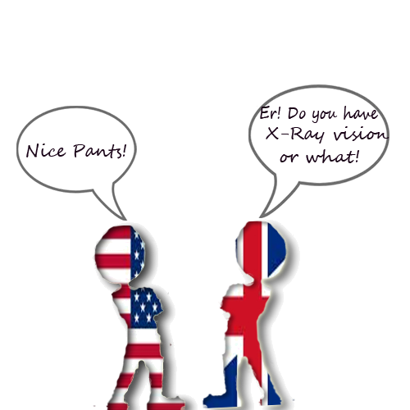

What’s their problem?
What have they mentioned about the differences between British English and American English?

Slide 4

Same things, different names
British English
trousers
American English
pants

Slide 5
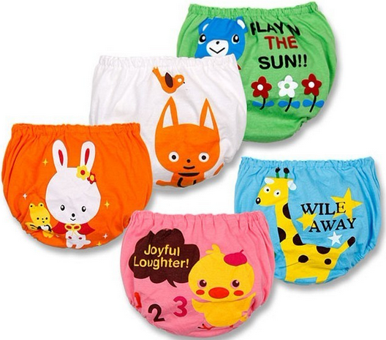
pants
British English
American English
underwear

Slide 6
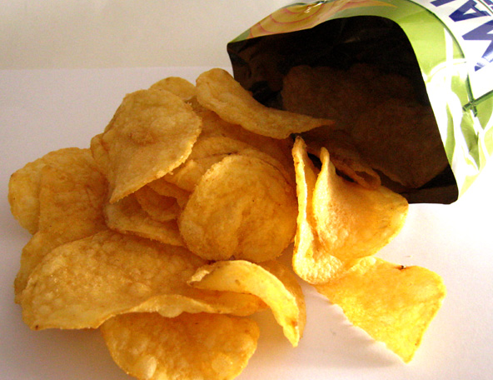
British English
crisps
American English
chips

Slide 7

British English
chips
American English
French fries

Slide 8
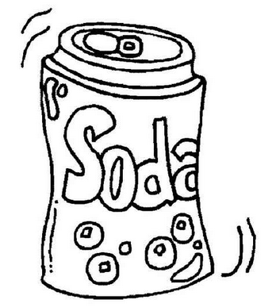
British English
fizzy drink
soda
American English

Slide 9

British English
film
movie
American English

Slide 10
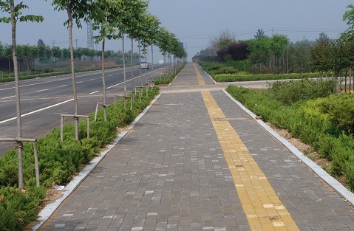
British English
pavement
American English
sidewalk

Slide 11




Can you understand the different kinds
of English these people are using?
Do you know some other similar examples?
OK. But how shall we go to the movies?
Let’s go to the pictures!
Er, but the subway station is far away.
Why not go by Underground?

Slide 12

Fill in the table below.
Chinese | BrE | AmE
秋天 | autumn | fall
公寓 | flat
汽油 |  | gas, gasoline
电梯 | lift
地铁 |  | subway
橡皮 | rubber
垃圾 |  | garbage/trash
度假 | be on holiday
Do you know some other differences between BrE and AmE?
apartment
petrol
elevator
underground
eraser
rubbish
be on vacation

Slide 13
BrE & AmE
Main differences
BrE
AmE
spelling
colour
color
theatre
theater
travelled
traveled
film
movie
vocabulary
football
soccer
autumn
fall
pronunci
-ation
dance[dɑ:ns] [dæns]
neither[naɪðə(r)] [niðɚ]
clerk [klɑ:k] [klɝk]

Slide 14
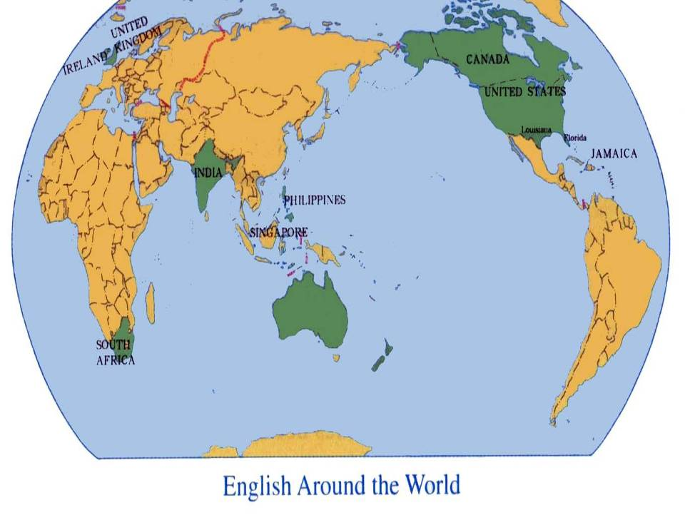
English is spoken in many countries
throughout the world. In some
important ways they are very
different from one another. They
are called world Englishes.

Slide 15



There are many varieties (分类) of
English around the world such as:
Varieties of English
Canadian English
British English
American English
Australian English
Indian English

Slide 16
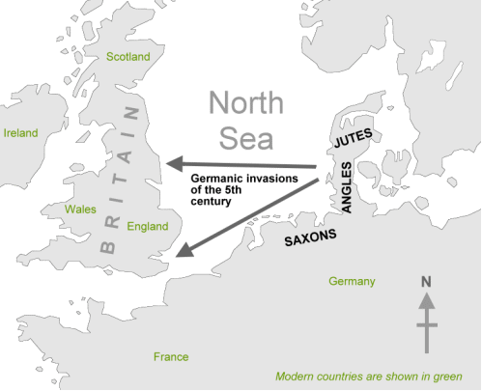
Development of English
The history of the English language really started with the arrival of three Germanic tribes who crossed the North Sea from Denmark and northern Germany.

Slide 17
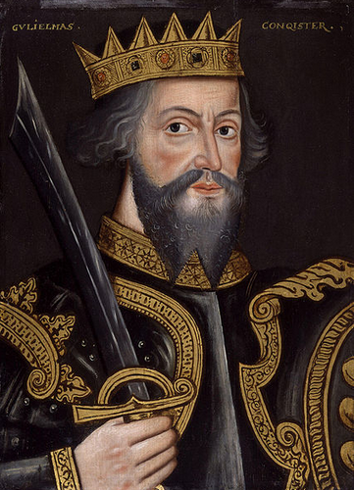
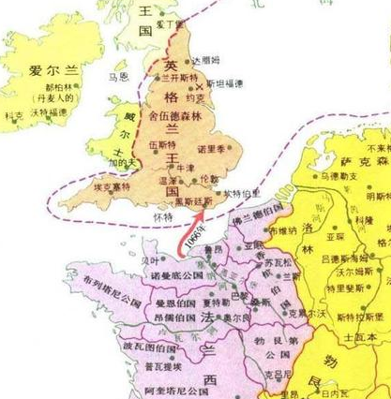
English changes
In 1066, William the Conqueror, the Duke of Normandy (part of modern France), invaded and conquered England. Then French became the language of the upper classes. In the 14th century English became dominant in Britain again, but with many French words added.

Slide 18
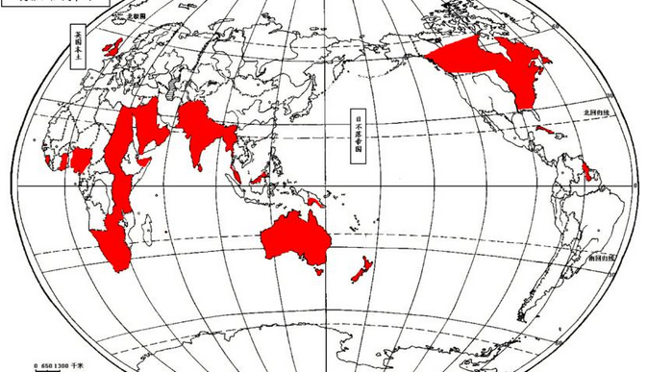
World English
In 1620 some British settlers moved to America. Later in the 18th century some British people were take to Australia. And because of English colonial expansion, English is spoken as a foreign or second language in many parts of the world.

Slide 19

Variations of the English language exist all over the world. The two most popular versions are British and American English. No matter which style you prefer, you must remain consistent throughout your work. Inconsistency can be confusing and looks unprofessional. Therefore, choose one or the other, and stick to your choice.

