Slide 1
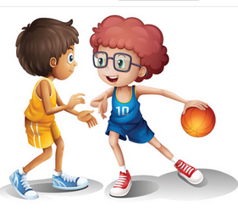
Words and
Expressions
ancient
compete
competitor
take part in
medal
stand for
adj. 古代的；古老的
vi. 比赛；竞争
n. 竞争者
参加；参与
n. 奖章；勋章；纪念章
代表；象征；表示

Slide 2
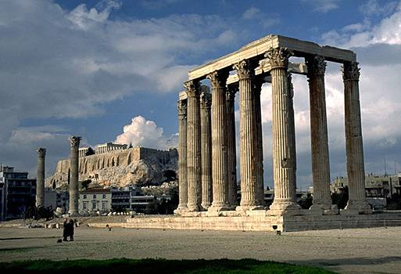
Where did the ancient Olympic Games
start?
Olympia
in Greece

Slide 3
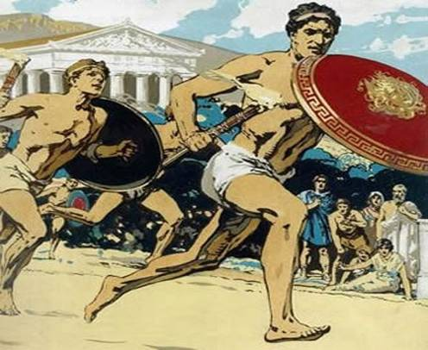
2. How many countries competed in the ancient Olympic Games?
only one,
Greece

Slide 4
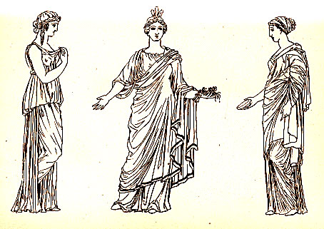
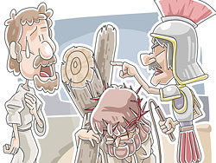
3. Who could not take part in the ancient
Olympic Games?
women and slaves

Slide 5
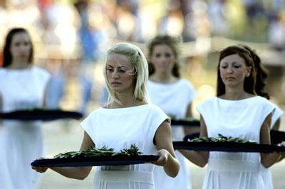
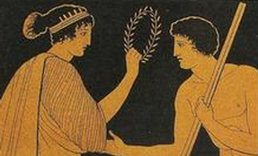
4. What was rewarded to the winners
in ancient Olympic Games?
olive wreath

Slide 6
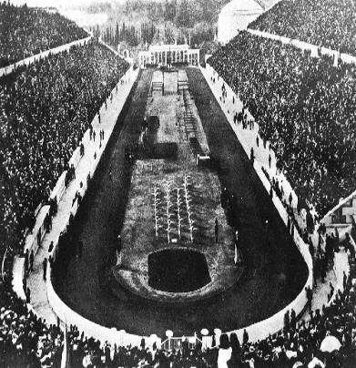
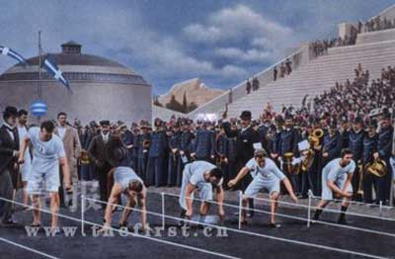
5. When and where did the modern
Olympic Games start?
Athens in 1896

Slide 7
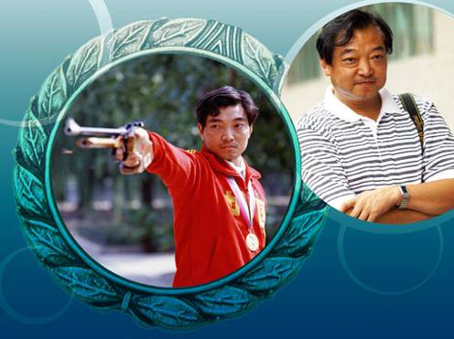
6. Who was China’s first gold medal winner and for what event?
Xu Haifeng for shooting

Slide 8
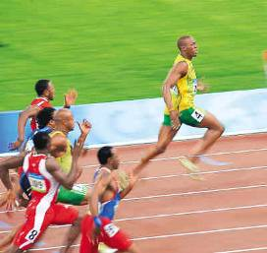
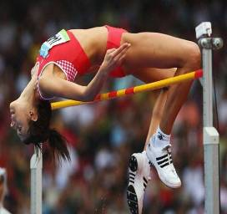
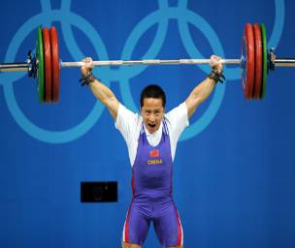
7. What are the three words that show the spirit of the Olympic Games?
swifter higher stronger

Slide 9
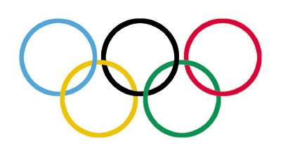
8. What do the five rings on the Olympic
flag stand for?
the five continents
Europe
Africa
America
Asia
Oceania

Slide 10
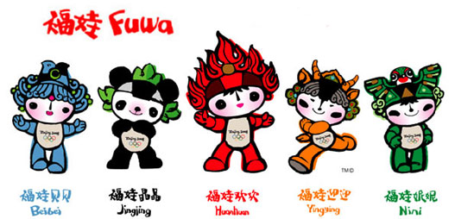
9. What are the official mascots for
the Beijing Olympics?
The five mascots are officially called
the Fuwa.

Slide 11
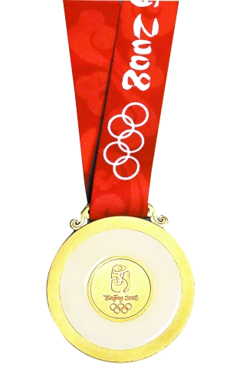
10. How many gold medals did China win
in the 29th Beijing Olympic Games?
51
11. What’s the motto of Beijing Olympic
Games?
One world, one dream

Slide 12


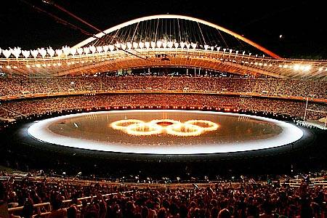
The Ancient
Olympic Games
VS
The Modern
Olympic Games

Slide 13

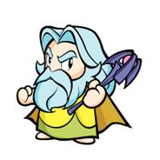
Do you know any differences
between the ancient and modern
Olympic Games? List two of them.

Slide 14
Ancient Olympic Games
1 Only free citizens of one country
could take part
2 Slaves and women could not take part
(except women in chariot races)
3 Always in the same place
4 Only once every four years
5 Limited number of events which
remained the same

Slide 15
Modern Olympic Games
1 Competitors from many countries
2 All adults can take part if they reach
the required standard for their event
3 Hosted by different countries
4 Summer and Winter Games; Special
and Paralympics
5 Many events which continue to increase

Slide 16
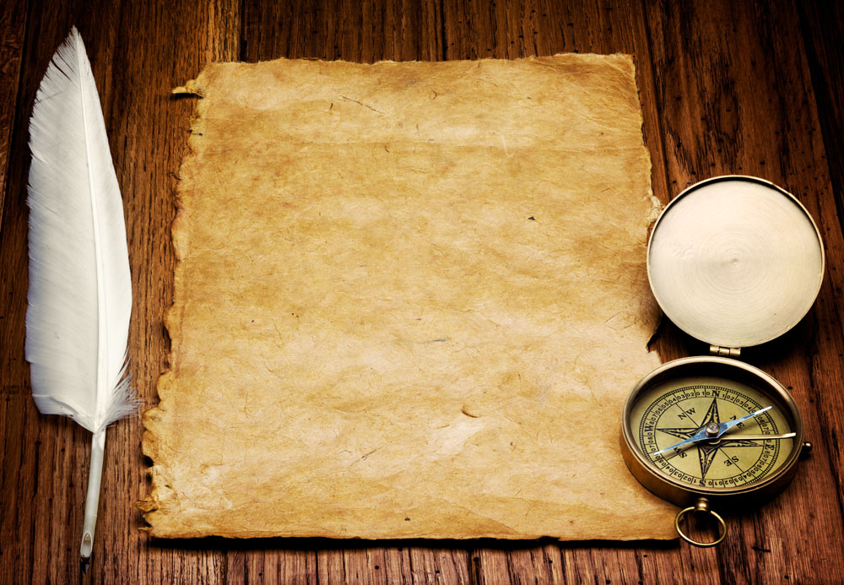
The Ancient
Olympic Games

Slide 17
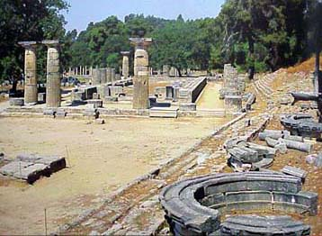
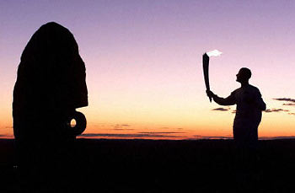
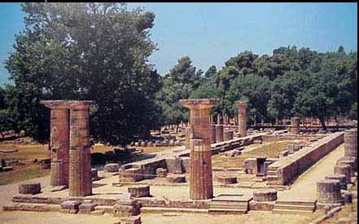

Slide 18
The Olympic Games in Ancient Greece
The ancient Greek Olympic Games were held every four years in Olympia, Greece. Only Greek free-born citizens could take part. Slaves were prevented from competing. Women could only take part in chariot races with horses. Married woman were not even allowed to watch the Games; only young girls, boys and men could watch. Married women who did try to watch could be put to death.

Slide 19
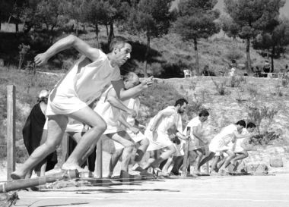
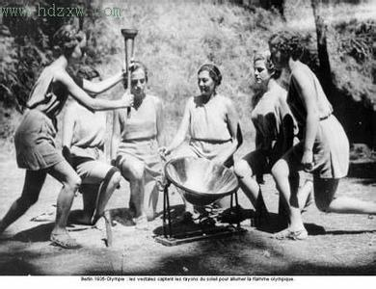
The winners got wreaths made of olive leaves. They did not receive money but they could get presents from their hometowns. Some towns fed their winners or gave them good seats at the theatre.

Slide 20
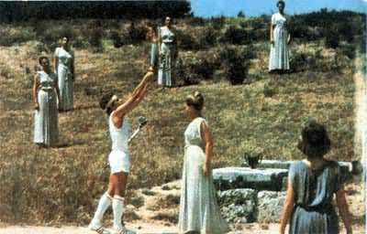
Many of the events in the ancient Olympic Games are part of the modern events in the present-day Olympic Games. The marathon was not part of the ancient Olympic Games, meanwhile, the chariot races(马车赛) and the pankration(古希腊式搏击 ) are not part of the modern Olympic Games.

Slide 21
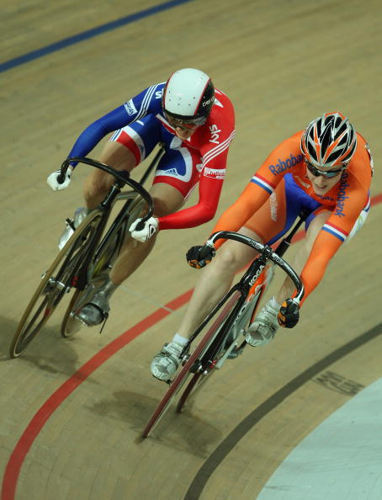
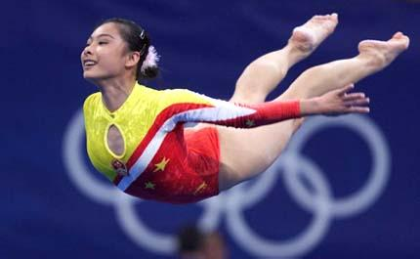
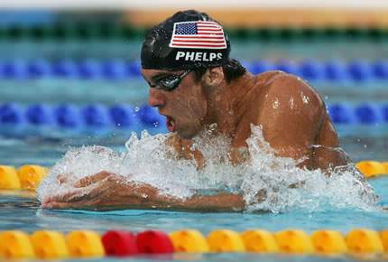
The Modern
Olympic Games

Slide 22
The Modern Olympic Games
The first modern Olympic games was held in Athens(雅典) in 1896 and only twelve nations participated. Since then the games had been held every four years except during the interruption of the two World War. The Olympic Games includes the Winter Olympic Games for ice and winter sports, the Paralympic Games for athletes with a disability, and the Youth Olympic Games for teenage athletes.

Slide 23

Can you Name the events of the Olympic Games according to the following signs?

Slide 24




Events of the Olympic Games
Swimming
Boxing
Cycling
Diving

Slide 25




Events of the Olympic Games
Basketball
Badminton
Baseball
Archery

Slide 26




Events of the Olympic Games
Gymnastics
Sailing
Horse riding
Soccer

Slide 27
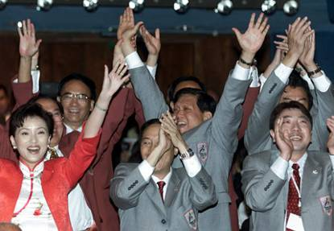
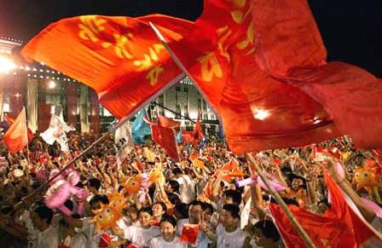
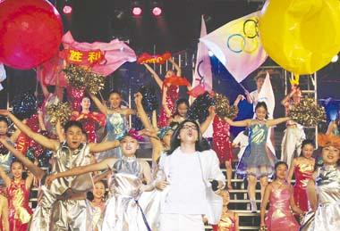
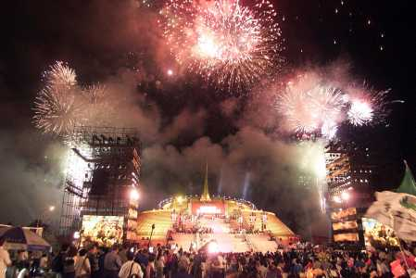
Do you still remember the moments?
Look at these pictures
Beijing Olympic Games

Slide 28
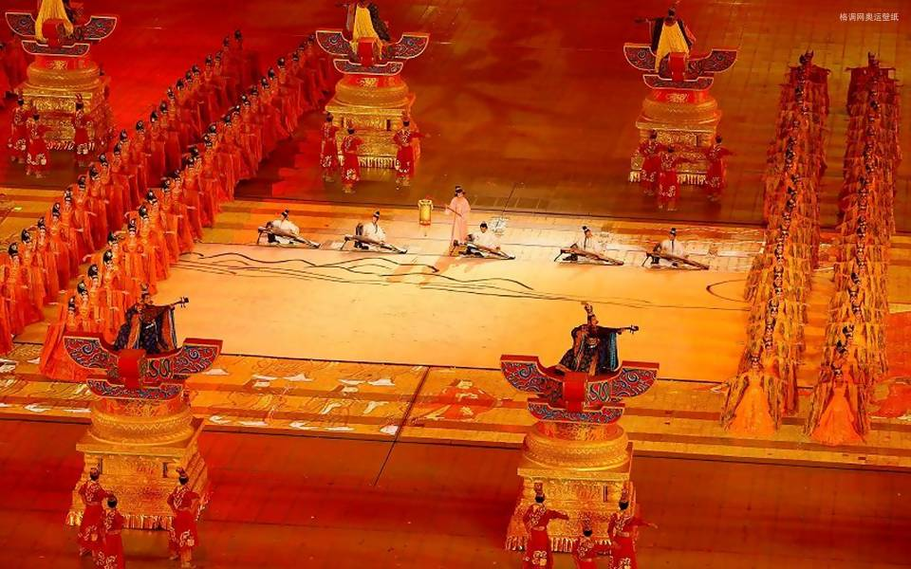
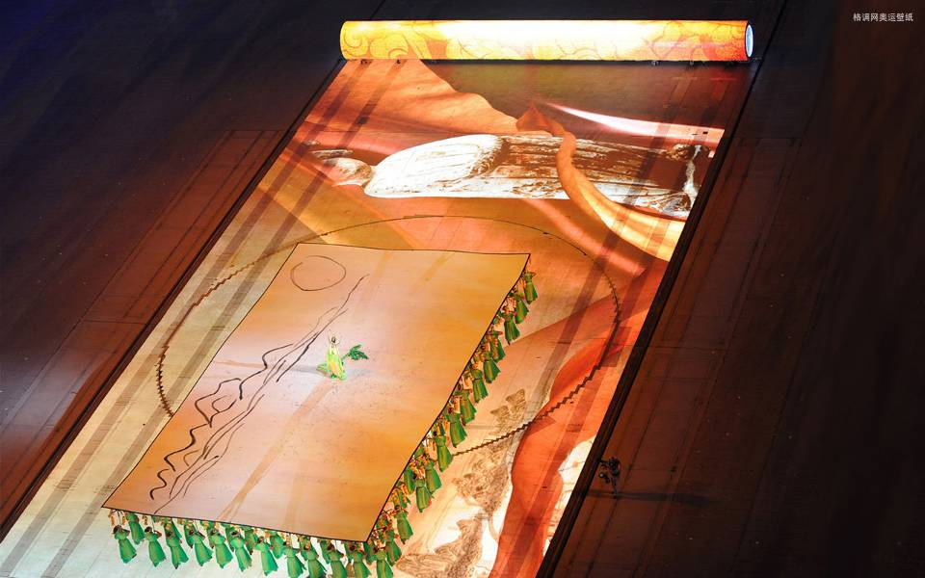
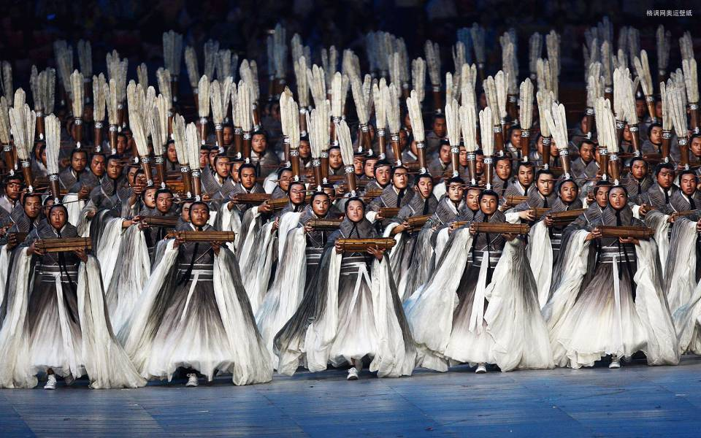
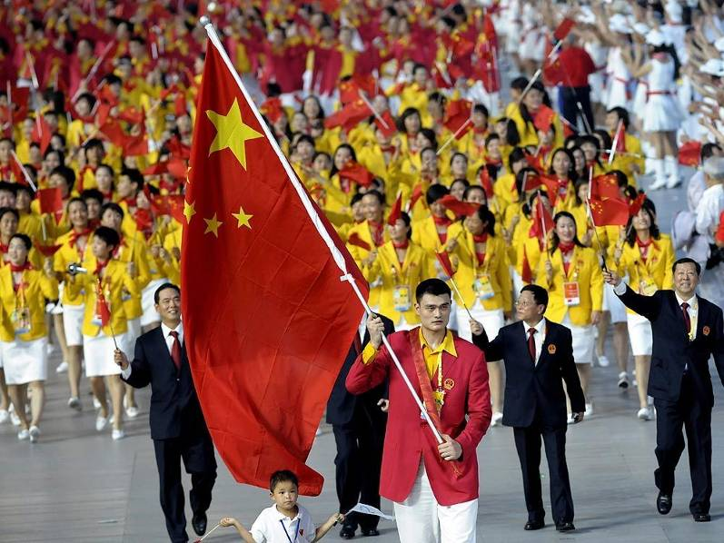
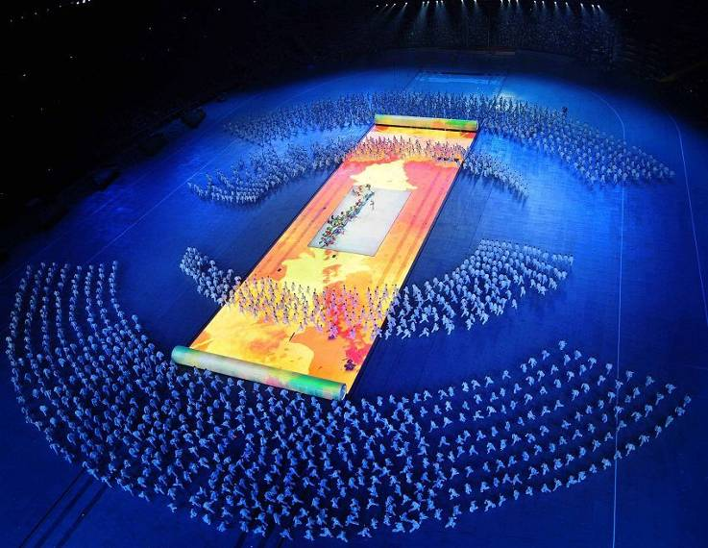
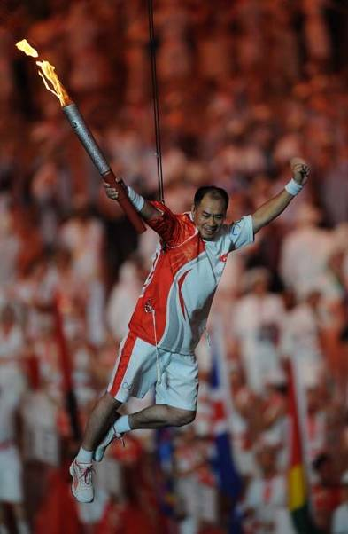
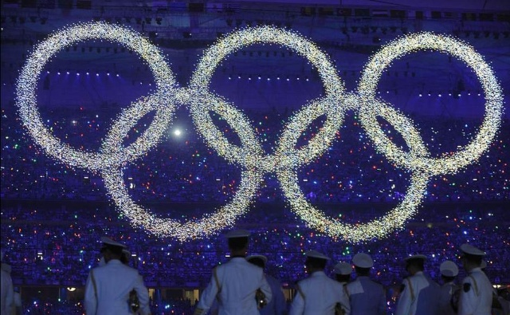
opening ceremony

Slide 29
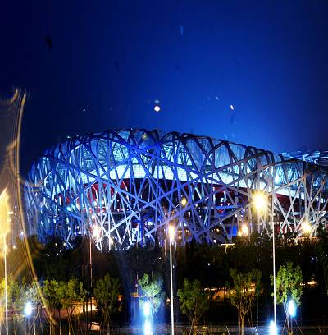
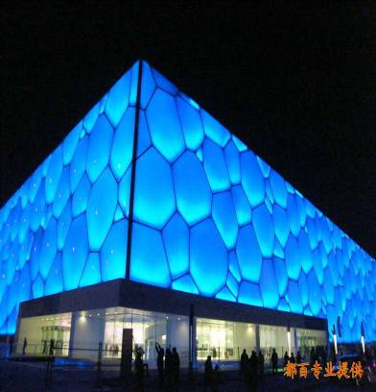
Bird Nest
Water Tube

Slide 30
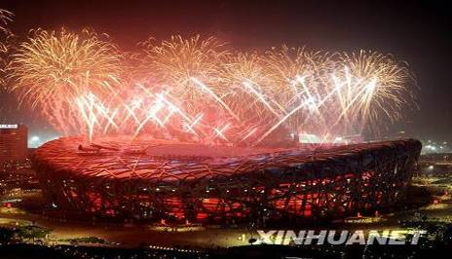
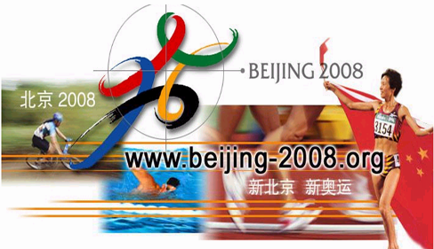
Motto
One World,
One Dream
New Beijing,
Great Olympics

Slide 31
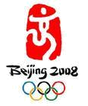
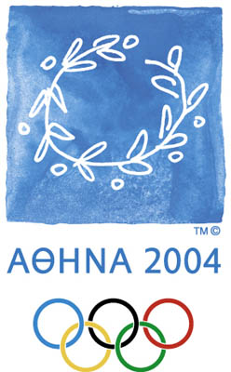
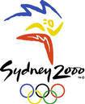
Emblem (会徽)

Slide 32
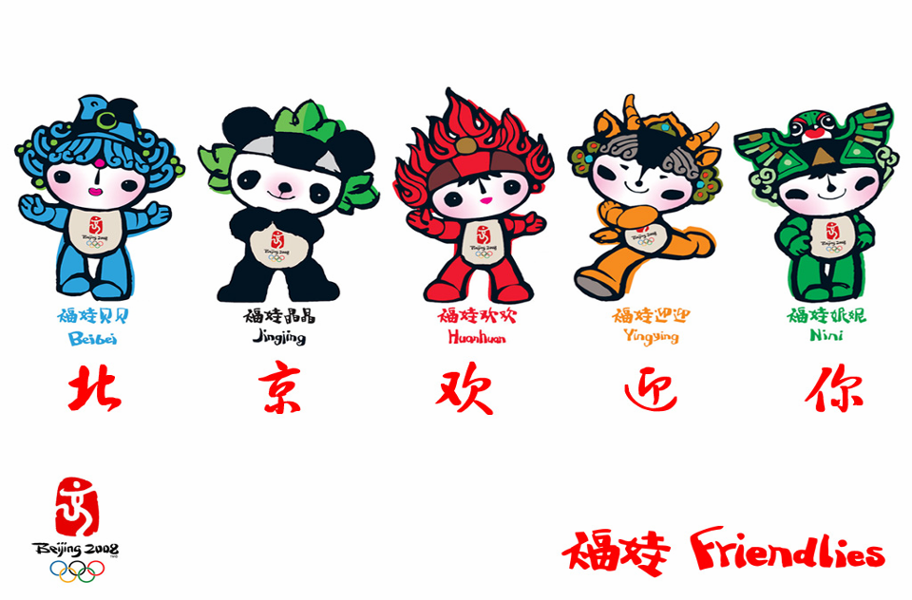
prosperity
happiness
passion
health
good luck
Fuwa
Beijing Olympic Mascots

Slide 33
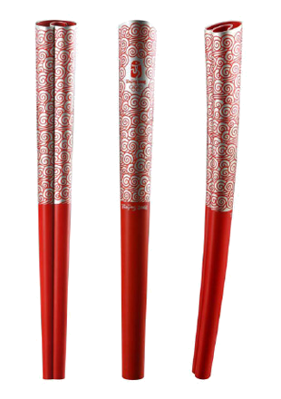
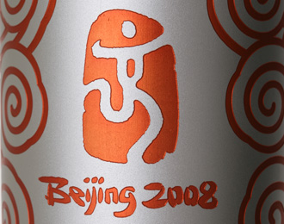
The Torch of the Beijing Olympic Games

Slide 34
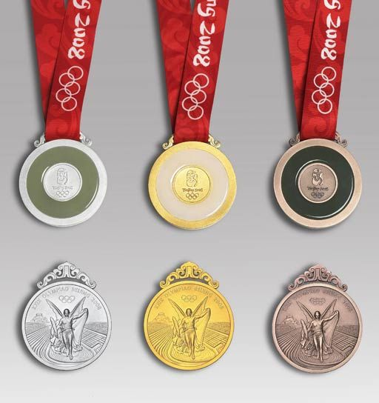
medals decorated with jade
Olympic Medals
silver
gold
bronze

