Slide 1

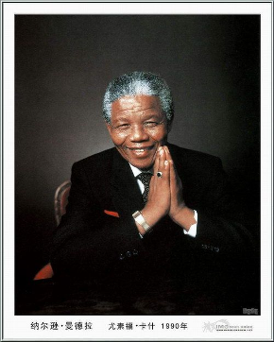

Unit 5
Nelson Mandela
— a modern hero

Slide 2
Words review
quality
mean
active
generous
self
selfish
selfless
n. 质量; 品质; 性质
adj. 吝啬的; 自私的; 卑鄙的
adj. 积极的; 活跃的
adj. 慷慨的; 大方的
n. 自我; 自身
adj. 自私的
adj. 无私的; 忘我的

Slide 3
Words review
selflessly
devote
devoted
found
republic
principle
peaceful
mankind
adv. 无私地; 忘我地
vt. (与to连用)献身; 专心于
adj. 忠实的; 深爱的
vt. 建立; 建设
n. 共和国; 共和政体
n. 法则; 原则; 原理
adj. 和平的; 平静的; 安宁的
n. 人类

Slide 4

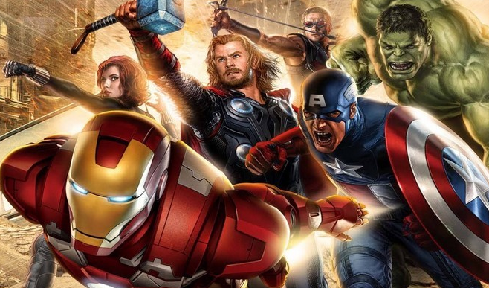
Are they heroes? How do you define hero? What qualities does a great person have?

Slide 5
selfless
strong
determined
brave
hard-working
Qualities
of the great
people
generous
devoted
kind
confident
easy-going
responsible
warm-hearted
helpful
honest
independent

Slide 6

Who is he?

Slide 7
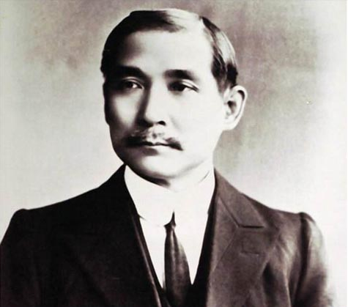
Who is he?
He was born in a peasant family in 1866.
He is a Chinese who founded the first Republic in China in 1911 after many years’ fighting.
He strongly believed in the three principles:
nationalism; people’s rights; people’s
livelihood.
Sun Yat-sen

Slide 8

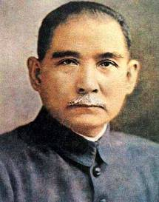
Sun Yat-sen (1866 - 1925), China
He was a Chinese revolutionary leader and statesman, the
founder of the Kuomintang and the first provisional president
of the Republic of China.

Slide 9
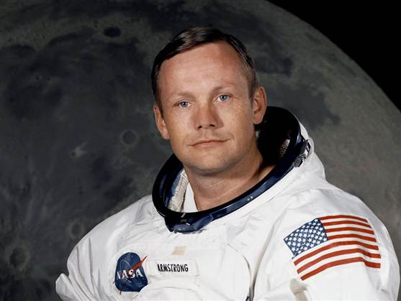
Who is he?
He was a pilot in the American Air Force
and later joined the astronaut program.
He was the first man to land on the moon in July 1969.
He said, “That’s one small step for a man,
one giant leap for mankind.”
Neil Armstrong

Slide 10
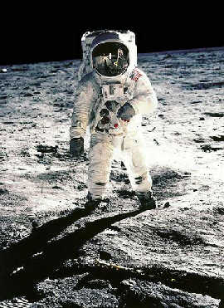
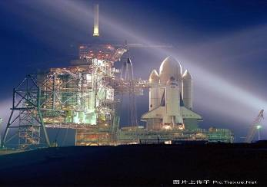
Neil Armstrong
(1930 - 2012), USA
American pilot, astronaut; the first person to walk on the moon

Slide 11
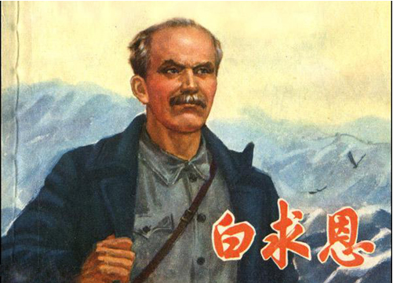
Who is he?
He was a Canadian who worked selflessly in China as a doctor and saved many Chinese people.
He fought against the German Nazis and Japanese invaders during World War II.
Unfortunately he got blood poisoning
while working in China and died here.
Norman Bethune

Slide 12

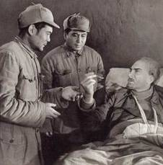
Norman Bethune (1890 - 1939), Canada He was a Canadian,
a Communist and also a doctor. He supported the Chinese Communist Party and went to help their army as a doctor and to train other doctors. He invented mobile field hospital units which could be moved quickly to the places where the war was being fought.

Slide 13
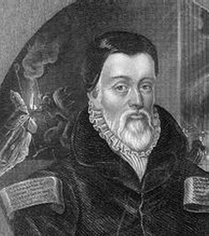
Who is he?
He was a man who wrote the Bible in English so all could read it.
He died for his ideas but his work is
still used in the official Bible today.
William Tyndale

Slide 14
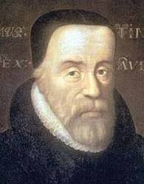
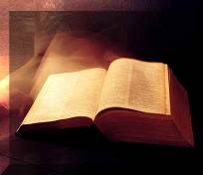
William Tyndale (1494 - 1536),
Britain He believed that the Bible should be read by everyone. He translated the Bible into easily readable English for the people of his time. The priests and some religious people opposed his idea. At last he was caught and put to death for his beliefs.

Slide 15
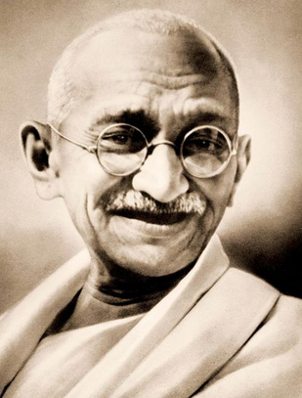
Who is he?
He was the father of the Indian nation of the twentieth century.
He gave up a rich life for his ideas.
He fought for his country to be free from
the UK in a peaceful way.
Mohandas Gandhi

Slide 16

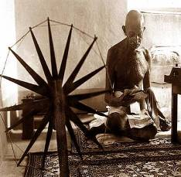
Mohandas Gandhi (1869 - 1948),
India He formed an
organization leading the India’s
struggle for equal rights. He was
a model of a different kind of
political leader. Mohandas
Gandhi was educated in the
United Kingdom and received
a law degree from University
College in London.

Slide 17
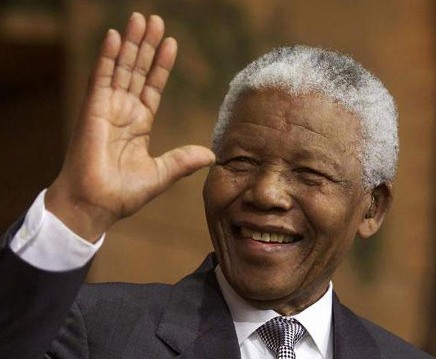
Who is he?
He was the former president of South
Africa who fought for black people.
He helped black people get the same rights as white people.
He was in prison for almost thirty years.
Nelson Mandela

Slide 18
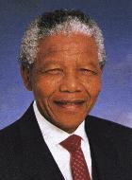
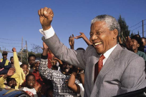
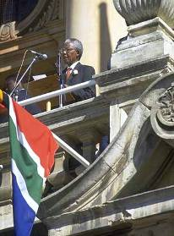
Nelson Mandela (1918 - 2013), South Africa In order to make the black people get the freedom,
he fought many years and was
in prison for 27 years.
He helped the black people to realize the dream of making
black and white people equal.

Slide 19



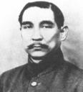
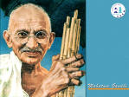

Most great people are also famous people, but famous people may not be great people.

Slide 20
A great man is
1. one who helps others especially when they are ready to sacrifice something to help.
2. one who unselfishly gives up something to achieve his goal.
3. one who has gone through struggles
and difficulties for their noble cause.
4. one who is very dedicated and
persistent in achieving his noble goal.

Slide 21

Great people in your heart
Who is the great person in your heart?
Why do you like him\her so much?
Did he\she do anything for others?
What are\were his\her best qualities?

Slide 22
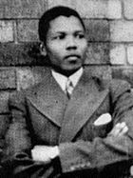
Nelson Mandela was born on 18 July, 1918 in Transkei, South Africa. Mandela became the first member of his family to attend a school, where his teacher Miss Mdingane gave him the English name "Nelson".

Slide 23
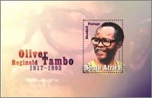
After enrolling (入学), Mandela began to study for a Bachelor of Arts at the Fort Hare University, where he met Oliver Tambo. Tambo and Mandela became lifelong friends
and colleagues.

Slide 24
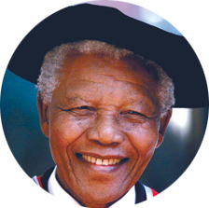
After the 1948 election
victory of the Afrikaner-
dominated National Party,
Mandela began actively participating in politics. Nelson Mandela was elected the first black President in South Africa in 1994.

Slide 25
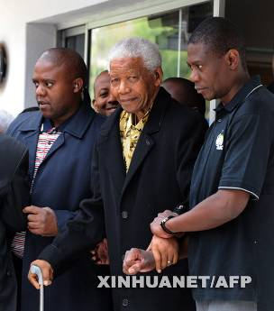
In 1961, he became the
President of the African
National Congress (ANC).
He helped the black people
to get the same rights as the
white people. He fought for the black
people and was in prison for 27 years.

Slide 26
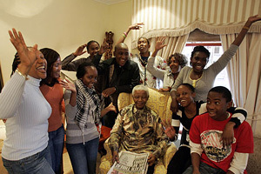
Mandela's 90th birthday was marked
across the country on 18 July 2008, with
the main celebrations held at his home-
town of Qunu. In a speech to mark his
birthday, Mandela called for the rich
people to help poor
people across the world.

Slide 27
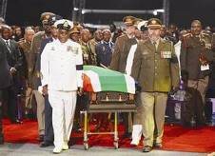
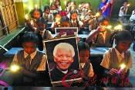
After suffering from a prolonged respiratory infection (呼吸道感染), Mandela died on 5 December 2013 at the age of 95. He died at around 20:50 local time (UTC+2) at his home in Houghton, Johannesburg, surrounded by his family. His death was announced on television by President Jacob Zuma. On 6 December 2013, President Zuma announced a national mourning (国丧) period of ten days.

