Slide 1

Unit 5 Canada – “The True North”
Period 7 Integrating skills

Slide 2
Listening, Talking, Writing, Summing-up and Self-test

Slide 3
Listening on p. 69
Li Daiyu and Liu Qian were asked to give a report telling their new Canadian friends about China.

Slide 4
Pre-listening
1. Discuss with your partner what the most important points are for a foreigner to know about China.
2. Predict what the girls will say in their report.

Slide 5
1st listening : Main idea
A comparison between Chinese and Canadian geography and climatic features.

Slide 6
2nd listening : details
True or False
China is over 7,000 kilometers from east to west.
2. Both China and Canada have mountains in the west of the country.
F
T

Slide 7
3. The Great Wall cannot keep the desert’s dust away from Beijing.
4. China has 15 neighbouring countries while Canada only has one .
5. Canadians cannot talk with people in their neighbouring country because they do not speak English.
T
T
F

Slide 8
3rd listening : Discussion
Why might people from Canada want to visit Hainan? Give some reasons.

Slide 9
Talking on p. 69
What are some of the major similarities and differences between China and Canada? Discuss your ideas in small groups. Use the map on p. 33 and the map of China to help you.

Slide 10
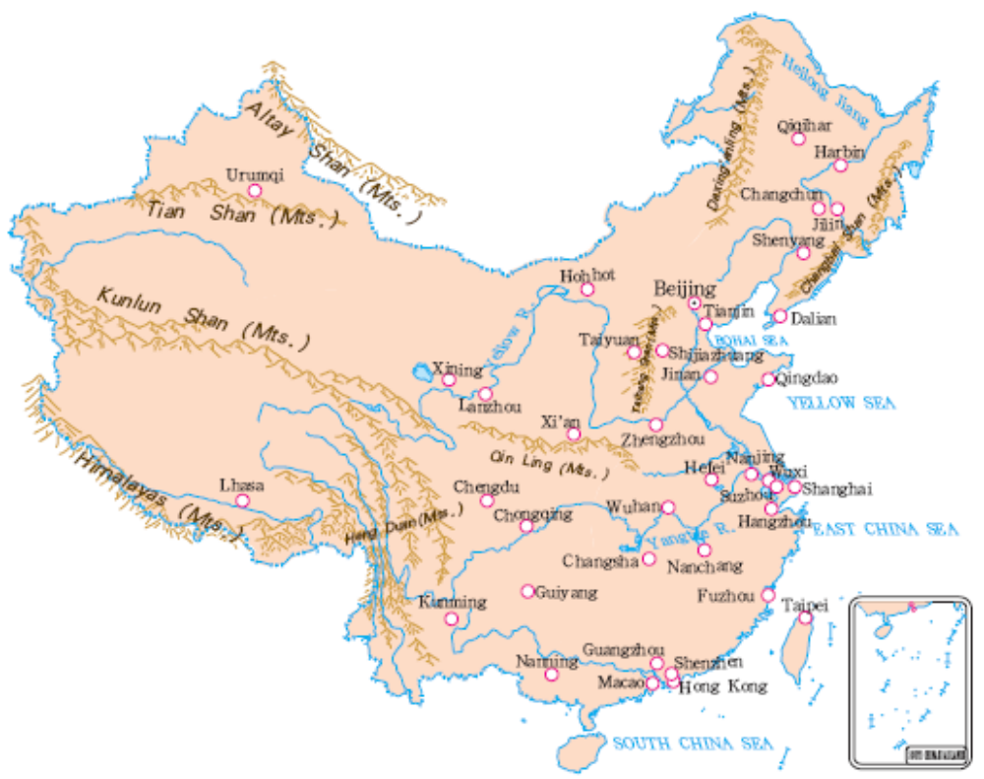
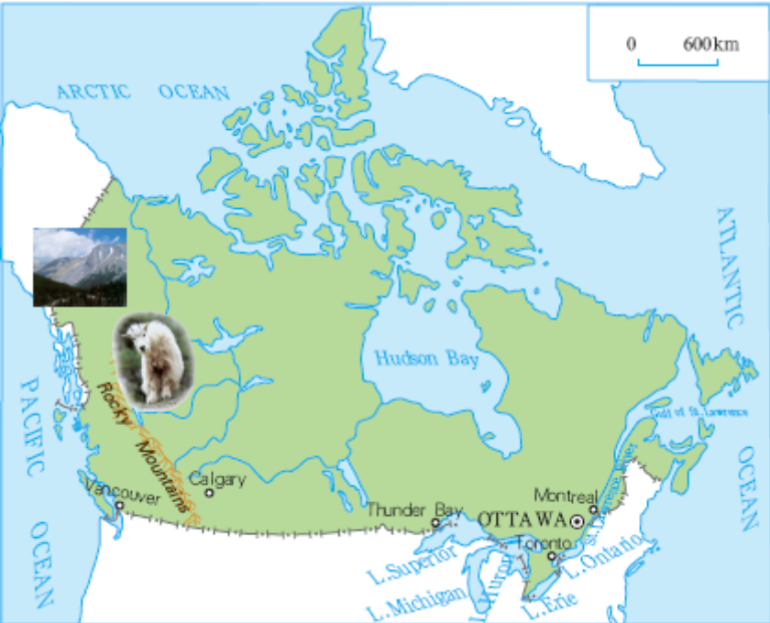

Slide 11
Report on Canada and China
Geography
Natural resources
Seasons and climates
Population
Major cities
Places of interest

Slide 12
Writing on p. 75
A group of visiting students are coming on a three to five-day tour of your city or town. Plan what places are best for them to visit, which direction they will go and what the places are like. Use the words and expressions you have learned for geographical direction and location.

Slide 13
Happy Feet Tour Company
Day one: Arrive in … Check into the hotel in the morning and have lunch. In the afternoon go out to see the sights … In the evening, …
Day two: …
Day three: …
Day four: …

Slide 14
Summing up
Write down what you have learned about Canada.
______________________________________________
______________________________________________
______________________________________________
From this unit you have also learned
Useful verbs:__________________________________
______________________________________________
Useful nouns: _________________________________
______________________________________________
Useful adjectives and adverbs: ____________________
______________________________________________
Other expressions: _____________________________
______________________________________________
A new grammar item: ___________________________
__________________________________________

Slide 15
Homework
1. Review all of the language points and grammar items in this unit.
2. Please finish the self-test and evaluate yourself.

