Slide 1

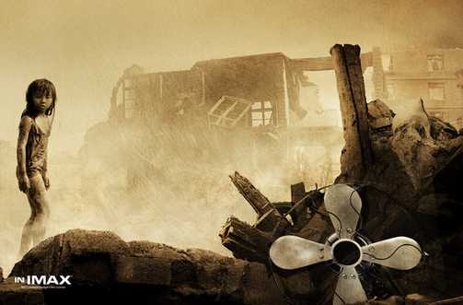

Unit 4
A NIGHT THE EARTH
DIDN’T SLEEP

Slide 2
Words review
well
crack
smelly
farmyard
pipe
burst
million
n. 井
n. 裂缝；噼啪声
vt. & vi.（使）开裂；破裂
adj. 发臭的；有臭味的
n. 农场；农家
n. 管；导管
vi. (burst, burst) 爆裂；爆发
n. 突然破裂；爆发
n. 百万

Slide 3
Words review
event
nation
canal
steam
dirt
ruin
suffering
extreme
n. 事件；大事
n. 民族；国家；国民
n. 运河；水道
n. 蒸汽；水汽
n. 污垢；泥土
n. 废墟；毁灭
vt. 毁灭；使破产
n. 苦难；痛苦
adj. 极度的

Slide 4
Words review
injure
survivor
destroy
brick
dam
track
useless
shock
vt. 损害；伤害
n. 幸存者；生还者；残存物
vt. 破坏；毁坏；消灭
n. 砖；砖块
n. 水坝；堰堤
n. 轨道；足迹；痕迹
adj. 无用的；无效的；无益的
vt. & vi.（使）震惊；震动
n. 休克；打击；震惊

Slide 5
Words review
rescue
trap
electricity
disaster
bury
mine
miner
shelter
n. & vt. 援救；营救
vt. 使陷入困境
n. 陷阱；困境
n. 电；电流；电学
n. 灾难；灾祸
vt. 埋葬；掩埋；隐藏
n. 矿；矿山；矿井
n. 矿工
n. 掩蔽；掩蔽处；避身处

Slide 6
Match
as if
at an end
in ruins
dig out
a (great) number of
严重受损；破败不堪
掘出；发现
许多；大量的
照常
仿佛；好像
结束；终结

Slide 7
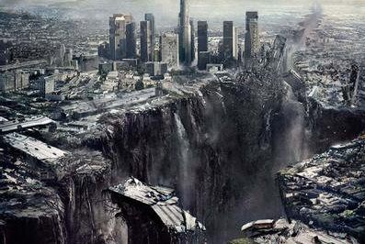
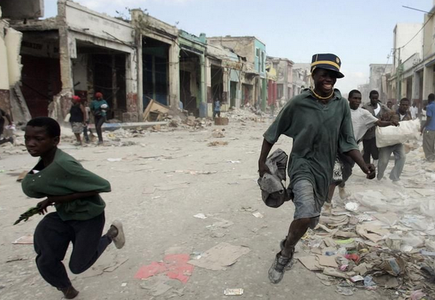
Have you experienced an earthquake?
How do you feel about an earthquake?
terrible
frightening
be at panic
desperate for opportunities to survive

Slide 8
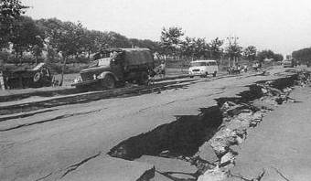
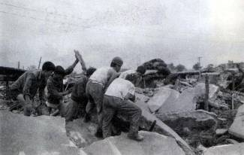
Main idea of the passage
The passage mainly talks about a/an
___________(what) that happened in
_________ (where)in ______.(when)
earthquake
Tangshan
1976

Slide 9
Organization of the text
Clue (线索) of the story:
time order
para 1
Part 1:
signs
Before the earthquake strange things began to happen but no one paid attention to them.
paras 2 & 3
damage
Part 2:
The earthquake destroyed the city of Tangshan. The people were very shocked at the destruction.
para 4
recovery
Part 3:
The army came to help the survivors, bringing hope for a new life.

Slide 10

















During the earthquake
What do these numbers stand for?
3:42 am
11
kilometers
200 kilometers
15 seconds
2/3
8 & 30
75%, 90%
400,000

Slide 11




3:42 am
At 3:42 am everything began to shake.
11
kilometers
11 kilometers directly below the city
The earthquake was felt in Beijing, which is more than 200 kilometres away.
200 kilometers
A huge crack was 8 kilometers long and thirty metres wide.
8 & 30

Slide 12






15
seconds
In 15 seconds a large city lay in ruins.
Two-thirds of the people in Tangshan died or were injured.
2/3
The number of people who were killed or injured reached more than 400,000.
400,000
75% of the city’s factories and buildings and 90% of its homes were gone.
75%,
90%

Slide 13

After the earthquake
organize teams
dig out the trapped
bury the dead
The army
build shelters for survivors
What should be done immediately?
be taken to the city by train, truck and plane
Workers
Fresh
water

Slide 14



Choose the best answer.
1. The earthquake began at ________.
A. 3:00 am, June 28, 1976
B. 3:00 am, July 28, 1976
C. 3:42 am, July 28, 1976
2. _________ people were killed or
injured in the quake.
A. Less than 400,000
B. More than 400,000
C. More than 150,000

Slide 15
3. Before the earthquake the following
happened EXCEPT that _______.
A. the water in the well rose and fell
B. the animals were too nervous to eat
C. bright lights appeared in the sky
D. people made good preparations for
the earthquake
4. How long did the earthquake last?
A. Ten seconds. B. Fifteen seconds.
C. Twenty seconds. D. Half a minute.

Slide 16
5. Which of the following didn’t happen
during the earthquake?
A. A huge crack appeared in the roads.
B. Bricks covered the whole ground.
C. The injured were sent to hospital
immediately.
D. The railway tracks became useless
pieces of steel.

Slide 17



True or false
One-third of the people died or were
injured during the earthquake.
2. Such a great number of people died
because the quake happened while they
were working.
3. All the hospitals had been destroyed.
Two-thirds
sleeping

Slide 18
4. Only supply of water and electricity
was cut off.
5. Almost everything in Tangshan was destroyed.
6. Before the earthquake there wasn’t
anything strange happening.
7. Workers rescued most of the 10,000
coal miners to the south of the city.
The supply of water, food and electricity
was
something
The army

Slide 19
Join the correct parts of the sentences.
P27 1
1 The chickens didn’t
eat because
2 The people didn’t
worry because
3 Such a great number
of people died because
4 Water was needed
because
5 The people did not
lose hope because
A the army came
to help them.
B the quake
happened while
they were sleeping.
C they were nervous.
D dams and wells
were useless.
E they didn’t know
what the strange
events meant.

Slide 20


Careful reading
重难点句式分析

Slide 21
1. then, later that afternoon, another big quake which was almost as strong as the first one shook Tangshan.
定语从句
as…as… “与…一样”，其中的第一个as为副词，其后通常接adj. 或 adv.(用原级)，第二个as可用作连词。
She’ll soon be as tall as her mother.
她很快就会和她母亲一样高了。
接着，在下午晚些时候，又一次和第一次一样强烈的地震震撼着唐山。

Slide 22
Translation
1. 我跑的没你快。
I can't run as fast as you.
2.这些是我们所有人都坚信的原则。
These are principles which we all believe in.

Slide 23
1. It seemed as if the world was at an end!
世界似乎到了末日！
表语从句
as if “仿佛; 好像” 可在look, seem等系动词后引导表语从句。
at an end 结束; 终结
1. 看来他好像不能按时到达了。
It looks as if he won’t arrive in time.
2. 他的职业生涯结束了。
His career was at an end.

Slide 24


P27 5
Talk and Practice
Choose a paragraph and act out an interview between a reporter and a survivor from the Tangshan earthquake.

Slide 25
Complete the passage with proper words, which will help you retell the text.
Strange things appeared before the Tangshan earth-quake happened. The well walls had deep cracks. A ______ (smell) gas came out of them. Many animals were too nervous ______ . Bright lights were seen in the sky. The water pipes ________ and _____. At 3:42 am on July 28, 1976, everything began to shake. It seemed ______ the world was __________. Steam burst from holes in the ground. Hard hills of rock became rivers of dirt.
smelly
to eat
cracked
burst
as if
at an end

Slide 26
lay in ruins
Soon the whole city __________ . The number of people who ___________ (kill) or injured reached more than 400,000. Later that afternoon, another big quake which was almost ___ strong ____ the first one shook Tangshan. Everyone in the city was shocked and wondered how long the disaster would ___. _______ (luck), the army organized teams to ________ those who were trapped and to bury ________. Workers built shelters for _________. ____________ was taken to the city by train, truck and plane. Thanks to the army, the city began to _______ again.
were killed
as
as
last
Luckily
dig out
the dead
survivors
Fresh water
breathe

Slide 27
A powerful magnitude-8.2 earthquake struck off Chile's northern coast on Tuesday night, causing landslides and setting off a small tsunami (海啸) that forced an evacuation (撤离) of coastal areas.
In the city of Arica, the mayor reported some minor injuries and said some homes made of adobe (土砖) were destroyed. The quake shook modern buildings in nearby Peru and in Bolivia's (玻利维亚) high altitude capital of La Paz (拉巴斯).
The US Geological (地质的) Survey initially (最初) reported the quake at 8.0, but later upgraded (升级) the magnitude. It said the quake struck 61 miles (99 kilometers) northwest of the Chilean city of Iquique (伊基克，智利城市) at 8:46 pm,

Slide 28
hitting a region that has been rocked by numerous quakes over the past two weeks.
The quake was so strong that the shaking experienced in Bolivia's capital about 290 miles (470 kilometers) away was the equivalent of a 4.5-magnitude tremor, authorities there said.
At least eight strong aftershocks (余震) followed in the first few hours, including a 6.2 tremor. More aftershocks and even a larger quake could not be ruled out, said seismologist (地震学家) Mario Pardo at the University of Chile.
Some roads in northern Chile were blocked by landslides, causing traffic jams among people leaving the coast.

