Slide 1
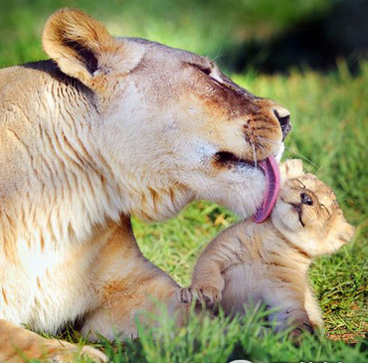
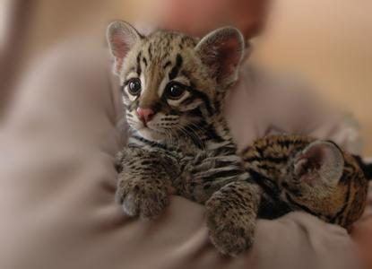
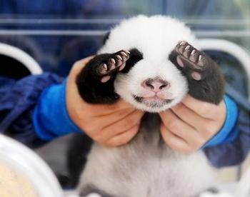
Unit 4
Wildlife protection

Slide 2
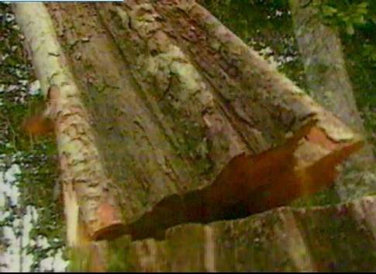

Animals in danger

Slide 3


Lead-in 1
Who is he?
Yao Ming. The former NBA star and Chinese basketball icon.

Slide 4


The former NBA star and Chinese basketball icon Yao Ming has dedicated his last few years to raising awareness of wildlife protection.

Slide 5
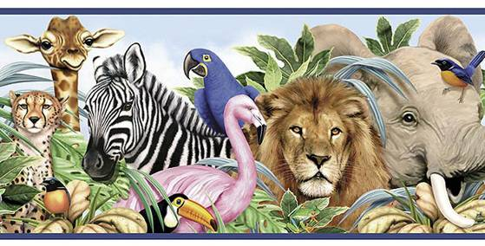
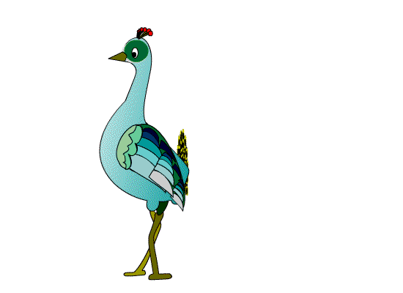
What’s the meaning of wildlife?
Animals or plants live or grow in natural conditions.

Slide 6

Wild plants and animals have to
look after themselves. They need
food, a good environment and
safety. If their habitat is threatened
or they cannot find enough food,
their numbers may decrease. As a
result these endangered animals
may even die out. They need help.
This is what wildlife protection is
all about.

Slide 7
Why is it meaningful to protect wildlife?
The most important reason for saving wild animals is that they are part of our ecosystem. Every species of wildlife plays a role to maintain the balance of life on Earth. Thus, the loss of any species can affect us directly or indirectly.
Secondly, wild animals provide many valuable substances such as medicine and fur, the financial value of wild species is important to the economies of many nations.
Finally, wild animals have aesthetic(美学的) appeal. They are beautiful creatures of nature and are a part of our bio-diversity.

Slide 8
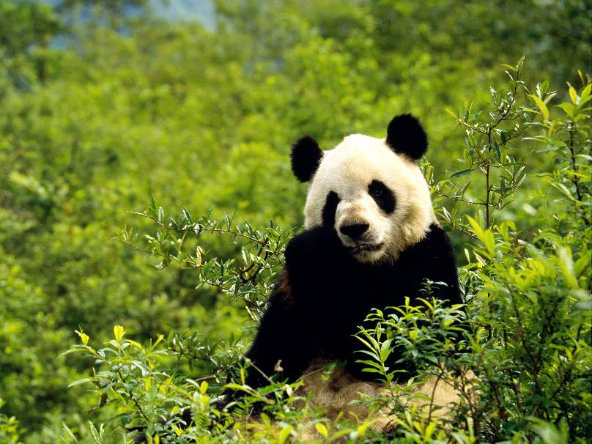
Who am I?
I live in China.
I’m black and white.
I eat bamboo and move by walking.
panda

Slide 9
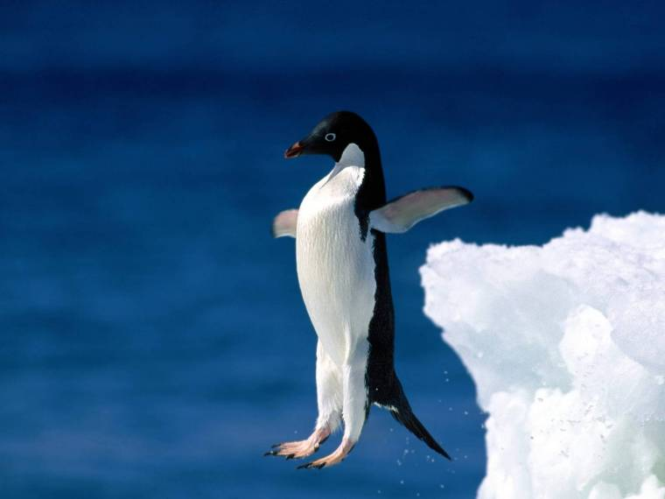
Who am I ?
I have an orange beak (喙).
I wobble (摇摆) back and forth. I have a white stomach (肚子).
I slide (滑行) on the ice.
penguin

Slide 10
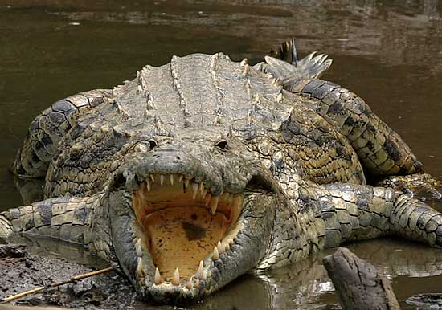
Who am I?
        I live in lakes and rivers.
        I eat fish and birds.
        I have four legs and a long tail.
        I have lots of sharp teeth.
crocodile

Slide 11
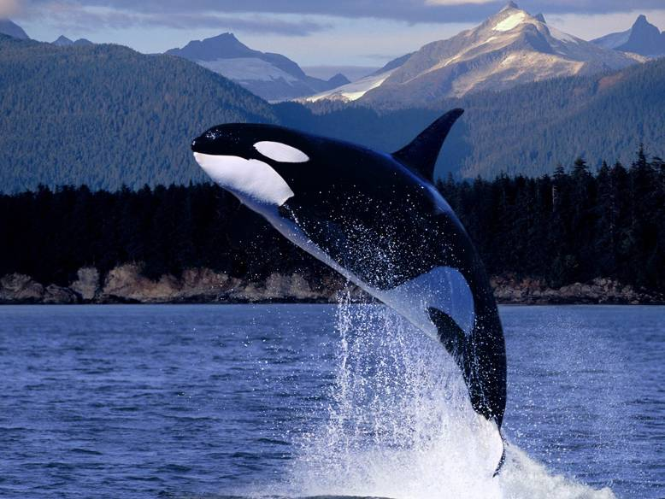
Who am I?
I live in the ocean (海洋).
I can go in the deep water.
I have a hole on top of my head. I have the largest size in the world.
blue whale

Slide 12
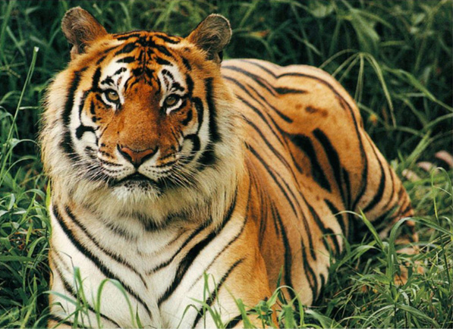
Who am I?
I live in the forest.
I eat other small animals.
I am called “King of all the beasts”.
tiger

Slide 13
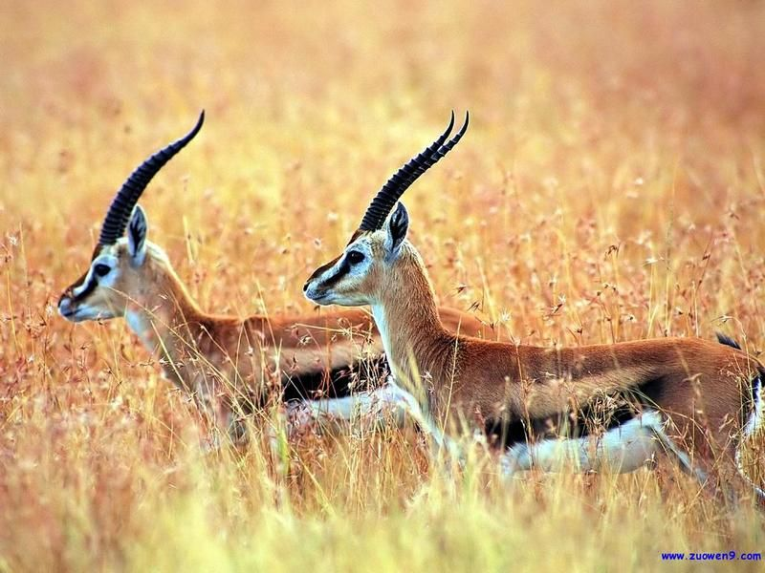
Tibetan antelope

Slide 14
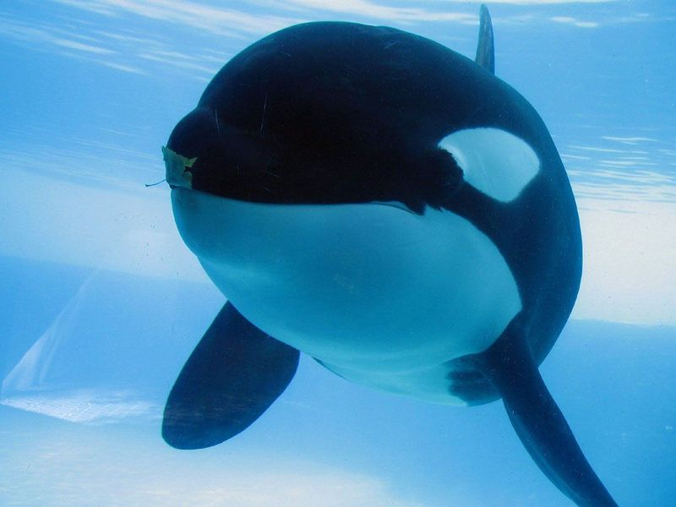
blue whale

Slide 15
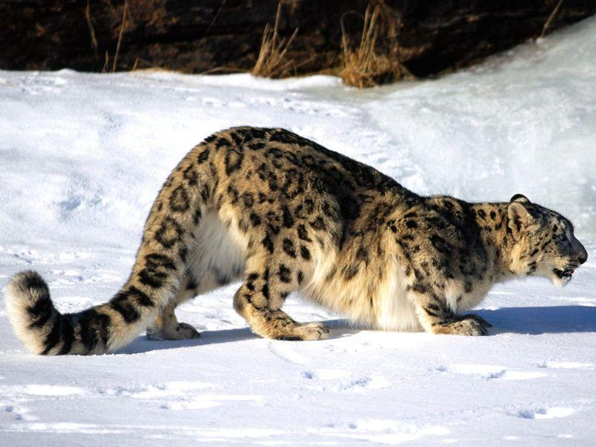
snow leopard

Slide 16
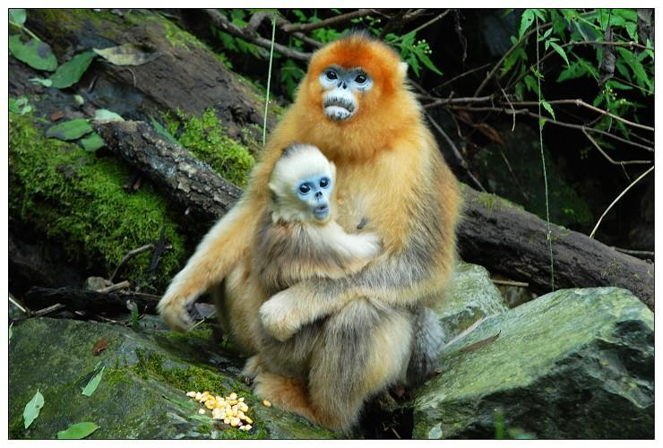
golden monkey

Slide 17
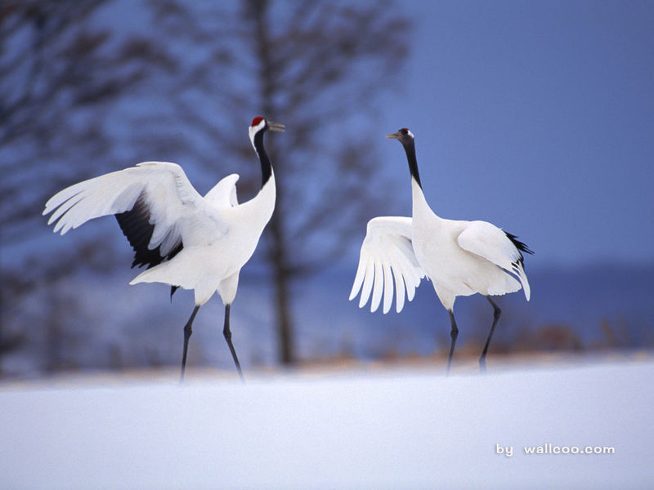
red-crowned crane

Slide 18
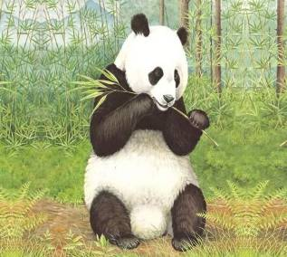
A report on some endangered wildlife in China
Problem
not enough food: loss of bamboo growing areas
Number before concern
Panda
nearly all disappeared
Number after concern
One habitat in China
about 1,600 after more than 50 reserves set up to protect bamboo areas
Wolong Nature Reserve, Sichuan Province

Slide 19
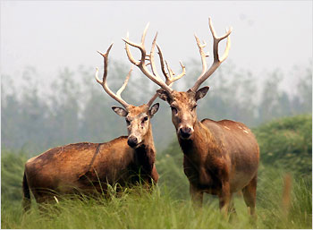
Problem
disappeared from China
Number before concern
none
Milu deer
Number after concern
more than 2,500 after being brought back from UK
One habitat in China
Nanhaizi Milu Park, Beijing

Slide 20
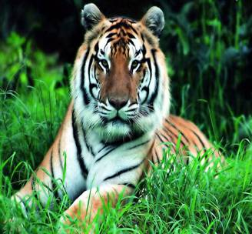
Problem
too much hunting in the 1950s
Number before concern
very few
South China tiger
One habitat in China
Number after concern
Baishanzu National Natural Protection Zone, Zhejiang Province
about 30-40 remain after being left in peace with no hunting

Slide 21
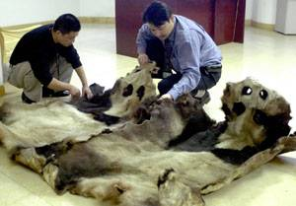
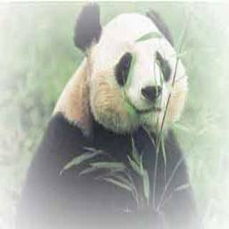
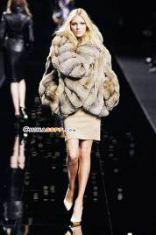
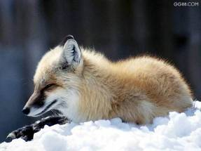
What do people kill them for?
fur
&
skin

Slide 22
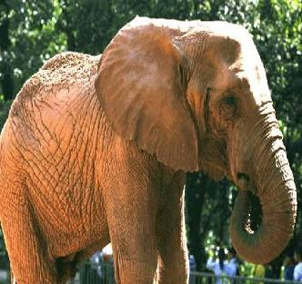
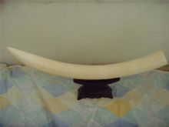
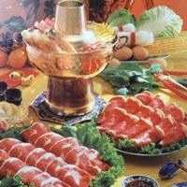
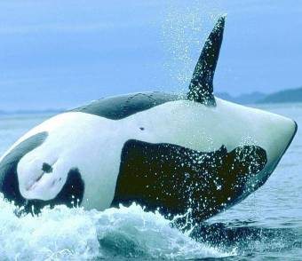
tusk
meat

Slide 23

Animals are endangered!
Forests are endangered!
Are we human beings endangered?
humans
animals
Harmonious
plants

Slide 24
What should we do to protect wild animals?
Not to over kill wildlife.
Not to pollute our environment.
Not to over cut forest.
To collect money to help them.
To build nature reserves.
…

Slide 25
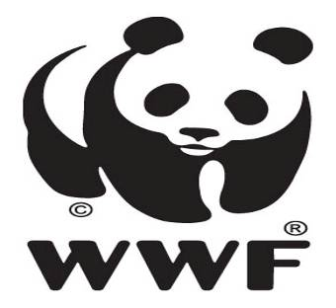
What does WWF stand for?
World Wildlife Fund
世界野生生物基金会
The logo of WWF

Slide 26

World Wildlife Fund 世界野生生物基金会
world’s largest privately financed conservation organization
protect endangered species and their habitats
works in more than 100 countries with nearly 5 million members

